Slide 1




Network Security For Energy
CSP004_C_E
SLIDE SET #5: DNS SECURITY
PRESENTATION BY:
ANTONIOS NTIB

Slide 2
What is the meaning behind learning how DNS works and how it impacts the Energy Sector
DNS is a technology that is being used to access website, servers, web services etc.. in a easy manner as it resolves the URLs assigned public static IPs. This helps a lot as people, users, developers, etc… are able to access critical infrastructure without the need of remembering the addressing numbers of IPs.
DNS Security policies can be used to filter out specific traffic and block malicious traffic as it may prevent users to not access specific web services on the Internet.
It can also work as isolating mechanism for web services and internal infrastructure that may have access to critical and sensitive data.
DNS can be source of attacks such as DDoS, SPAM Email, DNS Amplification Attacks. By learning the fundamentals and the innerworkings of DNS Security, cybersecurity experts can be prevent those attacks.

Slide 3
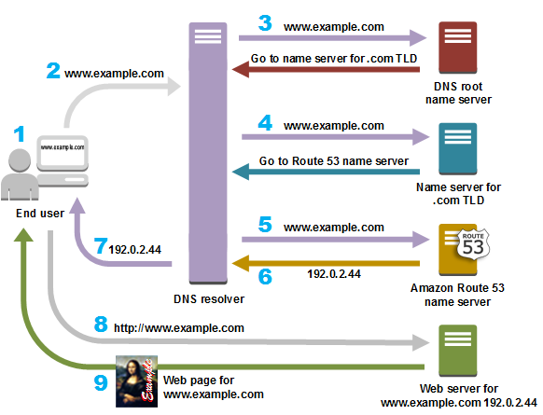
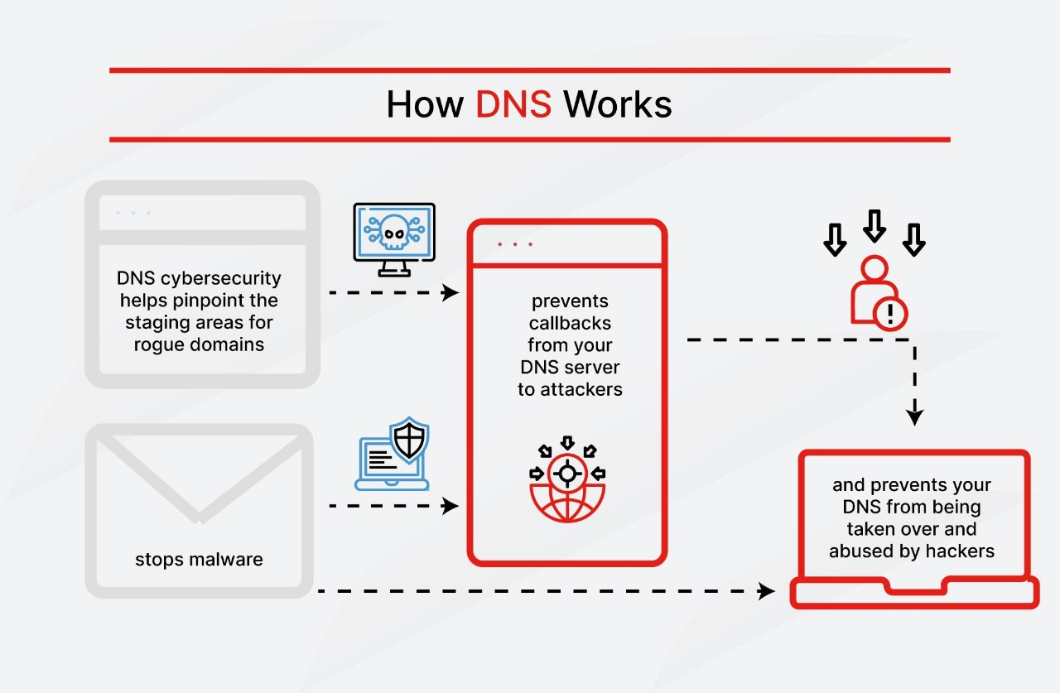

Slide 4
4 Most Common DNS Security Extensions (DNSSEC)
Cryptographic DNS data authentication, which uses a symmetric key to provide access to DNS data.
Response policy zones, which use rules regarding what DNS queries can do.
Data authentication and integrity, which centers around using cryptographically-generated signatures, which get bounded to the resource records of your DNS. This introduces cryptographic signature-based protection to all DNS queries because a query simply cannot be made without interfacing with a DNS resource record.
Authenticated denial of existence (DoE). This makes it possible for the DNS resolver to determine whether a domain actually exists.

Slide 5
Purpose of Naming
Addresses are used to locate objects
Names are easier to remember than numbers
You would like to get to the address or other objects using a name
DNS provides a mapping from names to resources of several types
1

Slide 6
Domain Name System (DNS)
Forward DNS Resolution
Given a domain name lookup the associated IP address
Reverse DNS lookup
Given an IP address lookup the domain name associated with the IP address
Usage: Network troubleshooting, anti-spam techniques
2

Slide 7
DNS—Distributed Database
DNS records are kept in a distributed fashion
Highly dynamic
Decentralized authority
3

Slide 8
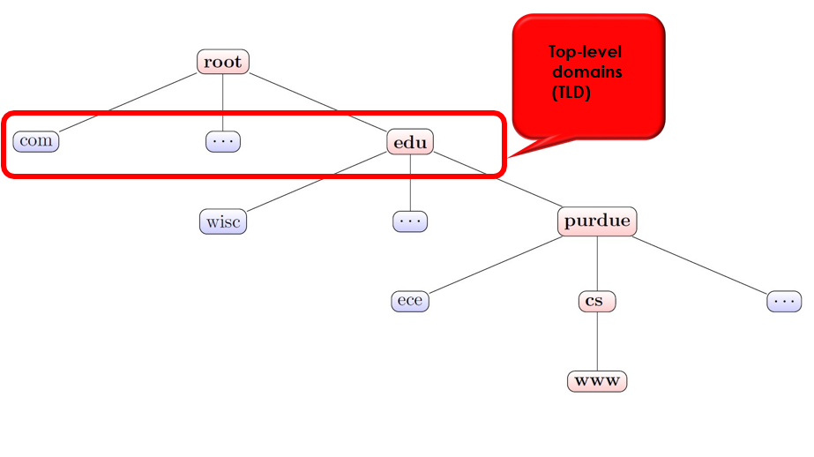
DNS–Hierarchical Namespace
4

Slide 9
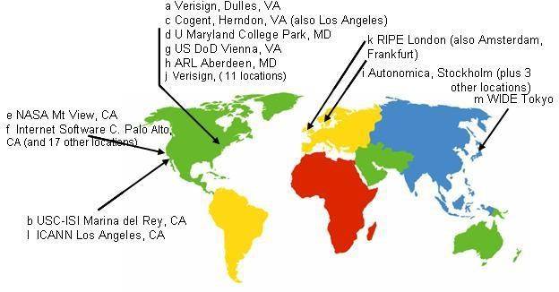
Root DNS Servers
5

Slide 10
Domain Name Servers
Top-level domain (TLD) servers
Responsible for com, org, net, edu, etc.
All top-level country domains, e.g. uk, fr, ca, jp, in.
Network Solutions, LLC controls com servers
Authoritative DNS servers
Organization’s DNS servers, providing authoritative hostname to IP mappings for organization’s servers.
Can be maintained by organization or service provider
Local DNS servers
Not strictly part of the domain hierarchy
Each ISP (university, hospital, company) has one
6

Slide 11
DNS Resolving
When a host makes a DNS query, it is forwarded to a local upstream resolver
The local upstream resolver acts as a proxy and forwards query into the domain name hierarchy
Two resolution schemes:
Iterative
Recursive
7

Slide 12
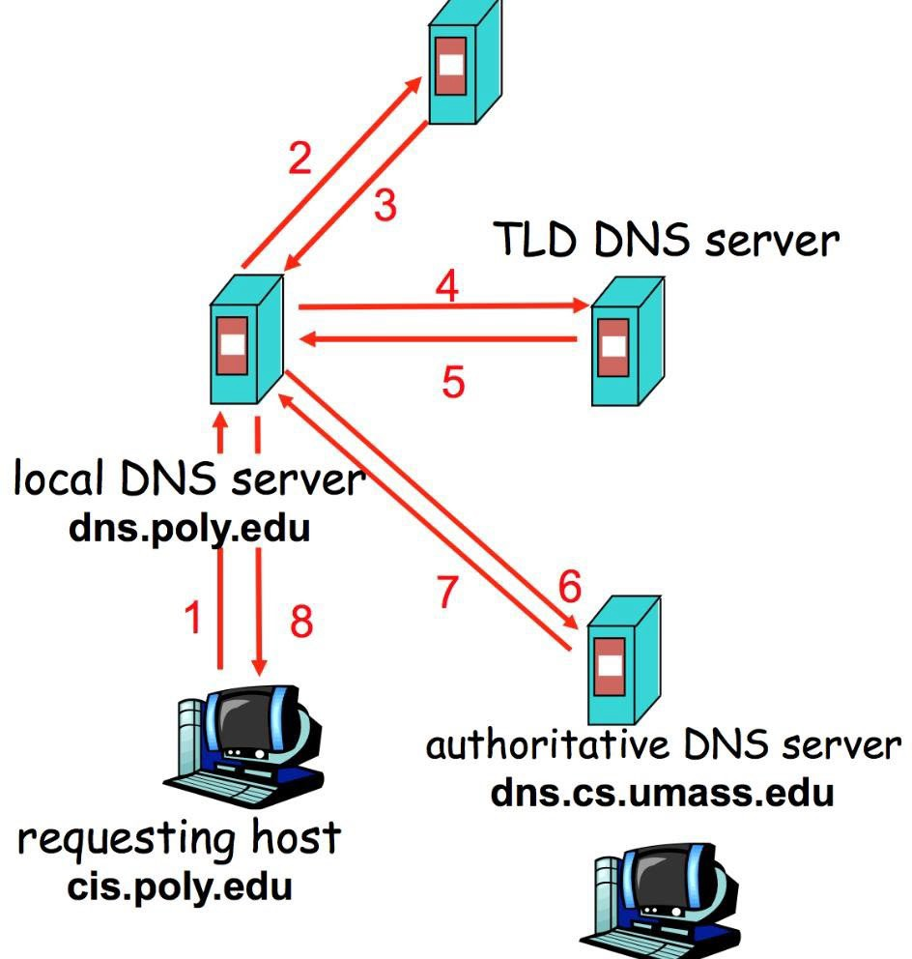
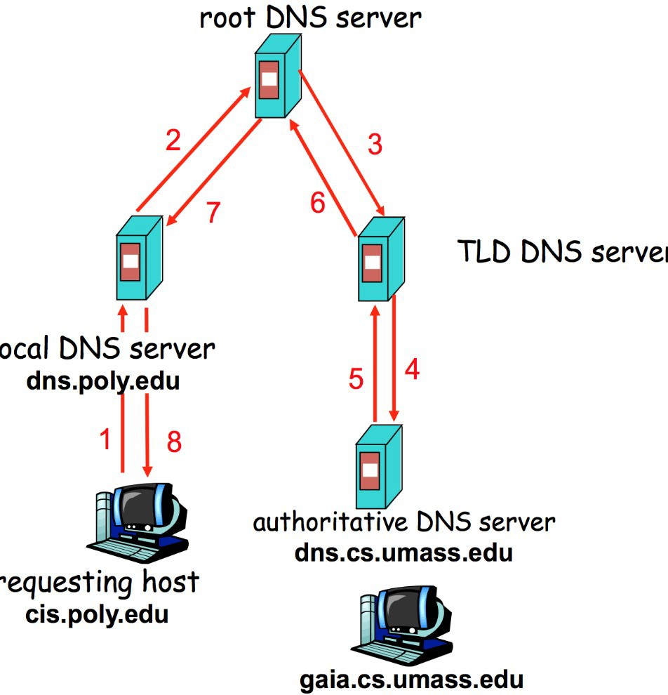


Iterative and Recursive Resolution
Iterative
Recursive
8

Slide 13
DNS Result Caching
DNS responses are cached
Enables responding to the same query fast
Negative results are cached too
Saves time for nonexistent sites, e.g., mistyping
Cached data has expiration
Each DNS record (also known as, resource record or just RR) has an associated field called Time-To-Live (in short, TTL)
9

Slide 14
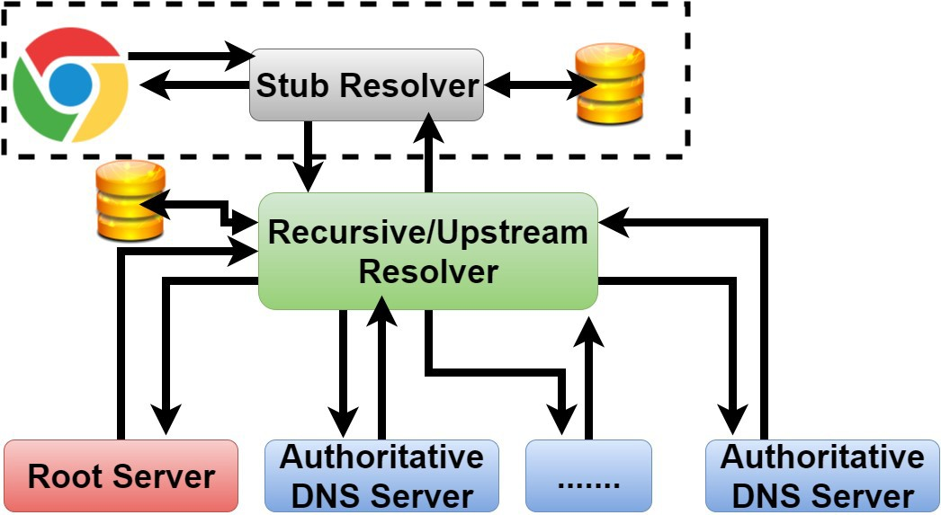
DNS Name Resolution
10

Slide 15
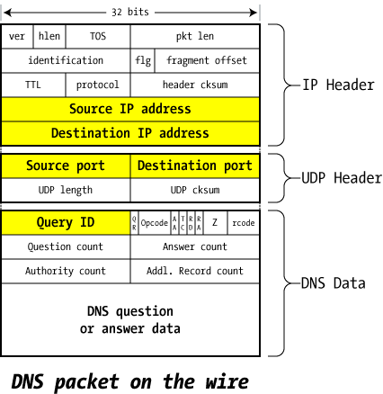
DNS Packet in the Wire
1-bit, 0-Query, 1-
16-bit ID
0-
1 for Authoritative
Answer,
0-otherwise
1 for truncated
Response code
answer
1 for recursion desired
1 for recursion available
11

Slide 16
Selective DNS Record Types
A record
Domain name to IP mapping
NS record
Information about (authoritative) DNS server
MX record
Mail exchange record
SOA record
Key information about the zone (e.g., contact address of the admin)
CNAME record
Canonical or alias of a domain
TXT record
Textual description of the domain
12

Slide 17
DNS Packet Payload
Question Section
Contains the question asked
Answer Section
Contains the records that answer the question
Authority Section
Contains the records that point to domain authority
Additional Section
Glue records
IP address of the domain authorities
Break circular dependency
13

Slide 18
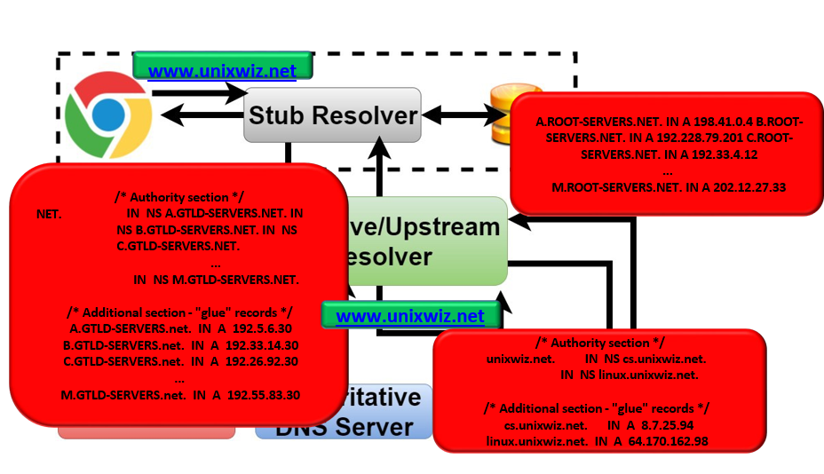
DNS Name Resolution
www.unixwiz.net
14

Slide 19
Inherent DNS Vulnerabilities
Users typically trust the host-address mapping provided by the DNS
What can go wrong with bad DNS information?
DNS resolvers trust responses received after sending out queries
How can one exploit this?
Root of all evil:
No authentication for DNS responses
15

Slide 20
User side attack—Pharming
Exploit DNS poisoning attack
Change IP addresses to redirect URLs to bad sites •
Potentially more dangerous than phishing attacks
DNS poisoning attacks are not uncommon:
January 2005, the domain name for a large New York ISP, Panix, was hijacked to a site in Australia
November 2004, Google and Amazon users were sent to Med Network Inc., an online pharmacy
16

Slide 21
DNS Cache Poisoning
Attacker wants his IP address returned for a DNS query
When the resolver asks ns1.google.com for www.google.com, the attacker could reply first, with his own IP
What is supposed to prevent this?
Transaction or Query ID
16-bit random number
The real server knows the number, because it was contained in the query
The attacker has to guess
17

Slide 22
DNS Cache Poisoning (contd.)
Responding before the real DNS server
An attacker can guess when a DNS cache entry times out and a query has been sent, and provide a fake response.
The fake response will be accepted only when its 16-bit transaction ID matches the query
CERT reported in 1997 that BIND uses sequential transaction ID and is easily predicted
fixed by using random transaction IDs
18

Slide 23
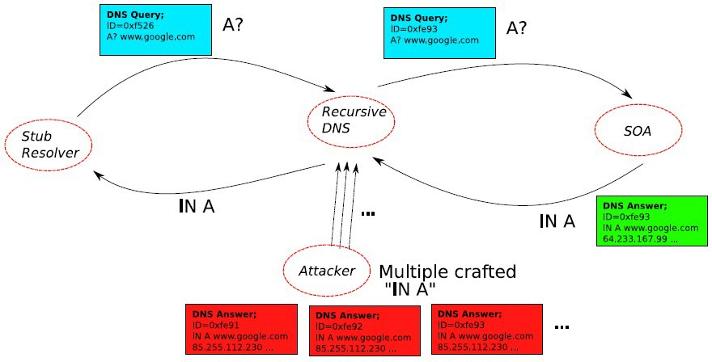
DNS Cache Poisoning: Racing to Respond First
19

Slide 24
DNS Cache Poisoning Attack 1 Schuba and Spafford in 1993
Intuition: Predictable Query ID (QID)
First, guess QID:
Ask (dns.target.com) for www.evil.org
Request is sent to dns.evil.org (get QID)
Attacker controls dns.evil.org
Second, attack:
Ask (dns.target.com) for www.yahoo.com
Gives responses from dns.yahoo.com to the attackers chosen IP
20

Slide 25
Defense: the Bailiwicks Rules
The bailiwick system prevents foo.com from declaring anything about com, or some other new TLD, or www.google.com
Using the bailiwicks rules
The root servers can return any record
The com servers can return any record for com
The google.com servers can return any record for
google.com
21

Slide 26
DNS Cache Poisoning Attack 2
Birthday Attack – Vagner Sacramento 2002
Have many clients send the same DNS request to the resolver
Each such request generated a DNS query
Send hundreds of reply with random TXID at the same time
Due to birthday paradox, the success probability can be close to 1:
With a few hundred client queries and several hundred fake responses
22

Slide 27
DNS Cache Poisoning – so far
Early versions of DNS servers deterministically incremented the ID field
Vulnerabilities were discovered in the random ID generation
Weak random number generator
The attacker is able to predict the ID if knowing several IDs in previous transactions
Birthday attack
16- bit (only 65,536 options).
Force the resolver to send many identical queries, with different IDs, at the same time
Increase the probability of making a correct guess
23

Slide 28
DNS Cache Poisoning Attack 3
Dan Kaminsky 2008
Kaminsky Attack
Big security news in summer of 2008
DNS servers were quickly patched to defend against this attack
Sophisticated attack
In prior attacks, when the attacker loses the race, the record is cached with a TTL
Before TTL expires, new instance of the attack cannot be carried out
Poisoning address for google.com in a DNS server is not easy
24

Slide 29
Features of Kaminsky Attack
The attacker does not need to wait to launch an attack
The bad guy asks the resolver to look up www.google.com
If the bad guy lost the race, the other race for www.google.com will be suppressed by the TTL
If the bad guy asks the resolver to look up 1.google.com, 2.google.com, 3.google.com, and so on
Each new query starts a new race
Eventually, the bad guy will win
he is able to spoof 183.google.com
So what? No one wants to visit 183.google.com
25

Slide 30
Kaminsky-style Poisoning
A bad guy who wins the race for “183.google.com” can end up stealing “www.google.com” as well
Original malicious response:
google.com NS www.google.com
www.google.com A6.6.6.6
Killer response:
google.com NS ns1.google.com
26

Slide 31
Kaminsky-style Poisoning
Why does it succeed?
The attacker can start a new instance of attack anytime without waiting for the cache entry to expire
No wait penalty for racing failure
The attack is only bandwidth limited
26

Slide 32

Defenses based on increasing the entropy
27

Slide 33
Defense –1(Source Port Randomization)
Use a random source port for each out-going DNS query
Entropy: 16-bit (from TXID) + 11-bit (from source port) = 27-bit entropy
To win, the attacker has a much bigger space of possible IDs to forge a valid response
Limitation: When the resolver is behind a NAT device, the additional entropy provided by source port randomization is low (e.g., 2 bits)
28

Slide 34
Defense-2 (0x20 Randomization)
Domain names are case-insensitive
www.google.com and WWW.GOOGLE.COM resolves to the same IP address
Randomly change some of the characters in the domain name to upper case letters
The expectation is that the resolver responding will copy the domain name in the response from the query
Limitations:
Attacker can query: www.123.com
Some of the resolvers always return domain name in all lower-case
Some of the resolvers use a case-sensitive matching
70% resolvers support 0x20 randomization
29

Slide 35
Defense –3 (WSEC DNS)
While querying root or TLD DNS servers, prepend random prefix
Ddsj030gojfd.www.google.com and www.google.com returns the same RRs (not IP)
Limitations:
Domain names can be maximum 255-byte length
Attackers can query 255-byte domains
This is applicable to referrals not A queries
Some resolvers exclude long domain names as they are uncommon
30

Slide 36
Defense – 4
(Randomize destination IP address)
Multiple IP addresses for a DNS server
Choose one randomly from that list to query
Limitations:
The set of IP addresses are small
They are many time predictable
Attack it to make it more predictable
31

Slide 37
Defense—5 (Randomizing Source IP)
This is called the NAT-antidote
This is applicable when the resolver is behind a NAT
When NAT receives a query from the resolver, it randomly changes the source IP address to a random IP in that network
Limitations:
Extra entropy depends on the network size
32

Slide 38
Attack Detection
Αdaptive & Longterm Defenses
Received a response for a query and the TXID of the response does not match with the query’s TXID
Can happen in benign cases as DNS runs on top of UDP
34

Slide 39
Defense—6 (Sandwich Antidote)
Detect attack and apply sandwich antidote
For querying www.google.com
Query 1: dfjfdkjfhksdf.google.com
Query 2: www.google.com [REAL QUERY]
Query 3: jkjkjoiojohh.google.com
Observe whether the response arrive in-order
Limitation:
Our experiment suggest that 50% of the queries arrive in order
35

Slide 40
Defense—7 (DNSSEC)
Proposed as a long-term solution
Uses digitally signed responses
Prevents cache
poisoning attacks
Limitations:
Adoption is very slow– 1% of all the .com and .net domains are secured by DNSSEC
Opens door for DoS attack due to large response size
36

Slide 41
Defense – 8 (Use TCP)
Run DNS protocol on top of TCP instead of UDP
Limitations:
High latency (almost 2X)
Resolver throughput rate (1/10th)
Not all resolvers support TCP
In our experiment with Alexa’s top 15K domains, 10% of their authoritative nameservers do not support TCP – includes Facebook
37

Slide 42
Defense – 9 (Adaptively use TCP)
Run DNS protocol on top of TCP instead of UDP only when detected attack
Nominum implemented it in their product Vantio CacheServe
Limitations:
Attack detection is not fine-grained – benign cases will be considered as attack
Same as before
38

Slide 43

Thank you

