Slide 1




Network Security For Energy
CSP004_C_E
SLIDE SET #3: Cryptography: Cryptographic Hash Functions And Message Authentication Code
PRESENTATION BY:
ANTONIOS NTIB

Slide 2
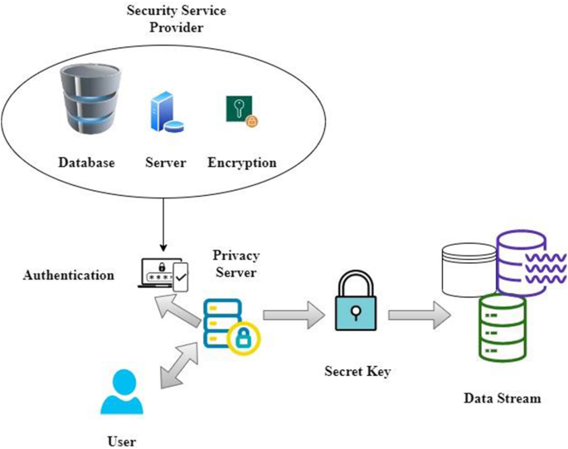
What is the use of cryptography and hash functions in systems and infrastructure of the Energy Sector?
Encryption of databases that contain sensitive and important information, such as personal data of customers, billing information, statistical data important to energy production of the plants.
Hash function can be used for authentication purposes and verify the integrity of important files

Slide 3
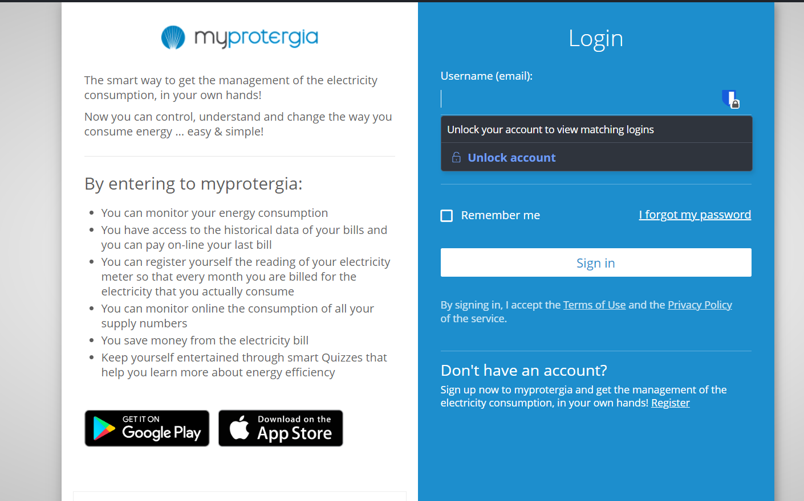
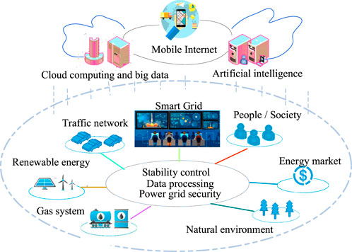
What is the use of cryptography and hash functions in systems and infrastructure of the Energy Sector? (cont’d)
Certificates can be used in critical infrastructure of the power plants, such as encrypting communication in the internal networks of a power plant, creating secure connection when customers visit web services for invoices, consumption history, registering meter reading manually.
IoT infrastructure, such as smart meters, which use Internet traffic to send wirelessly and automatically readings for energy consumption to energy provider must establish an encrypted connection before sending any data foe security and validity reasons.

Slide 4
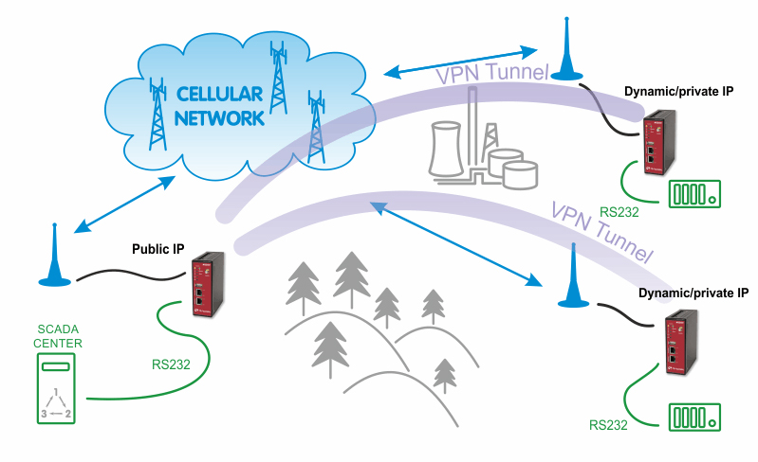
What is the use of cryptography and hash functions in systems and infrastructure of the Energy Sector? (cont’d)
PtP communications between power plants or external energy production units for data exchange must be encrypted and secured for protecting unauthorized access.
Internal network communications, such LAN networks used by employees, VoIP communication must be encrypted for data protection and privacy reasons

Slide 5



Data Integrity and Source Authentication
Encryption does not protect data from modification by another party.
Most encryption schemes are malleable:
  Modifying ciphertext result in (somewhat) predictable change in plaintext
Need a way to ensure that data arrives at destination in its original form as sent by the sender.

Slide 6
Hash Functions
A hash function maps a message of an arbitrary length to a m-bit output
  output known as the fingerprint or the message digest
What is an example of hash functions?
  Give a hash function that maps Strings to integers in [0,2^{32}-1]
Cryptographic hash functions are hash functions with additional security requirements
2

Slide 7
Using Hash Functions for Message Integrity
Method 1: Uses a Hash Function h, assuming a secure (adversary cannot modify) channel for short messages
  Transmit a message M over the normal (insecure) channel
  Transmit the message digest h(M) over the secure channel
  When receiver receives both M’ and h, how does the receiver check to make sure the message has not been modified?
This is insecure. How to attack it?
A hash function is a many-to-one function, so collisions can happen.
3

Slide 8
Security Requirements for Cryptographic Hash Functions
Given a function h:X →Y, then we say that h is:
preimage resistant (one-way):
if given y ∈Y it is computationally infeasible to find a value x ∈X s.t. h(x) = y
2-nd preimage resistant (weak collision resistant):
if given x ∈ X it is computationally infeasible to find a value x’ ∈ X, s.t. x’≠x and h(x’) = h(x)
collision resistant (strong collision resistant):
if it is computationally infeasible to find two distinct values x’,x ∈ X, s.t. h(x’) = h(x)
4

Slide 9
Usage of Hash Functions?
Suppose that you have outsourced a database, and want to find a record; how to ensure that a result you get back is really in the database?
5

Slide 10
Merkle Hash Tree for Data Authentication
Construct a binary tree where each leaf corresponds to a piece of data
Each internal node is hash of two children
Authentication the root using some method
A leaf node along with the sibling node of each node to the path suffices to authenticate the node
  Needs log(n) to authenticate any node
6

Slide 11
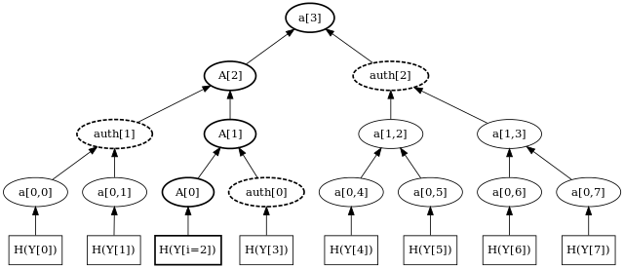
Merkle Hash Tree for Data Authentication
"MerkleTree2" by Tsuruya - Own work. Licensed under Public Domain via Commons - https://commons.wikimedia.org/wiki/File:MerkleTree2.svg#/media/File:MerkleTree2.svg
7

Slide 12
Usages of Cryptographic Hash Functions
Software integrity
  E.g., tripwire
Timestamping (cryptographic commitment)
  How to prove that you have discovered a secret on an earlier date without disclosing the context of a secret?
Authenticating logs (a long history of events)
Covered later
  Message authentication
  One-time passwords
  Digital signature
8

Slide 13
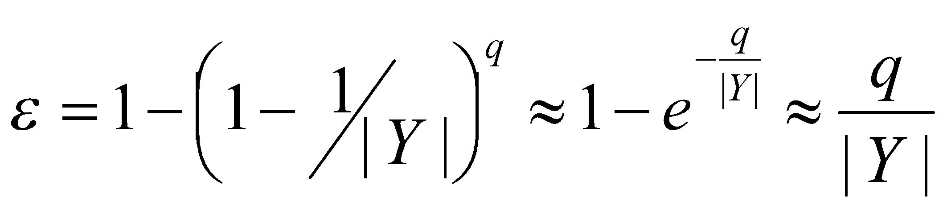
Bruteforce Attacks on Hash Functions
Attacking one-wayness
  Goal: given h:X→Y, y∈Y, find x such that h(x)=y
  Algorithm:
    pick a random value x in X, check if h(x)=y, if h(x)=y, returns x; otherwise iterate
    after failing q iterations, return fail
  The average-case success probability is
    The first approximation holds when |Y| is large,
    The second roughly holds when q/|Y| is small (e.g., < 0.5)
  Let |Y|=2^{m}, to get ε to be close to 0.5, q ≈2^{m-1}

Slide 14
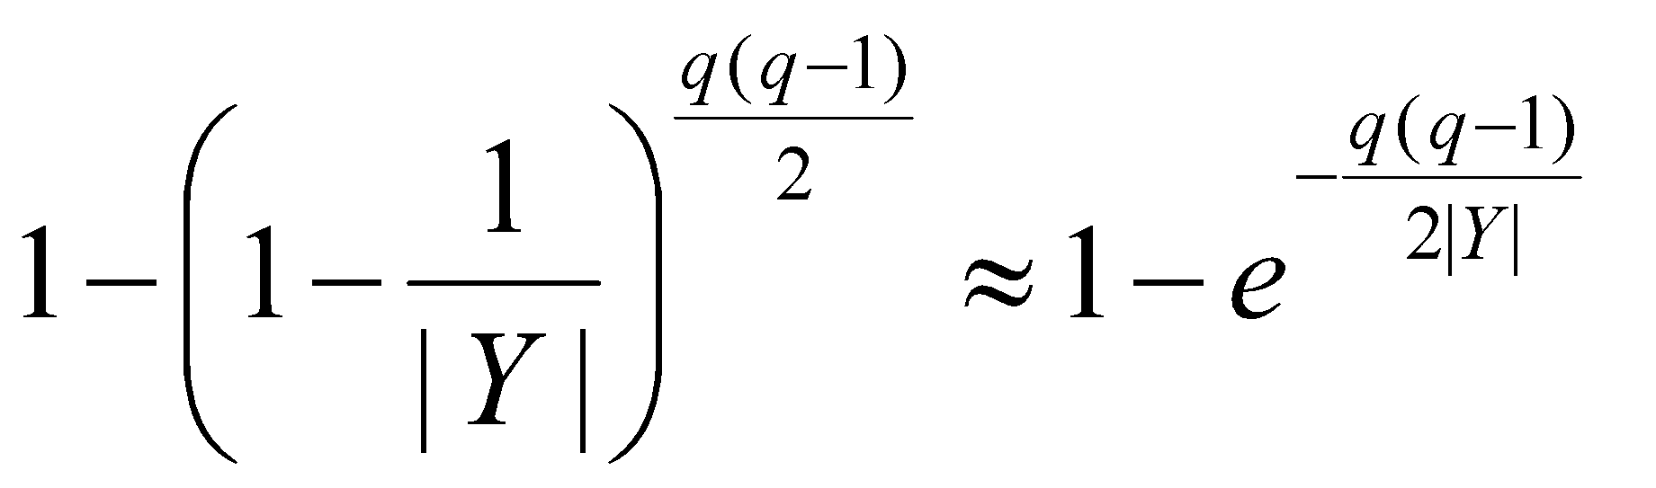
Bruteforce Attacks on Hash Functions
Attacking collision resistance
  Goal: given h, find x, x’ such that h(x)=h(x’)
  Algorithm: pick a random set X₀ of q values in X for each x∈X₀, computes y_{x}=h(x) if y_{x}=y_{x’} for some x’≠x then return (x,x’) else fail
  The average success probability is
  Let |Y|=2^{m}, to get ε to be close to 0.5, q ≈2^{m/2}
  This is known as the birthday attack.
10

Slide 15
Choosing Parameters
The level of security (for collision resistance) of a hash function that outputs n bits, is about n/2 bits
  i.e., it takes 2^{n/2} time to bruteforce it
  Assuming that no better way of attacking the hash function is known
Longer outputs often means more computation time and more communication overhead
The level of security for encryption function using k-bit key is about k bits

Slide 16
Choosing the length of Hash outputs
The Weakest Link Principle:
  A system is only as secure as its weakest link.
  Hence all links in a system should have similar levels of security.
Because of the birthday attack, the length of hash outputs in general should double the key length of block ciphers
  SHA-224 matches the 112-bit strength of triple-DES (encryption 3 times using DES)
  SHA-256, SHA-384, SHA-512 match the new key lengths (128,192,256) in AES
  If small output size is highly important, and one is sure that collision-resistance is not needed (only one-wayness is needed), then same size should be okay.
12
Notes:
Which hash function to use?

Slide 17
Well Known Hash Functions
MD5
  output 128 bits
  collision resistance completely broken by researchers in China in 2004
SHA1
  output 160 bits
  no collision found yet, but method exist to find collisions in less than 2^80
  considered insecure for collision resistance
  one-wayness still holds
SHA2 (SHA-224, SHA-256, SHA-384, SHA-512)
  outputs 224, 256, 384, and 512 bits, respectively
  No real security concerns yet
SHA3 (224, 256, 384, 512)
13

Slide 18
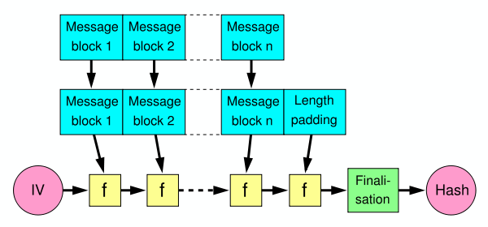
Merkle-Damgard Construction for Hash Functions
Message is divided into fixed-size blocks and padded
Uses a compression function f, which takes a chaining variable (of size of hash output) and a message block, and outputs the next chaining variable
Final chaining variable is the hash value
M=m₁m₂…m_{n}; C₀=IV, C_{i+1}=f(C_{i},m_{i}); H(M)=C_{n}
14

Slide 19
NIST SHA-3 Competition
NIST completed a competition for SHA-3, the next generation of standard hash algorithms
2007: Request for submissions of new hash functions
2008: Submissions deadline. Received 64 entries. Announced first-round selections of 51 candidates.
2009: After First SHA-3 candidate conference in Feb, announced 14 Second Round Candidates in July.
2010: After one year public review of the algorithms, hold second SHA-3 candidate conference in Aug. Announced 5 Third-round candidates in Dec.
2011: Public comment for final round
2012: October 2, NIST selected SHA3
  Keccak (pronounced “catch-ack”) created by Guido Bertoni, Joan Daemen and Gilles Van Assche, Michaël Peeters

Slide 20
Hash Family
A hash family is a four-tuple (X,Y,K,H ), where
  X is a set of possible messages
  Y is a finite set of possible message digests
  K is the keyspace
  For each K∈K, there is a hash function h_{K}∈H . Each h_{K}: X →Y
Alternatively, one can think of H as a function K×X→Y

Slide 21
Message Authentication Code (MAC)
A MAC scheme is a hash family, used for message authentication
MAC(K,M) = H_{K}(M)
The sender and the receiver share secret K
The sender sends (M, H_{k}(M))
The receiver receives (X,Y) and verifies that H_{K}(X)=Y, if so, then accepts the message as from the sender
To be secure, an adversary shouldn’t be able to come up with (X’,Y’) such that H_{K}(X’)=Y’.
MAC: Using a shared secret (or a limit-bandwidth confidential channel) to achieve authenticity/integrity.

Slide 22
Security Requirements for MAC
Secure against the “Existential Forgery under Chosen Plaintext Attack”
  Challenger chooses a random key K
  Adversary chooses a number of messages M₁, M₂, .., M_{n}, and obtains t_{j}=MAC(K,M_{j}) for 1≤j≤n
  Adversary outputs M’ and t’
  Adversary wins if ∀j M’≠M_{j}, and t’=MAC(K,M’)
Basically, adversary cannot create the MAC value for a message for which it hasn’t seen an MAC

Slide 23
Constructing MAC from Hash Functions
Let h be a one-way hash function
MAC(K,M) = h(K || M), where || denote concatenation
  Insecure as MAC with a hash function that uses the Merkle-Damgard construction:
  given M and t=h(K || M), adversary can compute M’=M||Pad(M)||X and t’, such that h(K||M’) = t’

Slide 24
HMAC: Constructing MAC from Cryptographic Hash Functions
HMAC_{K}[M] = Hash[(K⁺ ⊕ opad) || Hash[(K⁺ ⊕ ipad)||M)]]
K⁺ is the key padded (with 0) to B bytes, the input block size of the hash function
ipad = the byte 0x36 repeated B times
opad = the byte 0x5C repeated B times.
ADD REFERENCE TO PAPER: URL FROM STACKEXCHANGE
At high level, HMACK[M] = H(K || H(K || M))
Hash function is used twice, in nested fashion.

Slide 25
HMAC Security
If used with a secure hash functions (e.g., SHA-256) and according to the specification (key size, and use correct output), no known practical attacks against HMAC

Slide 26
MAC Can also be Constructed using Block Cipher
The CBC mode can be used to define CBC-MAC
GCM (Galois/Counter Mode) is currently widely used
  Provide message authentication and encryption at the same time

Slide 27

Thank you

