Slide 1




Network Security For Energy
CSP004_C_E
SLIDE SET #8: Web Security
PRESENTATION BY:
ANTONIOS NTIB

Slide 2
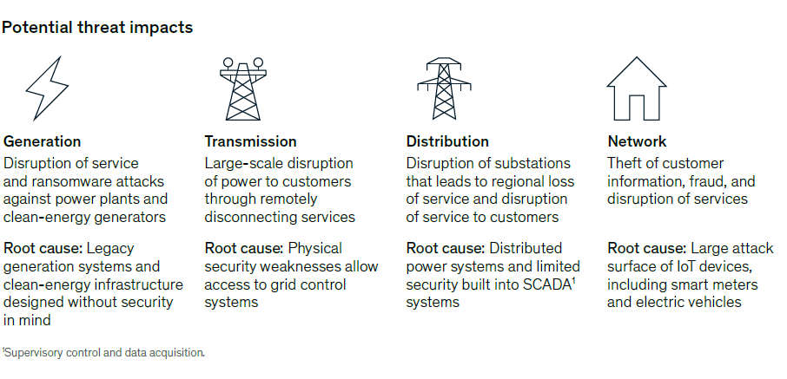
Web Security and its Role to the Energy Sector
Now that the Energy Sector is evolving and modernize its infrastructure with smart meters, web services for customers and other types services and infrastructure offered via internet, the need of protecting the digital assets that the energy sector uses to deliver energy has increased more than ever. Different types of attacks like sql injection, DDoS, cross-site scripting, etc.. Could be potentially used to disrupt the delivery network of energy, the backbone production and/or services that end-customer use. Learning how to secure web services and devices which use full-stack services is an important part of a cyber-security experts who want to defend such entities from attacks

Slide 3
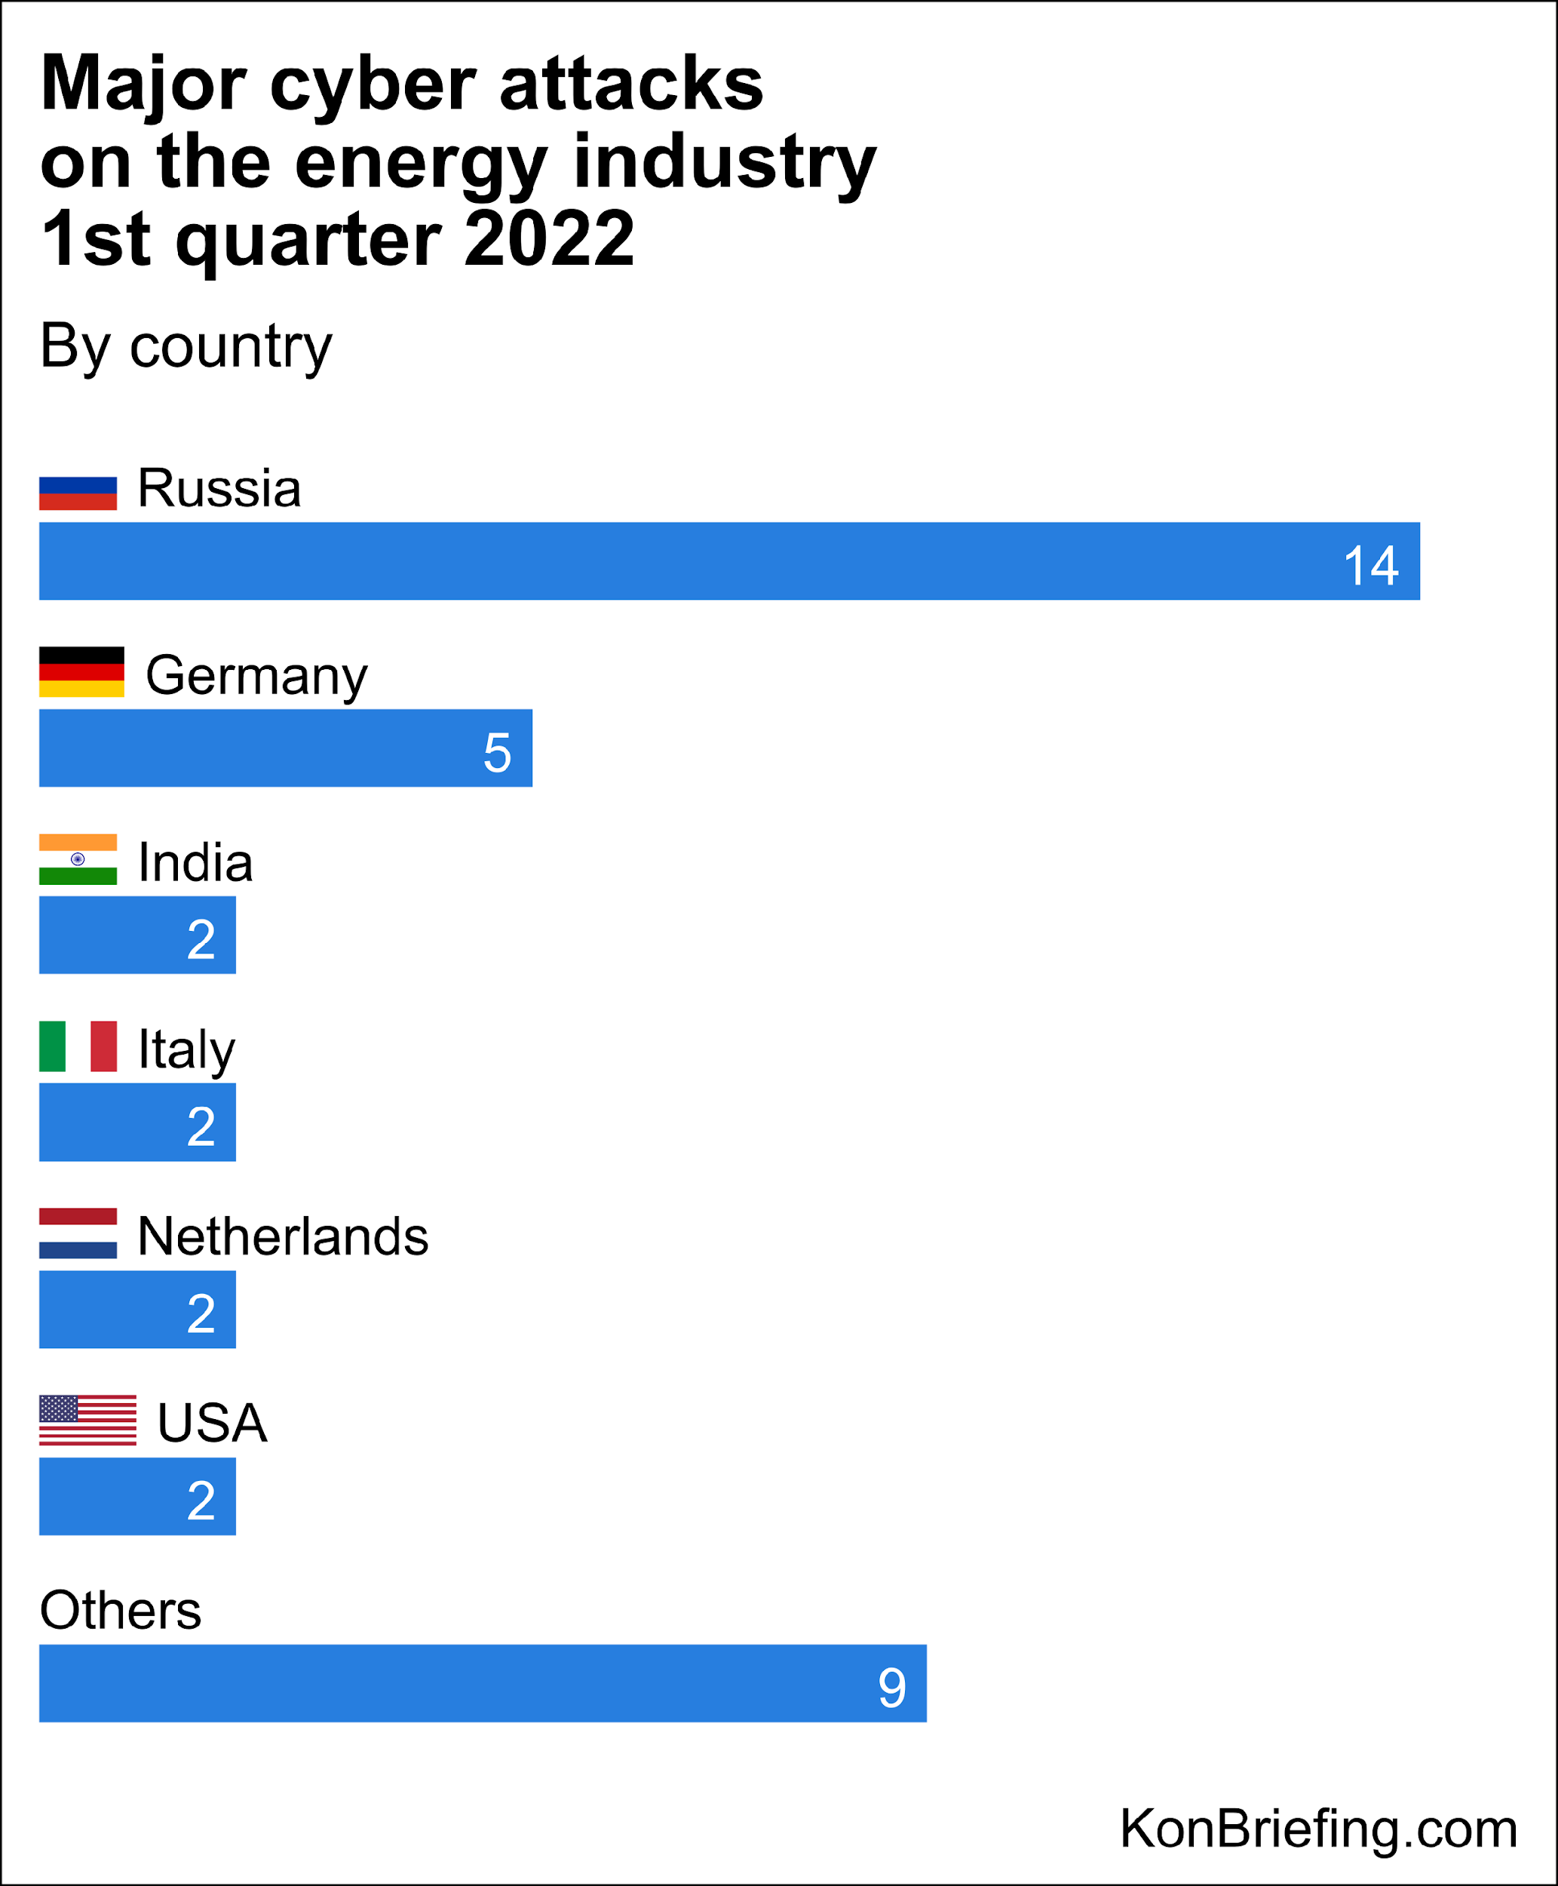
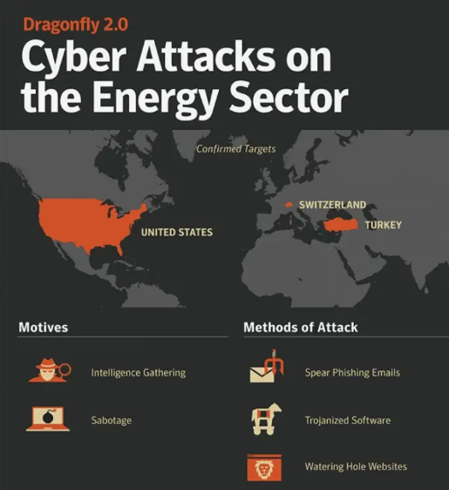
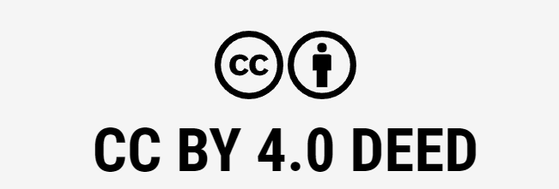
Web Security and its Role to the Energy Sector (cont’d)

Slide 4
Background
Many sensitive tasks are done through web
  Online banking, online shopping
  Database access
  System administration
Web applications and web users are targets of many attacks
  Cross site scripting
  SQL injection
  Cross site request forgery
  Information leakage
  Session hijacking
2

Slide 5
Web Browser and Network
Browser sends requests
Web site sends response pages, which may include code
Interaction susceptible to network attacks
request
Network
Browser
Web site
reply
OS
Hardware
3

Slide 6
Web Security/Privacy Issues
Secure communications between client & server
  HTTPS (HTTP over Secure Socket Layer)
User authentication & session management
  Cookies & other methods
Active contents from different websites
  Protecting resources maintained by browsers
Web application security
Web site authentication (e.g., anti-phishing)
Privacy concerns
4

Slide 7
HTTP: HyperText Transfer Protocol
Browser sends HTTP requests to the server
  Methods: GET, POST, HEAD, …
  GET: to retrieve a resource (html, image, script, css,…)
  POST: to submit a form (login, register, …)
  HEAD
Server replies with a HTTP response
Stateless request/response protocol
  Each request is independent of previous requests
  Statelessness has a significant impact on design and implementation of applications
5

Slide 8
Use Cookies to Store State Info
Cookies
  A cookie is a name/value pair created by a website to store information on your computer
Enters form data
Server
Browser
Response + cookies
Request + cookies
Server
Browser
Returns data
Http is stateless protocol; cookies add state
6

Slide 9
Cookies Fields
An example cookie from my browser
  Name session-token
  Content "s7yZiOvFm4YymG….”
  Domain .amazon.com
  Path /
  Send For Any type of connection
  Expires Monday, September 08, 2031 7:19:41 PM
7

Slide 10
Cookies
Stored by the browser
Used by the web applications
  used for authenticating, tracking, and maintaining specific information about users
    e.g., site preferences, contents of shopping carts
  data may be sensitive
  may be used to gather information about specific users
Cookie ownership
  Once a cookie is saved on your computer, only the website that created the cookie can read it
8

Slide 11
Web Authentication via Cookies
HTTP is stateless
  How does the server recognize a user who has signed in?
Servers can use cookies to store state on client
  After client successfully authenticates, server computes an authenticator and gives it to browser in a cookie
    Client cannot forge authenticator on his own (session id)
  With each request, browser presents the cookie
  Server verifies the authenticator
9

Slide 12



A Typical Session with Cookies
  Authenticators must be unforgeable and tamper-proof
  (malicious clients shouldn’t be able to modify an existing authenticator)
  How to design it?
client
server
POST /login.cgi
Verify that this
client is authorized
Set-Cookie:authenticator
GET /restricted.html
Cookie:authenticator
Check validity of
authenticator
Restricted content
10

Slide 13
Client Side Scripting
Web pages (HTML) can embed dynamic contents (code) that can be executed on the browser
JavaScript
  embedded in web pages and executed inside browser
Java applets
  small pieces of Java bytecodes that execute in browsers
Browser extensions (plug-ins) provide further client-side programming abilities
  E.g., Flash
12

Slide 14
HTML and Scripting
  <html>
  …
  <P>
  <script>
  var num1, num2, sum
  num1 = prompt("Enter first number")
  num2 = prompt("Enter second number")
  sum = parseInt(num1) + parseInt(num2)
  alert("Sum = " + sum)
  </script>
  …
  </html>
Browser receives content, displays HTML and executes scripts
13

Slide 15
Scripts are Powerful
Client-side scripting is powerful and flexible, and can access the following resources
  Local files on the client-side host
    read / write local files
  Webpage resources maintained by the browser
    Cookies
    Domain Object Model (DOM) objects
      steal private information
      control what users see
      impersonate the user
  Communicating with websites (via XMLHttpRequest)
14

Slide 16
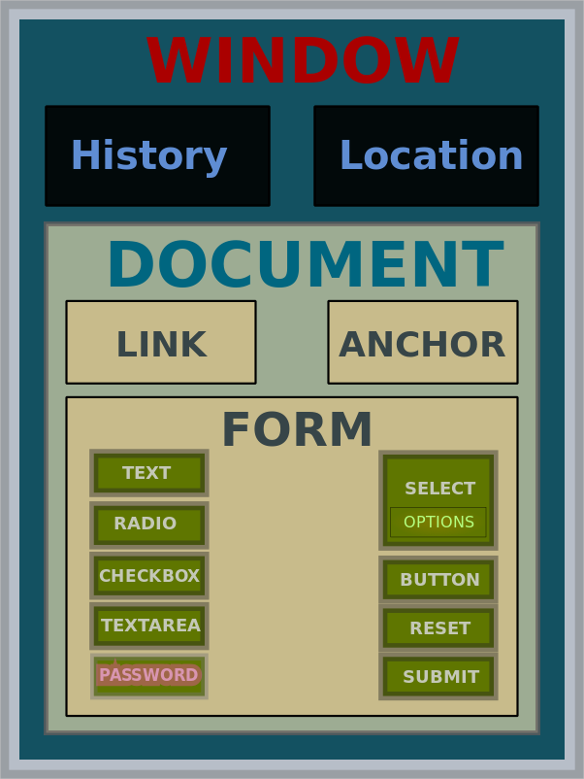
Domain Object Model (DOM)
Object-oriented model to represent webpages that allow programming access in Javascript
15

Slide 17
Browser as an Operating System
Web users visit multiple websites simultaneously
A browser serves web pages (which may contain programs) from different web domains
  i.e., a browser runs programs provided by mutually untrusted entities
  Running code one does not know/trust is dangerous
  A browser also maintains resources created/updated by web domains
Browser must confine (sandbox) these scripts so that they cannot access arbitrary local resources
Browser must have a security policy to manage/protect browser-maintained resources and to provide separation among mutually untrusted scripts
16

Slide 18
Sandbox
A security mechanism for separating/limiting running programs
  Running untrusted programs.
    E.g., javascripts in webpages, mobile apps
  Running programs that are likely to be exploited.
    E.g., network daemon programs
Implementation: Clearly identify what resources a program needs and cut off the rest
  Examples include operating system–level virtualization (such as Unix chroot), virtual machine monitors (VMMs), Java applets,
17

Slide 19
Same Origin Policy (SoP)
The basic security model enforced in the browser
SoP isolates the scripts and resources downloaded from different origins
  E.g., evil.org scripts cannot access bank.com resources
Use origin as the security principal
  Note that the concept of user accounts does not apply here as security principals
Origin = domain name + protocol + port
  all three must be equal for origin to be considered the same
18

Slide 20
Same Original Policy: What it Controls
Same-origin policy applies to the following accesses:
  manipulating browser windows
  URLs requested via the XmlHttpRequest
  manipulating frames (including inline frames)
  manipulating documents (included using the object tag)
  manipulating cookies
192

Slide 21
Problems with S-O Policy
Poorly enforced on some browsers
  Particularly older browsers
Limitations if site hosts unrelated pages
  Example: Web server often hosts sites for unrelated parties
    http://www.example.com/account/
    http://www.example.com/otheraccount/
  Same-origin policy allows script on one page to access properties of document from another
Can be bypassed in Cross-Site-Scripting attacks
Usability: Sometimes prevents desirable cross-origin resource sharing
202

Slide 22
Browser Architecture: One Process versus Multiple Processes
Most processes (e.g., Firefox, Internet Explorer) use one process for a web browser
  Multiple threads are used for rendering different webpages
Chrome uses multiple processes
  Use OS protection mechanism to ensure that webpages from different sites cannot easily interact
    Because they run in different processes
  Reliability advantage: crashing in rendering one website doesn’t affect another
  Security advantage: vulnerability in rendering does not compromise other sites; isolate plug-ins
  Uses 3 types of processes: browser, renderers, plug-ins
21

Slide 23
Cross Site Scripting (XSS)
Recall the basics
  scripts embedded in web pages run in browsers
  scripts can access cookies
    get private information
  and manipulate DOM objects
    controls what users see
  scripts controlled by the same-origin policy
Why would XSS occur
  Web applications often take user inputs and use them as part of webpage (these inputs can have scripts)
22

Slide 24
How XSS Works on Online Blog
Everyone can post comments, which will be displayed to everyone who view the post
Attacker posts a malicious comment that includes scripts (which reads local authentication credentials and send of to the attacker)
Anyone who view the post can have local authentication cookies stolen
Web apps will check that posts do not include scripts, but the check sometimes fail.
Bug in the web application. Attack happens in browser.
232

Slide 25
Effect of the Attack
Attacker can execute arbitrary scripts in browser
Can manipulate any DOM component on victim.com
  Control links on page
  Control form fields (e.g. password field) on this page and linked pages.
Can infect other users: MySpace.com worm.
242

Slide 26
MySpace.com (Samy worm)
Users can post HTML on their pages
  MySpace.com ensures HTML contains no
    <script>, <body>, onclick, <a href=javascript://>
  However, attacker find out that a way to include Javascript within CSS tags:
  <div style=“background:url(‘javascript:alert(1)’)”>
  And can hide “javascript” as “java\nscript”
With careful javascript hacking:
  Samy’s worm: infects anyone who visits an infected MySpace page … and adds Samy as a friend.
  Samy had millions of friends within 24 hours.
More info: http://namb.la/popular/tech.html
252

Slide 27
Avoiding XSS bugs (PHP)
Main problem:
  Input checking is difficult --- many ways to inject scripts into HTML.
Preprocess input from user before echoing it
PHP: htmlspecialchars(string)
& → &amp; " → &quot; ' → &#039; < → &lt; > → &gt;
  htmlspecialchars(
  “<a href='test'>Test</a>", ENT_QUOTES);
  Outputs:
  &lt;a href=&#039;test&#039;&gt;Test&lt;/a&gt;
262

Slide 28
Avoiding XSS bugs (ASP.NET)
ASP.NET 1.1:
  Server.HtmlEncode(string)
    Similar to PHP htmlspecialchars
  validateRequest: (on by default)
    Crashes page if finds <script> in POST data.
    Looks for hardcoded list of patterns.
    Can be disabled:
    <%@ Page validateRequest=“false" %>
272

Slide 29
Cross site request forgery (abbrev. CSRF or XSRF)
Also known as one click attack or session riding
Effect: Transmits unauthorized commands from a user who has logged in to a website to the website.
Recall that a browser attaches cookies set by domain X to a request sent to domain X; the request may be from another domain
  Site Y redirects you to facebook; if you already logged in, the cookie is attached by the browser
29

Slide 30
CSRF Explained
Example:
  User logs in to bank.com. Forgets to sign off.
  Session cookie remains in browser state
  Then user visits another site containing:
<form name=F action=http://bank.com/BillPay.php>
<input name=recipient value=badguy> …
<script> document.F.submit(); </script>
  Browser sends user auth cookie with request
    Transaction will be fulfilled
Problem:
  The browser is a confused deputy; it is serving both the websites and the user and gets confused who initiated a request
30

Slide 31
Real World CSRF Vulnerabilities
Gmail
NY Times
ING Direct (4th largest saving bank in US)
YouTube
Various DSL Routers
Purdue WebMail
PEFCU
Purdue CS Portal
…
31

Slide 32
Prevention
Server side:
  use cookie + hidden fields to authenticate a web form
    hidden fields values need to be unpredictable and user-specific; thus someone forging the request need to guess the hidden field values
  requires the body of the POST request to contain cookies
    Since browser does not add the cookies automatically, malicious script needs to add the cookies, but they do not have access because of Same Origin Policy
User side:
  logging off one site before using others
  selective sending of authentication tokens with requests (may cause some disruption in using websites)
32

Slide 33

Thank you

