Slide 1

Cybersecurity Risk Management and Governance
CSP003_S_H
Presentation by:
Prof. Shareeful Islam

Slide 2


Cybersecurity Risk Management and Governance
o1.
Goals: Who-What-Why you need to take this training
o2.
Training logistics: When-Where-How
o3.
Learning outcomes
o4.
Training outlines
o5.
Exercises details
o6.
Practical information and requirements
o7.
Registration information and contacts

Slide 3



CSP Training Logistic: When-Where-How
WHEN
WHERE
HOW
Time schedule: …..
ONLINE-ONSITE-Location Information
Delivery Method

Slide 4

Value Propositions
Benefits to Participants
Level of Training Module: Advanced
Cybersecurity Professional Training
Hands-on and Practical Skills Development
Rooted with European Cybersecurity Skills Framework
Cutting-edge insights from industry-academic experts
Specialized information on the energy sector
Certificate of the completion
Helps with skills development and career advancement

Slide 5

WHO
Profile of Training Participants
IT professional
Security professionals
Business leaders
and any other professionals that need or want to understand the basic concepts related to Cybersecurity risk management and Governance.

Slide 6

WHO
Prof. Dr. Shareeful Islam
Highly motivated and committed cyber security and risk management professional with experience in research, training and consultancy.
Consultant for managing cyber security risks and information security management system to develop risks management framework following ISO 27001:2013, ISO31000:2018, NIST-CSF, STIX threat modelling, CIS_CSC and other relevant standards in various business environments.
Certified Management of Risks (MoR), PRINCE 2 practitioner and a subject matter expert in Risk Management
Over 90 peer reviewed publications with top journals and conference
https://scholar.google.com/citations?user=IAxS1lsAAAAJ&hl=en

Slide 7

WHAT
Training Topics
Cyber security risk management in Maritime sector
Risk Management framework Governance processes
Role, responsibilities and authorities
Security controls and industry specific standards related to security management and governance

Slide 8

WHY
Learning Outcomes
Demonstrate an in-depth understanding of cyber security risk management framework in maritime sector;
Recognize the significant cybersecurity governance structures and processes;
Critically assess and report security risk and suggest suitable mitigation strategies in professional manner
Critically develop and evaluate security policy and select controls by following ISO 27019 for security governance.

Slide 9

Training Outline:
Part 1
Topic-1: Cyber security
Cyber security fundamentals
Cyber security context in energy sector
Topic-2: Risk Management framework
Risk management Basics
Principles of risk management and processes
Cybersecurity threats and vulnerability management

Slide 10
Information Security Vs. Cyber Security
Information security
  Protecting information and information systems from unauthorized use, assess, modification or removal.
  Two sub-categories
    Physical environment by ensuring the premises is secure
    No one can access information electronically
  Concerned with making sure data in any form is kept secure and is a bit more broad than cybersecurity
Cyber Security
  How individuals and organisations reduce the risk of cyber attack.
  Cyber security is the practice of protecting information and data from outside sources on the Internet.
  cyber security focuses on digital information but also, it deals with other things as well: Cyber crimes, cyber attacks, cyber frauds, law enforcement.

Slide 11
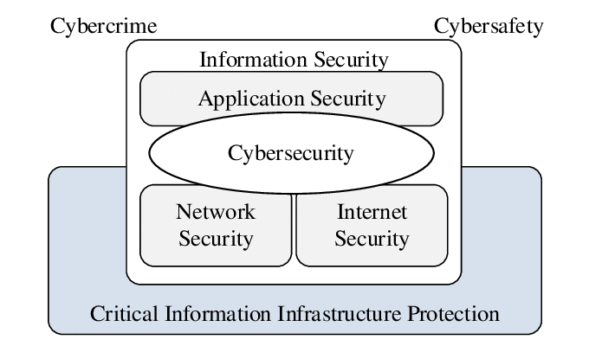

Slide 12
Security Target
The desired levels of security and assurance varies between organization, industries, even departments
There is not single approach applies to every one
Three main security goals
  Confidentiality(C)
  Integrity(I)
  Availability(A)
Three security services necessary to support the CIA
  Identification
  Authentication
  Authorization

Slide 13
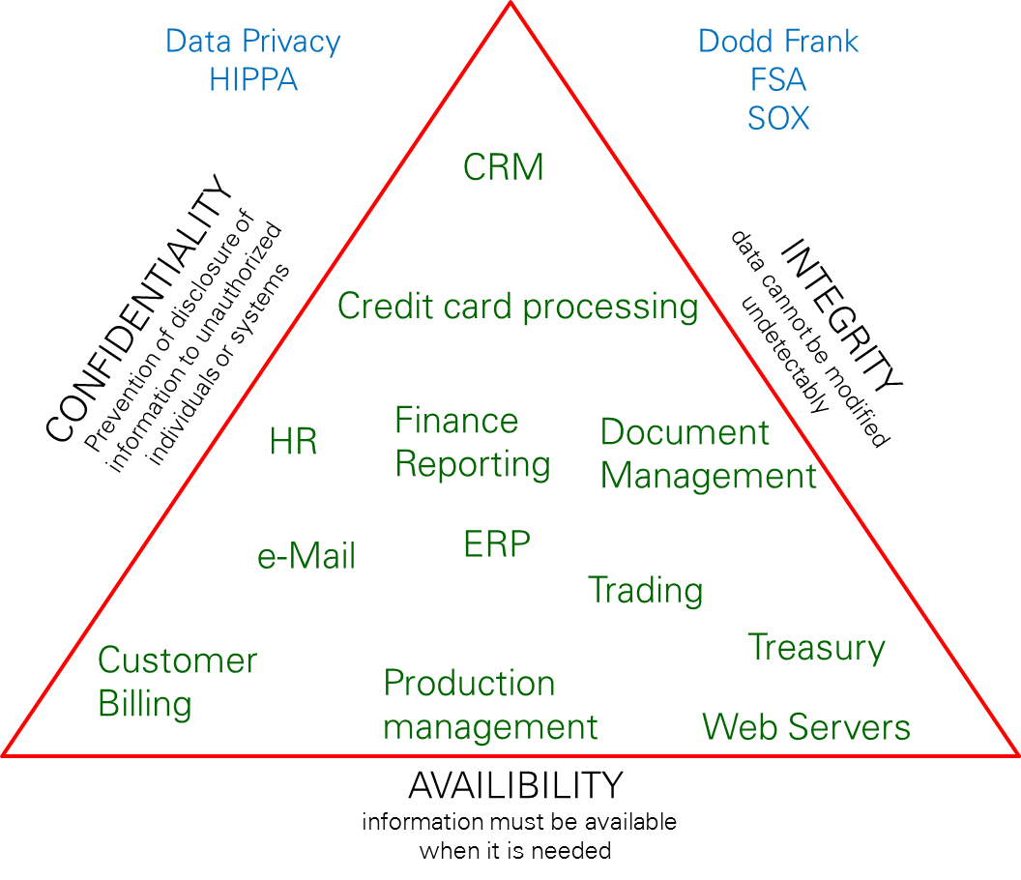
CIA
Ability to control or restrict access so that only authorized individuals can view sensitive information. Classification’s may include
Secret
Confidential
Internal &
Public
Typical risks: Loss of privacy, unauthorised access to information, Identity theft, etc.
Information is accurate and reliable and has not been tampered or changed in an unauthorized way. Integrity controls ensure that the information is authentic, accurate and reliable.
Typical risks: Fraudulent activities, manufacturing defects, inaccurate financial reporting, etc.
Data is available to the users when needed
Typical risks: Business disruption, loss of customer confidence, loss of revenue, etc.

Slide 14
Key Information Security Concepts
Access - a subject or object’s ability to use, manipulate, modify, or affect another subject or object.
Asset – anything that has value to an individual, an organization or a government
Cyber Space- interconnected digital environment of networks, services, systems, and processes
Threat: potential cause of an unwanted incident, which may result in harm to a system, individual or organization
Vulnerability: weakness of an asset or control that can be exploited by a threat
Cyber incident- cyber event that involves a loss of information security or impacts business operations

Slide 15
Key Information Security Concepts
Attack - an act that is an intentional or unintentional attempt to cause damage or compromise to the information and/or the systems that support it.
Control countermeasure- means of managing risk, including policies, procedures, guidelines, practices or organizational structures, which can be administrative, technical, management, or legal in nature
Exploit - to take advantage of weaknesses or vulnerability in a system.
Exposure - a single instance of being open to damage.
Malicious contents- applications, documents, files, data or other resources that have malicious features or capabilities embedded, disguised or hidden in them
Risk - the probability that something can happen.

Slide 16
Cyber security in maritime sector
Ships are becoming more digital with automation which require effective cyber security practice
Integrate both IT and OT.
  Secure vessel from unauthorized access
  Data breaches
Operational Technology (OT)
  Heavily rely on real time response
  Restricted access
  Need to ensure availability such as rebooting is not desirable
  Control physical world
  Proprietary software
  Less mature and attackers looking for vulnerabilities
Information Technology(IT)
  Consistent response
  May not be real time
  Data confidentiality and integrity

Slide 17
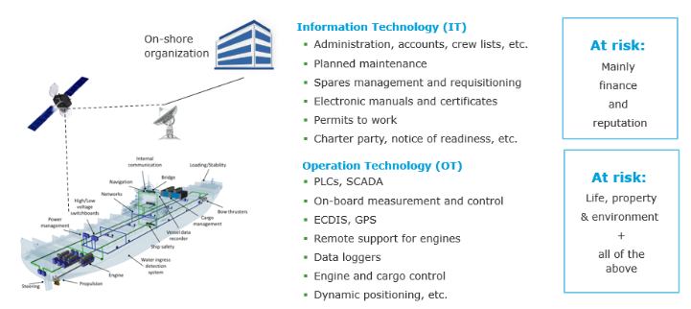
Cyber security in maritime sector
https://www.dnv.com/maritime/insights/topics/maritime-cyber-security/

Slide 18
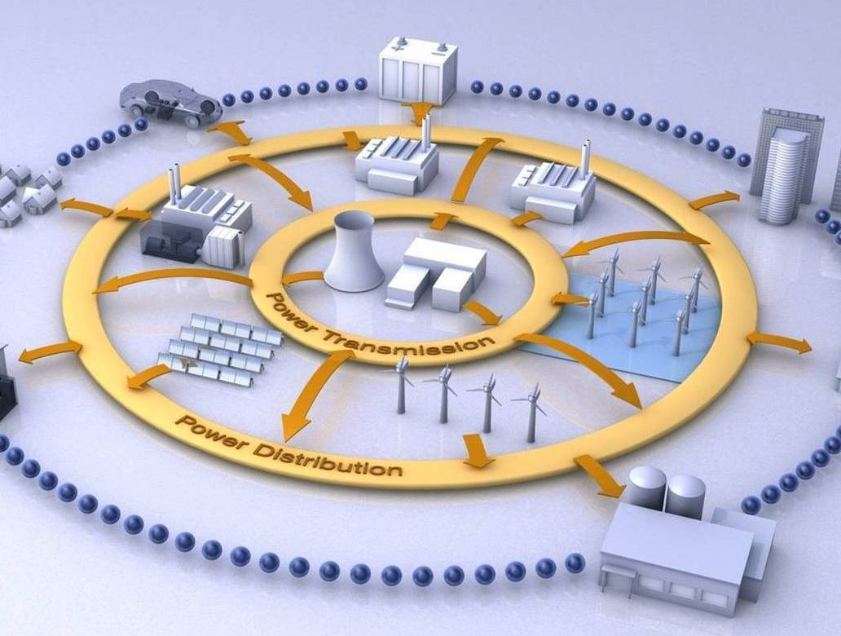
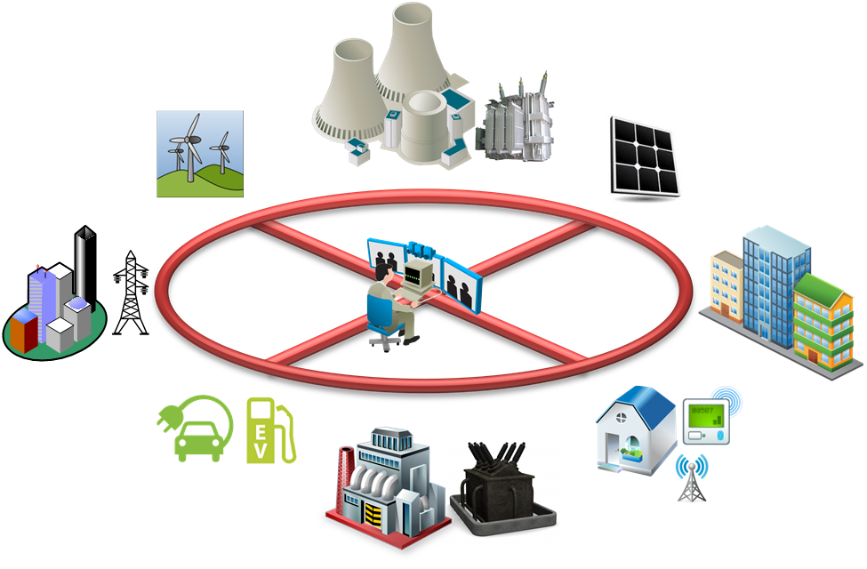
ICS/SCADA Around Us
ICS: Industrial Control System
SCADA: Supervisory Control and Data Acquisition

Slide 19
What is Risk?
  An uncertain event or a set of events that should it occur will have an effect on the achievement of objectives
M_o_R
Energy sector organizations those concern with programs or projects will encounter uncertain events when trying to achieve their objectives
  These events may arise inside or outside of the organization
  Threat: an uncertain event that would have a negative impact on the objectives if it occurred
  Opportunity: an uncertain event that would have a positive impact on the objective if it occurred

Slide 20
What is Cyber Security Risk?
The expected loss of confidentiality, Integrity,
Availability or Accountability
The probable frequency and probable magnitude
of future loss of confidentiality, integrity,
The goal of risk management is to maximize the
output of the organization in terms of services,
product and revenue while minimizing the chance of
unexpected negative outcomes

Slide 21
Risk Management framework
• RM commonly comprises of two general phases
- Risk assessment
• Risk identification
- List of risk items which threat in a specific context
• Risk analysis
- Transform raw risks into decision enabling knowledge
- Severity of the identified risks
• Risk prioritization
- Identified and analyzed risks are ranked by relevant weight
- Risk control
• Risk management plan
- How to address the prioritized risks?
- Which risks are acceptable
- Contingency plan
• Risk control
- Implement the risk control action
• Risk monitor
- Check the effectiveness of the implemented control action
- Identify new risks
• Risk resource repository
- Risk data based for future project

Slide 22
ISO 31000:Risk Management
Assist the organization in integrating risk management into significant activities and functions
The effectiveness of risk management will depend on its integration into the governance of the organization, including decision-making
  support from stakeholders, particularly top management
When designing the framework for managing risk, the organization should examine and understand its external and internal context
External Context
  cultural, political, legal, regulatory, financial, technological, economic and environmental factors
  contractual relationships and commitments;
Internal Context
  vision, mission and values;
  data, information systems and information flows;
  standards, guidelines and models adopted by the organization;
  — capabilities, understood in terms of resources and knowledge (e.g. capital, time, people, intellectual property, processes, systems and technologies);

Slide 23
Risk Management Activity
• Identify the assets
• Identify the threats to those assets
• Identify the vulnerabilities that might be exploited
by the threats
• Identify the impacts that losses of CIAA may
have on those assets
  Assets are resources or information to be protected
Goal
  Pro-actively gather all necessary information about an organization’s assets
    Monitor identified assets to become aware of attacks
      Take necessary actions
Importance
  Most organizations do not know of compromises
    92% of all information security incidents in 2011 identified by third parties
      E.g. law enforcement, other ISPs
    Often attacks have acted for weeks or months

Slide 24
Asset types
General
  Assets found in most organizations
  E.g. email
  Industry-wide checklists possible
Idiosyncratic
  Distinct to an organization
    E.g. student transcripts
  Correct identification difficult
  requires determination of the processes, procedures and activities in the organization
    Considerable effort and attention to detail necessary
Two approaches
  Bottom up
    Talking to co-workers/ Learning curve
    Learn the inner workings of the company/ Employee knowledge
  Top down
    “About us” on website/ Annual reports
    Vision statement/ Mission statement

Slide 25
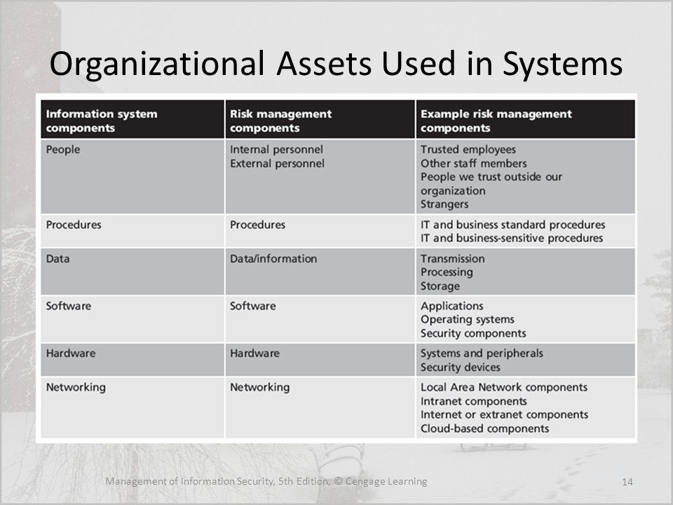
Organizational Assets
Asset | Asset Type | Sensitivity | Criticality
Laptop | Hardware Asset | Restricted | Required
Student Grades | Informational Asset | Restricted | Essential
Smith Richard- - Security Analyst | Personnel Asset | Restricted | Required
Microsoft Office Suite/moodle | Software Asset | Unrestricted | Deferrable
Microsoft Office License | Legal Asset | Unrestricted | Required

Slide 26
Asset Inventory
Asset Name | Category | DETAILS | POSSIBLE OWNER | Acceptable use | Required Protection | Sensitivity/ Criticality
 |  |  |  | Read Write Edit Distribution Delete | C=H/M/L I=H/M/L A=H/M/L

Slide 27
Threat Identification related to the Assets
    Capabilities, intentions and attack methods of adversaries to exploit or cause harm to assets
  NIST definition
    Any circumstance or event with the potential to adversely impact organizational operations and assets, individuals, other organizations or the nation through an information system via unauthorized access, destruction, disclosure or modification of information, and/ or denial of service
Goal
  Once assets are identified, identify threats for optimal information security investments
    No defense necessary if no harm anticipated

Slide 28
Threats
Threats sources
  Deliberate actions by people – This group includes people inside and outside your organization who might take deliberate action against your assets.
  Accidental actions by people – This group includes people inside and outside your organization who might accidentally harm your assets.
  System problems – These are problems with your information technology (IT) systems. Examples include hardware defects, software defects, unavailability of related systems, viruses, malicious code, and other system-related problems.
  Other problems – These are problems that are outside of your control. These can include natural disasters (e.g., floods and earthquakes) that can affect your organization’s IT systems, unavailability of systems maintained by other organizations, and interdependency issues. Interdependency issues include problems with infrastructure services, such as power outages, broken water pipes, and telecommunication outages.

Slide 29
Vulnerabilities
Weaknesses in information systems that gives threats the opportunity to compromise assets
Relationship with threats
  Vulnerability is not a risk without a threat exploiting it
  Threat is not a risk without a vulnerability to be exploited

Slide 30
Risk Analysis
Once the risks are identified we need to know how severe are the risks
Risk analysis estimate and prioritise the risks
  the likelihood or probability that the risk is real
  the consequences of the problems associated with the risk, should it occur.
Well-informed decisions about which risks need to be addressed and to what degree it is appropriate to mitigate the risks
Very challenging tasks
  Probability becomes truly subjective when a trust value does not exist

Slide 31
Risk Analysis
Defining likelihood
  Rating of both the probability that a threat will successfully exploit a vulnerability as well as how often that might occur
  Criteria
    Size of the threat universe(scope of the user community that can access a vulnerability)
    Motivation of the threat actor
    Sophistication of attack or skill level required
    Knowledge of organization
    Level of controls in place to deter or impede exploit
    Attractiveness of the target
Impact definition
  LOW impact: implies risk has a limited adverse effect on the business and CIAA
  Medium impact: implies risk has a serious adverse effect on the business and CIAA
  High impact: implies risk has a severe adverse effect on the business and CIAA

Slide 32
Risk Analysis
Risk level
  Low risk: implies that it is recommended to develop a corrective measure and contingency plan.
  Critical risk: implies the risk has a serious adverse affect on the organization and correctives actions are needed and contingency plan should be developed and execute within a specific period of time.
  Highly critical risk: implies the identified control measures for the risk mitigation need to be implemented immediately within a short duration through a plan.

Slide 33
Risk Analysis
Estimate the probability of occurrence
Probability is the overall rating—often a numerical value on a defined scale (such as 0.1 – 1.0)—of the probability that a specific vulnerability will be exploited
Estimate the impact on the project on a scale of 1 to 5, where
  1 = low impact
  5 = catastrophic impact
Risk Level
  In case of quantitative assessment
  Ri=P(Ri) X I(Ri)
  =.55 X . 8 [Assume P(Ri)=.55 and I(Ri)=.8]
  =.44

Slide 34
Risk Analysis
In case of qualitative assessment
  Ri=P(Ri) X I(Ri)
  Ri=Medium X High
  Ri=??
Likelihood impact
high medium low
High H H/M Extreme
Medium H/M M M/L
Low Extreme M/L L
Risk level determines the priority of the risks
  it is not possible to look at all the identified risks
  Risk that requires immediate attention

Slide 35
Risk Control
To gain control of the risks as early as possible
Initially focus on the top prioritized risk events and factors
Once possible countermeasure is identified then you need to select the most potential ones to control the risks
  Cost, technical expertise, assets
Without a true sense of the cost of the controls over time and impact to the organization to support them, hard to make the right decision
Risk threshold
    Specific level up to which a risk can be accepted
Its all about making decision and balancing the cost
Total expense of the controls should never cost more than the asset is worth

Slide 36
Risk Control Strategy
Avoid
  Changing some aspect of the project so that threats either can no longer have an impact or can no longer happen
  Ex: rearrange skype meeting instead of physical meeting
Reduce
  Reduce likelihood/impact of the risk
  Ex: more user training to reduce the low usability of product
Fallback
  A fallback plan if the risk occurs to reduce the impact of the risk
  Reactive
  Ex: Hire extra developers if schedule overruns
Transfer
  A third party takes on responsibility for the financial impact of the risk
  Ex: insurance

Slide 37
Risk Control Strategy
Accept Do nothing
  Keep the risk as it is more economical
  Risk need adequate monitoring
  Ex: competitor launch new product
Share (can be an opportunity)
  Pain/gain formula
  Risk sharing principles with third party
  Ex: customer/supplier agree to share the cost of price
Enhance (Opportunity)
  Enhance the probability of event occur
  Enhance the impact of the event
  Ex: delay product release
Reject (Opportunity)
  A conscious and deliberate decision is taken not to exploit/enhance the opportunity
  needs continuous monitoring
  Ex: Not take advantage of early release

Slide 38
Vulnerabilities
Lack of visibility each vessel OT networks
Lack of cyber security controls
  Specified for specific domains – bulk power distribution, metering
vulnerable IT systems on board for cargo management systems
  Loading and un-loading goods
Navigation systems
Insecure wireless communication
Port equipment, networks, operating systems, software, and infrastructure
Inherent complexity
  exposure to potential attackers and unintentional errors
  Interdependent networks introduce common vulnerabilities
Increased number of entry points and paths
Compromise of data confidentiality or customer privacy

Slide 39
Vulnerabilities
Real time monitoring
cybersecurity awareness among stakeholder including crew, employees, and contractors
Ransomware/Malware
Access
GPS/navigation system attack

Slide 40
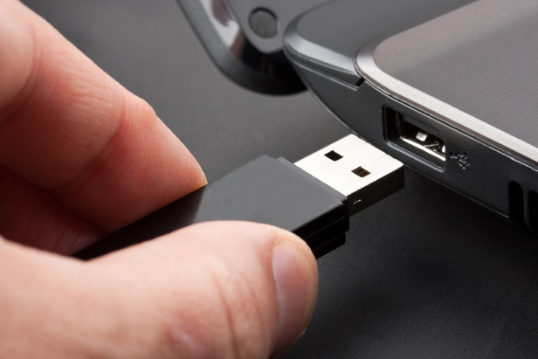
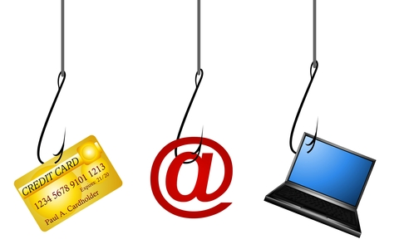
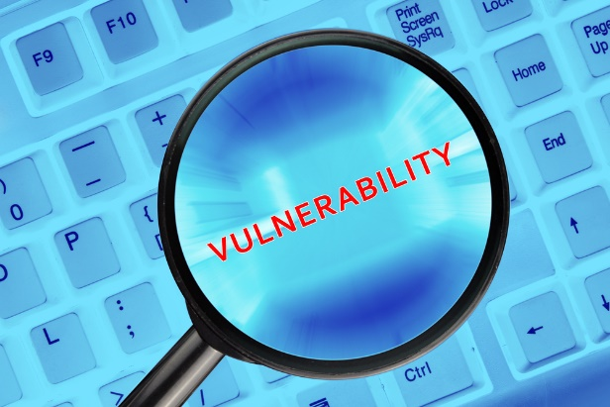
Attack Vectors Reaching the ICS/SCADA Network
Removable Media
Phishing
Software Vulnerabilities

Slide 41
Threats and risks in Scada
  unauthorized access can disrupt energy supply networks, leading to power outages and other damages.
  DoS, ransomware attacks, insider threats, and attacks targeting Industrial Control Systems (ICS) and Supervisory Control and Data Acquisition (SCADA) systems
  Risks
    Disruption of the service delivery
    Blackout
    erc

Slide 42
Vulnerabilities
Policies
Tools

Slide 43
Controls
Access controls
Encryption
Authentication
Regular security patches and updates
Physical security
Intrusion Detection Systems (IDS)
Blockchain

Slide 44
Training Outline:
Part 2
Topic-3: Security controls and standards of the specific domain.
Introduction to ISO/IEC 27001, status, versions, structure (Clauses 1-4 and Annex A).
ISO 27001:2022 / ISO/IEC 27002:2022 control themes
IMO Resolution MSC.428(98)

Slide 45

Topic-2:
Risk Management framework
We will cover these skills
Demonstrate an in-depth understanding of cyber security risk management framework in energy sector
Recognize the significant cybersecurity governance structures and processes in the energy sector
Critically assess and report security risk and suggest suitable mitigation strategies in professional manner

Slide 46
Topic-3:
Security controls and standards of the specific domain.
We will cover these skills
Gain basic knowledge on the structure, status and versions of ISO/IEC 27001
Gain knowledge on the themes of ISO/IEC 27002:2022
Get acquainted with basic terms and their definitions as used by ISO/IEC 27002
Get acquainted with how these basic terms are adapted to fit the energy utility sector.
Critically develop and evaluate security policy and select controls by following ISO 27019 for security governance.

Slide 47

Evaluation method
Evaluation Element | How | Notes
Coursework portfolio | Learner needs to produce a 3000-word portfolio at the end of the module by performing a list of tasks to demonstrate the learning outcomes are achieved. | (80%) Summative assessment
Presentation | Learners need to present the outcomes of the portfolio to demonstrate their understanding | (20%) Summative assessment
Group discussion | During the seminar

Slide 48

Introduction to
ISO/IEC 27001
ISO/IEC 27001 is the world's best-known standard for information security management systems (ISMS). It defines requirements an ISMS must meet.
The ISO/IEC 27001 standard provides companies of any size and from all sectors of activity with guidance for establishing, implementing, maintaining and continually improving an information security management system.
Conformity with ISO/IEC 27001 means that an organization or business has put in place a system to manage risks related to the security of data owned or handled by the company, and that this system respects all the best practices and principles enshrined in this International Standard.
https://www.iso.org/standard/27001

Slide 49



ISO/IEC 27001
Revision history
More previously

Slide 50
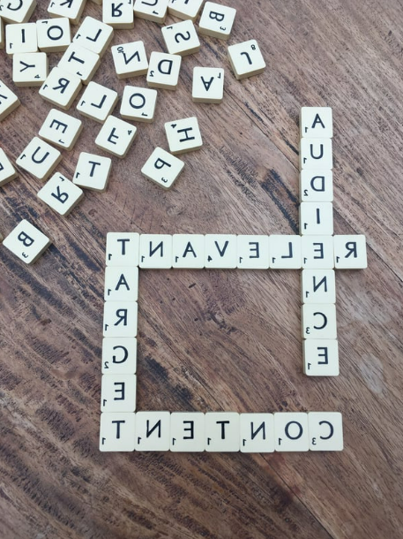
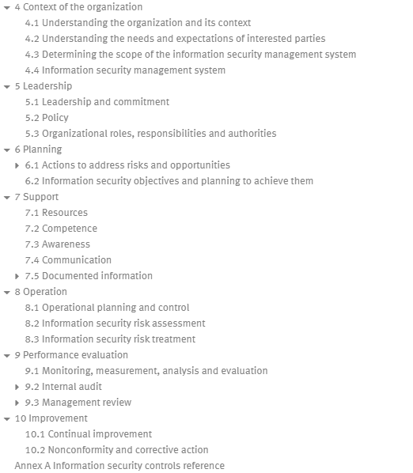
ISO/IEC 27001 Structure
https://www.iso.org/obp/ui/en/#iso:std:iso-iec:27001:ed-3:v1:en

Slide 51
ISO/IEC 27001 Structure
Clauses
https://www.iso.org/obp/ui/en/#iso:std:iso-iec:27001:ed-3:v1:en

Slide 52

ISO/IEC 27001 Clauses
4. Context of the organization
5. Leadership
6. Planning
7. Support
8. Operation
9. Performance Evaluation
10. Improvement

Slide 53
ISO/IEC 27001 Clauses
4. Context of the organization → Scope of the system and an analysis of issues and interested parties.
5. Leadership → Information Security Policy , Roles, responsibilities and authorities
6. Planning → Risk management methodology, risk assessment, risk register, risk treatment plans, Objectives and plans
7. Support → Competencies, Document management procedures, Communication procedures
8. Operation → Change Management procedure
9. Performance Evaluation → KPIs, Internal audit procedure, Internal audits, Management review
10. Improvement → Corrective actions procedure

Slide 54
ISO 27001 – Annex A
ISO 27001 in clauses 4-10, does not prescribe a set of measures / controls to be applied by organizations.
ISO 27001 mandates the design and implementation of a risk management process, that allows the organization to
- identify it’s own criteria for risk acceptance,
- consider the possible risks taking into account measures already in place (existing measures) and
- identity risks that do not fulfill them.
For these risks, the organization needs to propose (proposed measures) and implement suitable risk treatment plans.

Slide 55
ISO 27001 – Annex A
After this process, organizations are asked to compare the existing and proposed measures against a list of Information Security controls that can be used as reference, in order to see if something needed has been omitted.
A control is defined as a measure that modifies or maintains risk. Some of the controls are controls that modify risk, while others maintain risk.
An information security policy, for example, can only maintain risk, whereas compliance with the information security policy can modify risk. Moreover, some controls describe the same generic measure in different risk contexts.
[definition of control by ISO/IEC 27002:2022]

Slide 56
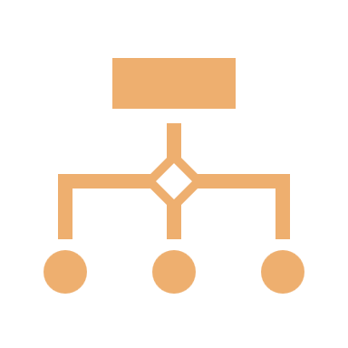



Structure of the controls
Organizational Controls
People
Controls
Physical Controls
Technological
Controls
if they concern people
if they concern physical objects
if they concern technology
37 controls
8 controls
14 controls
34 controls

Slide 57
ISO/IEC 27002:2022
The standard offers guidance on a broad range of information security controls that are commonly applied in many different organizations.
The guidance is generic and can be used by organizations of all types and sizes (including public and private sector, commercial and non-profit) who create, collect, process, store, transmit and dispose of information in many forms, including electronic, physical and verbal (e.g. conversations and presentations).

Slide 58
ISO/IEC 27002:2022 - Attributes
Control Type | Information security properties | Cybersecurity concepts | Operational capabilities | Security domains
# preventive # detective # corrective | # confidentiality # integrity # availability | # identify # protect # detect # respond # recover | # governance # asset management # information protection # human resource security # physical security # system and network security # application security …. | # governance and ecosystem # protection # defense # resilience

Slide 59
Standard IT environments VS Process control systems used by energy utilities and energy suppliers
Information technology (IT) is the development, management, and application of computer equipment, networks, software, and systems.
IT is crucial to modern business operations because it enables people and machines to communicate and exchange information.
IT Operations focus on the day-to-day management of IT departments, which includes managing devices, maintaining networks, testing the security of applications and systems, and providing technical support.
Infrastructure maintenance focuses on the process of setting up and maintaining infrastructure equipment, such as cabling, laptops, phones and phone systems, and physical servers.
IT Governance focuses on the process of ensuring that IT policies and services align with the needs and demands of the organization.*
Process control systems collect process data and monitor the status of the physical processes using sensors.
The systems then process this data and generate control outputs that regulate actions using actuators.
The control and regulation are automatic but manual intervention by operating personnel is also possible.
Information and information processing systems are therefore an essential part of operational processes within energy utilities.
Process control systems in the energy utility sector are increasingly interconnected to form complex systems.
vs
* https://www.fortinet.com/resources/cyberglossary/it-vs-ot-cybersecurity

Slide 60
IMO Resolution MSC.428(98)
International Maritime Organization’s (IMO) Resolution MSC.428(98)
  encourages administrations to ensure that cyber risks are appropriately addressed in existing safety management systems
  Based on NIST 800-53 R4 cybersecurity framework and tailored for the Maritime industry

Slide 61

Thank you
Please send all questions to:
shareeful@gmail.com

