Slide 1



Cybersecurity Risk Management and Governance in the Healthcare sector
CSP003_SA_H
Presentation by:
TRAINNERS NAMES

Slide 2


Slide 3


Cybersecurity Essentials and Management
o1.
Goals: Who-What-Why you need to take this training
o2.
Training logistics: When-Where-How
o3.
Learning outcomes
o4.
Training outlines
o5.
Exercises details
o6.
Practical information and requirements
o7.
Registration information and contacts

Slide 4



Goals: Who-What-Why you need to take this training
WHO
WHAT
WHY
WHO can attend the training modules and profiles of the attendees
Foundational of cybersecurity essentials and management for managers, leaders and working-professionals
Equipping participants with the knowledge and skills necessary to make a strategy to protect critical systems and data

Slide 5



CSP Training Logistic: When-Where-How
WHEN
WHERE
HOW
Time schedule: Autumn 2024
ONLINE-ONSITE-Location Information
Delivery Method

Slide 6

Value Propositions
Benefits to Participants
Level of Training Module: Advanced
Cybersecurity Professional Training
Hands-on and Practical Skills Development
Rooted with European Cybersecurity Skills Framework
Cutting-edge insights from industry-academic experts
Specialized information on the Health sector
Certificate of the completion
Helps with skills development and career advancement

Slide 7

WHO
Profile of Training Participants
IT professional
Security professionals
Business leaders
and any other professionals that need or want to understand the basic concepts related to Cybersecurity risk management and Governance.

Slide 8

WHO
Chatzopoulou Argyro (Iro)
Experienced Lead Auditor and Trainer with a demonstrated history of working in the services industry. Skilled in all kinds of audits including ISO 27001, Information Systems, IT Service Management, Privacy, Quality and Business Continuity.
A person with strong communication and management skills honed through conducting more than 1500 audits, delivering more than 500 training courses and managing teams nationally or internationally.
Member of CEN/CLC/JTC 13 "Cybersecurity & Data Protection“
Member of the ISO/IEC JTC1 SC27 "Information Security, Cybersecurity & Data Privacy“
Member to the Ad-Hoc Working Group on the European Cybersecurity Skills Framework

Slide 9

WHAT
Training Topics
Cyber security in Health sector
Risk Management framework Governance processes
Role, responsibilities and authorities
Security controls and industry specific standards related to security management and governance

Slide 10

WHY
Learning Outcomes
Demonstrate an in-depth understanding of cyber security risk management framework in Health sector;
Recognize the significant cybersecurity governance structures and processes in the Health sector;
Critically assess and report security risk and suggest suitable mitigation strategies in professional manner
Critically develop and evaluate security policy and select controls by following ISO 27019 for security governance.

Slide 11

Training Outline
Part-1
Topic-1: Cyber security in Health sector
Cyber security fundamentals
Cyber security context in Health sector
Topic-2: Risk Management framework
Risk management Basics
Principles of risk management and processes
Cybersecurity threats and vulnerability management in the Health sector
Examples and exercises

Slide 12
Training Outline:
Part-2
Topic-3: Security controls and standards of the specific domain.
Introduction to ISO/IEC 27001, status, versions, structure (Clauses 1-10 and Annex A).
ISO 27001:2013 / ISO/IEC 27002:2013 control themes
Terms and definitions of ISO 27000 adapted to the Health utility domain
Guidance on the controls of ISO/IEC 27002:2013 adapted to the Health utility domain.
Health specific controls as proposed by ISO 27700:2016.

Slide 13

Topic-1: Cyber security in Health sector
We will cover these skills

Slide 14
Topic-2:
Risk Management framework
We will cover these skills
Demonstrate an in-depth understanding of cyber security risk management framework in energy sector
Recognize the significant cybersecurity governance structures and processes in the energy sector
Critically assess and report security risk and suggest suitable mitigation strategies in professional manner

Slide 15
Topic-3:
Security controls and standards of the specific domain.
We will cover these skills
Gain basic knowledge on the structure, status and versions of ISO/IEC 27001
Gain knowledge on the themes of ISO/IEC 27002:2013
Get acquainted with basic terms and their definitions as used by ISO/IEC 27002
Get acquainted with how these basic terms are adapted to fit the Health utility sector.
Critically develop and evaluate security policy and select controls by following ISO 27799 for security governance.

Slide 16

Evaluation method
Evaluation Element | How | Notes
Coursework portfolio | Learner needs to produce a 2000-word report at the end of the module by performing a list of tasks to demonstrate the result of threat and vulnerability assessment and control to tackle the threats based on a real-world scenario. | (80%) Summative assessment
Presentation | Learner needs to develop log book based on the individual exercise covered at the end of each session to demonstrate their understanding of the knowledge covered by the module. | (20%) Formative assessment
Group discussion | During the seminar

Slide 17

Background Knowledge and Prerequisites
Background knowledge:
Basic understanding of computers and networking (IT)
Basic understanding of cybersecurity concepts
Prerequisites:
None

Slide 18

Resources: Books and Reference Materials
ISO/IEC 27000:2018, Information technology. Security techniques. Information security management systems. Overview and vocabulary, https://www.iso.org/standard/73906.html
ISO/IEC 27001:2013, Information technology. Security techniques. Information security management systems. Requirements. https://www.iso.org/contents/data/standard/05/45/54534.html
ISO/IEC 27002:2013, Information technology. Security techniques. Code of practice for information security controls. https://www.iso.org/standard/54533.html
ISO 27799:2016, Health informatics. Information security management in health using ISO/IEC 27002. https://www.iso.org/standard/62777.html

Slide 19

Registration: How to register and other practical information
The specific registration process for the Cybersecurity Risk Management and Governance training may vary depending on the training provider or institution. However, the general steps are typically straightforward and can be completed online or in person.
Online Registration
In-Person Registration
Additional Practical Information

Slide 20

Course progress
o1.
Cyber security in Health sector
o2.
Risk Management framework
o3.
Security controls and standards of the specific domain

Slide 21
Course progress
o1.
Cyber security in energy sector
o2.
Risk Management framework
o3.
Security controls and standards of the specific domain

Slide 22
Course progress
o1.
Cyber security in energy sector
o2.
Risk Management framework
o3.
Security controls and standards of the specific domain

Slide 23

Introduction to
ISO/IEC 27001
ISO/IEC 27001 is the world's best-known standard for information security management systems (ISMS). It defines requirements an ISMS must meet.
The ISO/IEC 27001 standard provides companies of any size and from all sectors of activity with guidance for establishing, implementing, maintaining and continually improving an information security management system.
Conformity with ISO/IEC 27001 means that an organization or business has put in place a system to manage risks related to the security of data owned or handled by the company, and that this system respects all the best practices and principles enshrined in this International Standard.
https://www.iso.org/standard/27001

Slide 24



ISO/IEC 27001
Revision history
More previously

Slide 25

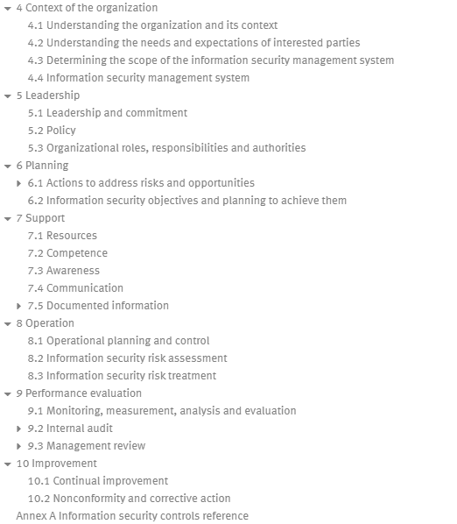
ISO/IEC 27001 Structure
https://www.iso.org/obp/ui/en/#iso:std:iso-iec:27001:ed-3:v1:en

Slide 26
ISO/IEC 27001 Structure
Clauses
https://www.iso.org/obp/ui/en/#iso:std:iso-iec:27001:ed-3:v1:en

Slide 27

ISO/IEC 27001 Clauses
4. Context of the organization
5. Leadership
6. Planning
7. Support
8. Operation
9. Performance Evaluation
10. Improvement

Slide 28
ISO/IEC 27001 Clauses
4. Context of the organization → Scope of the system and an analysis of issues and interested parties.
5. Leadership → Information Security Policy , Roles, responsibilities and authorities
6. Planning → Risk management methodology, risk assessment, risk register, risk treatment plans, Objectives and plans
7. Support → Competencies, Document management procedures, Communication procedures
8. Operation → Change Management procedure
9. Performance Evaluation → KPIs, Internal audit procedure, Internal audits, Management review
10. Improvement → Corrective actions procedure

Slide 29
ISO 27001 – Annex A
ISO 27001 in clauses 4-10, does not prescribe a set of measures / controls to be applied by organizations.
ISO 27001 mandates the design and implementation of a risk management process, that allows the organization to
- identify it’s own criteria for risk acceptance,
- consider the possible risks taking into account measures already in place (existing measures) and
- identity risks that do not fulfill them.
For these risks, the organization needs to propose (proposed measures) and implement suitable risk treatment plans.

Slide 30
ISO 27001 – Annex A
After this process, organizations are asked to compare the existing and proposed measures against a list of Information Security controls that can be used as reference, in order to see if something needed has been omitted.
A control is defined as a measure that modifies or maintains risk. Some of the controls are controls that modify risk, while others maintain risk.
An information security policy, for example, can only maintain risk, whereas compliance with the information security policy can modify risk. Moreover, some controls describe the same generic measure in different risk contexts.
[definition of control by ISO 27000:2018]

Slide 31
ISO 27001 – Annex A
After this process, organizations are asked to compare the existing and proposed measures against a list of Information Security controls that can be used as reference, in order to see if something needed has been omitted.
A control is defined as a measure that modifies or maintains risk. Some of the controls are controls that modify risk, while others maintain risk.
An information security policy, for example, can only maintain risk, whereas compliance with the information security policy can modify risk. Moreover, some controls describe the same generic measure in different risk contexts.
[definition of control by ISO 27000:2018]

Slide 32
Structure of the controls
Annex A Control areas
Information security policies
Organization of information
security
Human resources security
Asset
Management
Operations
security
Access Control
Cryptography
Physical and environmental security
Communications security
System acquisition, development and maintenance
Supplier
relationships
Information security incident
management
Information security aspects of business continuity
management
Compliance
5
6
7
8
9
10
11
12
13
14
15
16
17
18

Slide 33
ISO/IEC 27002:2013
The standard offers guidance on a broad range of information security controls that are commonly applied in many different organizations.
The guidance is generic and can be used by organizations of all types and sizes (including public and private sector, commercial and non-profit) who create, collect, process, store, transmit and dispose of information in many forms, including electronic, physical and verbal (e.g. conversations and presentations).

Slide 34
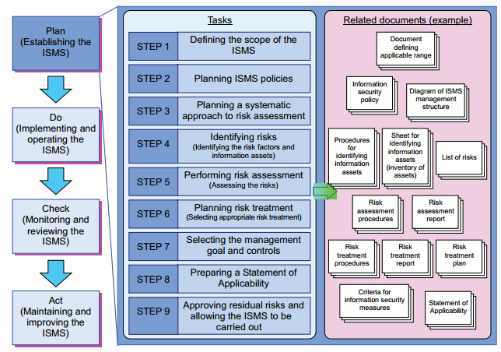
Tasks and related documents for establishing the ISMS
* https://www.fortinet.com/resources/cyberglossary/it-vs-ot-cybersecurity

Slide 35
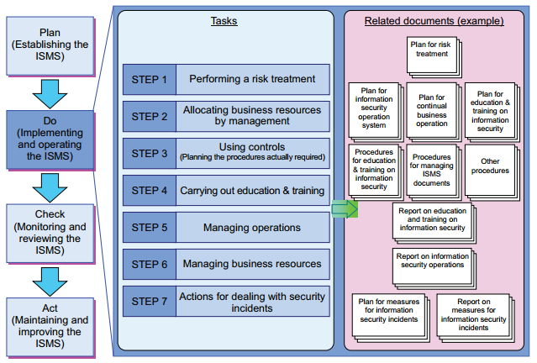
Tasks and related documents for implementing and operating the ISMS
* https://www.fortinet.com/resources/cyberglossary/it-vs-ot-cybersecurity

Slide 36
ISO 27799:2016 and ISO/IEC 27002:2013
ISO/IEC 27002 is already being used extensively for health informatics IT security management through the agency of national or regional guidelines in several countries. ISO 27799 draws upon the experience gained in these national endeavours in dealing with the security of personal health information and is intended as a companion document to ISO/IEC 27002.
ISO 27799 applies ISO/IEC 27002 to the healthcare domain in a way that carefully considers the appropriate application of security controls for the purposes of protecting personal health information.
These considerations have, in some cases, led the authors to conclude that application of certain ISO/IEC 27002 control objectives is essential if personal health information is to be adequately protected. ISO 27799 therefore places constraints upon the application of certain security controls specified in ISO/IEC 27002.
* https://www.fortinet.com/resources/cyberglossary/it-vs-ot-cybersecurity

Slide 37
Threats to Health information security (ISO 27799:2016)
Masquerade by insiders (including masquerade by health professionals and support staff)
Masquerade by service providers (including contracted maintenance personnel, such as system software engineers, hardware repair personnel and others who may have a pro-forma legitimate reason to access systems and data)
Masquerade by outsiders (including hackers)
Unauthorised use of a health information application
Introduction of damaging or disruptive software (including viruses, worms, and other “malware”)
Misuse of system resources
Communications infiltration
Communications interception
Repudiation
Connection failure (including failures of health information networks)
Embedding of malicious code
Accidental misrouting
* https://www.fortinet.com/resources/cyberglossary/it-vs-ot-cybersecurity

Slide 38
Threats to Health information security (ISO 27799:2016)
Technical failure of the host, storage facility, or network infrastructure
Environmental support failure (including power failures and disruptions of service arising from natural or man-made disasters)
System or network software failure
Application software failure (e.g. of a health information application)
Operations error
Maintenance error
User error
Staff shortage
Theft by insiders (including theft of equipment or data)
Theft by outsiders (including theft of equipment or data)
Wilful damage by insiders
Wilful damage by outsiders
Terrorism
* https://www.fortinet.com/resources/cyberglossary/it-vs-ot-cybersecurity

Slide 39
Terms and Definitions
health informatics
scientific discipline that is concerned with the cognitive, information processing and communication tasks of healthcare practice, education and research, including the information science and technology to support these tasks
health information system
repository of information regarding the health of a subject of care in computer-processable form, stored and transmitted securely, and accessible by multiple authorised users

Slide 40
Terms and Definitions
healthcare
type of services provided by professionals or paraprofessionals with an impact on health status
healthcare organization
organization that provides healthcare services
health professional
person who is authorised by a recognised body to be qualified to perform certain health duties

Slide 41
Terms and Definitions
identifiable person
one who can be identified, directly or indirectly, in particular by reference to an identification number or one or more factors specific to his physical, physiological, mental, economic, cultural or social identity
subject of care
one or more persons scheduled to receive, receiving, or having received a health service
patient
subject of care consisting of one person

Slide 42
Terms and Definitions
personal health information
information about an identifiable person that relates to the physical or mental health of the individual

Slide 43
A.5 Information security policies
Health-specific controls
A.5.1.1 Policies for information security
A.5.1.2 Review of the policies for information security

Slide 44
A.5 Summary

Slide 45
A.6 Organization of information security
Health-specific controls
A.6.1.1 Information security roles and responsibilities
A.6.1.2 Segregation of duties
A.6.1.5 Information security in project management
Non Health-specific controls
A.6.1.3 Contact with authorities
A.6.1.4 Contact with special interest groups
A.6.2.1 Mobile device policy
A.6.2.2 Teleworking

Slide 46
A.6 Summary

Slide 47
A.7 Human resource security
Health-specific controls
A.7.1.1 Screening
A.7.1.2 Terms and conditions of employment
A.7.2.2 Information security awareness, education and training
Non Health-specific controls
A.7.2.1 Management responsibilities
A.7.2.3 Disciplinary process
A.7.3.1 Termination or change of employment responsibilities

Slide 48
A.7 Summary

Slide 49
A.8 Asset management
Health-specific controls
A.8.1.1 Inventory of assets
A.8.1.4 Return of assets
A.8.2.1 Classification of information
A.8.2.2 Labelling of information
A.8.3.1 Management of removable media
A.8.3.2 Disposal of media

Slide 50
A.8 Asset management
Non Health-specific controls
A.8.1.2 Ownership of assets
A.8.1.3 Acceptable use of assets
A.8.2.3 Handling of assets
A.8.3.3 Physical media transfer

Slide 51
A.8 Summary

Slide 52
A.9 Access control
Health-specific controls
A.9.1.1 Access control policy
A.9.2.1 User registration and de-registration
A.9.2.6 Removal or adjustment of access rights
A.9.4.1 Information access restriction

Slide 53
A.9 Access control
Non Health-specific controls
A.9.1.2 Access to networks and network services
A.9.2.2 User access provisioning
A.9.2.3 Management of privileged access rights
A.9.2.4 Management of secret authentication information of users
A.9.2.5 Review of user access rights
A.9.3.1 Use of secret authentication information
A.9.4.2 Secure log-on procedures
A.9.4.3 Password management system
A.9.4.4 Use of privileged utility programs
A.9.4.5 Access control to program source code

Slide 54
A.9 Summary

Slide 55
A.10 Cryptography
Non Health-specific controls
A.10.1.1 Policy on the use of cryptographic controls
A.10.1.2 Key management

Slide 56
A.10 Summary

Slide 57
A.11 Physical and environmental security
Health-specific controls
A.11.1.1 Physical security perimeter
A.11.2.5 Removal of assets
A.11.2.6 Security of equipment and assets off-premises
A.11.2.7 Secure disposal or reuse of equipment

Slide 58
A.11 Physical and environmental security
Non Health-specific controls
A.11.1.2 Physical entry controls
A.11.1.3 Securing offices, rooms and facilities
A.11.1.4 Protecting against external and environmental threats
A.11.1.5 Working in secure areas
A.11.1.6 Delivery and loading areas
A.11.2.1 Equipment siting and protection
A.11.2.2 Supporting utilities
A.11.2.3 Cabling security
A.11.2.4 Equipment maintenance
A.11.2.8 Unattended user equipment
A.11.2.9 Clear desk and clear screen policy

Slide 59
A.11 Summary

Slide 60
A.12 Operations security
Health-specific controls
A.12.1.2 Change management
A.12.1.4 Separation of development, testing and operational environments
A.12.2.1 Controls against malware
A.12.3.1 Information backup
A.12.4.2 Protection of log information
A.12.4.4 Clock synchronisation

Slide 61
A.12 Operations security
Non Health-specific controls
A.12.1.1 Documented operating procedures
A.12.1.3 Capacity management
A.12.4.1 Event logging
A.12.4.3 Administrator and operator logs
A.12.5.1 Installation of software on operational systems
A.12.6.1 Management of technical vulnerabilities
A.12.6.2 Restrictions on software installation
A.12.7.1 Information systems audit controls

Slide 62
A.12 Summary

Slide 63
A.13 Communications security
Health-specific controls
A.13.2.4 Confidentiality or non-disclosure agreements

Slide 64
A.13 Communications security
Non Health-specific controls
A.13.1.1 Network controls
A.13.1.2 Security of network services
A.13.1.3 Segregation in networks
A.13.2.1 Information transfer policies and procedures
A.13.2.2 Agreements on information transfer
A.13.2.3 Electronic messaging

Slide 65
A.13 Summary

Slide 66
A.14 System acquisition, development and maintenance
Health-specific controls
A.14.1.1.1 Uniquely identifying subjects of care
A.14.1.1.2 Output data validation
A.14.1.3.1 Publicly available health information

Slide 67
A.14 System acquisition, development and maintenance
Non Health-specific controls
A.14.1.1 Information security requirements analysis and specification
A.14.1.2 Securing application services on public networks
A.14.1.3 Protecting application services transactions
A.14.2.1 Secure development policy
A.14.2.2 System change control procedures
A.14.2.3 Technical review of applications after operating platform changes

Slide 68
A.14 System acquisition, development and maintenance
Non Health-specific controls
A.14.2.4 Restrictions on changes to software packages
A.14.2.5 Secure system engineering principles
A.14.2.6 Secure development environment
A.14.2.7 Outsourced development
A.14.2.8 System security testing
A.14.2.9 System acceptance testing
A.14.3.1 Protection of test data

Slide 69
A.14 Summary

Slide 70
A.15 Supplier relationships
Health-specific controls
Α.15.1.1 Information security policy for supplier relationships

Slide 71
A.15 Supplier relationships
Non Health-specific controls
Α.15.1.2 Addressing security within supplier agreements
Α.15.1.3 Information and communication technology supply chain
Α.15.2.1 Monitoring and review of supplier services
Α.15.2.2 Managing changes to supplier services

Slide 72
A.15 Summary

Slide 73
A.16 Information security incident management
Health-specific controls
Α.16.1.2 Reporting information security events

Slide 74
A.16 Information security incident management
Non Health-specific controls
Α.16.1.1 Responsibilities and procedures
Α.16.1.3 Reporting information security weaknesses
Α.16.1.4 Assessment of and decision on information security events
Α.16.1.5 Response to information security incidents
Α.16.1.6 Learning from information security incidents
Α.16.1.7 Collection of evidence

Slide 75
A.16 Summary

Slide 76
A.17 Information security aspects of business continuity management
Non Health-specific controls
Α.17.1.1 Planning information security continuity
Α.17.1.2 Implementing information security continuity
Α.17.1.3 Verify, review and evaluate information security continuity
Α.17.2.1 Availability of information processing facilities

Slide 77
A.17 Summary

Slide 78
A.18 Compliance
Non Health-specific controls
Α.18.1.1 Identification of applicable legislation and contractual requirements
Α.18.1.2 Intellectual property rights
Α.18.1.3 Protection of records
Α.18.1.4 Privacy and protection of personally identifiable information
Α.18.1.5 Regulation of cryptographic controls
Α.18.2.1 Independent review of information security
Α.18.2.2 Compliance with security policies and standards
Α.18.2.3 Technical compliance review

Slide 79
A.18 Compliance

Slide 80
Controls with no additional guidance for information security management in health.
A.6.1.3 Contact with authorities
A.6.1.4 Contact with special interest groups
A.8.1.3 Acceptable use of assets
A.8.2.3 Handling of assets
A.8.3.3 Physical media transfer
A.9.2.4 Management of secret authentication information of users (although it should be noted that time pressures found in health delivery situations can make effective use of passwords difficult to employ. Many health organizations have considered the adoption of alternative authentication technologies to address this problem.)
A.9.4.2 Secure log-on procedures

Slide 81
Controls with no additional guidance for information security management in health.
A.9.4.3 Password management system
A.9.4.4 Use of privileged utility programs
A.9.4.5 Access control to program source code
A.11.1.3 Securing offices, rooms and facilities
A.11.1.5 Working in secure areas
A.11.2.2 Supporting utilities
A.11.2.7 Secure disposal or reuse of equipment
A.11.2.8 Unattended user equipment
A.12.1.1 Documented operating procedures

Slide 82
Controls with no additional guidance for information security management in health.
A.12.1.3 Capacity management
A.12.6.1 Management of technical vulnerabilities
A.12.6.2 Restrictions on software installation
A.12.7.1 Information systems audit controls
A.13.1.1 Network controls
A.13.1.3 Segregation in networks
A.13.2.2 Agreements on information transfer
A.14.1.1 Information security requirements analysis and specification

Slide 83
Controls with no additional guidance for information security management in health.
A.14.2.1 Secure development policy
A.14.2.2 System change control procedures
A.14.2.3 Technical review of applications after operating platform changes
A.14.2.4 Restrictions on changes to software packages
A.14.2.5 Secure system engineering principles
A.14.2.6 Secure development environment
A.14.2.7 Outsourced development
A.14.2.8 System security testing

Slide 84
Controls with no additional guidance for information security management in health.
A.15.1.3 Information and communication technology supply chain
A.15.2.1 Monitoring and review of supplier services
A.15.2.2 Managing changes to supplier services
A.16.1.3 Reporting information security weaknesses
A.16.1.5 Response to information security incidents
A.16.1.6 Learning from information security incidents
A.17.1.3 Verify, review and evaluate information security continuity

Slide 85
Controls with no additional guidance for information security management in health.
A.17.2.1 Availability of information processing facilities
A.18.1.2 Intellectual property rights
A.18.1.3 Protection of records
A.18.1.5 Regulation of cryptographic controls
A.18.2.1 Independent review of information security
A.18.2.2 Compliance with security policies and standards

Slide 86
Controls with or with no additional guidance for information security management in health.

Slide 87

Thank you
Please send all questions to:
ac@apiroplus.solutions

