Slide 1



Human Factors and Cybersecurity in the Energy Sector
CSP002_SS_E
Presentation by:
Dr. Ricardo G. Lugo, TalTech
Dr. Kitty Kioskli, trustilio
Prof. Paresh Rathod

Slide 2


Slide 3


CSP002_S_M: Human Factors of Cybersecurity for the Energy Sector
o1.
Goals: Who-What-Why you need to take this training
o2.
Training logistics: When-Where-How
o3.
Learning outcomes
o4.
Training outlines
o5.
Exercises details
o6.
Practical information and requirements
o7.
Registration information and contacts

Slide 4



Goals: Who-What-Why you need to take this training
WHO
WHAT
WHY
Open to all
Foundation understanding of Human Factors for cybersecurity in energy sector
Equipping participants with the knowledge and skills necessary to understand how human aspects influence in cybersecurity if he energy sector

Slide 5
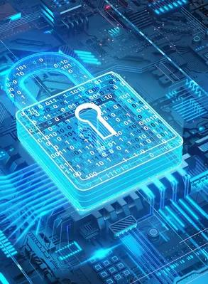
Background Knowledge and Prerequisites
Background knowledge:
Basic understanding of computers and networking
Familiarity with common internet security threats and vulnerabilities
Awareness of cybersecurity
Prerequisites:
None

Slide 6
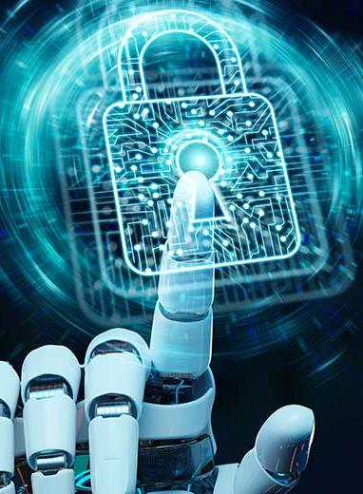
Technical Tools and Other Requirement
Technical Tools
Computer with Internet Access
Web Browser
Other Requirements
Awareness of Internet Security Practices / Willingness to Learn and Experiment / Active Participation

Slide 7

Value Propositions
Benefits to Participants
Level of Training Module: Basic / Advance
Cybersecurity Professional Training
Hands-on and Practical Skills Development
Rooted with European Cybersecurity Skills Framework
Cutting-edge insights from industry-academic experts
Helps with skills development and career advancement

Slide 8
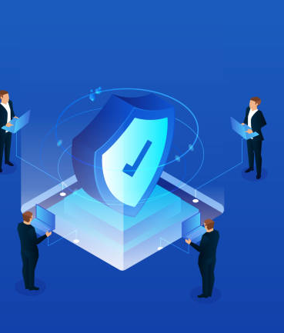
WHO
Profile of Training Participants
Managers and Leaders
Working-life professionals
SMEs and Public Sector Employees
Cybersecurity practitioners and enthusiasts
Students

Slide 9

WHO
Profile of Trainer
Dr. Ricardo Lugo, Senior Researcher, Estonian Maritime Academy, TalTech
Dr. Kitty Kioskli, CEO & Cofounder of trustilio BV
Prof. Paresh Rathod, Laurea University of Applied Sciences

Slide 10
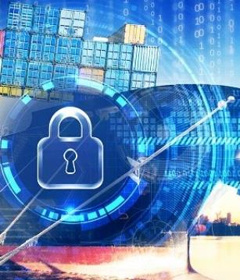
WHAT
Training Topics
Day 1
Introduction to Human Aspects of Cybersecurity in the Energy Sector
Psychological and Social Factors in Energy Sector Cybersecurity
Human Vulnerabilities in Energy Sector Cybersecurity
Insider threats
Adverserial Behaviour in the Energy Sector

Slide 11
WHAT
Training Topics
Day 2
Organisational Culture, Communication, and Cybersecurity
Communication and Collaboration Across Domains
Decision Making at Strategic, Operational, and Tactical Levels
Training, Awareness, and Communication Programs for Energy Sector Personnel
Future Trends, Challenges, and the Role of Communication

Slide 12

WHY
Learning Outcomes
Knowledge:
Gain an understanding of the psychological, social, and organizational elements that shape cybersecurity actions within the energy sector.
Understand the critical role of communication and teamwork in bolstering energy sector cybersecurity across different segments.
Learn how decision-making frameworks are applied at strategic, operational, and tactical levels within energy sector cybersecurity.
Recognize the profiles and strategies of adversaries targeting energy infrastructure.
Evaluate human-related threats and vulnerabilities in energy contexts.
Understand how to implement cybersecurity trainings in energy operations.

Slide 13
WHY
Learning Outcomes
Skills:
Use effective communication plans tailored to energy sector cybersecurity needs.
Detect and counteract human-centric threats and vulnerabilities in energy operations.
Engage with interdisciplinary teams to address the human dimensions of cybersecurity in energy settings.
Examine real-world energy sector cybersecurity breaches to identify human errors and lapses in communication.
Classify adversaries targeting energy interests and scrutinize their tactics.
Design and evaluate cybersecurity training programs tailored for the energy sector.

Slide 14
WHY
Learning Outcomes
Competencies:
Lead discussions pertinent to cybersecurity in the energy sector at various levels of decision-making.
Cultivate an environment of transparent communication and teamwork focused on cybersecurity within the energy sector.
Understand the needs of training within the context of energy sector cybersecurity.
Identify human-centric threats and vulnerabilities in sectorial operations.

Slide 15



Day 1
WHEN
WHERE
HOW
Time schedule: Spring 2024
ONLINE—Digital Link
Face to Face

Slide 16

Importance of Human Factors:
Overview of Energy Sector Cybersecurity
Importance of cybersecurity in the energy sector.
Unique cybersecurity challenges in the energy sector.
Role of human factors in cybersecurity.
Examples that will be used:
  Spear Phishing Attack on a U.S. Electric Utility (2019)
  US department of Energy (2013)
  Ukranian Power Grid Attack (2015)
Notes:
In today's interconnected world, cybersecurity has become a cornerstone of the energy sector. The sector faces unique challenges, including the reliance on digital technologies and the specific threats targeting energy sector assets. Understanding these challenges is crucial, as human factors often play a pivotal role in both the creation and mitigation of cyber risks. By exploring these aspects, we set the stage for a comprehensive approach to enhancing cybersecurity in the energy sector.
The energy sector is frequently targeted by cyber attacks due to its critical infrastructure status and the potentially high impact of disruptions. Human factors often play a crucial role in these incidents, as attackers exploit social engineering techniques, human errors, and insider threats. Here are three notable cybersecurity incidents targeting human factors within the energy sector:
Spear Phishing Attack on a U.S. Electric Utility (2019):
In 2019, a group of hackers used a spear-phishing campaign to target employees of a U.S. electric utility company. The attackers crafted convincing emails that appeared to be from a trusted source, containing malicious links. Employees who clicked on these links inadvertently provided the attackers with access credentials. This incident underscored the importance of training employees to recognize phishing attempts and the continual threat these attacks pose, especially in sensitive industries like energy.
Stuxnet Worm (2010):
While primarily a sophisticated malware attack targeting Iranian nuclear facilities, Stuxnet also relied heavily on human factors for its propagation. The worm spread through infected USB flash drives, exploiting the human tendency to trust and use portable storage devices without suspicion. This reliance on human interaction to spread the malware made Stuxnet one of the first major cyber weapons known to have caused physical, real-world damage to an energy facility.
Ukrainian Power Grid Attack (2015):
In December 2015, the Ukrainian power grid experienced a significant cyber attack that resulted in widespread power outages. The attackers used spear phishing emails to install malware on networks belonging to three regional electricity distribution companies. The attack was coordinated to not only disrupt service but also to hamper recovery efforts by overloading call centers and wiping software on critical systems. This incident highlighted the vulnerabilities in the energy sector’s cybersecurity practices and the effectiveness of targeting human operators to facilitate broader network compromise.
These incidents illustrate the varied ways in which human factors can be exploited in cyber attacks against the energy sector. They emphasize the need for ongoing cybersecurity training, robust access controls, and awareness of the tactics used by cyber adversaries.

Slide 17
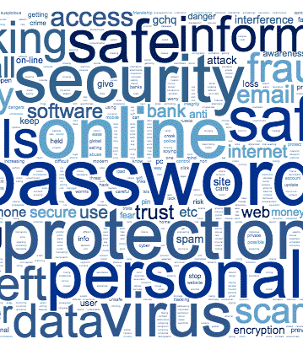
Importance of Human Factors:
Human Factors in Cybersecurity
Definition and significance of human factors in cybersecurity.
Common human errors contributing to cybersecurity breaches.
Strategies to mitigate human-related risks.
Notes:
Human factors in cybersecurity refer to the range of human behaviours, decisions, and interactions that can impact the security of information systems. These include both inadvertent actions, such as misplacing a security badge or choosing a weak password, and deliberate actions, like insider threats. Examples of common human errors include using the same password across multiple systems, clicking on phishing email links, or failing to update software with security patches. To mitigate these risks, strategies such as comprehensive awareness training, regular security audits, the implementation of two-factor authentication, and the use of password managers can be highly effective. By addressing these human elements through targeted strategies, understanding their implications, and implementing robust security policies, we can significantly enhance our defences against cyber threats, creating a more resilient cybersecurity environment within the energy sector.

Slide 18

Importance of Human Factors:
Psychological Implications
Psychological aspects influencing cybersecurity behaviours.
The effect of cognitive biases on security decisions.
Implementing psychological principles to enhance cybersecurity measures.
Notes:
In the context of the energy sector, understanding the psychological factors that influence cybersecurity behaviours is paramount. The 2019 spear-phishing attack on a U.S. electric utility is a case in point where psychological biases played a significant role. For instance, employees might have an 'illusion of control' where they believe they are less vulnerable to cybersecurity threats due to their expertise or position. This could lead them to neglect standard security practices, such as being cautious with email attachments and links, under the assumption that they can outwit potential threats.
Similarly, an 'optimism bias' could lead to the misconception that their particular utility, or the energy sector as a whole, is unlikely to be targeted by sophisticated cyber-attacks.
'Confirmation bias' could result in staff favouring information that aligns with their belief that their cybersecurity measures are sufficient, leading them to dismiss or undervalue new security alerts that suggest otherwise. For example, they might ignore prompts to change passwords or update systems due to a false sense of security based on past experiences where no breaches occurred.
To mitigate these biases, energy companies can employ techniques like 'nudging'. By designing systems that make the secure option the default choice, employees are steered towards more secure behaviors without having to make conscious decisions. For instance, after the spear-phishing incident, the utility could implement automatic software updates or require regular password changes without waiting for user initiation. Incorporating principles from psychology into cybersecurity strategies can greatly enhance the robustness of these measures. Simulating spear-phishing attacks in a controlled environment, akin to inoculation, can prepare employees for real-life scenarios. This controlled exposure can reduce the success rate of actual attacks by familiarizing employees with the tactics used by attackers, effectively counteracting the overconfidence born from biases like the illusion of control and optimism.By combining a deep understanding of psychological tendencies with technical defences, energy organizations like the targeted U.S. utility can develop more effective training programs and security protocols. Such measures would not only be more intuitive for employees but also more difficult for attackers to circumvent, leading to a stronger cybersecurity posture in the energy sector.

Slide 19
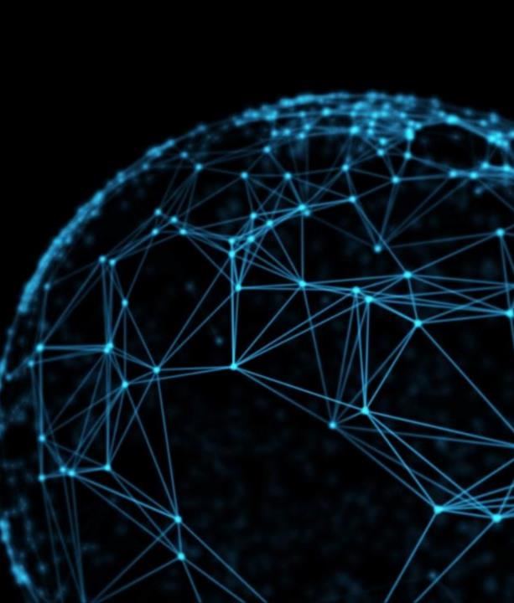
Importance of Human Factors:
Social Influence
Impact of social dynamics on cybersecurity practices.
Role of organizational culture in shaping cybersecurity behaviors.
Importance of social engineering awareness.
Notes:
In the energy sector, the social dynamics within organizations can have a profound effect on cybersecurity. A strong culture of safety, an already well-established factor within the energy sector due to the physical dangers of the work, can be an asset when extended to include cybersecurity measures. For instance, if the safety culture within the utility company that suffered the spear-phishing attack had robustly incorporated cybersecurity, employees might have been more vigilant and sceptical of the malicious emails they received.
Peer Influence: The behaviour of influential members within a utility company can set a powerful precedent. If a senior engineer or a respected team leader openly prioritizes cybersecurity, it can create a norm where cybersecurity is treated with the seriousness it deserves. In the context of the spear-phishing incident, if leaders had been vocal about the dangers of such attacks and had demonstrated good practices, employees might have been more likely to question and verify unusual emails.
Organizational Culture: A utility company’s shared values, beliefs, and norms can either strengthen or weaken its cybersecurity posture. An organizational culture that values transparency and open communication can promote the sharing of information about potential cyber threats. For example, if the culture within the attacked utility had encouraged transparency, employees might have shared suspicious emails with IT departments sooner, possibly averting the breach.
Conversely, if the culture minimizes the importance of cybersecurity awareness and training, it can lead to a workforce that is ill-prepared to recognize or respond to cybersecurity incidents. In the spear-phishing scenario, a lack of emphasis on cybersecurity might have contributed to the success of the attack.
Implementation of Cybersecurity Practices: Implementing regular cybersecurity drills can instill a proactive stance among employees, just as safety drills do for physical safety risks. After the attack, the utility might have realized the value in such drills to prepare their workforce for future incidents.
Stigmatization of Security Mistakes: If the culture stigmatizes the admission of mistakes, employees may hide or ignore security breaches out of fear of reprisal, leading to underreporting and a lack of necessary corrective action. Post-incident, the utility may need to address this aspect of their culture to ensure that all staff feel comfortable reporting potential threats.
By understanding and shaping the social and cultural elements within energy sector organizations, companies can better prepare for and defend against future cyber threats. The 2019 attack on the U.S. electric utility highlights the need for a cultural shift towards integrating cybersecurity as a core value of the organization's safety and operational procedures.

Slide 20
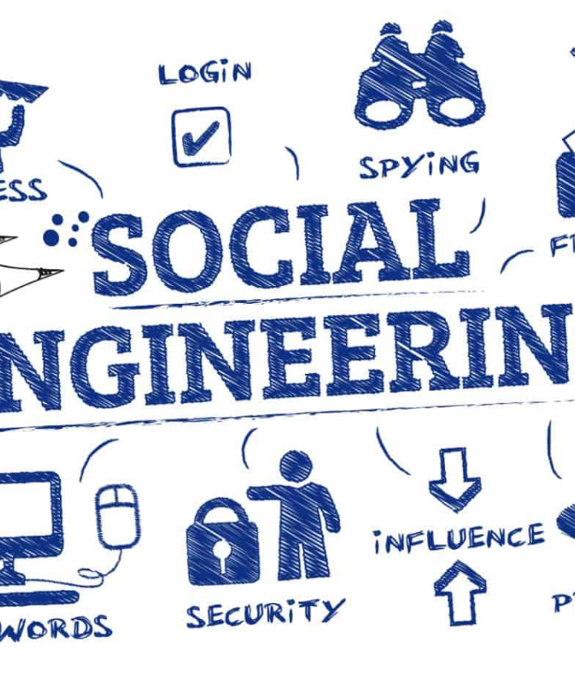
Importance of Human Factors:
Social Engineering
Importance of social engineering awareness.
Social Engineering
  Reciprocity; Commitment and Consistency, Social Proof; Authority; Liking; Scarcity
Notes:
Social engineering in the context of cybersecurity refers to the manipulation of individuals into divulging confidential or personal information that may be used for fraudulent purposes. It's a tactic that relies heavily on human interaction and often involves tricking people into breaking standard security procedures. Social engineering attacks are particularly insidious because they exploit human nature rather than technological vulnerabilities. The Spear Phishing Attack on a U.S. Electric Utility (2019), the Stuxnet Worm and the Ukranian Power Grid Attack (2015) all used social engineering strategies to breach the companies. These strategies are based on the foundational frameworks for understanding how social engineering works is Robert Cialdini's six principles of influence:
Reciprocity: People tend to return a favour. In a social engineering context, an attacker might offer 'helpful' information or a gift to the target with the expectation that the target will feel obliged to offer something valuable in return, such as access to a restricted system.
Commitment and Consistency: Once people commit to an action or stance, they're more likely to follow through with it. Attackers might first get a small, seemingly innocent commitment from their target, which leads to larger commitments that compromise security.
Social Proof: People tend to do things they see others doing. In social engineering, this might involve an attacker pretending to be part of a group that the target trusts, inducing the target to act in a way consistent with the group's perceived actions or norms.
Authority: People tend to obey authority figures. Attackers may pose as senior executives or IT personnel to extract sensitive information or gain access to restricted areas.
Liking: People are more easily influenced by those they like. Attackers might build a relationship or rapport with their target before attempting to exploit that relationship for malicious purposes.
Scarcity: Perceived scarcity will generate demand. For example, an attacker might create a false sense of urgency by claiming that immediate action is needed to prevent a dire consequence.
Understanding the use of social engineering attacks to the energy sector, we can illustrate how such attacks could be tailored to target utility companies and other energy sector stakeholders:
Email Phishing: Cybercriminals might craft emails impersonating credible entities like the National Electric Reliability Council or a major equipment vendor, requesting utility workers to click on links that lead to malware-laden sites or trick them into divulging sensitive network credentials under the pretense of a 'mandatory security audit'.
Impersonation: Attackers may impersonate government energy regulators or cybersecurity auditors and reach out to plant operators via email or phone, directing them to disable certain network protections for a so-called 'compliance check', exploiting their respect for and compliance with authority.
Urgent Updates: Leveraging the principles of urgency and authority, attackers could send fraudulent notifications about critical system updates required for the grid management software, compelling staff to hastily implement software that could introduce backdoors or other vulnerabilities.
Recognizing these tactics is crucial for energy sector entities to cultivate effective training and awareness initiatives. This would empower employees to identify and withstand such attacks, thereby safeguarding crucial infrastructure and the sensitive data associated with energy production and distribution.

Slide 21
Importance of Human Factors:
Social Engineering
Ransomware
Scarcity and reciprocity
Notes:
Ransomware attacks, a form of malicious software designed to block access to a computer system or files until a sum of money is paid, often leverage psychological tactics to increase their effectiveness. Two such tactics are the principles of scarcity and reciprocity, which are deeply rooted in human psychology and frequently exploited in social engineering contexts.
Scarcity Principle in Ransomware
Urgency and Time Limits: Ransomware attacks often include a countdown timer or a strict deadline by which the ransom must be paid. This creates a sense of scarcity regarding the time available to resolve the situation without losing access to critical data permanently. The scarcity principle suggests that people value resources more when they are less available, making the data or system access seem more valuable and increasing the likelihood of compliance with the ransom demand.
Limited Offers for Decryption Keys: Attackers might claim that the decryption key is only available for a limited period or that its price will increase after a certain deadline. This artificial scarcity pressures victims into acting quickly out of fear of losing their last chance to recover their files.
Reciprocity Principle in Ransomware
Fake Promises of Data Return: In leveraging reciprocity, attackers often promise to return access to the encrypted data upon payment of the ransom. The idea is that if the victim 'complies' with the attacker's 'request' for payment, the attacker will reciprocate by restoring access to the data. This exploitation of the reciprocity principle relies on the victim's hope and belief in a fair exchange, even though there is no guarantee that the attacker will honour the agreement.
'Free' Decryption of a Few Files: Some ransomware operators offer to decrypt a small number of files for free as a 'goodwill gesture' or 'proof' that they can indeed decrypt the data. This action exploits the reciprocity principle by providing something of value upfront with the expectation that the victim will feel compelled to reciprocate by paying the ransom to recover the remainder of their files.
In both cases, the attackers rely on the inherent human response to these psychological triggers. The principle of scarcity creates a heightened sense of value and urgency around the data or access being held ransom, while the principle of reciprocity plays on human tendencies for fair exchange and reciprocation, even in the context of an adversarial interaction. Understanding these underlying psychological tactics can help individuals and organizations better prepare for and respond to ransomware attacks, emphasizing the importance of scepticism, critical evaluation of the situation, and adherence to established protocols for incident response instead of reacting impulsively to the attackers' manipulations.

Slide 22

Psychological and Social Factors in Energy Sector Cybersecurity
Understanding Human Psychology
Cognitive biases and their impact on cybersecurity.
Psychological theories relevant to cybersecurity behaviour.
Designing cybersecurity systems with human psychology in mind.
  Situational Awareness (Endsley, 1998)
An interface redesign that reduced user errors based on psychological research.
Notes:
Incorporating psychological principles into cybersecurity for the energy can significantly enhance the effectiveness of our defences. Understanding cognitive biases is crucial; for instance, 'optimism bias' might lead a crew member to underestimate the risk of cyber threats, while 'confirmation bias' could result in dismissing critical security alerts that don't align with their preconceived notions of safety. These biases can manifest in risky behaviours, such as neglecting to update security protocols or underestimating the sophistication of phishing attempts that mimic legitimate communications from authorities.
To counteract these challenges, applying psychological theories like 'self-efficacy' and 'metacognition' is vital. Self-efficacy, defined as one's belief in their ability to succeed, directly influences how crew members engage with cybersecurity practices. High self-efficacy can motivate proactive security behaviours, such as regularly updating passwords and adhering to security protocols. Conversely, low self-efficacy might lead to avoidance or hesitancy in taking necessary security actions. Metacognition, the awareness of one's own thought processes, encourages crew members to critically evaluate their decisions and actions, particularly in response to cyber threats, helping to identify and correct potential biases.
In designing cybersecurity systems for the domain, incorporating these psychological insights is key. For example, systems can be designed to enhance situational awareness, a concept detailed by Mica Endsley, which involves understanding the current environment, projecting future states, and comprehending the implications of those states for the system's goals. By providing clear, concise, and timely information about potential cyber threats and system status, we can foster a high level of situational awareness among the crew, enabling them to make informed decisions swiftly.
Ergonomic design also plays a crucial role. Systems should be intuitive and align with natural human tendencies to minimize errors. For instance, implementing user-friendly interfaces that guide users through secure processes effortlessly, or designing warning systems that effectively capture attention without leading to habituation, ensures that crew members remain vigilant and engaged with cybersecurity practices. By integrating the principles of self-efficacy, metacognition, and situational awareness into the ergonomic design of cybersecurity systems, energy sector personnel can not only mitigate the risk of cyber threats but also empower them to be active participants in the cybersecurity posture of their stations.

Slide 23

Psychological and Social Factors in Energy Sector Cybersecurity
Social Dynamics and Cybersecurity
Influence of social norms and peer behaviour on individual cybersecurity practices.
The role of leadership in fostering a security-conscious culture.
  Role Modelling (Bandura, 1988)
Social factors in cybersecurity training and awareness programs.
Notes:
In the energy sector, leadership styles have a profound impact on cybersecurity attitudes and beliefs. An authoritative leadership style, characterized by stringent rules and hierarchical decision-making, might ensure that cybersecurity protocols are followed promptly. However, this approach may also suppress open communication and limit creative problem-solving when facing cybersecurity challenges within a utility or energy company.
In contrast, a transformational leadership style aims to inspire and motivate employees through a collective commitment to security goals. This could promote proactive cybersecurity behaviours and nurture a culture of ongoing learning and adaptability. Nonetheless, without well-defined procedures and accountability, there's a risk that such a leadership approach might result in inconsistent application of cybersecurity practices across different departments.
Bandura's concept of role modelling is highly applicable in the energy context. Leaders who visibly prioritize cybersecurity, stay abreast of the latest security measures, and have an insightful understanding of cyber threats will likely encourage similar priorities and behaviours in their teams. A CIO or Chief Security Officer who exemplifies good cybersecurity practices can lead a modelling effect, significantly bolstering the organization’s resilience.
When it comes to training and awareness, leadership attitudes are just as pivotal. Leaders who comprehend the importance of ongoing cybersecurity education can lead the development and execution of comprehensive training initiatives. They can ensure these programs are routinely refreshed to mirror evolving threats and methodologies. Such leaders may support hands-on training and live drills that boost real-time awareness and practical skills amongst staff. Alternatively, leaders who perceive cybersecurity training as merely a ‘need to do’ task may neglect proper training in these areas or ot understand the importance of tailored training, weakening cybersecurity resilience. Ultimately, effective leadership within the energy sector should achieve a balance, fostering a culture that not only enforces adherence to cybersecurity protocols but also encourages transparency, innovation, and continued learning. By embodying best practices in cybersecurity and demonstrating positive behaviours, leaders can significantly shape the security culture and resilience of energy sector operations.

Slide 24

Psychological and Social Factors in Energy Sector Cybersecurity
Enhancing Security Through Psychology
Psychological strategies to increase security protocol adherence.
Behavioural change techniques applied to cybersecurity.
The role of motivation and rewards in enhancing cybersecurity behaviours.
Real-world example: A rewards program that successfully increased cybersecurity vigilance among crew members.
Future BCT using AI
Notes:
Enhancing security through psychology in the energy sector involves understanding and addressing the human elements that influence cybersecurity. Applying psychological principles helps tailor cybersecurity strategies to the behaviors, motivations, and attitudes of personnel within the sector.
For example, incorporating regular psychological assessments in the energy sector can help identify potential insider threats before they materialize. Training programs that include elements of behavioural psychology can improve adherence to security protocols by emphasizing the personal and collective benefits of robust cybersecurity practices.
The strategic application of behaviour change techniques (BCTs) is crucial in the energy sector's cybersecurity efforts. BCTs, such as motivational interviewing, goal-setting, feedback, and rewards, can encourage compliance and proactive security behaviours. Understanding what motivates individuals allows organizations to tailor their cybersecurity programs to incentivize desired behaviours effectively. For instance, rewards can reinforce compliance with IT security policies, and employees might receive recognition or tangible benefits for consistently following best practices, like regularly updating passwords or completing cybersecurity training modules.
A real-world application of this approach in the energy sector could involve an energy company introducing a 'Cybersecurity Champion' program. In this program, individuals who exemplify excellent cybersecurity habits are recognized monthly. This not only motivates others to adhere to security protocols but also fosters a competitive yet collaborative environment where cybersecurity becomes a shared responsibility.
Effective BCT implementation can include:
Educating: Providing comprehensive training that explains the reasons behind cybersecurity measures, enhancing employees' understanding and acceptance.
Empowering: Encouraging employees to take ownership of their cybersecurity practices through participatory workshops where they can suggest improvements to current protocols.
Enabling: Offering the tools and resources necessary to perform secure behaviours, such as easy-to-use software for reporting suspicious activities.
Engaging: Developing a platform where employees can share experiences and strategies for overcoming cybersecurity challenges.
The integration of psychology into cybersecurity practices in the energy sector helps build a culture where every individual feels responsible for cyber safety, not just knowing what to do but having the confidence to act on it, from reporting suspicious emails to following protocol when a security breach is suspected.

Slide 25
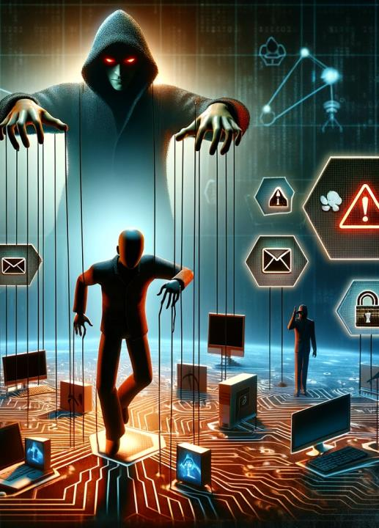
Psychological and Social Factors in Energy Sector Cybersecurity
Addressing Social Engineering Threats
Understanding social engineering tactics from a psychological perspective.
Training personnel to recognize and respond to social engineering attacks.
Building a culture of scepticism, vigilance and verification.
Real-world example: A company's response to a spear-phishing campaign targeting energy sector employees.
Notes:
Social engineering attacks in the energy sector have become increasingly sophisticated, highlighting the critical need for adaptive cybersecurity training. Historical incidents such as the spear-phishing attacks against the Ukrainian Power Grid in 2015 and a U.S. electric utility in 2019 demonstrate how attackers have evolved from simple phishing to more complex strategies like spear-phishing and the use of "deep fakes". These techniques use AI to create highly convincing audio and video impersonations of trusted individuals.
Evolving Training Programs:
To combat these advanced tactics, the energy sector must develop training programs that continuously adapt to the latest threats. This includes integrating awareness of emerging technologies like AI that can be used for malicious purposes. Traditional training modules are no longer sufficient; personnel need to be aware of and understand how to identify and respond to AI-driven social engineering attacks.
Building a Culture of Scepticism and Vigilance:
Employees in the energy sector must be trained to approach every interaction with scepticism, especially when it involves requests for sensitive information or actions. Vigilance can be bolstered through regular, realistic training exercises that simulate the latest social engineering tactics. Moreover, establishing robust verification processes, such as using multi-factor authentication and verifying requests through multiple communication channels, should be a standard practice.
Interactive and Continuous Learning Approaches:
Implementing interactive workshops, gamified learning experiences, and regular drills can help inculcate critical thinking and proactive response behaviours among employees. Such training helps build a mindset that prioritizes questioning and verification, crucial for defending against sophisticated social engineering attacks.
Staying Ahead of Threats:
The dynamic nature of cybersecurity threats, particularly in the energy sector, requires a commitment to continuous learning and adaptation. By fostering a culture that embraces ongoing education and critical evaluation of security protocols, energy organizations can enhance their resilience against an ever-evolving threat landscape.
For more in-depth insights on how the energy sector can enhance its defences against social engineering, referring to guidelines provided by cybersecurity authorities such as the Department of Energy or cybersecurity research organizations could provide valuable frameworks and strategies for improvement.

Slide 26

Human Vulnerabilities in Energy Sector Cybersecurity
Identifying Human Vulnerabilities
Common human vulnerabilities in energy sector cybersecurity contexts.
The role of user behaviour analytics in identifying risky behaviours.
Strategies for mitigating human vulnerabilities.
Real-world example: Incident involving an exploited vulnerability due to poor password practices.
Notes:
In the energy sector, human vulnerabilities often arise from everyday practices that inadvertently leave systems open to cyber-attacks. Common areas of concern include the mishandling of credentials, such as utility workers using the same passwords for multiple systems or discussing them in insecure settings, and the improper management of electronic communications, where phishing emails may be misinterpreted as legitimate messages from regulatory bodies or business affiliates.
Additionally, the use of personal devices linked to operational networks without adequate security can introduce significant risks.
Behavior analytics becomes a crucial instrument, allowing monitoring of employee behaviour to identify anomalies that might suggest a security compromise. For instance, an unscheduled login to the energy management system during off-hours or repeated failed attempts to access secure areas of the network could be indicators of a security threat.
To mitigate these risks, energy companies should implement both technical and procedural safeguards that are specifically designed for their operational environment. This includes establishing role-based access controls to ensure employees can only reach the parts of the network necessary for their tasks, thus minimizing the likelihood of inadvertent or deliberate abuse.
Keeping systems updated with the latest patches and software is also essential, particularly as the grid becomes increasingly digitized and interconnected.
An effective incident response plan is another key component, detailing isolation protocols for compromised systems to curb the spread of an attack, clear reporting lines for swift action, and post-incident reviews to enhance future defences. Creating a security-conscious organisational culture that emphasizes scepticism and the importance of reporting unusual activities can further reinforce a utility’s defences against cyber threats.
In essence, addressing human vulnerabilities within the energy sector requires a holistic strategy that integrates behaviour analysis, technical defences, and a robust cybersecurity-centric culture. By remaining alert and continuously adapting to the dynamic landscape of cyber threats, energy organizations can protect their critical infrastructure and the communities they serve from the consequences of cyber-attacks.
In 2013 an attack on the U.S. Department of Energy where hackers were able to gain personal information of over 104,000 employees, contractors, and family members. They achieved this by exploiting a vulnerability that was in part due to inadequate password management 14 workstations 'were configured with default or easily guessed passwords'. The attackers initially gained access through a contractor's system that did not require two-factor authentication and used passwords that were not complex or changed frequently. This allowed the attackers to navigate through the network and access sensitive information. The breach highlighted the need for stringent password policies and the implementation of multi-factor authentication to secure access to sensitive systems and data. The incident served as a wake-up call for the energy sector to enforce better password practices and strengthen overall cybersecurity measures to protect against such vulnerabilities.

Slide 27
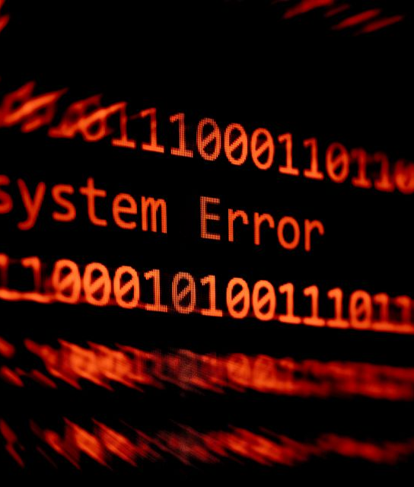
Human Vulnerabilities in Energy Sector Cybersecurity
Impact of Human Error
Types of human errors and their consequences for cybersecurity.
Methods for reducing errors, such as simplification of systems and processes.
Importance of error reporting and management systems.
Notes:
Human error is a significant risk factor in the energy sector as well, often acting as an entry point for cyber incidents. he 2013 cyberattack on the U.S. Department of Energy as previously described. Although this incident wasn’t solely due to individual human error, it underscored how systemic vulnerabilities can be exacerbated by human factors, leading to substantial data breaches.
In the energy sector, simplifying system interfaces and processes can greatly reduce the chances of human error. High-stress environments, such as control rooms managing the electrical grid, can increase the likelihood of mistakes. By implementing user-friendly systems and intuitive procedures, the cognitive load on operators can be decreased. For instance, automating routine security protocols and ensuring that software updates are conducted promptly and correctly can help to avoid oversights.
Additionally, creating an organizational culture that promotes the open reporting of errors without fear of punishment is crucial. When staff feel empowered to report issues, the organization can learn from these incidents and improve their systems. Such an approach reinforces the importance of vigilance and views cybersecurity as a shared responsibility.
In essence, by streamlining technical systems and fostering a supportive reporting environment, energy organizations can minimize human error and strengthen their cybersecurity resilience, helping to safeguard critical infrastructure from cyber threats.

Slide 28

Human Vulnerabilities in Energy Sector Cybersecurity
Training to Reduce Human Error
Role of targeted training programs in addressing specific human vulnerabilities.
  Simulation
  Gamification
  Scenario based learning
  Continuous learning
The importance of simulation and drills in reinforcing correct behaviors.
Continuous improvement of training programs based on incident feedback.
Notes:
Tailoring cybersecurity training methods for the energy sector involves creating programs that reflect the unique challenges and systems encountered by those in utilities and power generation. Here's how these methods can be adapted to the energy sector:
Simulation-Based Training: Cybersecurity programs could simulate attacks on power grid control systems, giving operators hands-on experience in detecting and mitigating attacks. For example, a training module might mimic a spear-phishing campaign targeting the utility’s email system, teaching employees how to discern between legitimate and malicious messages and adhere to incident response procedures.
Gamified Learning Platforms: Integrating game mechanics into training can boost engagement and learning retention. An energy-sector training platform might feature interactive challenges that mirror real-life scenarios, such as identifying and responding to anomalous behaviour in the SCADA (Supervisory Control and Data Acquisition) systems that manage electrical flows, with rewards for successful completion.
Scenario-Based Workshops: Tailored workshops with table top exercises that focus on specific cybersecurity situations relevant to the energy sector, like securing smart grid communications or protecting nuclear facility control systems from digital sabotage, can help employees grasp the practical aspects of their cybersecurity roles. Such workshops might involve practicing the response to a breach in a simulated power plant control room.
Continuous Learning Programs: Continuing education programs are also necessary due to the dynamic nature of cyber threats. For the energy sector, this could mean regular briefings on potential vulnerabilities in smart meters or updates on threat intelligence related to national grid security. These could be disseminated through online platforms, ensuring staff are kept informed of the latest developments and strategies in cybersecurity.

Slide 29

Human Vulnerabilities in Energy Sector Cybersecurity
Enhancing Situational Awareness
Importance of situational awareness in preventing human errors.
  Endsly
    Perception
    Comprehenssion
    Projection
Tools and technologies to support situational awareness in cybersecurity.
  Adpeted viualisations
Integrating situational awareness into daily operations and decision-making.
Notes:
Enhancing situational awareness is pivotal in energy sector cybersecurity, especially when considering human factors. Mica Endsley's model of situational awareness offers a structured approach to understanding and improving this critical competency within the energy sector domain. Endsley defines situational awareness in three levels: perception of elements in the environment, comprehension of their meaning, and projection of their future status.
Applying Endsley's model of situational awareness to cybersecurity in the energy sector involves three critical stages: perception, comprehension, and projection. Here's how each stage can be contextualized within the energy sector's unique challenges:
Perception:
The first level, perception, involves accurately detecting critical cybersecurity information within the energy infrastructure. For utility operators, this might include noticing irregular power usage patterns that hint at a cybersecurity breach, or receiving alarms from an Intrusion Detection System (IDS) indicating possible unauthorized access to operational technology systems. Identifying these signs early is crucial for triggering the subsequent stages of situational awareness.
Comprehension:
At the comprehension level, the focus shifts to understanding what the perceived information means. For example, an alert from an IDS might indicate a Distributed Denial of Service (DDoS) attack targeting energy management systems. Training and experience are essential here, as they enable energy sector professionals to interpret such alerts correctly and understand their potential impacts on the energy grid, such as disruptions to power distribution or potential damage to infrastructure.
Projection:
The final level, projection, involves anticipating future events based on the current understanding of the situation. In the energy sector, an operator might predict that if a DDoS attack is not mitigated, it could lead to grid instability or even widespread outages. This foresight allows for preemptive actions, such as rerouting power or isolating compromised parts of the grid, to prevent broader disruptions and maintain service continuity.
By integrating these three levels of situational awareness, energy companies can enhance their ability to preemptively address cybersecurity threats, minimize damage, and quickly recover from incidents. This proactive approach is essential in maintaining the reliability and security of critical energy infrastructure. Such a structured model helps ensure that all levels of an organization—from operational staff to executive management—are aligned in their understanding and response to cybersecurity threats, making the energy sector more resilient against the ever-evolving landscape of cyber threats.
In the energy sector, visualization systems are integral to enhancing situational awareness and decision-making in a complex operational environment. Here’s how such systems can be applied in the energy sector, with a real-world example:
Enhanced Perception: Visualization systems improve situational awareness by presenting critical data, such as energy production metrics or grid health, in formats that are easily digestible. For example, a grid management dashboard might use a color-coded alert system to highlight fluctuations in power load, enabling operators to identify and respond to issues like overloads or outages quickly.
Aiding Comprehension: These systems integrate data from diverse sources, such as weather reports, power demand forecasts, and infrastructure integrity scans, into a coherent visual format. This could involve a platform that maps out the grid and overlays real-time data on power flow, weather conditions, and cyber threat alerts, helping operators understand how these elements interact and affect the grid.
Facilitating Projection: Visualization tools in the energy sector can model scenarios like the impact of a cyberattack on substation controls or the cascading effects of a grid failure. Such predictive analytics are vital for projecting future system states and preparing contingency plans.
Energy Sector Example: A real-world example is the North American Electric Reliability Corporation's (NERC; Canada) Electricity Information Sharing and Analysis Center (E-ISAC) portal. This system offers a unified view of cybersecurity threats, grid status, and response strategies. It presents complex information in a format that helps utility operators to set up strategies to monitor the cybersecurity health of the grid and anticipate potential issues based on current threats and historical data. For instance, if the visualization system indicates a surge in phishing attempts targeting utilities in a particular region, operators can brace for potential impacts on network security and coordinate with relevant authorities to bolster defences.
Real-World Example: One pertinent example of this approach is the response to the Ukraine power grid cyberattack in 2015. Operators at the Ukrainian power companies used visualization tools to understand the extent of the attack and identify the substations affected. The tools helped to illustrate the attack's progress and its implications for the grid, which was crucial in formulating a timely and effective response.
By adopting advanced visualization systems, energy sector organizations can significantly improve their situational awareness and ability to respond to cybersecurity challenges. These systems transform complex datasets into clear, actionable intelligence, which is critical for maintaining grid stability and responding to incidents promptly and effectively.

Slide 30

Understanding Insider Threats in Energy Sector Cybersecurity
Introduction to Insider Cybersecurity Threats for te Energy Sector
Definition of Insider Threats: Actions by individuals from within the organization that negatively affect the confidentiality, integrity, or availability of the organization's information systems.
Unintentional vs. Malicious Threats: Differentiating between non-malicious actions that lead to vulnerabilities and deliberate attempts to harm the organization.
Importance of Vigilance: Emphasizing the need for continuous monitoring and robust security protocols to mitigate these risks.
Notes:
Insider threats in the energy sector refer to potentially harmful actions that originate from individuals within the organization. These individuals may have access to sensitive systems and data, capable of inflicting damage, either unintentionally or deliberately. The distinction between insider threats, such as an employee accidentally introducing malware, and deliberate threats, such as an insider deliberately sabotaging infrastructure, is crucial. Considering the complexity and critical nature of energy infrastructure, the sector is highly vulnerable to such threats. Persistent monitoring, combined with robust security measures, is essential to protect energy cyber-assets from these insider threats.
Insider threats are a widespread concern across various industries, including energy, due to the insiders' potential access to sensitive systems and information. Research suggests that insider threats are one of the top risks to cybersecurity, secondary only to external hackers, and there has been an increase in such incidents over time (Greitzer et al., 2008). The energy sector, increasingly dependent on digital technology and smart grids, is at heightened risk of cyber threats from within. Issues of security, confidentiality, integrity, and availability are significant concerns in this sector, particularly as it undergoes digital transformation, making it prone to insider threats (Ashraf et al., 2023). The energy sector has also seen a substantial increase in cybersecurity breaches involving operational technology, highlighting the need for a detailed examination of the cybersecurity challenges it confronts, including those posed by insider threats (Akpan et al., 2022).
An effective method for countering insider threats is to develop a thorough understanding of the behavioural indicators that may signal an impending risk. It's essential to adopt predictive modelling frameworks that merge data from the cyber domain with psychological and motivational elements that contribute to malicious insider behaviours (Greitzer & Hohimer, 2011).
For more in-depth knowledge of the frequency and countermeasures of insider threats in the energy sector, it is advisable to examine the following papers:
Greitzer, F., Moore, A., Cappelli, D. M., Andrews, D., Carroll, L., & Hull, T. D. (2008). Combating the Insider Cyber Threat. IEEE Security & Privacy, 6(1), 61–64.
Greitzer, F., & Hohimer, R. (2011). Modeling Human Behavior to Anticipate Insider Attacks. Journal of Strategic Security, 4(2), 25–48.
National Institute of Standards and Technology (NIST). (2013). Managing Information Security Risk: Organization, Mission, and Information System View. NIST Special Publication 800-39.
Bell, A. J. C., Rogers, M., & Pearce, J. (2019). The insider threat: Behavioral indicators and factors influencing likelihood of intervention. International Journal of Critical Infrastructure Protection, 24, 166-176.

Slide 31
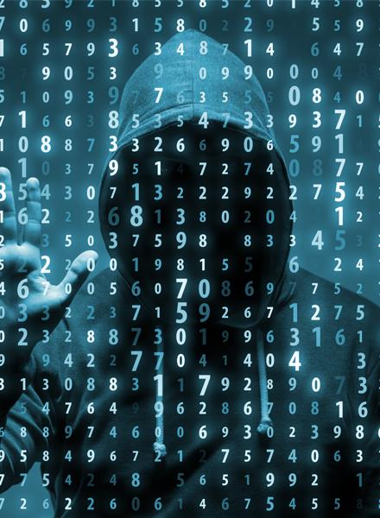
Mitigating Insider Cybersecurity Threats in the Energy Sector
Risk Factors
Employees are not trained to fully understand and apply laws, mandates, or regulatory requirements related to their work and that affects the organization’s security.
Employees are unaware of the steps they should take at all times to ensure that the devices they use—both company issued and BYOD—are secured at all times.
Employees are sending highly confidential data to an unsecured location in the cloud, exposing the organization to risk.
Employees break your organization’s security policies to simplify tasks.
Employees expose your organization to risk if they do not keep devices and services patched and upgraded to the latest versions at all times
Notes:
In the energy sector, employees may not be fully trained in understanding and applying laws, mandates, or regulatory requirements, compromising organizational security. There's often a lack of awareness about securing both company-issued and personal devices used for work. Risks are heightened when confidential data is inappropriately shared to unsecured cloud locations. Additionally, security policies might be bypassed by employees seeking to simplify their tasks, inadvertently increasing vulnerability. It's also vital for all devices and services to be regularly updated and patched, as failure to do so exposes the organization to cyber threats.

Slide 32
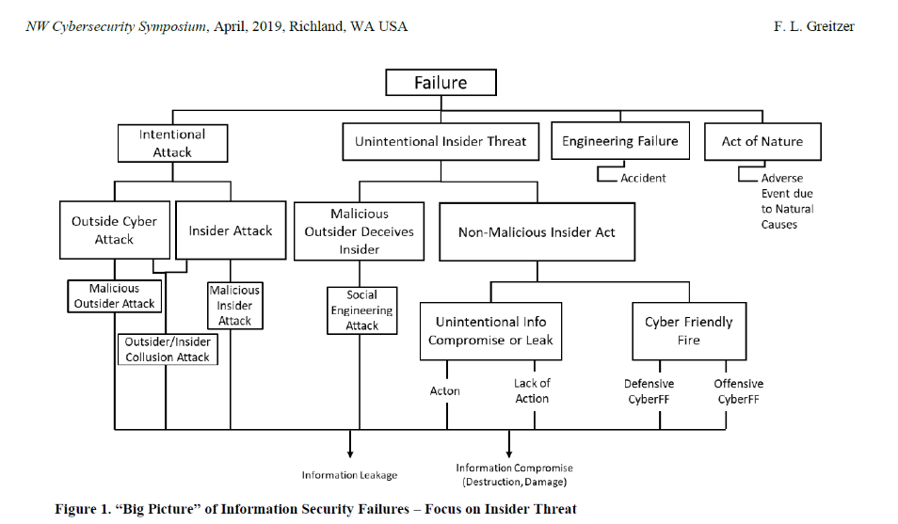
Notes:
Greitzer, F. L. (2019, April). Insider Threats: It's the HUMAN, Stupid!. In Proceedings of the Northwest Cybersecurity Symposium (pp. 1-8).
The article by Frank L. Greitzer titled "Insider Threats: It’s the HUMAN Stupid!" from the proceedings of NCS '19 discusses the complexity of insider threats, which include both intentional and unintentional acts that can compromise organizational security. The research highlights that insider threats are not only on par with external hacking threats in terms of frequency but often result in more costly damages. Current guidelines and policies often set only minimum standards for monitoring and mitigating such threats, which may not fully address the human factors that significantly contribute to these risks. Greitzer's work underscores the need to integrate behavioural indicators with technical indicators to develop more proactive and comprehensive approaches to insider threat assessment. The individual factors can be related to insider threat risks in cybersecurity are indeed nuanced. Personality traits, for example, can include an individual's propensity for risk-taking, response to stress, and how they handle conflict. These traits can potentially influence their likelihood of committing a security breach. For instance, a highly stressed employee might be more prone to overlook security protocols or make careless mistakes that could lead to a breach. Behaviours and attitudes in the workplace are also critical indicators. Changes in normal behaviour, such as suddenly working odd hours without explanation or displaying unusual interest in matters outside their scope of work, could signal risk. Attitudes that show disregard for company policies or an overtly negative sentiment towards the organization could also foreshadow potential insider threats. Personal issues, such as financial problems or grievances against the company, might push an individual to act out against the organization. Employees struggling with such issues might be more susceptible to committing fraud or theft of intellectual property. Lastly, sociocultural or ideological factors could motivate someone to act in a way that aligns with their beliefs, which might conflict with the interests of their employer. For example, an employee might leak sensitive information due to a belief that the public has a right to know, reflecting a hacktivist ideology.
Understanding these factors and their complexities is key to developing a proactive approach to insider threat detection and prevention. It involves observing and evaluating a range of subtle human elements and integrating them into a comprehensive security strategy.

Slide 33
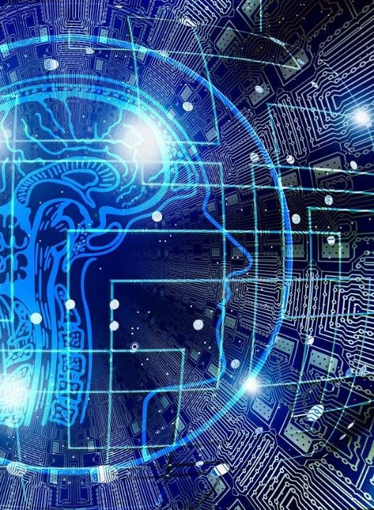
Understanding Insider Threats in Energy Sector Cybersecurity
Unintentional Insider Threats
Definition: Unintentional threats stemming from carelessness, lack of awareness, or mistakes.
Examples in Energy Context: Staff may inadvertently introduce malware by connecting a personal device to systems or fail to follow proper protocol due to inadequate training.
  Stuxnet Worm (2010)
Consequences: Such actions can compromise power stations, natural and human catastrophes
Prevention Strategies: Regular training, implementing user-friendly security measures, and establishing a culture of security awareness.
Notes:
Unintentional insider threats often result from innocent mistakes or a lack of cybersecurity awareness among crew members and port staff. Examples might include a crew member using a compromised USB stick or an administrator accidentally leaving a database unprotected. Such incidents can lead to serious consequences like the accidental disclosure of sensitive data or the disruption of essential navigational systems. Prevention strategies must therefore focus on user education, employing user-friendly security measures that simplify adherence to best practices, and fostering a strong security culture within the organization.
Stuxnet Worm (2010): While primarily a sophisticated malware attack targeting Iranian nuclear facilities, Stuxnet also relied heavily on human factors for its propagation. The worm spread through infected USB flash drives, exploiting the human tendency to trust and use portable storage devices without suspicion. This reliance on human interaction to spread the malware made Stuxnet one of the first major cyber weapons known to have caused physical, real-world damage to an energy facility.
Liu, L., De Vel, O., Han, Q.-L., Zhang, J., & Xiang, Y. (2018). Detecting and Preventing Cyber Insider Threats: A Survey. IEEE Communications Surveys & Tutorials, 20(2), 1397–1417. IEEE Xplore

Slide 34

Understanding Insider Threats in Energy Sector Cybersecurity
Malicious Insider Threats in the Energy Sector
Definition: Deliberate actions by insiders to steal, manipulate, or destroy data or disrupt systems.
Examples in Energy Sector Context:
  General Electric (2018 & 2020)
Potential Impact: These acts can cause significant financial loss, damage to reputation, or even physical risks to the power station and staff
Detection and Response: Importance of background checks, monitoring systems for unusual activities, and having an incident response plan in place.
Notes:
Malicious insider threats are premeditated actions taken by individuals who aim to cause harm to the energy organizations. They might be motivated by financial gain, personal vendettas, or ideological reasons., this could involve the intentional introduction of malware into the control systems of a power station or providing outsiders with access to secure areas. The impact can be devastating, with potential outcomes ranging from financial loss to risks to the ship's safety. Detecting these threats requires robust monitoring systems, thorough background checks of personnel, and an effective incident response strategy to deal with breaches when they occur.
Insider threats have risen 44% over the past two years, according to Ponemon research (https://www.bankinfosecurity.com/whitepapers/2022-ponemon-cost-insider-threats-global-report-w-10798) . The research also shows that companies still struggle to close down these threats quickly enough, with incidents taking 85 days to discover. Energy organizations face a dual problem with insider threats. Users with network access can exfiltrate sensitive information, while data loss could affect critical operations.
2018- Xiaoqing Zheng, a former GE Power engineer, was sentenced to 24 months in prison for conspiring to steal trade secrets for the benefit of China. Convicted after a four-week trial, Zheng was found to have collaborated with others in China to misappropriate GE's turbine technology. The Department of Justice emphasized the case as a clear example of economic espionage.
General Electric Employees Stole Trade Secrets to Gain a Business Advantage (2020)
In this famous insider threat case, two General Electric (GE) employees downloaded thousands of files with trade secrets from company servers. They then uploaded the files to the cloud or sent them to private email addresses. In addition, they convinced a system administrator to grant them inappropriate access to sensitive corporate data. Then, one of the employees started a new company with stolen intellectual property on advanced computer models used to expertly calibrate turbines used in power plants. That company then competed with GE in tenders for calibrating turbines and submitted much lower bids than GE. Not surprisingly, GE lost several several bids for turbine calibration to this new lower priced competitor. When GE discovered that the company had been founded by their prior employee, they reported the incident to the FBI. The FBI investigated this crime for several years, and in 2020 both malicious insiders were convicted and sent to prison. They were fined $1.4 million in restitution to General Electric. the issue is that none of these malicious insider threat actions triggered a response from GE’s cybersecurity system.
Reference:
Centre for the Protection of National Infrastructure (CPNI). (2020). Insider Threat Risk Mitigation.

Slide 35
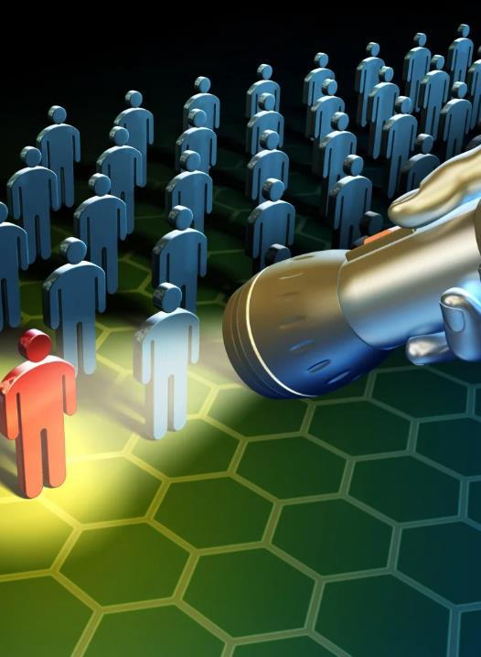
Mitigating Insider Cybersecurity Threats in the Energy Sector
Strategies to Counteract Insider Cybersecurity Threats
Holistic Security Culture: Developing a security culture where every member is aware and invested in the protection of cyber assets.
Access Controls: Implementing strict access controls and privilege management to limit the potential damage insiders can inflict.
Behavioural Analytics: Using behavioural analytics to detect anomalies that could indicate insider threats.
Continuous Education and Training: Ensuring that all personnel receive regular cybersecurity education and training to understand the evolving threat landscape.
Notes:
Mitigating insider threats in the industry requires a multi-faceted approach that combines technical controls with a strong organizational security culture. By establishing rigorous access control measures and privilege management, organizations can limit what insiders can access and potentially misuse. Behavioural analytics can further identify unusual patterns of behaviour that may indicate a threat. Moreover, ongoing education and training ensure that staff at all levels remain informed about the latest cybersecurity practices and threats. Such proactive strategies not only prevent incidents but also ensure swift and effective responses to insider-related breaches.
Reference:
Cybersecurity and Infrastructure Security Agency (CISA). (2021). Insider Threat Mitigation.

Slide 36
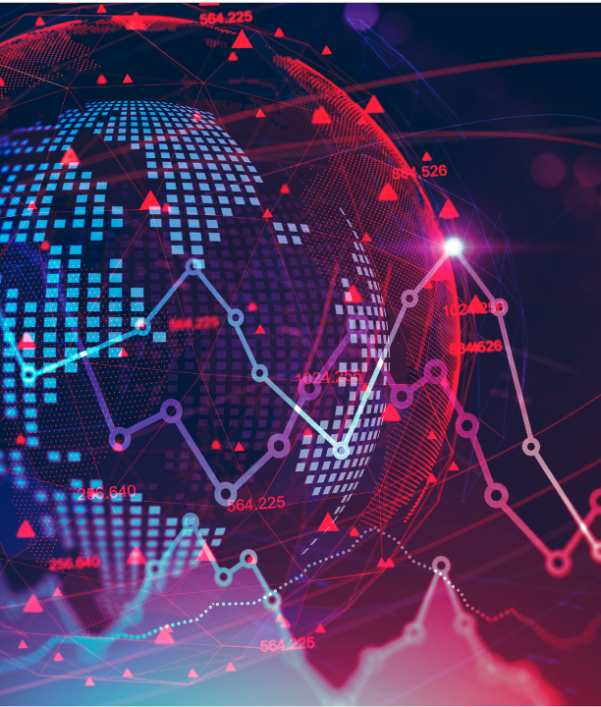
Adversarial Behavior in Energy Sector Cybersecurity
Understanding Adversarial Behavior in Energy Sector Cybersecurity
Definition: Adversarial behavior refers to deliberate actions by external entities aimed at compromising cybersecurity in the energy sector.
Threat Actors:
  Cybercriminals
  State-sponsored groups,
  Hacktivists
  Thrill Seekers
  Cyberterrorists
Notes:
Adversarial behaviour in cybersecurity encompasses a range of activities carried out by external threat actors. These actors have various motives, from espionage to financial gain or disruption of operations. For example, state-sponsored groups may seek to disrupt international shipping routes,. Understanding the intent and capability of these actors is crucial for developing effective cybersecurity measures in the domain. Threat actors, also known as cyberthreat actors or malicious actors, are individuals or groups that intentionally cause harm to digital devices or systems. Threat actors exploit vulnerabilities in computer systems, networks and software to perpetuate various cyberattacks, including phishing, ransomware and malware attacks.
Today, there are many types of threat actors, all with varying attributes, motivations, skill levels and tactics. Some of the most common types of threat actors include hacktivists, nation-state actors, cybercriminals, thrill seekers, insider threat actors and cyberterrorists.
Cybercriminals: These individuals or groups commit cybercrimes mostly for financial gain. Common crimes that are committed by cybercriminals include ransomware attacks and phishing scams that trick people into making money transfers or divulging credit card information, login credentials, intellectual property or other private or sensitive information.
Nation-state actors: Nation states and governments frequently fund threat actors with the goal of stealing sensitive data, gathering confidential information or disrupting another government’s critical infrastructure. These malicious activities often include espionage or cyberwarfare and tend to be highly funded, making the threats complex and challenging to detect.
Hacktivists: These threat actors use hacking techniques to promote political or social agendas, such as spreading free speech or uncovering human rights violations. Hacktivists believe that they are affecting positive social change and feel justified in targeting individuals, organizations or government agencies to expose secrets or other sensitive information. A well-known example of a hacktivist group is Anonymous, an international hacking collective that claims to advocate for freedom of speech on the internet.
Thrill seekers: Thrill seekers are just what they sound like: they attack computer and information systems primarily for fun. Some want to see how much sensitive information or data they can steal; others want to use hacking to better understand how networks and computer systems work. One class of thrill seekers, called script kiddies, lack advanced technical skills, but use pre-existing tools and techniques to attack vulnerable systems, primarily for amusement or personal satisfaction. Though they don't always seek to cause harm, thrill seekers can still cause unintended damage by interfering with a network's cybersecurity and opening the door to future cyberattacks.
Cyberterrorists: Cyberterrorists start politically or ideologically motivated cyberattacks that threaten or result in violence. Some cyberterrorists are nation-state actors; others are actors on their own or on behalf of a nongovernment group.
As the frequency and severity of cybercrimes continue to grow, understanding these different types of threat actors is increasingly critical for improving individual and organizational cybersecurity.
Threat actors in cybersecurity utilize a varied arsenal, selecting tactics based on their goals and capabilities. Malware, including viruses and Trojan horses, is a common tool that disrupts systems by posing as legitimate software. Ransomware, a subset of malware, locks or threatens to expose data unless a ransom is paid, with some attacks targeting high-profile victims for greater payouts. Phishing schemes deceive users into divulging sensitive data or downloading malicious software, often through personalized emails (spear phishing) or by impersonating high-level executives (whale phishing). These methods, alongside other strategies like social engineering and advanced persistent threats (APTs), showcase the multifaceted approaches adversaries employ to exploit both human and technical vulnerabilities.

Slide 37
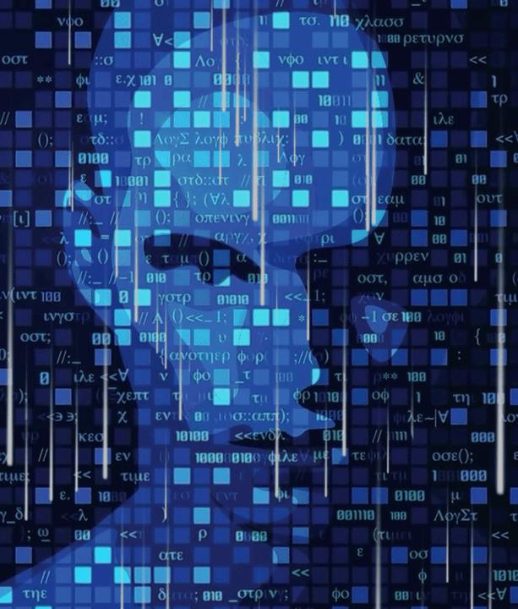
Adversarial Behavior in Cybersecurity in Energy Sector
Impact of Adversarial Cyber Attacks on the Energy Sector
Colonial Pipeline attack (2021): substantial disruption to fuel supply to consumers
Impact on Commerce: could shut down critical infrastructure and impact both the economy and daily li
Impact on Confidentiality: Theft of sensitive information.
Notes:
Cyberattacks on the energy sector have become a significant threat due to the essential nature of energy infrastructure and its interconnections with other critical sectors. A notable example that highlights the vulnerabilities and potential impact of such attacks was the Colonial Pipeline incident in 2021. This cyberattack caused substantial disruption to fuel supply in the United States, demonstrating how malicious actors could shut down critical infrastructure and impact both the economy and daily life​ (The Department of Energy's Energy.gov)​.
Moreover, politically motivated cyberattacks have also been identified as a significant risk, especially when carried out by nation-states or domestic 'hacktivists' as a means of retaliation against geopolitical actions. Ransomware attacks, in particular, have shown a considerable increase, doubling in the first half of 2021, with a significant portion of victims in the US​ (gevernova)​.
On the technological front, the discovery of the Pipedream/Incontroller malware linked to Russia, capable of impacting industrial systems controlling critical infrastructure, marked a critical development in the cybersecurity landscape. The existence of Industroyer2 malware, designed to cause damage by manipulating industrial control systems, was also disclosed. Both of these pieces of malware underline the increasing sophistication of cyber threats aimed at the energy sector​ (SecurityWeek)​.

Slide 38
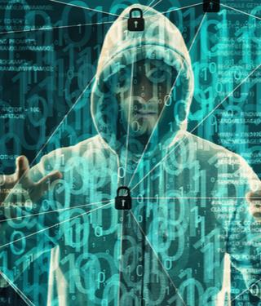
Adversarial Behavior in Energy Sector Cybersecurity
Real-World Examples of Adversarial Attacks in the Energy Sector
Ukranian Power Grid Attack (2015)
Colonial Pipeline Ransomware Attack (2021)
DESFA (2022)
People’s Energy (UK; 2020)
Notes:
Real-world examples of adversarial attacks in the energy sector underscore its susceptibility to cybersecurity threats. Notably, the 2015 Ukrainian power grid attack, where adversaries remotely accessed and controlled power distribution networks, leading to widespread electricity outages, demonstrates the impact of such incursions. The United States also witnessed the Colonial Pipeline ransomware attack in 2021, which halted pipeline operations and spurred a temporary fuel shortage. Additionally, energy companies have faced data breaches resulting in the theft of sensitive operational and customer data, illustrating the critical need for robust cyber defenses in the energy sector.
In recent years, there have been several significant data breaches at energy companies in the EU. For example, in August 2022, DESFA, Greece's major natural gas distributor, reported a data breach and IT system outage following a cyberattack. Although the company's IT team acted swiftly to contain the breach, The hacking group operating under the name of Ragnar Locker claimed responsibility for the ransomware attack, saying it had published more than 360 GB of data allegedly stolen from DESFA.​ (https://www.resecurity.com/blog/article/ransomware-attacks-against-the-energy-sector-on-the-rise-nuclear-and-oil-gas-are-major-targets-2024)​. Initially discovered in April 2020, Ragnar Locker is both ransomware and a ransomware gang. The threat actor has been on the Federal Bureau of Investigation's (FBI) radar since the gang breached 52 organizations across 10 critical infrastructure sectors. The critical industries that Ragnar Locker has breached include energy, manufacturing, financial services, government, and information technology.
Additionally, in December 2020, UK energy supplier People's Energy disclosed a data breach that affected personal information of its customers. The breach involved unauthorized access to one of the company's systems used to store member data. The company acted immediately to secure their systems and started informing affected customers. Although financial information was not accessed, other personal data was impacted​ (https://www.securityweek.com/uk-energy-startup-peoples-energy-discloses-data-breach/)​.
These incidents highlight the ongoing risks and challenges faced by the energy sector in terms of cybersecurity, underscoring the importance of robust security measures to protect against such threats.
Reference:
National Institute of Standards and Technology (NIST). (2018). Framework for Improving Critical Infrastructure Cybersecurity. https://www.nist.gov/cyberframework.

Slide 39

Adversarial Behaviour in Cybersecurity in Energy Sector
Mitigating Against Adversarial Behaviour in Cybersecurity for the Energy Sector
Adoption of NIST Framework: Implementing the NIST Cybersecurity Framework for managing and mitigating cyber risks effectively.
Utilization of ENISA Guidelines.
Strengthening ties with global partners for shared intelligence and joint cybersecurity exercises.
Establishing rapid response protocols in alignment with ENISA's incident handling recommendations.
Notes:
Integrating ENISA's frameworks alongside existing cybersecurity measures can enhance cybersecurity. ENISA offers guidelines and best practices for risk management, incident reporting, and response strategies tailored to critical infrastructure. Combining these with organizational measures, such as adopting the NIST Cybersecurity Framework and promoting international cooperation, can provide a comprehensive defence against cyber threats. Training and continuous monitoring, can further strengthen energy sector cybersecurity posture.

Slide 40

Evaluation method
Outline the evaluation elements and assessment process
Evaluation Element | How | Notes
Day 1: Group Presentation | Case study
Day 2: Multiple Choice Quizzes | Online Quizzes

Slide 41
Group Presentation
Groups will be made
You will be given a case study
2-3 hours preparation
Presentation is 15 minutes
Execution:
Include visual aids like charts or infographics to illustrate key points.
Goal: Identify and discuss how human factors can influence cybersecurity in the energy sector and to discuss ways to strengthen human elements to prevent future incidents.

Slide 42
Group Presentation
Presentation Outline:
Introduction:
  Provide an overview of the selected case, including what happened and the impact in energy sector operations.
  Detailed Case Analysis:
  Outline the timeline of events and the methods used by attackers.
  Discuss vulnerabilities exploited, particularly focusing on human factors.
Human Factors Assessment:
  Identify specific human errors or oversights contributing to the incident.
  Analyse psychological elements such as trust, complacency, or lack of cybersecurity awareness.
Psychological Considerations:
  Evaluate the cognitive biases or social engineering techniques that may have played a role.
  Discuss the psychological impact on staff and how it may have influenced their response to the incident.
Recommendations for Improvement:
  Offer strategies to enhance human factors-related security, such as better training or more effective awareness campaigns.
  Suggest policies or practices that could mitigate similar incidents in the future.
Conclusion: Recap the main human factors identified and the broader implications for cybersecurity for the energy sector.
Q&A Session: Be prepared to engage with the audience and answer questions regarding the incident and your analysis.

Slide 43
Day 2
Organizational
Decision Making
Training

Slide 44
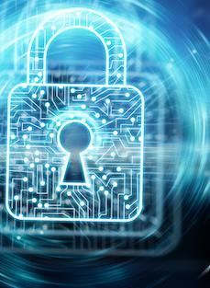
Organizational Culture, Communication, and Cybersecurity
Role of Organizational Culture
Definition and impact of organizational culture on cybersecurity.
Characteristics of a strong cybersecurity culture.
  Values (Lencioni, 2002)
  Adherence and compliance
Strategies for cultivating a positive cybersecurity culture.
  Psychological Safety in the Workplace
Notes:
Organizational culture within the industry can be understood through four distinct levels, each contributing uniquely to the cybersecurity posture of organizations.
Organisational Values
Core: This level represents the fundamental beliefs and values that are widely accepted and practiced within the organization. In the context of cybersecurity, a core culture that prioritizes safety, security, and vigilance forms the bedrock upon which other cybersecurity practices are built. For example, an organization where the core belief is that 'every crew member is a cybersecurity defender' naturally cultivates an environment where security practices are ingrained in daily operations.
Aspirational: These are the ideals that the organization strives to achieve, which may not yet be fully realized or embedded in daily practices. For energy sector cybersecurity, aspirational culture could involve becoming the industry leader in cyber resilience or achieving zero cybersecurity incidents. Setting such aspirations helps to align efforts and resources towards enhancing cybersecurity capabilities and encourages continuous improvement.
Permission-to-Play: This level encompasses the basic behaviours and norms expected of everyone in the organization, essentially the 'rules of the game' for being part of the team. In terms of cybersecurity, this might include adherence to standard security protocols, such as regular password changes and not clicking on unknown links in emails. These baseline expectations ensure a minimum level of compliance across the organization, critical for maintaining foundational cybersecurity hygiene.
Accidental: These are the traits that have formed spontaneously over time, without being intentionally cultivated by leadership. While these can sometimes be positive, they can also lead to vulnerabilities in cybersecurity if, for example, an accidental culture of 'bypassing protocols for convenience' takes root. Identifying and addressing these accidental cultural traits is crucial for closing gaps in the organization's cybersecurity defences.
In the context of cybersecurity, organizational culture influences both adherence to best practices and compliance with policies. Adherence involves a more voluntary, belief-driven action where crew members follow cybersecurity practices because they believe in their importance and efficacy. Compliance, on the other hand, might be driven more by the desire to meet external requirements or avoid penalties, which may not always engender a deep commitment to the underlying principles of cybersecurity.
The concept of psychological safety is indeed a critical component in fostering a robust cybersecurity culture, especially in sectors where the consequences of security breaches can be significant, such as in the energy sector. In this domain, psychological safety means creating an environment where individuals feel secure enough to report anomalies, discuss vulnerabilities, and collaborate on security without fear of negative consequences.
For the energy sector, which encompasses critical infrastructure like power plants and electricity grids, the benefits of psychological safety include:
Proactive Threat Identification: Employees are more likely to report anomalies and potential threats without the fear of being wrong or facing retribution.
Collaborative Problem-Solving: Teams can work together openly to address vulnerabilities and improve systems, leading to better outcomes.
Innovation in Security Measures: When employees feel safe to voice out-of-the-box ideas, the organization may benefit from innovative solutions that could be overlooked in a more restrictive environment.
Compliance and Best Practices: An atmosphere of trust encourages adherence to protocols not out of obligation, but because employees understand and believe in their importance.
Employee Well-being and Retention: Workers who feel their contributions are valued and their well-being is a priority are more likely to stay loyal to the company, ensuring a knowledgeable and experienced workforce.
To weave psychological safety into the fabric of cybersecurity, energy sector organizations must commit to education and training, clear communication, and supportive leadership. By focusing on these areas, they create a secure and resilient operational environment, crucial for the energy sector where the risks and impacts are amplified.
Building such an environment requires commitment at all levels of the organization, from executives to frontline employees. It's about fostering a mindset where cybersecurity is everyone's responsibility, and where every individual feels like an integral part of the security.

Slide 45

Organizational Culture, Communication, and Cybersecurity
Effective Cybersecurity Communication
Principles of effective communication in cybersecurity.
Overcoming barriers to effective cybersecurity communication.
Role of transparent communication in incident response.
Post cybersecurity incident
Notes:
Effective communication is paramount in ensuring the robustness of cybersecurity measures. It involves clear, concise, and timely sharing of information about potential threats, security protocols, and incident response strategies among all stakeholders.
Defining Effective Communication: In the context of cybersecurity, effective communication means delivering the right information, to the right people, at the right time, in a manner that is both understandable and actionable. For example, a cybersecurity analyst discovering a potential threat on power systems should be able to convey the severity and required actions to plant leaders and staff without ambiguity, using language that is accessible to non-specialists.
Origins of Communication Difficulties: Communication challenges often arise from the technical complexity of cybersecurity information and the diverse backgrounds of decision-makers and cybersecurity analysts. Analysts, deeply versed in technical jargon, may struggle to translate cybersecurity risks and needs into terms that resonate with senior management, who are focused on operational continuity and safety. This disconnect can lead to underestimation of risks and delayed decision-making.
Overcoming Communication Barriers:
Training and Awareness: Implementing cross-training sessions where decision-makers are educated on basic cybersecurity principles and analysts are trained in effective communication skills can bridge the knowledge gap. This mutual understanding facilitates more meaningful conversations about cybersecurity risks and strategies.
Use of Visualization Tools: Employing visual aids such as dashboards that illustrate cybersecurity threats and their potential impacts on energy sector operations can help demystify complex information, making it easier for decision-makers to grasp the urgency and respond appropriately.
Developing Common Language: Establishing a common language or set of terminologies that both cybersecurity professionals and energy sector decision-makers understand can significantly reduce miscommunication. This could involve simplifying cybersecurity jargon or using analogies related to energy sector operations to explain cyber concepts.
Regular Briefings and Reports: Instituting regular briefings where cybersecurity analysts provide updates in a structured, concise manner can keep decision-makers informed without overwhelming them with technical details. Tailored reports that highlight key cybersecurity metrics, potential impacts on operations, and actionable recommendations are particularly effective.
Creating Cybersecurity Liaison Roles: Designating individuals who understand both the operational context and cybersecurity to act as liaisons can facilitate smoother communication. These individuals can translate technical risks into operational impacts and vice versa, ensuring that both sides understand the priorities and constraints of the other.
Effective communication plays a critical role in the success of cybersecurity incident response procedures, particularly in the high-stakes environment of operations:
Rapid Identification and Assessment: Clear communication channels between crew members, cybersecurity analysts, and decision-makers ensure that potential threats are promptly identified and accurately assessed. When everyone understands how to report suspicious activities and whom to report to, the initial detection of incidents is accelerated, allowing for quicker response times.
Coordinated Response Efforts: Effective communication facilitates the coordination of response efforts across different departments and levels of the organization. For example, if a cybersecurity incident impacts power station control systems, clear communication ensures that the technical team, leaders and staff work in sync to implement contingency plans, minimizing operational disruptions.
Decision-Making Efficiency: Enhancing communication between cybersecurity analysts and decision-makers ensures that the latter are provided with succinct, actionable information. This clarity helps decision-makers to quickly understand the severity of the incident, the potential impact on operations, and the necessary steps to mitigate the threat, leading to more effective and timely decisions.
Stakeholder and Regulatory Communication: In the event of a cybersecurity incident, organizations may need to communicate with external stakeholders, including regulatory bodies, port authorities, and other ships. Effective communication protocols ensure that these parties receive accurate, timely information about the incident and the response measures being taken, maintaining trust and compliance with energy sector cybersecurity regulations.
Post-Incident Analysis and Learning: After resolving a cybersecurity incident, effective communication is key in conducting debriefings and post-incident analyses. These sessions, which involve clear and open discussions about what happened, why it happened, and how the response was managed, are crucial for identifying lessons learned and areas for improvement. This process strengthens future incident response efforts and the overall cybersecurity posture.
Maintaining Morale and Trust: Clear, transparent communication during and after cybersecurity incidents helps maintain the trust and morale of the staff and other stakeholders. Keeping everyone informed about the situation, the steps being taken, and the resolution of the incident reassures personnel and stakeholders that the organization is capable of managing cybersecurity threats effectively.
In summary, effective communication enhances every aspect of cybersecurity incident response, from the initial detection of a threat to the post-incident analysis. By ensuring that critical information flows efficiently and accurately among all involved parties, organizations can respond to cybersecurity incidents more effectively, minimizing their impact on operations and ensuring the safety and security of assets.

Slide 46

Organizational Culture, Communication, and Cybersecurity
Leadership in Cybersecurity Culture
Building cybersecurity leadership at all levels of the organization.
  Vertically AND horizontally
Notes:
Leadership plays a crucial role in establishing a cybersecurity culture within the energy sector, impacting operations from oil rigs to power plants. Here's how leadership's role in cybersecurity can be tailored specifically for the energy sector:
Empowering Technicians and Engineers: On-site leadership involves equipping technical personnel with the knowledge and tools to recognize and respond to cyber threats to operational technology. This includes understanding how to secure industrial control systems and respond to incidents without disrupting operations.
Energy Sector Cybersecurity Advocates: In power plants and other facilities, leadership involves identifying individuals who champion cybersecurity within their departments. They are tasked with maintaining vigilance, spreading best practices, and serving as the first line of defense against digital threats.
Cross-Departmental Cybersecurity Collaboration: Leaders in the energy sector should facilitate the creation of cross-functional teams that include members from various operational domains. These teams work in unison to create a defense strategy that incorporates the unique challenges and workflows of energy operations.
Continuous Learning and Adaptation: The energy sector requires leaders who promote ongoing education in the face of evolving cyber threats. This may involve regular updates to training protocols, workshops on the latest threats, and strategic partnerships with cybersecurity experts.
Incentivizing Vigilance: A key aspect of leadership is recognizing and rewarding proactive cybersecurity behavior. Whether it’s through formal recognition programs or informal shout-outs in meetings, this reinforces the value placed on cybersecurity.
Integrative Leadership Training: Prospective leaders in the energy sector should be trained not just in the technical aspects of cybersecurity but in fostering a culture that values vigilance, innovation, and communication regarding cyber risks.
Leaders in the energy sector must foster a culture where cybersecurity is everyone’s business, integrating it into all aspects of operation. By doing so, they help create a resilient and vigilant energy infrastructure.

Slide 47

Organizational Culture, Communication, and Cybersecurity
Fostering Collaboration and Trust
Defining Collaboration and Trust: Collaboration involves the sharing of information, resources, and best practices to enhance collective cybersecurity defences. Trust underpins these collaborative efforts, ensuring that shared information is reliable and that partners will act responsibly with shared data and insights.
Importance of trust and collaboration in cybersecurity efforts.
  Information Sharing
  Joint Cybersecurity exercises
Techniques for building trust within and across teams.
  Alliances, partnerships
Collaborative approaches to cybersecurity problem-solving.
Real-world example: Cross-departmental collaboration project that strengthened overall cybersecurity posture.
Notes:
In the European energy sector, collaboration and trust are pivotal to enhancing cybersecurity defenses due to the interconnected nature of energy systems. The European Union has acknowledged this need and is actively working to fortify the sector through various initiatives.
The EU's Security Union Strategy, presented in July 2020, underlines the importance of safeguarding critical energy infrastructure from physical, cyber, and hybrid threats. This strategy emphasizes the necessity for sector-specific initiatives to bolster the resilience of vital components like power grids and gas pipelines across Europe. Moreover, these measures aim to standardize the level of cybersecurity across the EU, ensuring that energy operators in different countries are equally protected against potential cyber incidents (European Commission, 2024).
Furthermore, the first-ever network code on cybersecurity for the EU electricity sector was adopted to improve the cyber resilience of critical EU energy infrastructure and services. This code establishes a structured process for conducting cybersecurity risk assessments within the electricity sector. It outlines specific legislation to address unique characteristics of the energy sector, such as real-time reaction needs and the integration of legacy systems with newer digital technologies. It also fosters a harmonized approach to cybersecurity among stakeholders and adapts to the evolving knowledge field (European Commission, 2024).
The European Union Agency for Cybersecurity (ENISA) plays a significant role in the implementation of the NIS Directive and supports both member states and the private sector to achieve a higher level of cybersecurity. It engages various stakeholders to contribute to policy initiatives and facilitates information flows to respond to cyber incidents effectively. For instance, ENISA is part of the European Energy Information Sharing and Analysis Centre (EE-ISAC), which helps utilities to enhance the cybersecurity and resilience of their grids (ENISA).
European joint cybersecurity exercises that involve the energy sector are an essential part of the EU's efforts to enhance the cyber resilience of its critical infrastructure. The Cyber Europe 2024 exercise will simulate attacks on the energy sector, reflecting the increasing frequency of cyberattacks on energy infrastructure since 2017. This exercise aimes to address the challenges and responses to potential massive and destructive attacks that could destabilize the European economy, focusing on the critical role of the energy sector in the EU's economic stability (ENISA).
Furthermore, the European Commission has implemented a comprehensive legislative framework to protect critical energy infrastructure, notably with initiatives such as the EU Cybersecurity strategy, the Directive on Security of Network and Information Systems (NIS Directive), and the Clean energy for all Europeans package. This framework includes the network code on cybersecurity for the electricity sector, which emphasizes recurrent cybersecurity risk assessments and a harmonized approach to tackle specific sector characteristics like real-time reaction requirements and cascading effects across interconnected grids (European Commission).
The Commission collaborates with entities like the European Energy–Information Sharing Analysis Centre (EE-ISAC). EE-ISAC helps utilities improve their cybersecurity and resilience by enabling trust-based data and information sharing, reflecting the importance of collaboration and information exchange for an effective cybersecurity posture in the energy sector (European Commission).
These initiatives highlight the EU's dedication to strengthening the cybersecurity of its energy sector, acknowledging the interconnected and digitalized nature of modern energy systems and the importance of joint efforts to safeguard against evolving cyber threats.These EU initiatives reflect a commitment to fostering an environment where both private and public stakeholders work collaboratively, sharing knowledge and resources to collectively defend against cyber threats and ensure the continuous and secure operation of Europe's energy infrastructure.

Slide 48
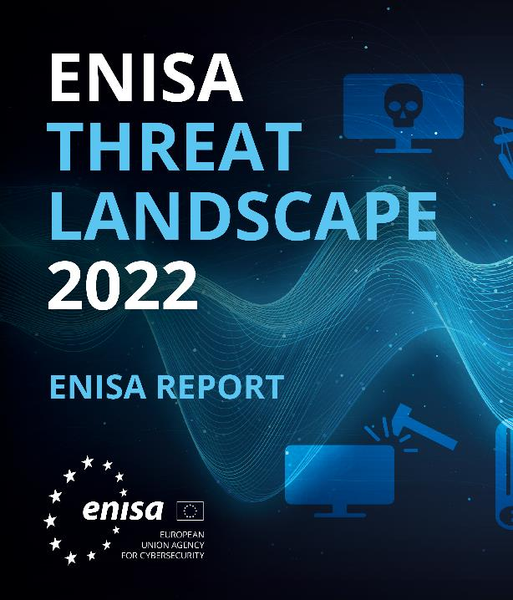
Communication and Collaboration Across Domains
Cross-Domain Cybersecurity Challenges
Challenges and opportunities in cross-domain cybersecurity collaboration.
  EU Agency for Cooperation of Energy Regulators (ACER) attack
Importance of interoperability and shared standards.
  ENISA, NIS 2
Strategies for effective cross-domain communication.
Notes:
In the energy sector, cybersecurity challenges also emerge from the integration of operational technology (OT) with information technology (IT), involving numerous stakeholders and spanning across multiple industries. For instance, energy infrastructures, such as power plants and electric grids, face cyber threats that could impact both IT systems and the OT that controls physical processes. A real-world example includes incidents like the 2015 attack on the Ukrainian power grid, where hackers caused power outages affecting thousands of people. This event highlighted the need for comprehensive cybersecurity strategies that integrate both IT and OT considerations. Similarly, the EU's response to cybersecurity challenges in critical sectors like energy is guided by initiatives from the European Union Agency for Cybersecurity (ENISA) and legislative frameworks such as the NIS 2 Directive. These frameworks support the energy sector in enhancing resilience by providing expertise, facilitating information sharing, and establishing stringent cybersecurity requirements for operators.
In the European energy sector, a significant example of cross-domain mitigation is seen in the joint efforts to address the cybersecurity challenges posed by the increasing digitization and interconnectivity of energy systems. The Smart Grids Task Force, under the European Commission, has been instrumental in developing sector-specific strategies to reinforce the implementation of the NIS directive at the energy sector level. This work has been crucial in increasing cybersecurity awareness and preparedness across the sector.
A notable cybersecurity incident in the European energy sector involved the EU Agency for Cooperation of Energy Regulators (ACER), which reported a cyberattack in November 2023. Despite the attack, ACER maintained its operational functions and launched a full investigation, collaborating closely with the European Union’s Computer Emergency Response Team (CERT-EU) to mitigate the consequences and prevent further damage. This incident highlights the cross-domain challenges in the energy sector, particularly the need for collaboration between regulatory bodies, cybersecurity teams, and emergency response units. It also underscores the critical importance of cybersecurity preparedness and the ability to respond effectively to cyber threats that target essential energy infrastructure and regulatory bodies. Such incidents emphasize the interconnected nature of cybersecurity, where effective defence and response mechanisms require cooperation across different domains and between various stakeholders, including public institutions and private companies. This kind of collaborative approach is essential for maintaining the resilience and integrity of Europe's critical energy infrastructure.

Slide 49
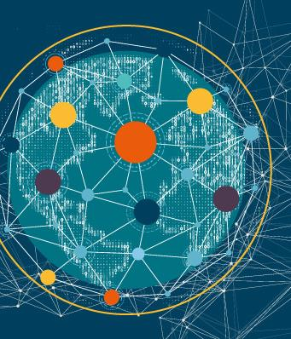
Communication and Collaboration Across Domains
Building Collaborative Networks
The role of professional networks and alliances in enhancing cybersecurity.
Benefits of public-private partnerships in cybersecurity initiatives.
  ESCO
Leveraging expertise across domains for comprehensive cybersecurity solutions.
Notes:
In the energy sector, establishing robust collaborative networks is crucial for enhancing cybersecurity resilience, similar to practices in the sector. These networks, which include public-private partnerships, industry associations, and international collaborations, facilitate the exchange of critical threat intelligence, best practices, and technological solutions across the energy ecosystem.
Strong public-private partnerships are vital for linking governmental cybersecurity initiatives with private energy stakeholders. These partnerships help in the timely sharing of threat intelligence and the development of coordinated response strategies, ensuring synchronization of efforts between public authorities and private companies.
Participation in industry associations and Energy Information Sharing and Analysis Centers (ISACs) allows energy organizations to exchange sector-specific cybersecurity information. These platforms also facilitate collaborative problem-solving and joint initiatives, bolstering the sector's cyber defenses.
Engaging in international collaborations, such as those supported by organizations like the International Energy Agency (IEA) or regional cybersecurity bodies, helps stakeholders access a broader pool of expertise and resources. These efforts can lead to the development of harmonized cybersecurity standards and practices, strengthening the sector's capability to counteract global cyber threats.
In the European energy sector, the establishment of robust collaborative networks is a cornerstone strategy for enhancing cybersecurity resilience, much like the practices observed in the sector. The European Union has been particularly proactive in this regard, launching several initiatives that involve public-private partnerships, industry associations, and international collaborations to bolster the cybersecurity of its critical energy infrastructure.
The European Commission has adopted a network code aimed at improving the cyber resilience of the EU electricity sector. This initiative is part of a broader strategy to ensure high, common levels of cybersecurity across member states, particularly for cross-border electricity flows. It establishes processes for regular cybersecurity risk assessments and mandates the development of mitigating measures for identified risks. This network code is a significant step toward creating a unified cybersecurity framework within the EU energy sector.
The EU has a comprehensive legislative framework to tackle cybersecurity challenges, including the EU Cybersecurity Strategy and the Directive on Security of Network and Information Systems (NIS Directive). These measures provide a structured approach to enhancing the security of network and information systems across the EU, including the energy sector. They emphasize the need for member states to develop national strategies and cooperate on cybersecurity issues.
The EU promotes collaboration with entities such as the EE-ISAC to facilitate the exchange of information and best practices among utilities. This helps improve the cybersecurity and resilience of their grids by enabling trust-based data and information sharing.
These European initiatives highlight the importance of collaborative networks that incorporate a wide range of stakeholders from both the public and private sectors. They are crucial for sharing critical threat intelligence, best practices, and technological solutions, thereby enhancing the collective cybersecurity posture of the energy sector in Europe.

Slide 50
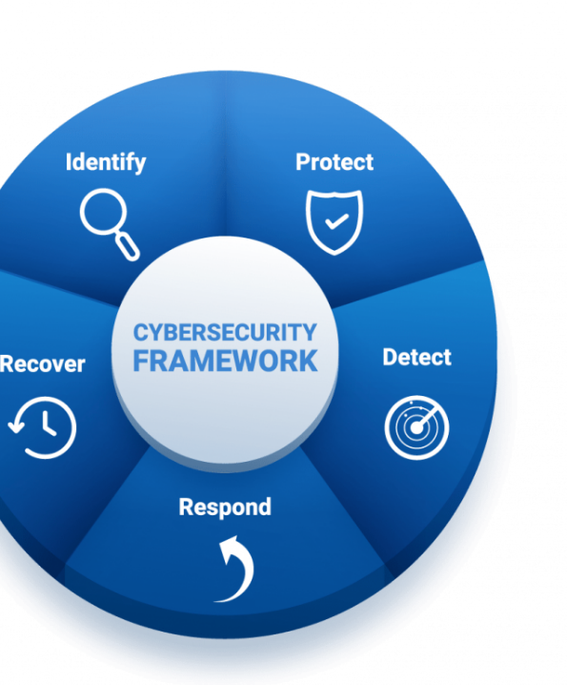
Communication and Collaboration Across Domains
Collaborative Incident Response
Principles of collaborative incident response planning.
Importance of clear roles and communication channels during incidents.
Benefits of joint exercises and simulations.
  Decision-making under pressure
  Cultural aspects
Locked-Shields and the Energy Sector
Notes:
Incorporating human factors into collaborative incident response strategies is crucial for enhancing cybersecurity preparedness in the energy sector. The sector's complexity and the diversity of stakeholders involved demand a deep understanding of how human behaviors, decision-making processes, and team dynamics influence the effectiveness of incident responses.
Key Aspects of Human Factors in Energy Sector Cybersecurity include:
Communication and Coordination: Effective incident response in the energy sector relies heavily on clear communication and seamless coordination among various stakeholders, including utility workers, cybersecurity teams, and regulatory bodies. Developing protocols that address human factors such as language barriers, cultural differences, and stress-induced miscommunications is essential. These protocols ensure that information is accurately conveyed and acted upon during a cyber incident.
Decision-Making Under Pressure: Cyber incidents in the energy sector often require quick decision-making under high-pressure conditions. Stress, cognitive overload, and fatigue can significantly impact the quality of these decisions. Training programs that simulate real-world cyberattack scenarios can help personnel develop the skills needed to make effective decisions swiftly, even in stressful situations.
Team Dynamics and Leadership: The effectiveness of a collaborative incident response is also influenced by team dynamics and leadership styles. Leaders who are skilled in crisis leadership can enhance the response capability of their teams by maintaining morale, effectively delegating tasks, and fostering a collaborative problem-solving environment.
Cultural and Organizational Diversity: The energy sector involves a variety of organizations, each with its own culture and operational procedures. Acknowledging and integrating this diversity in incident response efforts is vital for ensuring effective collaboration towards a common goal.
A practical example of incorporating human factors into collaborative incident response is seen in cyber defense exercises similar to NATO's Locked Shields exercise, although tailored for the energy sector. These exercises might simulate scenarios such as an attack on a power grid's operational technology systems, involving various stakeholders like utility companies, government cybersecurity agencies, and international partners.
Participants in these exercises face challenges that go beyond the technical aspects of cyber threat mitigation. They must manage communication across diverse organizations, make rapid decisions with limited information, and maintain team effectiveness under stress. Such exercises are critical for enhancing the sector's preparedness, highlighting the importance of human factors in cybersecurity.
By focusing on realistic cyber threats and emphasizing the human elements of incident response, these exercises equip stakeholders in the energy sector with the necessary skills, processes, and understanding required for effective collaborative incident management in real-world cyber incidents.

Slide 51

Communication and Collaboration Across Domains
Overcoming Barriers to Collaboration
Common barriers to effective cybersecurity collaboration and how to overcome them.
The role of trust and transparency in collaborative efforts.
Best practices for sustaining long-term collaborative relationships.
Port of San Diego incident
Notes:
In the energy sector, especially within the EU, overcoming common barriers to robust cybersecurity defense is essential. These barriers often include a lack of shared standards, mismatched security protocols across different organizations, and a deficiency in clear communication channels. To address these challenges, the EU has been proactive in establishing unified security frameworks, engaging in joint cybersecurity exercises, and forming dedicated platforms for threat intelligence sharing.
EU Example of Overcoming Barriers:
The European Union has implemented several initiatives to foster collaboration and enhance cybersecurity across the energy sector. One key framework is the Network Code on Cybersecurity for the electricity sector, which aims to harmonize cybersecurity practices and enhance the resilience of cross-border electricity flows. This involves regular risk assessments, development of mitigation strategies, and a governance model that aligns with existing mechanisms in EU legislation​
Building Trust and Transparency:
Trust and transparency are crucial for effective collaboration within the EU energy sector. The EU promotes these principles through transparency in incident reporting and an open sharing of threat intelligence among Member States. This is supported by the EU's NIS Directive, which enhances trust among member states by setting a common level of security for network and information systems across the EU​
Sustaining Collaborative Relationships:
To sustain long-term collaborative relationships, the EU energy sector engages in regular communication, mutual support during crises, and continuous alignment of strategic objectives. The EU's initiatives often include regular workshops, joint training sessions, and the sharing of best practices. For example, the EU facilitates these activities through entities like the European Energy – Information Sharing and Analysis Centre (EE-ISAC), which improves the cybersecurity and resilience of the energy grid by enabling trust-based data and information sharing​
These structured approaches not only prepare the EU to handle incidents more effectively but also ensure that the region's energy sector remains resilient against evolving cyber threats.

Slide 52

Decision Making at Strategic, Operational, and Tactical Levels
Strategic Decision Making
Overview of strategic decision-making in energy sector cybersecurity.
Long-term planning and policy development for robust cybersecurity frameworks.
Integration of cybersecurity into overall business strategy.
Real-world example: A energy sector company's strategic decision to adopt a zero-trust architecture.
Notes:
In the energy sector, strategic decision-making regarding cybersecurity involves setting long-term goals and creating comprehensive frameworks to protect critical infrastructure from cyber threats. This type of decision-making requires an extensive overview of the organization's objectives, potential cyber risks, and the resources available for cybersecurity initiatives.
For instance, an energy company might decide to invest in a system-wide cybersecurity enhancement that could include the implementation of advanced intrusion detection systems, integrated threat management software, and extensive training programs for IT staff and other relevant employees. This decision would be driven by the strategic goal of ensuring the reliability and security of energy supply, safeguarding sensitive data, and maintaining compliance with national and international cybersecurity standards.
An example of such strategic decision-making is evident in initiatives like the European Union's Network Code on Cybersecurity for the electricity sector, which mandates that energy companies in member states enhance their cybersecurity measures to protect the energy grid and ensure secure cross-border electricity flows. This regulatory framework requires companies to conduct regular risk assessments, implement robust security measures, and participate in continent-wide emergency response exercises.
For example, integrating Zero-trust architecture is a cybersecurity framework that mandates strict identity verification for every person and device trying to access resources on a private network, regardless of whether they are inside or outside the network perimeter. The concept of zero-trust architecture operates under the principle "never trust, always verify," which means it does not automatically trust anything inside or outside its perimeters and instead verifies everything trying to connect to its systems before granting access.
Here are some key components and principles of zero-trust architecture:
Least Privilege Access: This principle ensures that users and devices are granted the minimum level of access necessary to perform their tasks. Access rights are strictly enforced based on a thorough understanding of who is requesting access, the context of the request, and the risk of the access environment.
Microsegmentation: The network is divided into small, secure zones to maintain separate access for separate parts of the network. Each segment requires separate access permissions, which reduces the attack surface and limits the movement of an attacker within the network.
Multi-factor Authentication (MFA): Zero-trust systems often require multiple layers of authentication to verify the identity of users and devices beyond just username and password, enhancing security by integrating steps like one-time passcodes, biometric verification, or security tokens.
Continuous Monitoring and Validation: The zero-trust model requires continuous monitoring and validation of security configuration and posture, ensuring that any anomalies are detected and responded to swiftly.
Security Policies Enforcement: Zero-trust architectures use automated systems to enforce security policies in real-time, allowing organizations to respond to threats as they occur and improve their overall security posture.
Zero-trust architecture has been increasingly adopted as organizations recognize that traditional security models, which operate under the assumption that everything inside the network can be trusted, are no longer effective against sophisticated cyberattacks and insider threats. It provides a more robust and proactive approach to security, suitable for the modern digital landscape where threats can originate from anywhere. Implementing zero-trust can be complex and typically requires a comprehensive evaluation of an organization’s network and security policies. It often involves significant changes to how IT and business leaders think about network security.
By investing in comprehensive cybersecurity improvements, energy companies not only protect their own assets but also contribute to the stability and security of the broader energy market. This proactive approach to cybersecurity aligns with broader organizational objectives of maintaining operational continuity, complying with regulatory requirements, and protecting the public and economic interests from the consequences of potential cyberattacks.

Slide 53

Decision Making at Strategic, Operational, and Tactical Levels
Operational Decision Making
Role of operational decisions in maintaining day-to-day cybersecurity.
Operational responses to identified threats and vulnerabilities.
Coordination between cybersecurity teams and other operational units.
Real-world example: An operational decision to isolate a compromised system in a power plant, preventing a wider breach.
Notes:
In the energy sector, operational decision-making focuses on the day-to-day management of cybersecurity measures to secure operations. This involves decisions related to the implementation of security policies, the management of security incidents, and the allocation of resources for ongoing cybersecurity activities. For example, an operational decision might involve conducting a simulated cyber attack on a power plant to test the readiness of the operational team and the effectiveness of the plant's cybersecurity protocols. Such exercises are crucial as they help identify vulnerabilities and areas for improvement, ensuring that operational practices are continuously refined to counter emerging cyber threats.
In the context of a real-world energy sector scenario, operational decisions could also involve routine updates to firewall configurations, regular patches to software vulnerabilities, and the monitoring of network traffic for unusual activities. These measures are part of a broader strategy to maintain robust defences against potential cyberattacks, which are increasingly sophisticated and frequent in critical infrastructure sectors like energy.
Regular training sessions for IT and operational staff, along with drills involving both IT and engineering teams, can enhance an organization's ability to respond to incidents swiftly and effectively. These activities ensure that all parts of the organization understand their roles during an attack and can cooperate effectively under pressure. Such proactive operational management is essential in maintaining the security and resilience of energy infrastructures, helping to protect them against both internal and external cyber threats.

Slide 54

Decision Making at Strategic, Operational, and Tactical Levels
Tactical Decision Making
Nature of tactical decisions in responding to immediate cybersecurity threats.
Tools and techniques for effective tactical decision-making, including incident response teams and real-time threat intelligence.
Importance of agility and flexibility in tactical decisions.
Real-world example: Rapid tactical response to a ransomware attack on a management system.
Notes:
In the energy sector, tactical decision-making revolves around quick, on-the-spot decisions in response to specific cyber incidents, similar to practices in cybersecurity for the energy sector. These decisions often need to be made under pressure and require a rapid assessment of the situation alongside the deployment of predefined response protocols. A practical example of tactical decision-making in the energy sector could be the response to a ransomware attack on a utility's energy management system.
In such a scenario, the tactical decision might involve isolating the infected parts of the network to prevent the spread of the malware, implementing backup procedures to restore critical functions, and communicating swiftly with relevant stakeholders, including law enforcement and cybersecurity experts. This response exemplifies the immediate, focused actions necessary to mitigate the impact of the attack and restore normal operations as quickly as possible.
For example, during the 2017 cyberattack on Ukraine's energy infrastructure, tactical decisions included promptly switching to manual controls and isolating affected systems. These actions were crucial in minimizing the outage period and mitigating the attack's impact on the energy supply to end-users.
Such tactical responses are vital for maintaining resilience and continuity in the energy sector, ensuring that utilities can continue to provide essential services even in the face of cyber threats. These actions highlight the importance of having well-prepared incident response plans that can be quickly enacted when a cyber incident occurs.

Slide 55

Decision Making at Strategic, Operational, and Tactical Levels
Integrating Decision Levels
Ensuring coherence and alignment between strategic, operational, and tactical decision-making levels.
Mechanisms for feedback and learning across decision-making levels.
Role of leadership in bridging gaps between different decision-making levels.
Real-world example: Integrated decision-making framework that enabled a seamless response to a coordinated cyber-physical attack.
Notes:
In the energy sector, the integration of strategic, operational, and tactical decision-making levels is crucial for establishing a robust cybersecurity posture. Effective communication, collaboration, and a deep understanding of the operational environment are essential to align these decision-making levels with the sector's unique challenges and dynamics. This alignment enhances the organization’s cybersecurity resilience and adaptability in response to emerging threats.
Strategic Level:
At the strategic level, decisions include long-term investments in cybersecurity infrastructure, such as the development of advanced protective technologies and comprehensive risk management frameworks. These decisions guide the overall direction and policies for cybersecurity within the organization.
Operational Level:
The operational level focuses on implementing these strategies through daily management practices and protocols. This includes regular security assessments, the deployment of security solutions, and ongoing training programs for staff to ensure they are aware of and can respond to current cyber threats.
Tactical Level:
At the tactical level, the focus is on immediate, real-time responses to cyber threats and incidents. This involves quick decision-making to mitigate threats, such as deploying emergency patches, isolating affected systems, and engaging with incident response teams.
Integration Across Levels:
Achieving coherence across these levels requires clear communication channels to ensure that strategic decisions are effectively executed at the operational level and that insights from the ground influence strategic planning. For example, if operational teams frequently encounter specific cyber threats, this feedback should inform strategic decisions, potentially leading to shifts in cybersecurity tactics or resource allocation.
Feedback Loops:
Effective integration also relies on establishing feedback loops that allow insights and experiences from operational and tactical levels to inform strategic planning. This helps in adjusting strategies in real time and aligning them with the dynamic nature of cyber threats.
Real-world Example:
A practical example of this integrated approach can be seen in how major energy companies respond to significant cyber incidents. After such incidents, these companies often undertake comprehensive reviews of their cybersecurity strategies. They adjust their operational practices based on the insights gained, and refine tactical responses to be more effective against similar threats in the future.
For instance, after a cyber incident, a utility might enhance its intrusion detection systems and update its incident response strategies. These changes are then communicated across the organization to ensure that every team understands the new protocols and can act quickly during future incidents.
This integrated decision-making process ensures that the energy sector can maintain resilience and adapt quickly to new cyber threats, safeguarding critical infrastructure and the continuity of energy supplies.

Slide 56

Training, Awareness, and Communication Programs for Personnel
Importance of Training and Awareness
The critical role of continuous training and awareness in cybersecurity for the energy sector.
Elements of effective cybersecurity training programs for energy sector personnel.
The impact of awareness programs on reducing human error and enhancing security culture.
IMO, NIS 2
Notes:
In the European energy sector, training and awareness are critical for establishing a robust cybersecurity posture. This is essential to protect against cyber threats to infrastructure that's integral to public and economic welfare.
Training Programs: Training in the European energy sector needs to cover various topics, from recognizing phishing attempts to securing complex control systems used in power generation and distribution. Tailoring these programs to specific roles within the organization is crucial, ensuring that everyone from technicians to top executives understands the specific cyber risks relevant to their duties. For instance, engineers working on smart grids may need in-depth training on securing interconnected devices and systems.
Awareness Campaigns: Awareness initiatives are vital for keeping cybersecurity at the forefront of employees' minds. In the EU, this could involve regular newsletters, posters in workplaces, and interactive sessions that engage employees in identifying potential security breaches. Gamified learning platforms could also be employed to make the learning process more engaging and effective, ensuring retention and practical application of the knowledge.
Building a Security Culture: Beyond training and tactical awareness, embedding a strong security culture within every layer of the organization is essential. This culture must promote proactive behaviors, such as secure password practices and immediate reporting of suspicious activities. Each employee must feel personally responsible for the cyber safety of the organization.
EU-Specific Regulations and Guidelines: EU regulations play a significant role in shaping cybersecurity strategies within the energy sector. The EU's NIS Directive (Directive on Security of Network and Information Systems) mandates critical infrastructure sectors, including energy, to adopt rigorous security measures and report major cyber incidents. The recent update to this directive, known as NIS 2, expands these requirements, emphasizing the need for enhanced training and reporting practices to strengthen overall cybersecurity resilience across member states.
Real-World Example: Following the NIS Directive, energy companies across the EU have been required to integrate comprehensive cybersecurity training into their operational protocols. These programs prepare staff to deal with cyber threats effectively and ensure compliance with EU cybersecurity standards. For instance, a major EU-based energy provider might conduct regular cyber incident simulations to test the effectiveness of their training and refine response strategies accordingly.
In summary, the integration of strategic, operational, and tactical decision-making, supported by continuous training and awareness in the EU energy sector, is vital for safeguarding essential services against increasingly sophisticated cyber threats. The EU's regulatory framework provides a structured approach, while ongoing education and cultural initiatives ensure that these strategies are effectively implemented and continuously improved.

Slide 57
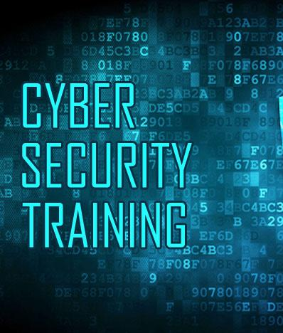
Training, Awareness, and Communication Programs for Personnel
Enhancing Communication for Cybersecurity
Best practices for communicating cybersecurity policies and incidents to personnel.
The role of clear, consistent communication in fostering a proactive cybersecurity stance.
  Clear Messaging
  Timely Information Flow
  Actionable Intelligence
Strategies for overcoming communication barriers in diverse and dynamic environments.
  Multichannel communication
  Feedback
Notes:
Enhancing communication for cybersecurity within the energy sector is a multifaceted endeavour, crucial for the effective management of cyber threats. Clear, timely, and actionable communication channels must be established and maintained to ensure the swift dissemination of cybersecurity information.
ClearMessaging: The complexity of cybersecurity information should be distilled into clear, concise messages that can be understood by all personnel, regardless of their technical expertise. For instance, rather than detailing the technical specifics of a malware attack, communicate the immediate actions that need to be taken, such as not using external drives or avoiding certain actions on computer systems.
Timely Information Flow: Speed is of the essence in responding to cyber threats. Establish protocols that outline how quickly information should be passed along the chain of command and to relevant personnel. An example might be automated alerts that immediately notify the IT department and engineers when a potential threat is detected.
Actionable Intelligence: Communication should not only inform but also instruct. It should provide clear instructions on the next steps to take. For example, if a vulnerability in a SCADA system is discovered, communication should include specific measures to mitigate risk, such as switching to a secondary system or updating software.
Multi-Channel Communication: Utilize various communication channels to ensure messages are received. This could involve email alerts, SMS, intranet updates, or even physical notices in common areas of the facilities.
Feedback: Establish a two-way communication flow where feedback from engineers and other staff is encouraged and acted upon. For example, a helpline or a dedicated inbox for reporting suspicious activities can provide insights into the effectiveness of current cybersecurity measures.
Real-World Example: A practical application of these principles is seen in how the Electricity Information Sharing and Analysis Center communicates cybersecurity alerts. They issue bulletins that are not overly technical, provide immediate action items, and disseminate these alerts through multiple channels, ensuring broad reach and understanding across the energy sector. This approach enhances the cybersecurity preparedness of the recipients and provides a model for effective communication strategies.

Slide 58
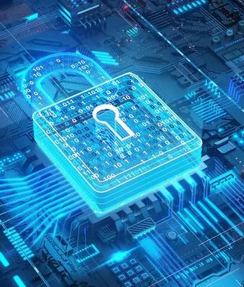
Training, Awareness, and Communication Programs for Personnel
Designing Effective Training Programs
Principles for designing engaging and impactful training programs.
  Habits, Self-efficacy, Metacognition
Incorporating adult learning theories and methodologies in cybersecurity training.
Use of simulations and drills in reinforcing learning and preparedness.
Real-world example: The use of VR simulations to train engineers and technicians on cybersecurity protocols.
Notes:
Designing effective cybersecurity training programs hinges not only on conveying information but also on fostering the right habits, bolstering self-efficacy, and cultivating metacognitive skills through tailored feedback. Habits are entrenched through consistent practice, and simulations and drills offer the perfect platform for this, enabling crew members to routinely exercise cybersecurity protocols until they become second nature.
Simulations empower engineers and technicians by enhancing their self-efficacy, giving them the confidence to tackle real cybersecurity challenges. This confidence is further developed when they successfully navigate through complex, simulated cyber events. Drills that incorporate metacognitive elements—prompting crew members to analyse and reflect on their decision-making process—help consolidate learning and ensure that lessons stick.
The incorporation of tailored feedback is crucial in these exercises. Just as debriefings in traditional energy sector drills allow for individualized learning points, immediate and personalized feedback in cybersecurity simulations ensures that each engineers and technicians can understand and correct their actions, reinforcing proper techniques and strategies.
Using VR and AR in training has revolutionized learning by providing an immersive, interactive environment. In the cybersecurity realm, an example can be found in how the aviation industry has adopted VR for pilot security training, with pilots practicing emergency responses in lifelike simulations that provide immediate feedback on their actions. Adapting this technology to cybersecurity, crew members could use VR to virtually experience cyberattacks, like a phishing scam targeting power plant control systems or unauthorized access to the secure data. Throughout these simulations, adaptive feedback mechanisms would analyse their responses, providing personalized insights and recommendations for improvement. This level of tailored feedback is critical for reinforcing good cybersecurity habits, enhancing self-efficacy, and fostering an environment of continuous learning and improvement in perations.

Slide 59

Training, Awareness, and Communication Programs for Personnel
Evaluating Effective Training Programs
  Process evaluation: Intervention
    Did it do its job
  Impact evaluation
        How has it changed
  Outcome evaluation
      Objective
    Subjective
  Involve stakeholders and participants
  Performance measures
  Subjective measures
Notes:
In evaluating cybersecurity training, a process evaluation would assess whether the training effectively conveyed critical knowledge and skills. An impact evaluation would measure changes in cybersecurity posture, such as reduced incidents. Outcome evaluations would examine both objective metrics, like the number of successful phishing attempts pre- and post-training, and subjective metrics, like crew confidence in handling cyber threats. Involving stakeholders, such as crew and IT staff, can provide valuable insights into both the performance of the training and subjective assessments of its effectiveness.
For further reading on best practices in cybersecurity training within the energy sector, Internationally, organizations such as the International Electrotechnical Commission (IEC) and the International Organization for Standardization (ISO) develop standards and guidelines that are widely adopted by countries and industries around the world, including the energy sector. These standards often include provisions for cybersecurity practices and risk management.
Furthermore, collaboration between countries through initiatives like the International Energy Agency (IEA) and international agreements can also influence cybersecurity guidelines for the energy sector on a global scale, and guidelines recommended by the European Union Agency for Cybersecurity (ENISA).
European Union Agency for Cybersecurity (ENISA). (2019). Cybersecurity culture guidelines: Behavioural aspects of cybersecurity. Retrieved from https://www.enisa.europa.eu.
.

Slide 60
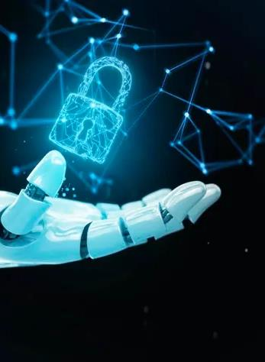
Future Trends, Challenges, and the Role of Communication
Emerging Cybersecurity Trends
An overview of emerging trends in cybersecurity, including AI, machine learning, and IoT.
The implications of these trends for cybersecurity strategies.
Preparing for future cybersecurity challenges through innovation and adaptability.
Real-world example: Adoption of AI-based threat detection systems.
Notes:
In the energy sector, staying updated with emerging cybersecurity trends, such as the use of Artificial Intelligence (AI) and the Internet of Things (IoT), is crucial for safeguarding against future threats. These technologies offer new tools for defense but also introduce new vulnerabilities. Preparing for these future challenges requires not only technological innovation but also strategic foresight to anticipate and mitigate potential threats.
Artificial Intelligence (AI): AI can be used in the energy sector to enhance the security of networked systems and operational technology. AI-driven anomaly detection systems, for example, can monitor grid operations to identify unusual patterns that may indicate a cybersecurity threat. This proactive approach allows for quicker responses to potential issues.
Internet of Things (IoT): IoT devices are increasingly integrated into energy infrastructures, from smart meters to IoT-enabled power management systems. While these devices provide efficiency and automation, they also expand the attack surface. Ensuring these devices are secure and that their integration into energy networks is protected from cyber threats is vital.
Strategic Implementation:
Technological Integration: Similar to the collaboration between Wärtsilä and Templar Executives in the maritime sector, energy companies can partner with cybersecurity firms to develop AI-based solutions that enhance the security of their operations. For example, energy companies might implement AI to detect and respond to anomalies in real-time, thus enhancing the resilience of power grids and other critical infrastructure.
Strategic Foresight: Energy sector stakeholders must not only implement current technologies but also anticipate future cybersecurity challenges. This involves conducting regular security assessments, updating risk management strategies, and staying informed about the latest cybersecurity developments.
A notable initiative in the energy sector is the collaboration between major energy firms and technology providers to implement AI-driven security systems that monitor and protect infrastructure. These systems are designed to detect unusual activities or potential breaches, thereby enhancing operational security. These initiatives show the energy sector's commitment to adopting cutting-edge technologies to safeguard against increasingly sophisticated cyber threats. AI-based systems represent a significant advancement in the evolution of energy sector cybersecurity, offering enhanced detection capabilities and contributing to more secure and resilient operations.

Slide 61

Future Trends, Challenges, and the Role of Communication
Addressing Future Cybersecurity Challenges
Anticipating and mitigating new types of cyber threats in the sector.
The importance of staying ahead of the curve through research and collaboration with cybersecurity experts.
Challenges posed by the increasing complexity and connectivity of operations.
Notes:
As energy sector operations become more complex and interconnected, new cybersecurity challenges will emerge. Proactively addressing these challenges requires a comprehensive approach that includes investing in advanced security solutions and fostering a culture of innovation. Collaborative efforts to develop proactive defence mechanisms can help mitigate the risks posed by future cybersecurity threats

Slide 62

Future Trends, Challenges, and the Role of Communication
The Evolving Role of Communication
The critical role of effective communication in addressing future cybersecurity challenges.
Enhancing cross-sector and cross-border communication for a unified response to cyber threats.
Leveraging new communication technologies and platforms for better threat intelligence sharing.
Real-world example: An international cybersecurity task force's use of a secure communication platform for real-time threat sharing and coordination.
Notes:
The role of communication in cybersecurity will become increasingly critical as the threat landscape evolves. Effective communication can enhance threat intelligence sharing and facilitate coordinated responses to cyber incidents. Leveraging new communication technologies and platforms, as well as fostering cross-sector collaborations, can significantly improve the energy sector's ability to anticipate and respond to emerging cyber threats

Slide 63
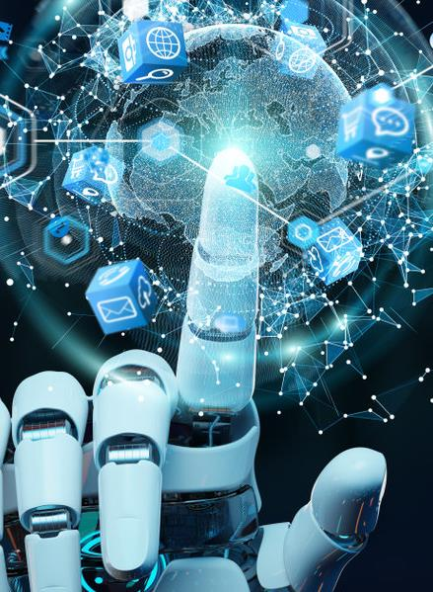
Future Trends, Challenges, and the Role of Communication
Preparing for the Future
Strategic planning and investment in cybersecurity capabilities to prepare for future challenges.
The role of leadership in fostering a forward-looking cybersecurity culture.
Importance of global cooperation and information sharing in strengthening cybersecurity resilience.
Notes:
Preparing for the future of cybersecurity in the energy sector requires a multifaceted approach that includes strategic planning, leadership commitment, and global cooperation. By embracing a culture of continuous learning and staying engaged with international cybersecurity efforts, organizations can develop resilient defences capable of withstanding the cybersecurity challenges of tomorrow

Slide 64
Evaluation method
Outline the evaluation elements and assessment process
Evaluation Element | How | Notes
Day 1: Group Presentation | Case study
Day 2: Multiple Choice Quizzes | Online Quizzes

Slide 65
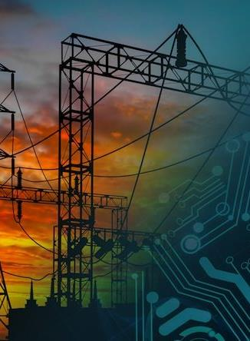
Resources: Books and Reference Materials
"European Cybersecurity Skills Framework": European Union Agency for Cybersecurity (ENISA) Publication
Ayodeji, A., Mohamed, M., Li, L., Di Buono, A., Pierce, I., & Ahmed, H. (2023). Cyber security in the nuclear industry: A closer look at digital control systems, networks and human factors. Progress in Nuclear Energy, 161, 104738.
Wiederhold, B. (2014). The Role of Psychology in Enhancing Cybersecurity. Cyberpsychology, Behavior, and Social Networking, 17(3), 131-132. Link
Franke, U., & Brynielsson, J. (2014). Cyber situational awareness–a systematic review of the literature. Computers & security, 46, 18-31.
Rekeraho, A., Cotfas, D. T., Cotfas, P. A., Bălan, T. C., Tuyishime, E., & Acheampong, R. (2024). Cybersecurity challenges in IoT-based smart renewable energy. International Journal of Information Security, 23(1), 101-117.
Ayodeji, A., Mohamed, M., Li, L., Di Buono, A., Pierce, I., & Ahmed, H. (2023). Cyber security in the nuclear industry: A closer look at digital control systems, networks and human factors. Progress in Nuclear Energy, 161, 104738.
Ani, U. D., He, H., & Tiwari, A. (2019). Human factor security: evaluating the cybersecurity capacity of the industrial workforce. Journal of Systems and Information Technology, 21(1), 2-35.
Thackray, H., McAlaney, J., Dogan, H., Taylor, J., & Richardson, C. (2016). Social Psychology: An Under-used Tool in Cybersecurity. Link
Knox, B. J., Lugo, R. G., & Sütterlin, S. (2019). Cognisance as a human factor in military cyber defence education. IFAC-PapersOnLine, 52(19), 163-168.
Endsley, M. R., & Jones, D. G. (2024). Situation Awareness Oriented Design: Review and Future Directions. International Journal of Human–Computer Interaction, 1-18.

Slide 66
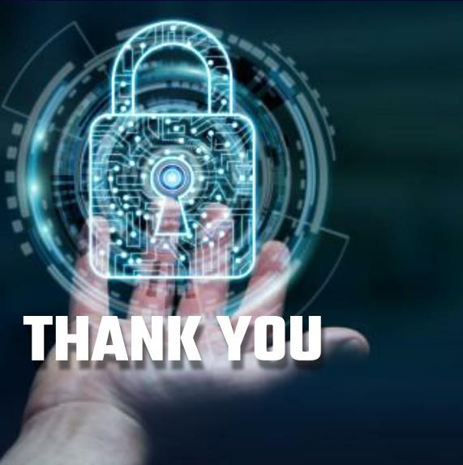
Thank you
Office hours:
M-Th 3:00pm-4:30pm room C402
Please send all questions to:
gehad@example.com

