Slide 1



Human Factors and Maritime Cybersecurity
CSP002_SS_M
Presentation by:
Dr. Ricardo G. Lugo, TalTech
Dr. Kitty Kioskli, trustilio
Prof. Paresh Rathod

Slide 2


Slide 3
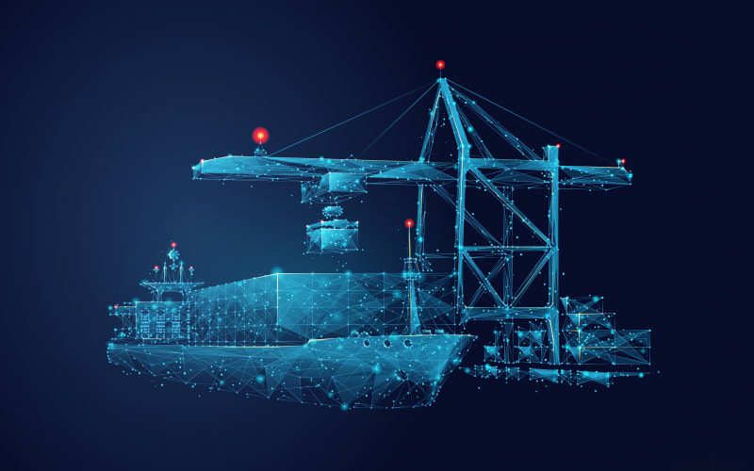

CSP002_S_M: Human Factors of Maritime Cybersecurity
o1.
Goals: Who-What-Why you need to take this training
o2.
Training logistics: When-Where-How
o3.
Learning outcomes
o4.
Training outlines
o5.
Exercises details
o6.
Practical information and requirements
o7.
Registration information and contacts

Slide 4



Goals: Who-What-Why you need to take this training
WHO
WHAT
WHY
Open to all
Foundation understanding of Human Factors for cybersecurity in maritime sector
Equipping participants with the knowledge and skills necessary to understand how human aspects influence in maritime cybersecurity

Slide 5

Background Knowledge and Prerequisites
Background knowledge:
Basic understanding of computers and networking
Familiarity with common internet security threats and vulnerabilities
Awareness of cybersecurity
Prerequisites:
None

Slide 6

Technical Tools and Other Requirement
Technical Tools
Computer with Internet Access
Web Browser
Other Requirements
Awareness of Internet Security Practices / Willingness to Learn and Experiment / Active Participation

Slide 7

Value Propositions
Benefits to Participants
Level of Training Module: Basic / Advance
Cybersecurity Professional Training
Hands-on and Practical Skills Development
Rooted with European Cybersecurity Skills Framework
Cutting-edge insights from industry-academic experts
Helps with skills development and career advancement
CSP Training Module Name: Human Factors in Cybersecurity for Maritime

Slide 8
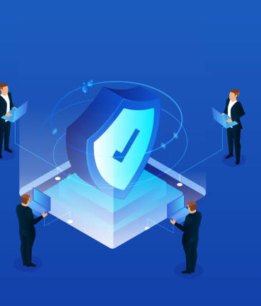
WHO
Profile of Training Participants
Managers and Leaders
Working-life professionals
SMEs and Public Sector Employees
Cybersecurity practitioners and enthusiasts
Students
CSP Training Module Name: Human Factors in Cybersecurity for Maritime

Slide 9

WHO
Profile of Trainer
Dr. Ricardo Lugo, Senior Researcher, Estonian Maritime Academy, TalTech
Dr. Kitty Kioskli, CEO & Cofounder of trustilio BV
Prof. Paresh Rathod, Laurea University of Applied Sciences
CSP Training Module Name: Human Factors in Cybersecurity for Maritime

Slide 10

WHAT
Training Topics
Day 1
Introduction to Human Aspects of Maritime Cybersecurity
Psychological and Social Factors in Maritime Cybersecurity
Human Vulnerabilities in Maritime Cybersecurity
Insider threats
Adverserial Behaviour in Maritime
CSP Training Module Name: Human Factors in Cybersecurity for Maritime

Slide 11
WHAT
Training Topics
Day 2
Organisational Culture, Communication, and Cybersecurity
Communication and Collaboration Across Domains
Decision Making at Strategic, Operational, and Tactical Levels
Training, Awareness, and Communication Programs for Maritime Personnel
Future Trends, Challenges, and the Role of Communication
CSP Training Module Name: Human Factors in Cybersecurity for Maritime

Slide 12

WHY
Learning Outcomes
Knowldge
Gain an understanding of the psychological, social, and organizational elements that shape cybersecurity actions within the maritime domain.
Understand the critical role of communication and teamwork in bolstering maritime cybersecurity across different sectors.
How decision-making frameworks are used at strategic, operational, and tactical levels within maritime cybersecurity.
Recognize the profiles and strategies of adversaries targeting maritime operations.
Evaluate human-related threats and vulnerabilities in maritime contexts.
CSP Training Module Name: Human Factors in Cybersecurity for Maritime

Slide 13
WHY
Learning Outcomes
Skills:
Use effective communication plans tailored to maritime cybersecurity needs.
Detect and counteract human-centric threats and vulnerabilities in maritime operations.
Engage with interdisciplinary teams to tackle the human dimensions of cybersecurity in maritime settings.
Examine real-world maritime cybersecurity breaches to pinpoint human errors and lapses in communication.
Classify adversaries targeting maritime interests and scrutinize their tactics.
Design and evaluate cybersecurity trainings tailored for maritime domains.
CSP Training Module Name: Human Factors in Cybersecurity for Maritime

Slide 14
WHY
Learning Outcomes
Competencies:
Understand the discussions pertinent to maritime cybersecurity at various levels of decision-making.
Cultivate an environment of transparent communication and teamwork focused on maritime cybersecurity.
Reflect on cybersecurity decision-making with the understanding of how human factors are related in the maritime arena.
Identify human-centric threats and vulnerabilities in maritime operations.
CSP Training Module Name: Human Factors in Cybersecurity for Maritime

Slide 15



Day 1
WHEN
WHERE
HOW
Time schedule: Spring 2024
ONLINE—Digital Link
Face to Face

Slide 16

Importance of Human Factors:
Overview of Maritime Cybersecurity
Importance of cybersecurity in maritime operations.
Unique cybersecurity challenges in the maritime sector.
Role of human factors in maritime cybersecurity.
Examples that will be used:
  Maersk Notpetya incident; Port of San Diego (2018)
CSP Training Module Name: Human Factors in Cybersecurity for Maritime
Notes:
In today's interconnected world, cybersecurity has become a cornerstone of maritime operations. The sector faces unique challenges, including the reliance on digital technologies and the specific threats targeting maritime assets. Understanding these challenges is crucial, as human factors often play a pivotal role in both the creation and mitigation of cyber risks. By exploring these aspects, we set the stage for a comprehensive approach to enhancing maritime cybersecurity.

Slide 17
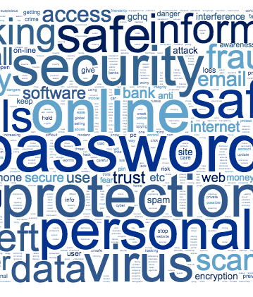
Importance of Human Factors:
Human Factors in Cybersecurity
Definition and significance of human factors in cybersecurity.
Common human errors contributing to cybersecurity breaches.
Strategies to mitigate human-related risks.
CSP Training Module Name: Human Factors in Cybersecurity for Maritime
Notes:
Human factors in cybersecurity refer to the range of human behaviours, decisions, and interactions that can impact the security of information systems. These include both inadvertent actions, such as misplacing a security badge or choosing a weak password, and deliberate actions, like insider threats. Examples of common human errors include using the same password across multiple systems, clicking on phishing email links, or failing to update software with security patches. To mitigate these risks, strategies such as comprehensive awareness training, regular security audits, the implementation of two-factor authentication, and the use of password managers can be highly effective. By addressing these human elements through targeted strategies, understanding their implications, and implementing robust security policies, we can significantly enhance our defenses against cyber threats, creating a more resilient cybersecurity environment within maritime operations.

Slide 18

Importance of Human Factors:
Psychological Implications
Psychological aspects influencing cybersecurity behaviours.
The effect of cognitive biases on security decisions.
Implementing psychological principles to enhance cybersecurity measures.
CSP Training Module Name: Human Factors in Cybersecurity for Maritime
Notes:
In the maritime domain, understanding the psychological aspects that influence cybersecurity behaviours is crucial. For instance, the 'illusion of control' can lead mariners to overestimate their ability to manage cybersecurity threats, while 'optimism bias' might result in underestimating the likelihood of becoming a target of cyber-attacks. Another common cognitive bias, 'confirmation bias', can cause individuals to Favour information that confirms their preconceptions, potentially ignoring critical security alerts that don't align with their beliefs.
Examples of these biases in the maritime sector include a captain dismissing the significance of a security update due to never having experienced a cyber-attack ('optimism bias'), or a crew member bypassing a new security protocol because it contradicts their established routine ('confirmation bias'). To counteract these biases, maritime organizations can implement psychological principles such as 'nudging', where small, subtle prompts encourage users to choose more secure options by default, like automatically updating software or generating complex passwords.
By leveraging insights from psychology to design user interfaces and security protocols that consider human tendencies and biases, maritime cybersecurity can be significantly enhanced. For example, simulating phishing attempts in a controlled environment can 'inoculate' crew members against real attacks, reducing the likelihood of successful deception. Through a better understanding of psychological aspects, maritime organizations can develop more effective training programs and security measures that align with human behaviour, making security practices both more intuitive and robust.

Slide 19

Importance of Human Factors:
Social Influence
Impact of social dynamics on cybersecurity practices.
Role of organizational culture in shaping cybersecurity behaviors.
Importance of social engineering awareness.
CSP Training Module Name: Human Factors in Cybersecurity for Maritime
Notes:
Social dynamics within the maritime domain can significantly influence cybersecurity practices. For example, the presence of a strong safety culture on a vessel can encourage crew members to prioritize cybersecurity as part of overall safety measures. Peer influence is another potent factor; when leading crew members demonstrate a commitment to cybersecurity practices, it sets a norm that others are likely to follow. Organizational culture, defined as the shared values, beliefs, and norms within a maritime organization, can greatly facilitate or hinder cybersecurity behaviours. A culture that values transparency and open communication can facilitate the sharing of information about potential cyber threats and encourage reporting of security incidents. Conversely, a culture characterized by a lack of emphasis on cybersecurity training and awareness can lead to complacency and decreased vigilance among crew members. Examples of how organizational culture impacts cybersecurity in the maritime domain include the implementation of regular cybersecurity drills, which can foster a proactive security stance, and the integration of cybersecurity into routine safety meetings, which emphasizes its importance. On the other hand, a culture that stigmatizes the reporting of security mistakes can lead to underreporting of incidents, significantly decreasing the organization's ability to respond to and mitigate cyber threats effectively.

Slide 20
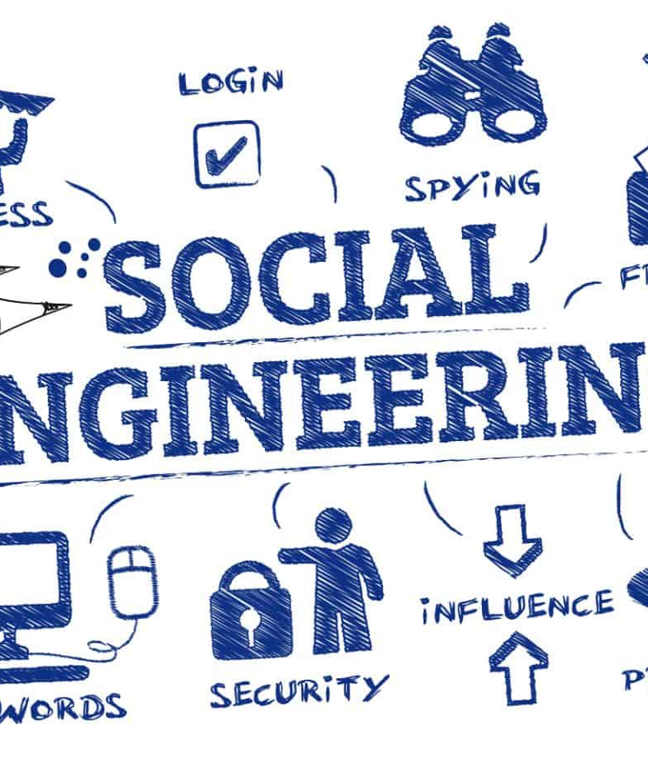
Importance of Human Factors:
Social Engineering
Importance of social engineering awareness.
Social Engineering
  Reciprocity; Commitment and Consistency, Social Proof; Authority; Liking; Scarcity
CSP Training Module Name: Human Factors in Cybersecurity for Maritime
Notes:
Social engineering in the context of cybersecurity refers to the manipulation of individuals into divulging confidential or personal information that may be used for fraudulent purposes. It's a tactic that relies heavily on human interaction and often involves tricking people into breaking standard security procedures. Social engineering attacks are particularly insidious because they exploit human nature rather than technological vulnerabilities.
One of the foundational frameworks for understanding how social engineering works is Robert Cialdini's six principles of influence, which are often leveraged in these attacks:
Reciprocity: People tend to return a favour. In a social engineering context, an attacker might offer 'helpful' information or a gift to the target with the expectation that the target will feel obliged to offer something valuable in return, such as access to a restricted system.
Commitment and Consistency: Once people commit to an action or stance, they're more likely to follow through with it. Attackers might first get a small, seemingly innocent commitment from their target, which leads to larger commitments that compromise security.
Social Proof: People tend to do things they see others doing. In social engineering, this might involve an attacker pretending to be part of a group that the target trusts, inducing the target to act in a way consistent with the group's perceived actions or norms.
Authority: People tend to obey authority figures. Attackers may pose as senior executives or IT personnel to extract sensitive information or gain access to restricted areas.
Liking: People are more easily influenced by those they like. Attackers might build a relationship or rapport with their target before attempting to exploit that relationship for malicious purposes.
Scarcity: Perceived scarcity will generate demand. For example, an attacker might create a false sense of urgency by claiming that immediate action is needed to prevent a dire consequence.
In the maritime domain, social engineering attacks could take various forms:
Email Phishing: Attackers might send emails pretending to be from a known shipping regulator or a partner company, asking the crew to click on a link that leads to a malicious website or to provide login credentials under the guise of a 'security check'.
Impersonation: Attackers could pose as port authorities or maritime security personnel and contact the ship's crew via radio or email, instructing them to lower their security measures for an 'inspection' or 'security check', exploiting the authority principle.
Urgent Updates: Under the guise of scarcity and authority, attackers might send fake alerts about immediate software updates needed for navigational systems, pushing the crew to install malicious software that compromises the ship's operations.
Understanding these principles and the nature of social engineering is crucial for maritime organizations to develop effective training and awareness programs, helping crew members recognize and resist such attacks, thereby protecting sensitive information and critical systems.

Slide 21
Importance of Human Factors:
Social Engineering
Ransomware
Scarcity and reciprocity
CSP Training Module Name: Human Factors in Cybersecurity for Maritime
Notes:
Ransomware attacks, a form of malicious software designed to block access to a computer system or files until a sum of money is paid, often leverage psychological tactics to increase their effectiveness. Two such tactics are the principles of scarcity and reciprocity, which are deeply rooted in human psychology and frequently exploited in social engineering contexts.
Scarcity Principle in Ransomware
Urgency and Time Limits: Ransomware attacks often include a countdown timer or a strict deadline by which the ransom must be paid. This creates a sense of scarcity regarding the time available to resolve the situation without losing access to critical data permanently. The scarcity principle suggests that people value resources more when they are less available, making the data or system access seem more valuable and increasing the likelihood of compliance with the ransom demand.
Limited Offers for Decryption Keys: Attackers might claim that the decryption key is only available for a limited period or that its price will increase after a certain deadline. This artificial scarcity pressures victims into acting quickly out of fear of losing their last chance to recover their files.
Reciprocity Principle in Ransomware
Fake Promises of Data Return: In leveraging reciprocity, attackers often promise to return access to the encrypted data upon payment of the ransom. The idea is that if the victim 'complies' with the attacker's 'request' for payment, the attacker will reciprocate by restoring access to the data. This exploitation of the reciprocity principle relies on the victim's hope and belief in a fair exchange, even though there is no guarantee that the attacker will honour the agreement.
'Free' Decryption of a Few Files: Some ransomware operators offer to decrypt a small number of files for free as a 'goodwill gesture' or 'proof' that they can indeed decrypt the data. This action exploits the reciprocity principle by providing something of value upfront with the expectation that the victim will feel compelled to reciprocate by paying the ransom to recover the remainder of their files.
In both cases, the attackers rely on the inherent human response to these psychological triggers. The principle of scarcity creates a heightened sense of value and urgency around the data or access being held ransom, while the principle of reciprocity plays on human tendencies for fair exchange and reciprocation, even in the context of an adversarial interaction. Understanding these underlying psychological tactics can help individuals and organizations better prepare for and respond to ransomware attacks, emphasizing the importance of scepticism, critical evaluation of the situation, and adherence to established protocols for incident response instead of reacting impulsively to the attackers' manipulations.

Slide 22

Psychological and Social Factors in Maritime Cybersecurity
Understanding Human Psychology
Cognitive biases and their impact on cybersecurity.
Psychological theories relevant to cybersecurity behaviour.
Designing cybersecurity systems with human psychology in mind.
  Situational Awareness (Endsley, 1998)
An interface redesign that reduced user errors based on psychological research.
Notes:
Incorporating psychological principles into maritime cybersecurity can significantly enhance the effectiveness of our defences. Understanding cognitive biases is crucial; for instance, 'optimism bias' might lead a crew member to underestimate the risk of cyber threats, while 'confirmation bias' could result in dismissing critical security alerts that don't align with their preconceived notions of safety. These biases can manifest in risky behaviours, such as neglecting to update security protocols or underestimating the sophistication of phishing attempts that mimic legitimate communications from maritime authorities.
To counteract these challenges, applying psychological theories like 'self-efficacy' and 'metacognition' is vital. Self-efficacy, defined as one's belief in their ability to succeed, directly influences how crew members engage with cybersecurity practices. High self-efficacy can motivate proactive security behaviours, such as regularly updating passwords and adhering to security protocols. Conversely, low self-efficacy might lead to avoidance or hesitancy in taking necessary security actions. Metacognition, the awareness of one's own thought processes, encourages crew members to critically evaluate their decisions and actions, particularly in response to cyber threats, helping to identify and correct potential biases.
In designing cybersecurity systems for the maritime domain, incorporating these psychological insights is key. For example, systems can be designed to enhance situational awareness, a concept detailed by Mica Endsley, which involves understanding the current environment, projecting future states, and comprehending the implications of those states for the system's goals. By providing clear, concise, and timely information about potential cyber threats and system status, we can foster a high level of situational awareness among the crew, enabling them to make informed decisions swiftly.
Ergonomic design also plays a crucial role. Systems should be intuitive and align with natural human tendencies to minimize errors. For instance, implementing user-friendly interfaces that guide users through secure processes effortlessly, or designing warning systems that effectively capture attention without leading to habituation, ensures that crew members remain vigilant and engaged with cybersecurity practices. By integrating the principles of self-efficacy, metacognition, and situational awareness into the ergonomic design of cybersecurity systems, maritime operations can not only mitigate the risk of cyber threats but also empower crew members to be active participants in the cybersecurity posture of their vessels.

Slide 23

Psychological and Social Factors in Maritime Cybersecurity
Social Dynamics and Cybersecurity
Influence of social norms and peer behavior on individual cybersecurity practices.
The role of leadership in fostering a security-conscious culture.
  Role Modelling (Bandura, 1988)
Social factors in cybersecurity training and awareness programs.
Notes:
In the maritime sector, leadership styles play a pivotal role in shaping cybersecurity behaviours. An authoritative leadership style, characterized by strict rules and top-down communication, might ensure quick compliance with cybersecurity protocols but can also stifle open dialogue and innovative thinking regarding cybersecurity challenges. Conversely, a transformational leadership style, which inspires and motivates crew members through a shared vision, can encourage proactive cybersecurity behaviours and foster a culture of continuous learning and improvement. However, without clear guidelines and accountability, this style might lead to inconsistencies in cybersecurity practices.
Bandura's concept of role modelling is particularly relevant here. Leaders in the maritime domain serve as role models for their crew. Their attitudes and behaviours towards cybersecurity set a benchmark for others. A leader who prioritizes cybersecurity, actively engages with the latest security practices, and demonstrates a clear understanding of cyber threats will likely inspire similar values and behaviours in their crew. This modelling effect can significantly enhance the overall cybersecurity posture of a vessel or maritime organization.
Leadership also has a profound impact on training and awareness programs. A leader who recognizes the importance of continuous education in cybersecurity can champion the development and implementation of comprehensive training programs, ensuring that they are regularly updated to reflect the latest threats and best practices. Such a leader might also advocate for simulation-based training and real-world exercises that enhance situational awareness and practical skills among the crew. On the other hand, a leader who views cybersecurity training as a check-box activity rather than an integral part of maritime operations might allocate insufficient resources to these programs or fail to enforce participation, thereby undermining the crew's ability to respond effectively to cyber incidents.
In summary, leadership within the maritime domain must strike a balance, fostering a culture that encourages adherence to cybersecurity protocols while also promoting openness, innovation, and continuous improvement. By embodying the principles of effective cybersecurity practices and role modelling positive behaviours, leaders can significantly influence the cybersecurity culture and resilience of maritime operations.

Slide 24

Psychological and Social Factors in Maritime Cybersecurity
Enhancing Security Through Psychology
Psychological strategies to increase security protocol adherence.
Behavioural change techniques applied to cybersecurity.
The role of motivation and rewards in enhancing cybersecurity behaviours.
Real-world example: A rewards program that successfully increased cybersecurity vigilance among crew members.
Future BCT using AI
Notes:
Enhancing security through psychology in the maritime domain involves understanding and addressing the human elements that influence cybersecurity. By applying psychological principles, maritime organizations can tailor their cybersecurity strategies to consider the behaviors, motivations, and attitudes of their personnel.
For example, incorporating regular psychological assessments can help identify potential insider threats before they materialize. Training programs that include elements of behavioral psychology can improve adherence to security protocols by emphasizing the personal and collective benefits of robust cybersecurity practices.
Enhancing security in the maritime sector through psychology involves the strategic application of behaviour change techniques (BCTs), which are systematic processes designed to influence and modify human behavior. In the context of maritime cybersecurity, BCTs can include methods such as motivational interviewing, goal-setting, feedback, and rewards to encourage compliance and proactive security behaviours among crew members and port staff.
Motivation and Rewards: By understanding what motivates individuals, maritime organizations can tailor their cybersecurity programs to incentivize desired behaviours. For example, rewards can be used to reinforce compliance with IT security policies. Employees might receive recognition or even tangible benefits for consistently following best practices, like regularly updating passwords or completing cybersecurity training modules.
Real-World Application: A practical implementation of this approach could be seen in a shipping company introducing a 'Cybersecurity Champion' program. In this program, individuals who exemplify excellent cybersecurity habits are recognized monthly. This not only motivates others to adhere to security protocols but also fosters a competitive yet collaborative environment where cybersecurity becomes a shared responsibility.
To implement BCTs effectively, maritime companies can: Educate: Provide comprehensive training that explains the reasons behind cybersecurity measures, enhancing employees' understanding and acceptance. Empower: Encourage employees to take ownership of their cybersecurity practices through participatory workshops where they can suggest improvements to current protocols. Enable: Offer the tools and resources necessary to perform secure behaviors, such as easy-to-use software for reporting suspicious activities.Engage: Develop a platform where employees can share experiences and strategies for overcoming cybersecurity challenges.
Mersinas and Chana (2022) discusses the significance of individual behaviour change in reducing the cyber-attack surface in the maritime sector. It points out that human error plays a dual role in cybersecurity: it can facilitate attacks, such as ransomware via phishing, yet proper security behaviour can act as a strong defence line. They propose the development of an AI-based tool tailored to the maritime environment to encourage individual cybersecurity behaviour changes. This tool would analyse and incorporate maritime security policies, guidelines, and standards, and would be personalized to individuals' roles, knowledge gaps, and behaviours. The end goal is to form secure habits among personnel, thus reducing the cyber-attack surface in the maritime industry.
Mersinas, K., & Chana, C. D. (2022). Reducing the Cyber-Attack Surface in the Maritime Sector via Individual Behaviour Change. In The Seventh International Conference on Cyber-Technologies and Cyber-Systems.

Slide 25
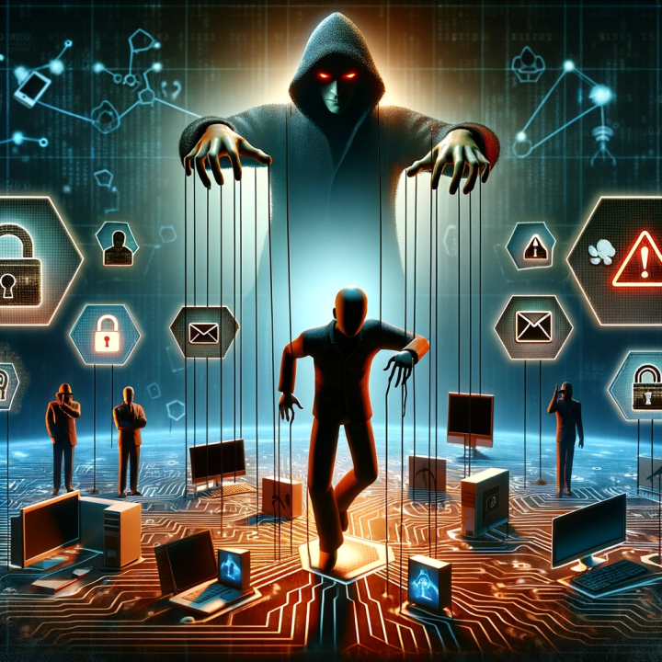
Psychological and Social Factors in Maritime Cybersecurity
Addressing Social Engineering Threats
Understanding social engineering tactics from a psychological perspective.
Training personnel to recognize and respond to social engineering attacks.
Building a culture of scepticism, vigilance and verification.
Real-world example: A company's response to a spear-phishing campaign targeting maritime executives.
Notes:
Social engineering attacks, which manipulate individuals into compromising security unwittingly, are becoming increasingly sophisticated in the maritime domain. Initially, these attacks often took the form of simple phishing emails, where attackers masqueraded as reputable entities to lure crew members into revealing sensitive information. However, as awareness and training around these tactics have improved, attackers have evolved their strategies to include more advanced techniques such as spear-phishing, where attacks are highly personalized to the target, and 'deep fakes,' which use AI-generated audio and video to impersonate trusted individuals convincingly.
The continuous evolution of social engineering attacks necessitates adaptive and continuously updated training programs in maritime cybersecurity. Traditional training modules may not suffice in the face of novel threats like AI-driven social engineering, where attackers leverage machine learning to analyse and mimic communication patterns, making fraudulent requests appear more legitimate than ever before. As these threats become more sophisticated, training programs must evolve to include awareness of these emerging technologies and their potential misuse in social engineering campaigns.
Developing scepticism, vigilance, and verification skills is paramount in combating these advanced threats. Crew members should be trained to approach every request for sensitive information or action with a healthy dose of scepticism, regardless of the apparent source. Vigilance can be enhanced through regular training exercises that simulate real-world scenarios, including the latest social engineering tactics. Verification processes should be ingrained in the organizational culture, such as double-checking requests through alternate communication channels or implementing multi-factor authentication to verify the identity of individuals requesting access or information.
Incorporating these principles into maritime cybersecurity training involves not just imparting knowledge but also fostering a mindset that values questioning and verification. Interactive workshops, gamified learning experiences, and regular drills can help develop these critical skills, ensuring that crew members are not only aware of the risks but also equipped to respond proactively. By embracing a culture of continuous learning and adaptation, maritime organizations can stay one step ahead of social engineering threats, safeguarding their operations in an ever-evolving cybersecurity landscape.

Slide 26
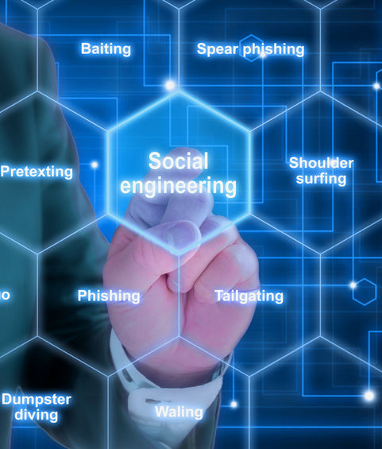
Human Vulnerabilities in Maritime Cybersecurity
Identifying Human Vulnerabilities
Common human vulnerabilities in maritime cybersecurity contexts.
The role of user behavior analytics in identifying risky behaviors.
Strategies for mitigating human vulnerabilities.
Real-world example: Incident involving an exploited vulnerability due to poor password practices.
CSP Training Module Name: Human Factors in Cybersecurity for Maritime
Notes:
In the maritime domain, human vulnerabilities often stem from routine operations that can inadvertently compromise cybersecurity. Common vulnerabilities include the mishandling of credentials, where crew members may reuse passwords across different systems or share them insecurely, and the improper management of email communications, where phishing attempts can easily be mistaken for legitimate correspondence from maritime authorities or business partners. Furthermore, the use of personal devices connected to shipboard systems without proper security measures can open avenues for cyber threats.
Behaviour analytics emerges as a powerful tool in this context, allowing us to monitor and analyse crew behaviours to identify patterns that might indicate a security risk. For example, an unexpected access to the ship's navigation systems late at night or multiple failed login attempts can be flagged for further investigation. This data-driven approach enables proactive identification and mitigation of risks before they escalate into security incidents.
Mitigation strategies extend beyond training to include technical and procedural safeguards tailored to the maritime environment. Implementing role-based access controls ensures that crew members have access only to the systems and information necessary for their duties, thereby reducing the risk of accidental or malicious misuse. Regularly updating and patching software on board can protect against known vulnerabilities, a critical step given the increasing reliance on digital navigation and communication systems in modern shipping.
Additionally, establishing a clear incident response protocol is essential. This protocol should include procedures for isolating affected systems to prevent the spread of a cyber threat, steps for reporting incidents to ensure timely action, and mechanisms for post-incident analysis to prevent future occurrences. By fostering a culture of scepticism, vigilance, and verification, maritime organizations can encourage crew members to question anomalies and report potential threats, further strengthening the ship's cybersecurity posture.
In summary, addressing human vulnerabilities in the maritime sector requires a comprehensive approach that combines behaviour analytics, technical solutions, and a strong organizational culture focused on cybersecurity. By staying vigilant and adapting to evolving threats, the maritime industry can safeguard its critical operations against the ever-present risk of cyber-attacks.

Slide 27
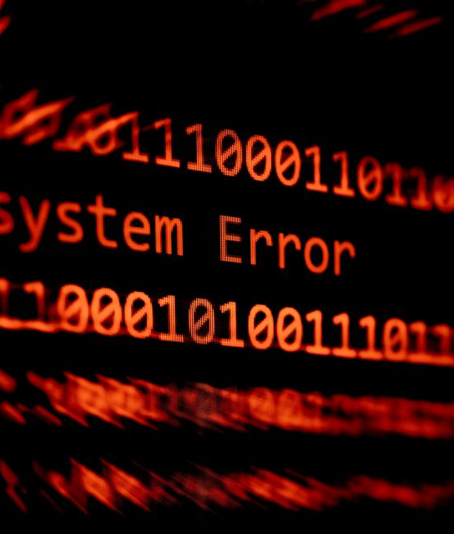
Human Vulnerabilities in Maritime Cybersecurity
Impact of Human Error
Types of human errors and their consequences for cybersecurity.
Methods for reducing errors, such as simplification of systems and processes.
Importance of error reporting and management systems.
CSP Training Module Name: Human Factors in Cybersecurity for Maritime
Notes:
In the maritime domain, Human error remains a significant threat to maritime cybersecurity, often serving as the catalyst for cyber incidents. A notable example occurred with the shipping company Maersk, which fell victim to the NotPetya malware attack in 2017. The malware infiltrated through an update of a Ukrainian tax software, spreading rapidly due to insufficient cybersecurity measures and awareness. This incident, though not solely due to individual human error, underscores the potential cascading effects when systemic vulnerabilities meet human oversight, leading to operational disruptions and substantial financial losses.
To mitigate such risks, simplification of systems and processes plays a pivotal role. In the high-pressure environment of maritime operations, complex systems can exacerbate the workload and stress on crew members, increasing the likelihood of errors. Simplifying these systems, through user-friendly interfaces and intuitive procedures, can significantly reduce the cognitive burden on crew members. For example, automating routine cybersecurity checks and streamlining the process for updating software can minimize the chances of human error, ensuring that essential tasks are completed accurately and efficiently.
Moreover, policies that foster a culture of open reporting without fear of reprisal are crucial. When crew members feel safe to report mistakes and near-misses, organizations can learn from these incidents and adapt their protocols to prevent future occurrences. Such policies not only encourage vigilance among crew members but also contribute to a collective understanding of cybersecurity as a shared responsibility.
In summary, by simplifying systems and processes, maritime organizations can alleviate the workload and stress on crew members, reducing the likelihood of errors that could compromise cybersecurity. Coupled with policies that encourage open reporting, these strategies can create an environment where cybersecurity is a collaborative and integral part of maritime operations, enhancing the overall resilience of the maritime industry against cyber threats.

Slide 28
Human Vulnerabilities in Maritime Cybersecurity
Training to Reduce Human Error
Role of targeted training programs in addressing specific human vulnerabilities.
  Simulation
  Gamification
  Scenario based learning
  Continuous learning
The importance of simulation and drills in reinforcing correct behaviors.
Continuous improvement of training programs based on incident feedback.
CSP Training Module Name: Human Factors in Cybersecurity for Maritime
Notes:
Effective training programs tailored to the maritime domain are crucial for enhancing cybersecurity awareness and preparedness among crew members. Examples include:
Simulation-Based Training: Programs that use realistic simulations of cyber-attacks on shipboard systems can provide crew members with hands-on experience in identifying and responding to threats. For example, a training module might simulate a phishing attack through the ship's email system, teaching crew members to recognize suspicious emails and understand the proper response protocols.
Gamified Learning Platforms: Incorporating game elements into cybersecurity training can increase engagement and retention of information. A maritime-specific program might involve a game where crew members earn points or badges for successfully completing cybersecurity challenges, such as detecting and reporting a simulated malware intrusion.
Scenario-Based Workshops: Workshops that present real-world cybersecurity scenarios specific to maritime operations can help crew members understand the context and implications of cyber threats. These workshops can cover topics like securing ship-to-shore communications and protecting navigation systems from tampering.
Continuous Learning Programs: Given the rapidly evolving nature of cyber threats, continuous learning programs that provide regular updates and training on new threats and security measures are vital. These might include monthly webinars on the latest cyber threats to the maritime industry and best practices for mitigating them.
These training programs, coupled with the simplification of systems and processes, can significantly reduce the likelihood of human error leading to cybersecurity incidents. By fostering a culture of vigilance and continuous improvement, maritime organizations can better protect their operations against the growing threat of cyber-attacks.

Slide 29

Human Vulnerabilities in Maritime Cybersecurity
Enhancing Situational Awareness
Importance of situational awareness in preventing human errors.
  Endsly
    Perception
    Comprehenssion
    Projection
Tools and technologies to support situational awareness in cybersecurity.
  Adpeted viualisations
Integrating situational awareness into daily operations and decision-making.
CSP Training Module Name: Human Factors in Cybersecurity for Maritime
Notes:
Enhancing situational awareness is pivotal in maritime cybersecurity, especially when considering human factors. Mica Endsley's model of situational awareness offers a structured approach to understanding and improving this critical competency within the maritime domain. Endsley defines situational awareness in three levels: perception of elements in the environment, comprehension of their meaning, and projection of their future status.
Endsley's Model Applied to Maritime Cybersecurity:
Perception: The first level involves the perception of critical information. In a maritime context, this could involve crew members recognizing unusual network activity or unauthorized access attempts to shipboard systems. Technologies like intrusion detection systems (IDS) can aid in this perceptual phase by alerting the crew to potential cybersecurity threats.
Comprehension: The second level is about understanding what the perceived information means. For the maritime crew, this might involve diagnosing an alert from the IDS as a potential malware attack targeting the ship's navigation systems. Comprehension is enhanced by cybersecurity training that equips crew members with the knowledge to interpret and assess cyber threats accurately.
Projection: The third level involves anticipating future events based on the current situation. In the maritime domain, this could mean a crew member predicting that a malware attack, if not mitigated, could lead to the malfunctioning of navigational systems, posing a risk to the ship's safety. This level of situational awareness enables proactive measures to be taken, such as isolating affected systems or implementing contingency plans for navigation.
Adapted maritime visualization systems play a crucial role in supporting situational awareness by providing crew members with clear, intuitive, and actionable information. These systems are designed to cater to the unique operational environment of maritime settings, translating complex data into easily interpretable visuals that enhance decision-making processes supporting situational awareness through visualization:
Enhanced Perception: Visualization systems help in the perceptual phase of situational awareness by presenting data, such as real-time network traffic or system integrity checks, in formats that are easily recognized. For instance, a dashboard that uses color-coded alerts to indicate the status of shipboard systems can quickly draw attention to potential issues, allowing crew members to perceive threats more effectively.
Aiding Comprehension: These systems contribute to the comprehension phase by integrating data from multiple sources into a coherent visual representation. For example, a geographic information system (GIS) that overlays cyber threat data onto navigational maps can help the crew understand the geographical context of cyber threats, such as areas with high incidents of GPS spoofing, making it easier to interpret the relevance and implications of cybersecurity alerts in relation to the ship's current location and planned route.
Facilitating Projection: Visualization systems support the projection phase by enabling scenario modelling and trend analysis. Tools that can simulate the potential progression of a cyber-attack or visualize the cascading effects of a system compromise can help crew members anticipate future states. This predictive capability allows for more informed decision-making, enabling proactive measures to mitigate risks.
Maritime Domain Example:
In the maritime domain, an example of a visualization system that supports situational awareness is an integrated bridge system (IBS) that incorporates cybersecurity alerts into its operational displays. By integrating cybersecurity data with navigation and operational information, the IBS can provide a holistic view of both physical and cyber-related threats. This integrated approach ensures that the crew is not only aware of their physical surroundings but also cognizant of the cyber dimension of maritime operations. For instance, if the IBS displays an alert about a potential cyber intrusion affecting the ship's propulsion systems, the crew can quickly understand the implications for the ship's manoeuvrability and take appropriate action.
By leveraging adapted maritime visualization systems, maritime organizations can significantly enhance situational awareness, ensuring that crew members are equipped with the knowledge and tools needed to navigate the complex landscape of maritime cybersecurity. These systems transform raw data into actionable intelligence, enabling more effective monitoring, decision-making, and response to cyber threats in the maritime environment.

Slide 30

Understanding Insider Threats in Maritime Cybersecurity
Introduction to Insider Cybersecurity Threats in Maritime
Definition of Insider Threats: Actions by individuals from within the organization that negatively affect the confidentiality, integrity, or availability of the organization's information systems.
Unintentional vs. Malicious Threats: Differentiating between non-malicious actions that lead to vulnerabilities and deliberate attempts to harm the organization.
Importance of Vigilance: Emphasizing the need for continuous monitoring and robust security protocols to mitigate these risks.
Notes:
Insider threats in maritime cybersecurity refer to potential harmful actions that stem from individuals within the maritime organization. These individuals may have access to sensitive systems and data and can cause damage, whether inadvertently or with intent. The distinction between unintentional threats, such as a crew member mistakenly downloading a virus, and malicious threats, such as an employee intentionally leaking sensitive information, is critical. Given the interconnectedness and technological dependencies of modern maritime operations, the sector is particularly susceptible to such risks. Continuous vigilance, backed by comprehensive security protocols, is paramount to safeguard maritime cyber-assets from these internal threats.
The prevalence of insider threats in cybersecurity is a significant concern in general and in the maritime sector specifically. Although insider threats can stem from both unintentional and malicious acts, they pose a considerable risk due to the potential access to sensitive systems and information that insiders have. Surveys and research in various industries, including maritime, indicate that insider threats are only second to hackers in terms of the cybersecurity risks they pose, with a marked increase in the number of such security incidents over the years (Greitzer, Moore, Cappelli, Andrews, Carroll, & Hull, 2008).
The maritime sector, with its growing reliance on digital technologies and IoT devices, faces an increased risk of cyber threats, including those from insiders. Cybersecurity risks in the maritime industry are discussed in detail with respect to security, confidentiality, integrity, and availability, considering the digital transformation's proneness to insider threats (Ashraf, Park, Hur, Kim, Alroobaea, Zikria, & Nosheen, 2023). Furthermore, the maritime sector has witnessed a 900% increase in cybersecurity breaches on operational technology as it adapts to the digital era, necessitating closer investigation into the cybersecurity challenges it faces, including insider threats (Akpan, Bendiab, Shiaeles, Karamperidis, & Michaloliakos, 2022).
An effective approach to mitigating insider threats involves a comprehensive understanding of the human behavioural triggers that may indicate a potential risk. Predictive modelling frameworks that integrate cyber domain data sources with psychological and motivational factors underlying malicious insider activities are critical (Greitzer & Hohimer, 2011).
For more detailed insights into the prevalence and mitigation of insider threats in the maritime sector, further reading and review of the research papers referenced here are recommended.
Greitzer, F., Moore, A., Cappelli, D. M., Andrews, D., Carroll, L., & Hull, T. D. (2008). Combating the Insider Cyber Threat. IEEE Security & Privacy, 6(1), 61–64.
Ashraf, I., Park, Y., Hur, S., Kim, S. W., Alroobaea, R., Zikria, Y. B., & Nosheen, S. (2023). A Survey on Cyber Security Threats in IoT-Enabled Maritime Industry. IEEE Transactions on Intelligent Transportation Systems, 24(4), 2677–2690.
Akpan, F., Bendiab, G., Shiaeles, S., Karamperidis, S., & Michaloliakos, M. (2022). Cybersecurity Challenges in the Maritime Sector. Network, 2, 123–138.
Greitzer, F., & Hohimer, R. (2011). Modeling Human Behavior to Anticipate Insider Attacks. Journal of Strategic Security, 4(2), 25–48.
National Institute of Standards and Technology (NIST). (2013). Managing Information Security Risk: Organization, Mission, and Information System View. NIST Special Publication 800-39.

Slide 31
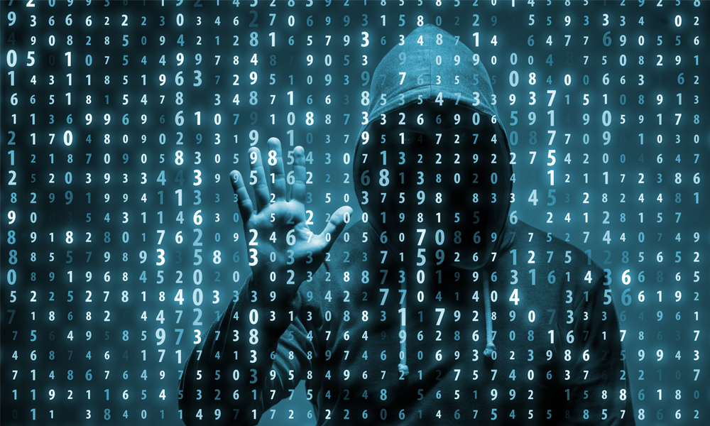
Mitigating Insider Cybersecurity Threats in Maritime
Risk Factors
Employees are not trained to fully understand and apply laws, mandates, or regulatory requirements related to their work and that affects the organization’s security.
Employees are unaware of the steps they should take at all times to ensure that the devices they use—both company issued and BYOD—are secured at all times.
Employees are sending highly confidential data to an unsecured location in the cloud, exposing the organization to risk.
Employees break your organization’s security policies to simplify tasks.
Employees expose your organization to risk if they do not keep devices and services patched and upgraded to the latest versions at all times
Notes:
In the maritime sector, employees may not be fully trained in understanding and applying laws, mandates, or regulatory requirements, compromising organizational security. There's often a lack of awareness about securing both company-issued and personal devices used for work. Risks are heightened when confidential data is inappropriately shared to unsecured cloud locations. Additionally, security policies might be bypassed by employees seeking to simplify their tasks, inadvertently increasing vulnerability. It's also vital for all devices and services to be regularly updated and patched, as failure to do so exposes the organization to cyber threats.

Slide 32
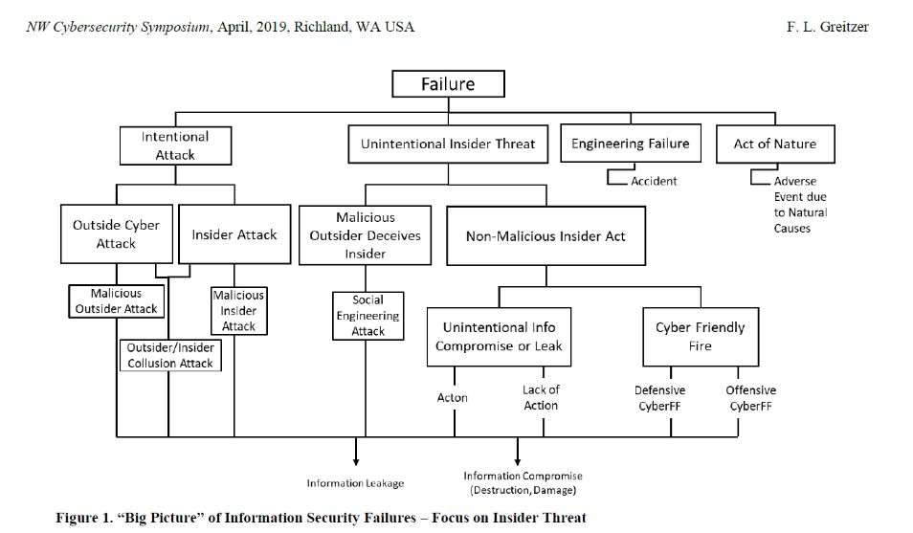
Notes:
Greitzer, F. L. (2019, April). Insider Threats: It's the HUMAN, Stupid!. In Proceedings of the Northwest Cybersecurity Symposium (pp. 1-8).
The article by Frank L. Greitzer titled "Insider Threats: It’s the HUMAN Stupid!" from the proceedings of NCS '19 discusses the complexity of insider threats, which include both intentional and unintentional acts that can compromise organizational security. The research highlights that insider threats are not only on par with external hacking threats in terms of frequency but often result in more costly damages. Current guidelines and policies often set only minimum standards for monitoring and mitigating such threats, which may not fully address the human factors that significantly contribute to these risks. Greitzer's work underscores the need to integrate behavioural indicators with technical indicators to develop more proactive and comprehensive approaches to insider threat assessment. The individual factors can be related to insider threat risks in cybersecurity are indeed nuanced. Personality traits, for example, can include an individual's propensity for risk-taking, response to stress, and how they handle conflict. These traits can potentially influence their likelihood of committing a security breach. For instance, a highly stressed employee might be more prone to overlook security protocols or make careless mistakes that could lead to a breach. Behaviors and attitudes in the workplace are also critical indicators. Changes in normal behaviour, such as suddenly working odd hours without explanation or displaying unusual interest in matters outside their scope of work, could signal risk. Attitudes that show disregard for company policies or an overtly negative sentiment towards the organization could also foreshadow potential insider threats. Personal issues, such as financial problems or grievances against the company, might push an individual to act out against the organization. Employees struggling with such issues might be more susceptible to committing fraud or theft of intellectual property. Lastly, sociocultural or ideological factors could motivate someone to act in a way that aligns with their beliefs, which might conflict with the interests of their employer. For example, an employee might leak sensitive information due to a belief that the public has a right to know, reflecting a hacktivist ideology.
Understanding these factors and their complexities is key to developing a proactive approach to insider threat detection and prevention. It involves observing and evaluating a range of subtle human elements and integrating them into a comprehensive security strategy.

Slide 33

Understanding Insider Threats in Maritime Cybersecurity
Unintentional Insider Threats
Definition: Unintentional threats stemming from carelessness, lack of awareness, or mistakes.
Examples in Maritime Context: A crew member may inadvertently introduce malware by connecting a personal device to ship systems or fail to follow proper protocol due to inadequate training.
Consequences: Such actions can compromise navigation systems, lead to data breaches, or disrupt operations.
Prevention Strategies: Regular training, implementing user-friendly security measures, and establishing a culture of security awareness.
Notes:
Unintentional insider threats often result from innocent mistakes or a lack of cybersecurity awareness among crew members and port staff. Examples might include a crew member using a compromised USB stick on shipboard systems or an administrator accidentally leaving a database unprotected. Such incidents can lead to serious consequences like the accidental disclosure of sensitive data or the disruption of essential navigational systems. Prevention strategies must therefore focus on user education, employing user-friendly security measures that simplify adherence to best practices, and fostering a strong security culture within the organization.
There are no known real world maritime examples therefore a hypothetical situation is given in the slide
Reference:
International Maritime Organization (IMO). (2021). Guidelines on Maritime Cyber Risk Management. MSC-FAL.1/Circ.3.
Liu, L., De Vel, O., Han, Q.-L., Zhang, J., & Xiang, Y. (2018). Detecting and Preventing Cyber Insider Threats: A Survey. IEEE Communications Surveys & Tutorials, 20(2), 1397–1417. IEEE Xplore

Slide 34
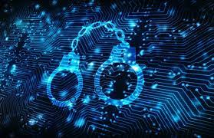
Understanding Insider Threats in Maritime Cybersecurity
Malicious Insider Threats in Maritime
Definition: Deliberate actions by insiders to steal, manipulate, or destroy data or disrupt systems.
Examples in Maritime Context: A disgruntled employee sabotaging ship systems, stealing sensitive cargo information, or colluding with external attackers.
Potential Impact: These acts can cause significant financial loss, damage to reputation, or even physical risks to the ship and crew.
Detection and Response: Importance of background checks, monitoring systems for unusual activities, and having an incident response plan in place.
Notes:
Malicious insider threats are premeditated actions taken by individuals who aim to cause harm to the maritime organization. They might be motivated by financial gain, personal vendettas, or ideological reasons. In a maritime context, this could involve the intentional introduction of malware into the control systems of a vessel or providing outsiders with access to secure areas. The impact can be devastating, with potential outcomes ranging from financial loss to risks to the ship's safety. Detecting these threats requires robust monitoring systems, thorough background checks of personnel, and an effective incident response strategy to deal with breaches when they occur.
There are no known real world maritime examples therefore a hypothetical situation is given in the slide
Reference:
Centre for the Protection of National Infrastructure (CPNI). (2020). Insider Threat Risk Mitigation.

Slide 35

Mitigating Insider Cybersecurity Threats in Maritime
Strategies to Counteract Insider Cybersecurity Threats
Holistic Security Culture: Developing a security culture where every member is aware and invested in the protection of maritime cyber assets.
Access Controls: Implementing strict access controls and privilege management to limit the potential damage insiders can inflict.
Behavioral Analytics: Using behavioral analytics to detect anomalies that could indicate insider threats.
Continuous Education and Training: Ensuring that all personnel receive regular cybersecurity education and training to understand the evolving threat landscape.
Notes:
Mitigating insider threats in the maritime industry requires a multi-faceted approach that combines technical controls with a strong organizational security culture. By establishing rigorous access control measures and privilege management, organizations can limit what insiders can access and potentially misuse. Behavioural analytics can further identify unusual patterns of behaviour that may indicate a threat. Moreover, ongoing education and training ensure that staff at all levels remain informed about the latest cybersecurity practices and threats. Such proactive strategies not only prevent incidents but also ensure swift and effective responses to insider-related breaches.
Reference:
Cybersecurity and Infrastructure Security Agency (CISA). (2021). Insider Threat Mitigation.

Slide 36

Adversarial Behavior in Maritime Cybersecurity
Understanding Adversarial Behavior in Maritime Cybersecurity
Definition: Adversarial behavior refers to deliberate actions by external entities aimed at compromising maritime cybersecurity.
Threat Actors:
  Cybercriminals
  State-sponsored groups,
  Hacktivists
  Thrll Seekers
  Cyberterrorists
Scope: Threat actors may target ship navigation systems, port operations, communication networks, and cargo handling systems.
CSP Training Module Name: Human Factors in Cybersecurity for Maritime
Notes:
Adversarial behaviour in maritime cybersecurity encompasses a range of activities carried out by external threat actors. These actors have various motives, from espionage to financial gain or disruption of maritime operations. For example, state-sponsored groups may seek to disrupt international shipping routes,. Understanding the intent and capability of these actors is crucial for developing effective cybersecurity measures in the maritime domain. Threat actors, also known as cyberthreat actors or malicious actors, are individuals or groups that intentionally cause harm to digital devices or systems. Threat actors exploit vulnerabilities in computer systems, networks and software to perpetuate various cyberattacks, including phishing, ransomware and malware attacks.
Today, there are many types of threat actors, all with varying attributes, motivations, skill levels and tactics. Some of the most common types of threat actors include hacktivists, nation-state actors, cybercriminals, thrill seekers, insider threat actors and cyberterrorists.
Cybercriminals: These individuals or groups commit cybercrimes mostly for financial gain. Common crimes that are committed by cybercriminals include ransomware attacks and phishing scams that trick people into making money transfers or divulging credit card information, login credentials, intellectual property or other private or sensitive information.
Nation-state actors: Nation states and governments frequently fund threat actors with the goal of stealing sensitive data, gathering confidential information or disrupting another government’s critical infrastructure. These malicious activities often include espionage or cyberwarfare and tend to be highly funded, making the threats complex and challenging to detect.
Hacktivists: These threat actors use hacking techniques to promote political or social agendas, such as spreading free speech or uncovering human rights violations. Hacktivists believe that they are affecting positive social change and feel justified in targeting individuals, organizations or government agencies to expose secrets or other sensitive information. A well-known example of a hacktivist group is Anonymous, an international hacking collective that claims to advocate for freedom of speech on the internet.
Thrill seekers: Thrill seekers are just what they sound like: they attack computer and information systems primarily for fun. Some want to see how much sensitive information or data they can steal; others want to use hacking to better understand how networks and computer systems work. One class of thrill seekers, called script kiddies, lack advanced technical skills, but use pre-existing tools and techniques to attack vulnerable systems, primarily for amusement or personal satisfaction. Though they don't always seek to cause harm, thrill seekers can still cause unintended damage by interfering with a network's cybersecurity and opening the door to future cyberattacks.
Cyberterrorists: Cyberterrorists start politically or ideologically motivated cyberattacks that threaten or result in violence. Some cyberterrorists are nation-state actors; others are actors on their own or on behalf of a nongovernment group.
As the frequency and severity of cybercrimes continue to grow, understanding these different types of threat actors is increasingly critical for improving individual and organizational cybersecurity.
Threat actors in cybersecurity utilize a varied arsenal, selecting tactics based on their goals and capabilities. Malware, including viruses and Trojan horses, is a common tool that disrupts systems by posing as legitimate software. Ransomware, a subset of malware, locks or threatens to expose data unless a ransom is paid, with some attacks targeting high-profile victims for greater payouts. Phishing schemes deceive users into divulging sensitive data or downloading malicious software, often through personalized emails (spear phishing) or by impersonating high-level executives (whale phishing). These methods, alongside other strategies like social engineering and advanced persistent threats (APTs), showcase the multifaceted approaches adversaries employ to exploit both human and technical vulnerabilities.
Reference:
United Nations. (2020). Review of Maritime Transport 2020. United Nations Conference on Trade and Development. https://unctad.org/system/files/official-document/rmt2020_en.pdf.

Slide 37

Adversarial Behavior in Maritime Cybersecurity
Impact of Adversarial Cyber Attacks on the Maritime Domain
Impact on Safety: Compromising navigation systems can lead to collisions or grounding.
Impact on Commerce: Disruption of cargo systems and port operations can cause economic losses and supply chain delays.
Impact on Confidentiality: Theft of sensitive information, such as shipping routes and cargo contents.
CSP Training Module Name: Human Factors in Cybersecurity for Maritime
Notes:
The impact of adversarial cyber-attacks on the maritime domain is profound. A breach in navigation systems, for example, can lead to serious safety concerns like ship collisions. From an economic perspective, cyber-attacks on ports can lead to substantial commercial losses due to halted operations and delayed deliveries. Additionally, the theft of confidential information compromises the security of international trade and can lead to loss of competitive advantage. For example, impacts of adversarial cyber-attacks in the maritime sector have been significant, with incidents leading to operational disruptions, financial losses, and safety concerns. The 2017 NotPetya malware attack on Maersk resulted in severe disruptions to its global operations and an estimated $300 million in losses.
BIMCO. (2020). Guidelines on Cyber Security Onboard Ships. BIMCO. https://www.bimco.org/products/publications/free/cyber-security.

Slide 38

Adversarial Behavior in Maritime Cybersecurity
Real-World Examples of Adversarial Attacks in Maritime
GPS Spoofing: Disrupting GPS signals leading to incorrect ship navigation.
Port Cyber Attacks: Targeting port IT systems to disrupt operations.
Data Breach: Stealing shipping information for competitive advantage or ransom.
CSP Training Module Name: Human Factors in Cybersecurity for Maritime
Notes:
Real-world examples of adversarial attacks in the maritime sector illustrate the vulnerability of maritime operations. A notable incident is the GPS spoofing attack experienced by several ships in the Black Sea, which reported incorrect positions. Another example includes cyber attacks on major ports like the Port of Barcelona, which saw its IT systems compromised, leading to operational delays. Moreover, cases of data breaches have occurred where adversaries stole sensitive shipping information, potentially for selling to competitors or for ransom demands.
Reference:
National Institute of Standards and Technology (NIST). (2018). Framework for Improving Critical Infrastructure Cybersecurity. https://www.nist.gov/cyberframework.

Slide 39

Adversarial Behavior in Maritime Cybersecurity
Mitigating Against Adversarial Behaviour in Maritime Cybersecurity
Adoption of NIST Framework: Implementing the NIST Cybersecurity Framework for managing and mitigating cyber risks effectively.
Utilization of ENISA Guidelines.
Strengthening ties with global partners for shared intelligence and joint cybersecurity exercises.
Establishing rapid response protocols in alignment with ENISA's incident handling recommendations.
CSP Training Module Name: Human Factors in Cybersecurity for Maritime
Notes:
Integrating ENISA's frameworks alongside existing cybersecurity measures can enhance maritime cybersecurity. ENISA offers guidelines and best practices for risk management, incident reporting, and response strategies tailored to critical infrastructures like the maritime sector. Combining these with organizational measures, such as adopting the NIST Cybersecurity Framework and promoting international cooperation, can provide a comprehensive defence against cyber threats. Training and continuous monitoring, can further strengthen maritime cybersecurity posture.

Slide 40

Evaluation method
Outline the evaluation elements and assessment process
Evaluation Element | How | Notes
Day 1: Group Presentation | Case study
Day 2: Multiple Choice Quizzes | Online Quizzes

Slide 41
Group Presentation
Groups will be made
You will be given a case study
2-3 hours preparation
Presentation is 15 minutes
Execution:
Include visual aids like charts or infographics to illustrate key points.
Goal: Identify and discuss how human factors can influence cybersecurity in the maritime sector and to discuss ways to strengthen human elements to prevent future incidents.

Slide 42
Group Presentation
Presentation Outline:
Introduction:
  Provide an overview of the selected case, including what happened and the impact on maritime operations.
  Detailed Case Analysis:
  Outline the timeline of events and the methods used by attackers.
  Discuss vulnerabilities exploited, particularly focusing on human factors.
Human Factors Assessment:
  Identify specific human errors or oversights contributing to the incident.
  Analyze psychological elements such as trust, complacency, or lack of cybersecurity awareness.
Psychological Considerations:
  Evaluate the cognitive biases or social engineering techniques that may have played a role.
  Discuss the psychological impact on staff and how it may have influenced their response to the incident.
Recommendations for Improvement:
  Offer strategies to enhance human factors-related security, such as better training or more effective awareness campaigns.
  Suggest policies or practices that could mitigate similar incidents in the future.
Conclusion: Recap the main human factors identified and the broader implications for maritime cybersecurity.
Q&A Session: Be prepared to engage with the audience and answer questions regarding the incident and your analysis.

Slide 43
Day 2
Organizational
Decision Making
Training

Slide 44

Organizational Culture, Communication, and Cybersecurity
Role of Organizational Culture
Definition and impact of organizational culture on cybersecurity.
Characteristics of a strong cybersecurity culture.
  Values (Lencioni, 2002)
  Adherence and compliance
Strategies for cultivating a positive cybersecurity culture.
  Psychological Safety in the Workplace (XXX
Notes:
Organizational culture within the maritime industry can be understood through four distinct levels, each contributing uniquely to the cybersecurity posture of maritime organizations.
Organisational Values
Core: This level represents the fundamental beliefs and values that are widely accepted and practiced within the organization. In the context of cybersecurity, a core culture that prioritizes safety, security, and vigilance forms the bedrock upon which other cybersecurity practices are built. For example, an organization where the core belief is that 'every crew member is a cybersecurity defender' naturally cultivates an environment where security practices are ingrained in daily operations.
Aspirational: These are the ideals that the organization strives to achieve, which may not yet be fully realized or embedded in daily practices. For maritime cybersecurity, aspirational culture could involve becoming the industry leader in cyber resilience or achieving zero cybersecurity incidents. Setting such aspirations helps to align efforts and resources towards enhancing cybersecurity capabilities and encourages continuous improvement.
Permission-to-Play: This level encompasses the basic behaviours and norms expected of everyone in the organization, essentially the 'rules of the game' for being part of the team. In terms of cybersecurity, this might include adherence to standard security protocols, such as regular password changes and not clicking on unknown links in emails. These baseline expectations ensure a minimum level of compliance across the organization, critical for maintaining foundational cybersecurity hygiene.
Accidental: These are the traits that have formed spontaneously over time, without being intentionally cultivated by leadership. While these can sometimes be positive, they can also lead to vulnerabilities in cybersecurity if, for example, an accidental culture of 'bypassing protocols for convenience' takes root. Identifying and addressing these accidental cultural traits is crucial for closing gaps in the organization's cybersecurity defences.
In the context of cybersecurity, organizational culture influences both adherence to best practices and compliance with policies. Adherence involves a more voluntary, belief-driven action where crew members follow cybersecurity practices because they believe in their importance and efficacy. Compliance, on the other hand, might be driven more by the desire to meet external requirements or avoid penalties, which may not always engender a deep commitment to the underlying principles of cybersecurity.
The concept of psychological safety, where individuals feel safe to take risks, admit mistakes, ask questions, and propose new ideas without fear of ridicule or retribution, is particularly beneficial for fostering a strong cybersecurity culture. In the maritime domain, where the isolation and pressures of shipboard life can amplify stresses and discourage open communication, creating an environment of psychological safety can encourage crew members to report security incidents or vulnerabilities promptly, share insights about potential threats, and collaborate more effectively on solutions.
The benefits of psychological safety in the maritime cybersecurity context include increased resilience to threats, as issues are more likely to be identified and addressed promptly; enhanced innovation, as crew members feel empowered to suggest and implement creative solutions to security challenges; and improved morale and job satisfaction, which contribute to a more vigilant and conscientious workforce.
By fostering a culture that values adherence to cybersecurity best practices, ensures compliance through understanding and commitment, and promotes psychological safety, maritime organizations can significantly enhance their defence against cyber threats, creating a more secure and resilient operational environment.

Slide 45

Organizational Culture, Communication, and Cybersecurity
Effective Cybersecurity Communication
Principles of effective communication in cybersecurity.
Overcoming barriers to effective cybersecurity communication.
Role of transparent communication in incident response.
Post cybersecurity incident
Notes:
Effective communication is paramount in ensuring the robustness of cybersecurity measures within maritime operations. It involves clear, concise, and timely sharing of information about potential threats, security protocols, and incident response strategies among all stakeholders.
Defining Effective Communication: In the context of cybersecurity, effective communication means delivering the right information, to the right people, at the right time, in a manner that is both understandable and actionable. For example, a cybersecurity analyst discovering a potential threat on the navigational systems should be able to convey the severity and required actions to the ship's captain and crew without ambiguity, using language that is accessible to non-specialists.
Origins of Communication Difficulties: Communication challenges often arise from the technical complexity of cybersecurity information and the diverse backgrounds of decision-makers and cybersecurity analysts. Analysts, deeply versed in technical jargon, may struggle to translate cybersecurity risks and needs into terms that resonate with senior management, who are focused on operational continuity and safety. This disconnect can lead to underestimation of risks and delayed decision-making.
Overcoming Communication Barriers:
Training and Awareness: Implementing cross-training sessions where decision-makers are educated on basic cybersecurity principles and analysts are trained in effective communication skills can bridge the knowledge gap. This mutual understanding facilitates more meaningful conversations about cybersecurity risks and strategies.
Use of Visualization Tools: Employing visual aids such as dashboards that illustrate cybersecurity threats and their potential impacts on maritime operations can help demystify complex information, making it easier for decision-makers to grasp the urgency and respond appropriately.
Developing Common Language: Establishing a common language or set of terminologies that both cybersecurity professionals and maritime decision-makers understand can significantly reduce miscommunication. This could involve simplifying cybersecurity jargon or using analogies related to maritime operations to explain cyber concepts.
Regular Briefings and Reports: Instituting regular briefings where cybersecurity analysts provide updates in a structured, concise manner can keep decision-makers informed without overwhelming them with technical details. Tailored reports that highlight key cybersecurity metrics, potential impacts on operations, and actionable recommendations are particularly effective.
Creating Cybersecurity Liaison Roles: Designating individuals who understand both the maritime operational context and cybersecurity to act as liaisons can facilitate smoother communication. These individuals can translate technical risks into operational impacts and vice versa, ensuring that both sides understand the priorities and constraints of the other.
Effective communication plays a critical role in the success of cybersecurity incident response procedures, particularly in the high-stakes environment of maritime operations:
Rapid Identification and Assessment: Clear communication channels between crew members, cybersecurity analysts, and decision-makers ensure that potential threats are promptly identified and accurately assessed. When everyone understands how to report suspicious activities and whom to report to, the initial detection of incidents is accelerated, allowing for quicker response times.
Coordinated Response Efforts: Effective communication facilitates the coordination of response efforts across different departments and levels of the organization. For example, if a cybersecurity incident impacts the navigational systems, clear communication ensures that the technical team, navigational officers, and the bridge crew work in sync to implement contingency plans, minimizing operational disruptions.
Decision-Making Efficiency: Enhancing communication between cybersecurity analysts and decision-makers ensures that the latter are provided with succinct, actionable information. This clarity helps decision-makers to quickly understand the severity of the incident, the potential impact on maritime operations, and the necessary steps to mitigate the threat, leading to more effective and timely decisions.
Stakeholder and Regulatory Communication: In the event of a cybersecurity incident, maritime organizations may need to communicate with external stakeholders, including regulatory bodies, port authorities, and other ships. Effective communication protocols ensure that these parties receive accurate, timely information about the incident and the response measures being taken, maintaining trust and compliance with maritime cybersecurity regulations.
Post-Incident Analysis and Learning: After resolving a cybersecurity incident, effective communication is key in conducting debriefings and post-incident analyses. These sessions, which involve clear and open discussions about what happened, why it happened, and how the response was managed, are crucial for identifying lessons learned and areas for improvement. This process strengthens future incident response efforts and the overall cybersecurity posture.
Maintaining Morale and Trust: Clear, transparent communication during and after cybersecurity incidents helps maintain the trust and morale of the crew and other stakeholders. Keeping everyone informed about the situation, the steps being taken, and the resolution of the incident reassures crew members and stakeholders that the organization is capable of managing cybersecurity threats effectively.
In summary, effective communication enhances every aspect of cybersecurity incident response in the maritime domain, from the initial detection of a threat to the post-incident analysis. By ensuring that critical information flows efficiently and accurately among all involved parties, maritime organizations can respond to cybersecurity incidents more effectively, minimizing their impact on operations and ensuring the safety and security of maritime assets.

Slide 46

Organizational Culture, Communication, and Cybersecurity
Leadership in Cybersecurity Culture
Building cybersecurity leadership at all levels of the organization.
  Vertically AND horizontally
Notes:
Leadership is the linchpin in cultivating a strong cybersecurity culture within maritime operations, both at sea and in port facilities. It transcends mere protocol enforcement, embodying a proactive, informed stance on cybersecurity that permeates every level of the organization.
Summarizing Leadership's Role from previous slides: Effective leadership in cybersecurity transcends traditional command structures, fostering an environment where every crew member and port employee is empowered and motivated to take part in cybersecurity efforts. Leaders set the tone by prioritizing cybersecurity in strategic planning, resource allocation, and daily operations, demonstrating through role modelling their actions that cybersecurity is integral to organizational success and safety and supporting crew and staff.
But leadership should be built both horizontally and vertically :
Empowering Ship Officers and Crew: On ships, leadership in cybersecurity means equipping officers and crew with the knowledge and authority to make informed decisions about cyber risks in real-time. This might involve training navigational officers in recognizing cyber threats to navigational systems and empowering them to implement immediate protective measures.
Port Facility Cybersecurity Champions: In port facilities, leadership can be fostered by appointing cybersecurity champions within different departments. These individuals, trained in cybersecurity best practices, act as points of contact for their teams, promoting awareness, reporting vulnerabilities, and ensuring that cybersecurity measures are understood and followed.
Cross-Functional Cybersecurity Teams: Establishing cross-functional teams that include members from IT, operations, security, and other relevant departments can foster leadership at various organizational levels. These teams, by collaborating on cybersecurity initiatives, ensure a holistic approach to cybersecurity that aligns with both the operational realities of maritime environments and the broader organizational strategy.
Continuous Professional Development: Encouraging and providing opportunities for continuous learning in cybersecurity across all levels of the organization is crucial. This might involve regular training sessions, attendance at cybersecurity conferences, or access to up-to-date resources on the latest cyber threats and defence strategies.
Recognition and Incentives: Recognizing and rewarding proactive cybersecurity behaviours and initiatives at all levels can reinforce the importance of cybersecurity and motivate continued engagement and leadership. This could range from formal awards to acknowledgment in team meetings.
Leadership Training Programs: Implementing leadership training programs that include a focus on cybersecurity can help current and future leaders develop the skills needed to lead effectively in the digital age. These programs should cover not only technical aspects of cybersecurity but also how to foster a culture of security, communicate effectively about cyber risks, and integrate cybersecurity into decision-making processes.
By promoting leadership in cybersecurity at all levels, maritime organizations can create a robust, proactive culture that is well-equipped to face the cybersecurity challenges unique to the maritime domain. This distributed approach to leadership ensures that cybersecurity is not siloed within IT departments but is integrated into every aspect of maritime operations, enhancing resilience and safeguarding the global maritime supply chain

Slide 47
Organizational Culture, Communication, and Cybersecurity
Fostering Collaboration and Trust
Defining Collaboration and Trust: Collaboration in the maritime sector involves the sharing of information, resources, and best practices to enhance collective cybersecurity defenses. Trust underpins these collaborative efforts, ensuring that shared information is reliable and that partners will act responsibly with shared data and insights.
Importance of trust and collaboration in cybersecurity efforts.
  Information Sharing
  Joint Cybersecurity exercises
Techniques for building trust within and across teams.
  Alliances, partnerships
Collaborative approaches to cybersecurity problem-solving.
Real-world example: Cross-departmental collaboration project that strengthened overall cybersecurity posture.
Notes:
In the maritime domain, collaboration and trust are foundational elements for a robust cybersecurity posture. The interconnected nature of maritime operations, involving ships, ports, and supply chains, necessitates a coordinated approach to cybersecurity. This collaboration extends beyond internal teams to include external stakeholders such as other shipping companies, regulatory bodies, and cybersecurity firms.
Defining Collaboration and Trust: Collaboration in the maritime sector involves the sharing of information, resources, and best practices to enhance collective cybersecurity defenses. Trust underpins these collaborative efforts, ensuring that shared information is reliable and that partners will act responsibly with shared data and insights.
Real-World Examples:
Maersk's Response to NotPetya: In the aftermath of the 2017 NotPetya attack, Maersk exemplified collaboration by transparently sharing their experience with the global maritime community. This openness helped other organizations understand the severity of the threat and take pre-emptive measures.
Information Sharing and Analysis Centers (ISACs): Maritime-specific ISACs provide platforms where companies, government agencies, and other stakeholders share threat intelligence and collaborate on cybersecurity best practices. The National Maritime Cybersecurity Plan encourages participation in ISACs, emphasizing their role in strengthening sector-wide cybersecurity.
Techniques for Fostering Collaboration and Trust:
Joint Cybersecurity Exercises: Conducting joint cybersecurity drills involving multiple stakeholders, such as shipping companies, port authorities, and governmental agencies, can enhance collaborative response capabilities to cyber incidents. These exercises simulate real-world scenarios, allowing participants to refine communication protocols and response strategies.
Cybersecurity Alliances: Forming alliances or coalitions dedicated to maritime cybersecurity can facilitate ongoing collaboration. These alliances provide structured frameworks for sharing intelligence, developing joint initiatives, and advocating for sector-wide cybersecurity standards.
Trust-Building Mechanisms: Implementing formal agreements, such as Memorandums of Understanding (MoUs), can establish clear expectations and responsibilities for collaboration, building a foundation of trust. Regular transparency reports and audits can also reassure stakeholders of each party's commitment to cybersecurity.
Cross-Sector Partnerships: Collaborating with industries outside the maritime sector, such as cybersecurity technology firms, can bring fresh perspectives and solutions to maritime cybersecurity challenges. These partnerships can facilitate the transfer of innovative technologies and practices tailored to the maritime context.
Community Building Initiatives: Creating forums, workshops, and conferences focused on maritime cybersecurity can foster a sense of community and shared purpose. These initiatives provide opportunities for networking, sharing experiences, and discussing emerging threats and trends.
By embracing these techniques and learning from real-world examples, the maritime industry can bolster its collective defences against cyber threats. Collaboration and trust not only enhance the sector's ability to respond to incidents but also contribute to a proactive and resilient cybersecurity culture that protects global maritime operations.

Slide 48
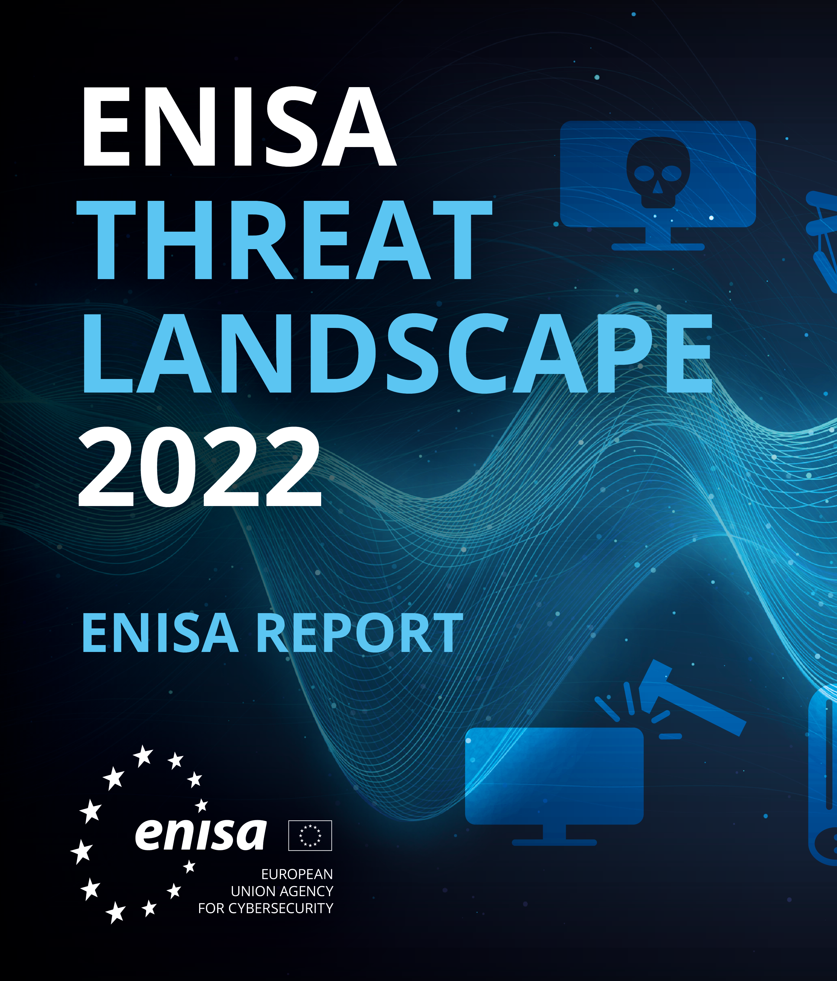
Communication and Collaboration Across Domains
Cross-Domain Cybersecurity Challenges
Challenges and opportunities in cross-domain cybersecurity collaboration.
  Port of San Diego (2018)
Importance of interoperability and shared standards.
  ENISA, NIS 2
Strategies for effective cross-domain communication.
CSP Training Module Name: Human Factors in Cybersecurity for Maritime
Notes:
Cross-domain cybersecurity challenges in the maritime sector often arise from the integration of operational technology (OT) with information technology (IT), the involvement of numerous stakeholders, and the global nature of maritime operations. These challenges require a collaborative approach that spans various domains and industries.
Real Maritime Examples of Cross-Domain Challenges:
Port Cybersecurity Incidents: Ports, as critical nodes in the maritime supply chain, utilize a blend of OT and IT to manage cargo, logistics, and communications. A cyber incident at a major port, such as the ransomware attack that disrupted operations at the Port of San Diego in 2018, highlights the cross-domain challenges between maritime operational activities and IT-based infrastructure management. The interconnectedness of port systems means that a breach in IT systems can quickly affect OT and disrupt physical operations. In September 2018, the Port of San Diego suffered a significant cybersecurity incident when it fell victim to a ransomware attack. The attack disrupted the port's IT systems, affecting park permits, public records requests, and other administrative operations. The Port responded by collaborating with federal, state, and local agencies to investigate the incident and restore affected systems, highlighting the importance of cross-domain collaboration in responding to maritime cybersecurity threats.
Vessel Navigation and Communication Systems: Modern vessels rely heavily on digital navigation and communication systems, which are susceptible to cyber threats. An example is the GPS spoofing incidents reported near the Black Sea, where ships' GPS systems were manipulated, showing vessels miles away from their actual locations. Such incidents underscore the need for collaboration between satellite communication providers (aerospace domain), maritime navigational authorities, and cybersecurity experts to address these threats.
ENISA and the NIS 2 Directive: The European Union Agency for Cybersecurity (ENISA) plays a crucial role in enhancing the cybersecurity posture of EU member states by providing expertise and advice. The NIS 2 Directive, which is an update to the EU's Directive on security of network and information systems, aims to achieve a high common level of cybersecurity across the Union. For the maritime sector, this directive helps establish clearer and more stringent security requirements for maritime transport and port services, promoting the adoption of standardized security measures and facilitating cross-domain collaboration to address cybersecurity risks.
Maritime Example of Cross-Domain Collaboration: A notable instance of cross-domain collaboration to mitigate a cyber threat in the maritime sector involved the response to the NotPetya malware attack on Maersk. In the aftermath, Maersk collaborated with cybersecurity firms, IT hardware and software providers, and governmental agencies to rapidly reconstruct its IT infrastructure and restore operations. This collaborative effort spanned across domains, including IT security, maritime operational technology, and international regulatory bodies, showcasing how diverse expertise and resources can be mobilized to address complex cybersecurity challenges effectively.
This cross-domain approach, supported by frameworks like ENISA's guidelines and the NIS 2 Directive, not only aids in responding to incidents but also in proactively establishing resilient cybersecurity practices. By fostering collaboration across various domains and industries, the maritime sector can enhance its defensive capabilities against the evolving landscape of cyber threats.

Slide 49
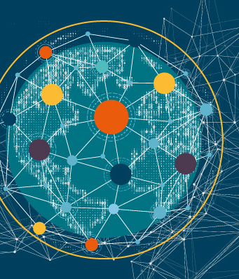
Communication and Collaboration Across Domains
Building Collaborative Networks
The role of professional networks and alliances in enhancing cybersecurity.
Benefits of public-private partnerships in cybersecurity initiatives.
  ESCO
Leveraging expertise across domains for comprehensive cybersecurity solutions.
CSP Training Module Name: Human Factors in Cybersecurity for Maritime
Notes:
In the maritime sector, building robust collaborative networks is essential for enhancing cybersecurity resilience. These networks, encompassing public-private partnerships, industry associations, and international collaborations, provide a platform for sharing critical threat intelligence, best practices, and technological solutions across the maritime ecosystem.
Key Strategies for Building Collaborative Networks:
Fostering Public-Private Partnerships: Establishing strong public-private partnerships is crucial for bridging the gap between governmental cybersecurity initiatives and private maritime stakeholders. These partnerships facilitate the sharing of timely threat intelligence and the development of coordinated response strategies, ensuring that both public and private entities are aligned in their cybersecurity efforts.
Engaging with Industry Associations and Maritime ISACs: Participation in industry associations and Maritime Information Sharing and Analysis Centres (ISACs) enables maritime organizations to share and receive sector-specific cybersecurity information. These platforms also provide opportunities for collaborative problem-solving and joint initiatives aimed at strengthening the sector's cyber defences.
Engaging in international collaborations, such as those facilitated by ENISA and other regional cybersecurity organizations, allows maritime stakeholders to benefit from a broader pool of expertise and resources. These collaborations can lead to the development of harmonized cybersecurity standards and practices, enhancing the sector's ability to counter global cyber threats.
A prime example of a successful collaborative network within the European maritime sector is the collaboration between ECSO (European Cyber Security Organisation) and various maritime stakeholders, including port authorities, shipping companies, and cybersecurity firms. This network focuses on addressing the unique cybersecurity challenges faced by the maritime industry, fostering innovation and sharing best practices. One notable initiative within this network involved a series of joint cybersecurity exercises simulating attacks on maritime operational technology systems. These exercises, which included participants from multiple countries, not only tested the participants' incident response capabilities but also highlighted the importance of cross-border and cross-sector collaboration in effectively managing maritime cyber threats.
By actively building and participating in these collaborative networks, the maritime sector can significantly enhance its collective cybersecurity posture. The sharing of insights, experiences, and resources within these networks enables a unified and proactive approach to cybersecurity, ensuring that the maritime industry remains resilient in the face of evolving cyber threats.

Slide 50
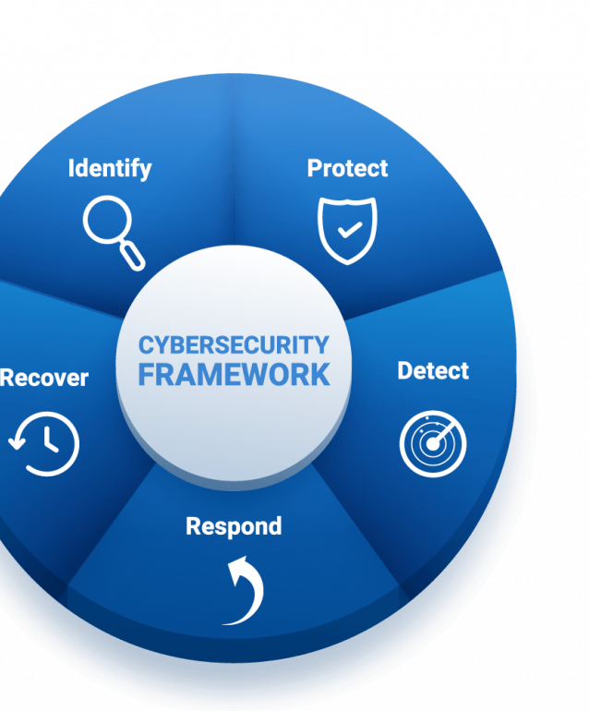
Communication and Collaboration Across Domains
Collaborative Incident Response
Principles of collaborative incident response planning.
Importance of clear roles and communication channels during incidents.
Benefits of joint exercises and simulations.
  Decision-making under pressure
  Cultural aspects
Locked-Shields and Maritime
CSP Training Module Name: Human Factors in Cybersecurity for Maritime
Notes:
Incorporating human factors into collaborative incident response strategies is essential for enhancing maritime cybersecurity preparedness. The dynamic and complex nature of maritime operations, coupled with the diversity of stakeholders involved, necessitates a comprehensive understanding of how human behaviors, decision-making processes, and team dynamics influence incident response effectiveness.
Communication and Coordination: Effective incident response relies heavily on clear communication and seamless coordination among crew members, port authorities, cybersecurity teams, and other stakeholders. Understanding the human factors involved in communication—such as language barriers, cultural differences, and stress-induced miscommunications—can help in developing protocols that ensure information is accurately conveyed and acted upon during a cyber incident.
Decision-Making Under Pressure: Cyber incidents often require rapid decision-making under high-pressure conditions. Factors such as stress, cognitive overload, and fatigue can impact decision quality. Training programs that simulate real-world scenarios can help maritime personnel develop the skills needed to make effective decisions quickly, even in stressful situations.
Team Dynamics and Leadership: The effectiveness of a collaborative incident response effort is also influenced by team dynamics and leadership styles. Leaders who understand the principles of crisis leadership, including maintaining team morale, delegating tasks effectively, and encouraging a collaborative problem-solving approach, can significantly enhance the response capability of their teams.
Cultural and Organizational Diversity: Maritime operations involve a wide range of organizations, each with its own culture and procedures. Recognizing and accommodating this diversity in collaborative incident response efforts is crucial for ensuring that all parties work effectively towards a common goal.
Locked Shields and Maritime Aspects:
An exemplary demonstration of incorporating human factors into collaborative incident response is seen in the Locked Shields exercise, one of the world's largest and most complex international live-fire cyber defence exercises, organized by the NATO Cooperative Cyber Defence Centre of Excellence (CCDCOE). Although primarily focused on broader national and international cyber defence, Locked Shields has included maritime-specific scenarios that highlight the importance of human factors in maritime cybersecurity.
For example, in a scenario where a port's operational systems are targeted, the exercise could simulate the challenges of coordinating incident response between the port's IT team, shipping companies, national cybersecurity agencies, and international partners. Participants must navigate not only the technical aspects of mitigating the cyber threat but also the human factors—such as managing communication across different organizations, making rapid decisions with limited information, and maintaining team effectiveness under stress.
These exercises underscore the critical role of human factors in enhancing maritime cybersecurity preparedness. By simulating realistic maritime cyber threats and emphasizing the human elements of incident response, Locked Shields and similar exercises help maritime stakeholders develop the skills, processes, and understanding necessary for effective collaborative incident response in the face of real-world cyber threats.

Slide 51

Communication and Collaboration Across Domains
Overcoming Barriers to Collaboration
Common barriers to effective cybersecurity collaboration and how to overcome them.
The role of trust and transparency in collaborative efforts.
Best practices for sustaining long-term collaborative relationships.
Port of San Diego incident
CSP Training Module Name: Human Factors in Cybersecurity for Maritime
Notes:
collaboration, especially in industries as critical as maritime, overcoming common barriers is essential for robust defence mechanisms. These barriers often include a lack of shared standards, mismatched security protocols across different organizations, and a deficiency in clear communication channels. To overcome them, establishing unified security frameworks, actively engaging in joint cybersecurity exercises, and forming dedicated communication platforms for threat intelligence sharing are key steps.
Trust and transparency are the cornerstones of effective collaborative efforts. Within the maritime sector, this involves open sharing of threat intelligence, transparent reporting of incidents, and a commitment to collective security rather than competitive secrecy. Trust is built through consistency in actions, adherence to agreed-upon protocols, and the mutual understanding that security is a shared responsibility.
For sustaining long-term collaborative relationships in cybersecurity, it’s crucial to maintain regular communication, offer mutual support during crises, and continuously align strategic objectives. Regular meetings, workshops, and joint training sessions can reinforce the partnership. Recognition of each party's contributions and celebrating collaborative achievements also foster a sense of community and shared purpose.
the importance of this collaboration is the cyberattack on the Port of San Diego in 2018. The attack disrupted the port’s IT systems and services, highlighting several barriers to effective cybersecurity collaboration, the necessity of trust and transparency, and the best practices for sustaining long-term relationships.
Overcoming Common Barriers: The Port of San Diego incident demonstrated barriers such as fragmented communication channels, varied cybersecurity maturity levels among stakeholders, and jurisdictional challenges. To overcome such obstacles, it is crucial to establish unified communication protocols, conduct regular joint cybersecurity training, and develop a mutual understanding of the roles and responsibilities across agencies.
Trust and Transparency: The attack at the Port of San Diego underscored the role of trust and transparency, which were key in the collaborative response involving local, state, and federal entities. Information sharing, often hindered by concerns over revealing vulnerabilities, must be encouraged through establishing clear protocols that protect sensitive information while allowing for the necessary flow of intelligence.
Sustaining Collaborative Relationships: Best practices observed include regular joint exercises, shared response plans, and continuous dialogue among stakeholders. After the incident, the Port of San Diego took steps to not only restore systems but also to strengthen alliances with other ports and law enforcement, ensuring a collective resilience to future cyber threats.
Using the Port of San Diego incident as a case study, we can derive key insights for enhancing collaborative efforts across the maritime cybersecurity landscape. It emphasizes the need for a proactive approach, maintaining strong relationships before incidents occur, which is essential for a rapid and effective response when facing cyber threats.

Slide 52

Decision Making at Strategic, Operational, and Tactical Levels
Strategic Decision Making
Overview of strategic decision-making in maritime cybersecurity.
Long-term planning and policy development for robust cybersecurity frameworks.
Integration of cybersecurity into overall business strategy.
Real-world example: A maritime company's strategic decision to adopt a zero-trust architecture.
Notes:
Strategic decision-making in maritime cybersecurity involves setting long-term goals and establishing comprehensive frameworks to protect maritime operations from cyber threats. This level of decision-making requires a broad view of the organization's objectives, potential cyber risks, and the resources available for cybersecurity initiatives. An example of strategic decision-making in the maritime domain is a shipping company deciding to invest in a fleet-wide cybersecurity upgrade, including advanced intrusion detection systems and crew training programs. This decision, driven by the company's strategic goal of ensuring operational continuity and safeguarding sensitive data, demonstrates a commitment to a proactive cybersecurity posture that aligns with broader organizational objectives.

Slide 53

Decision Making at Strategic, Operational, and Tactical Levels
Operational Decision Making
Role of operational decisions in maintaining day-to-day cybersecurity.
Operational responses to identified threats and vulnerabilities.
Coordination between cybersecurity teams and other operational units.
Real-world example: An operational decision to isolate a compromised system on a vessel, preventing a wider breach.
Notes:
Operational decision-making focuses on the day-to-day management of cybersecurity measures to maintain the security of maritime operations. This involves decisions related to the implementation of security policies, the management of security incidents, and the allocation of resources for ongoing cybersecurity activities. For instance, the operational decision to conduct a simulated cyber attack exercise on a container ship tests the crew's readiness and the effectiveness of the ship's cybersecurity protocols. Such exercises help identify vulnerabilities and areas for improvement, ensuring that operational practices are continuously refined to counter emerging cyber threats.

Slide 54

Decision Making at Strategic, Operational, and Tactical Levels
Tactical Decision Making
Nature of tactical decisions in responding to immediate cybersecurity threats.
Tools and techniques for effective tactical decision-making, including incident response teams and real-time threat intelligence.
Importance of agility and flexibility in tactical decisions.
Real-world example: Rapid tactical response to a ransomware attack on a port's cargo management system.
Notes:
Tactical decision-making in maritime cybersecurity is characterized by immediate, on-the-ground decisions in response to specific cyber incidents. These decisions are often made under pressure and require a rapid assessment of the situation and the deployment of predefined response protocols. A practical example of tactical decision-making is the response to a ransomware attack on a port's cargo management system. The tactical decision to isolate infected networks, implement backup procedures, and communicate with relevant stakeholders, including law enforcement and cybersecurity experts, exemplifies the swift, focused actions necessary to mitigate the impact of the attack and restore normal operations.

Slide 55

Decision Making at Strategic, Operational, and Tactical Levels
Integrating Decision Levels
Ensuring coherence and alignment between strategic, operational, and tactical decision-making levels.
Mechanisms for feedback and learning across decision-making levels.
Role of leadership in bridging gaps between different decision-making levels.
Real-world example: Integrated decision-making framework that enabled a seamless response to a coordinated cyber-physical attack.
Notes:
In each of these decision-making levels, the integration of effective communication, collaboration, and a thorough understanding of the maritime operational environment is crucial. By aligning strategic, operational, and tactical decision-making with the unique challenges and dynamics of the maritime domain, organizations can enhance their cybersecurity posture and resilience against cyber threats.Integrating strategic, operational, and tactical decision-making levels is crucial for a cohesive and effective maritime cybersecurity posture. This integration ensures that high-level objectives guide daily operations and that real-time insights from the ground influence strategic planning.
Achieving coherence between the levels requires clear communication channels and shared understanding across all levels of decision-making. For example, strategic decisions to invest in advanced cybersecurity technologies must be clearly communicated and understood by operational teams responsible for implementing these technologies and by tactical teams who will use them in response to immediate threats.
Effective integration also relies on establishing feedback loops that allow insights and experiences from operational and tactical levels to inform strategic planning. For instance, if tactical teams frequently encounter a specific type of cyber threat, this information should feed back to the strategic level to adjust overall cybersecurity strategies or allocate more resources to address this threat.
Integrating decision levels enhances the organization's adaptability and responsiveness to emerging threats. Strategic plans should be flexible enough to accommodate new information from operational and tactical experiences, ensuring that the organization's cybersecurity posture can evolve in response to the dynamic cyber threat landscape.
A real-world example of integrating decision levels in maritime cybersecurity can be seen in the response to the 2017 NotPetya malware attack. This incident underscored the importance of cohesive strategic, operational, and tactical responses to cyber threats in the maritime sector.
Strategic Level: Maersk's strategic response involved a comprehensive evaluation of their cybersecurity infrastructure and policies following the attack. Recognizing the need for stronger cyber resilience, the company committed to enhancing its cybersecurity framework, including investing in advanced cybersecurity technologies and establishing partnerships with leading cybersecurity firms.
Operational Level: Operationally, Maersk implemented the new cybersecurity measures across its global operations, which included upgrading systems, enhancing network security, and integrating robust cybersecurity protocols into their day-to-day operational processes. This also involved training staff on the new systems and protocols to ensure that everyone was aligned with the updated cybersecurity practices.
Tactical Level: On a tactical level, Maersk's crews and IT teams were equipped to identify and respond to cyber threats more effectively. The practical experience gained from managing the NotPetya incident informed their tactical approaches, such as isolating affected systems more quickly to prevent the spread of malware and maintaining operational continuity through alternative communication and operational channels during cyber incidents.
This real-world example illustrates how strategic decisions, influenced by the lessons learned from a significant cybersecurity incident, can guide operational changes and enhance tactical responses. By integrating these decision levels, Maersk improved its cybersecurity resilience, reducing the risk of future incidents disrupting their global operations.

Slide 56
Training, Awareness, and Communication Programs for Maritime Personnel
Importance of Training and Awareness
The critical role of continuous training and awareness in maritime cybersecurity.
Elements of effective cybersecurity training programs for maritime personnel.
The impact of awareness programs on reducing human error and enhancing security culture.
IMO, NIS 2
CSP Training Module Name: Human Factors in Cybersecurity for Maritime
Notes:
In the maritime industry, the significance of training and awareness cannot be overstated, as they are critical components of a robust cybersecurity posture. Comprehensive training ensures that all personnel, from the deck to the boardroom, understand the cyber threats they face, know how to recognize the signs of a cyber incident, and are equipped with the skills necessary to respond effectively. Awareness initiatives keep cybersecurity at the forefront of everyone’s mind, fostering a culture where security becomes second nature.
Training programs in the maritime sector must cover a wide range of topics, from the basics of identifying phishing emails to the complexities of securing navigation and communication systems. They should be tailored to the roles and responsibilities of different crew members, including how to respond to incidents during critical operations.
Awareness campaigns can be deployed through regular updates, posters, drills, and even gamified learning, ensuring that the knowledge is not only acquired but retained. These initiatives are crucial for reinforcing training and keeping the crew alert to the evolving nature of cyber threats.
Beyond training and awareness, it’s about building a culture where every individual feels responsible for the cyber safety of the vessel or port. This means not only knowing what to do but having the confidence to act, whether it’s reporting a suspicious email or following protocol when a security breach is suspected.
The effectiveness of these principles is the approach taken by the International Maritime Organization (IMO). In response to a significant increase in cyber threats against the shipping industry, the IMO has emphasized the importance of incorporating cybersecurity into safety management systems. They’ve set January 2021 as the deadline for maritime operators to comply with these new regulations, necessitating thorough training and awareness programs to meet these requirements. As a result, shipping companies have initiated comprehensive cybersecurity training for their crews, ensuring that they understand the new policies, can identify cyber threats, and know how to respond effectively. The NIS 2 Directive's implementation within the maritime sector will necessitate comprehensive updates to existing cybersecurity training programs. Maritime entities will need to educate staff on new risk management measures, including those addressing supply chain vulnerabilities, and ensure understanding of incident reporting obligations. Training must also facilitate information sharing within the industry while complying with data protection laws. Additionally, maritime leaders will be required to participate in cybersecurity governance, aligning with the Directive's mandate for oversight bodies. Training programs will extend beyond internal procedures, fostering an awareness of the Directive's cross-border collaboration initiatives, and promoting engagement with national and EU-wide cybersecurity authorities. The aim is to instill a robust and regulatory-compliant cybersecurity culture across all levels of maritime operations.

Slide 57
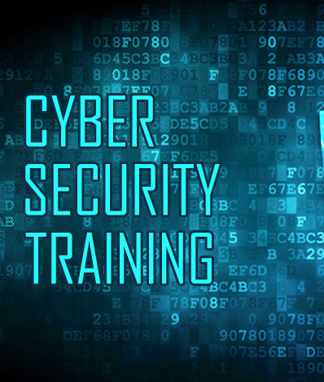
Training, Awareness, and Communication Programs for Maritime Personnel
Enhancing Communication for Cybersecurity
Best practices for communicating cybersecurity policies and incidents to maritime personnel.
The role of clear, consistent communication in fostering a proactive cybersecurity stance.
  Clear Messaging
  Timely Information Flow
  Actionable Intelligence
Strategies for overcoming communication barriers in diverse and dynamic maritime environments.
  Multichannel communication
  Feedback
CSP Training Module Name: Human Factors in Cybersecurity for Maritime
Notes:
Enhancing communication for cybersecurity within the maritime domain is a multifaceted endeavour, crucial for the effective management of cyber threats. Clear, timely, and actionable communication channels must be established and maintained to ensure the swift dissemination of cybersecurity information.
ClearMessaging: The complexity of cybersecurity information should be distilled into clear, concise messages that can be understood by all personnel, regardless of their technical expertise. For instance, rather than detailing the technical specifics of a malware attack, communicate the immediate actions that need to be taken, such as not using external drives or avoiding certain actions on the ship's computer systems.
Timely Information Flow: Speed is of the essence in responding to cyber threats. Establish protocols that outline how quickly information should be passed along the chain of command and to relevant personnel. An example might be automated alerts that immediately notify the IT department and ship officers when a potential threat is detected.
Actionable Intelligence: Communication should not only inform but also instruct. It should provide clear instructions on the next steps to take. For example, if a vulnerability in a navigation system is discovered, communication should include specific measures to mitigate risk, such as switching to a secondary system or updating software.
Multi-Channel Communication: Utilize various communication channels to ensure messages are received. This could involve email alerts, SMS, intranet updates, or even physical notices in common areas of the ship or port facilities.
Feedback: Establish a two-way communication flow where feedback from crew members and other staff is encouraged and acted upon. For example, a helpline or a dedicated inbox for reporting suspicious activities can provide insights into the effectiveness of current cybersecurity measures.
Real-World Example: A practical application of these principles is seen in how the U.S. Coast Guard communicates cybersecurity alerts. They issue bulletins that are not overly technical, provide immediate action items, and disseminate these alerts through multiple channels, ensuring broad reach and understanding across the maritime community. This approach enhances the cybersecurity preparedness of the recipients and provides a model for effective communication strategies within the maritime sector.

Slide 58
Training, Awareness, and Communication Programs for Maritime Personnel
Designing Effective Training Programs
Principles for designing engaging and impactful training programs.
  Habits, Self-efficacy, Metacognition
Incorporating adult learning theories and methodologies in cybersecurity training.
Use of simulations and drills in reinforcing learning and preparedness.
Real-world example: A maritime academy's use of VR simulations to train cadets on cybersecurity protocols.
CSP Training Module Name: Human Factors in Cybersecurity for Maritime
Notes:
Designing effective maritime cybersecurity training programs hinges not only on conveying information but also on fostering the right habits, bolstering self-efficacy, and cultivating metacognitive skills through tailored feedback. Habits are entrenched through consistent practice, and maritime simulations and drills offer the perfect platform for this, enabling crew members to routinely exercise cybersecurity protocols until they become second nature.
Simulations empower crew members by enhancing their self-efficacy, giving them the confidence to tackle real cybersecurity challenges. This confidence is further developed when they successfully navigate through complex, simulated cyber events. Drills that incorporate metacognitive elements—prompting crew members to analyse and reflect on their decision-making process—help consolidate learning and ensure that lessons stick.
The incorporation of tailored feedback is crucial in these exercises. Just as debriefings in traditional maritime drills allow for individualized learning points, immediate and personalized feedback in cybersecurity simulations ensures that each crew member can understand and correct their actions, reinforcing proper techniques and strategies.
Using VR and AR in training has revolutionized learning by providing an immersive, interactive environment. In the cybersecurity realm, an example can be found in how the aviation industry has adopted VR for pilot security training, with pilots practicing emergency responses in lifelike simulations that provide immediate feedback on their actions. Adapting this technology to maritime cybersecurity, crew members could use VR to virtually experience cyberattacks, like a phishing scam targeting the ship's communication systems or unauthorized access to the secure onboard data. Throughout these simulations, adaptive feedback mechanisms would analyse their responses, providing personalized insights and recommendations for improvement. This level of tailored feedback is critical for reinforcing good cybersecurity habits, enhancing self-efficacy, and fostering an environment of continuous learning and improvement in maritime operations.

Slide 59

Training, Awareness, and Communication Programs for Maritime Personnel
Evaluating Effective Training Programs
  Process evaluation: Intervention
    Did it do its job
  Impact evaluation
        How has it changed
  Outcome evaluation
      Objective
    Subjective
  Involve stakeholders and participants
  Performance measures
  Subjective measures
CSP Training Module Name: Human Factors in Cybersecurity for Maritime
Notes:
GPT
In evaluating maritime cybersecurity training, a process evaluation would assess whether the training effectively conveyed critical knowledge and skills. An impact evaluation would measure changes in cybersecurity posture, such as reduced incidents. Outcome evaluations would examine both objective metrics, like the number of successful phishing attempts pre- and post-training, and subjective metrics, like crew confidence in handling cyber threats. Involving stakeholders, such as crew and IT staff, can provide valuable insights into both the performance of the training and subjective assessments of its effectiveness.
For further reading on best practices in cybersecurity training within the maritime sector, you might explore the resources provided by the International Maritime Organization (IMO) and guidelines recommended by the European Union Agency for Cybersecurity (ENISA).
International Maritime Organization (IMO). (2021). Guidelines on maritime cyber risk management. Retrieved from https://www.imo.org.
European Union Agency for Cybersecurity (ENISA). (2019). Cybersecurity culture guidelines: Behavioural aspects of cybersecurity. Retrieved from https://www.enisa.europa.eu.
.

Slide 60

Future Trends, Challenges, and the Role of Communication
Emerging Cybersecurity Trends
An overview of emerging trends in cybersecurity, including AI, machine learning, and IoT.
The implications of these trends for maritime cybersecurity strategies.
Preparing for future cybersecurity challenges through innovation and adaptability.
Real-world example: Adoption of AI-based threat detection systems on smart ships.
Notes:
The maritime sector must stay abreast of emerging cybersecurity trends, such as the increasing use of artificial intelligence (AI) and the Internet of Things (IoT), to safeguard against future threats. These technologies offer new tools for defense but also present new vulnerabilities. Preparing for these future challenges requires not only technological innovation but also strategic foresight to anticipate and mitigate potential threats
One publicly known example is the collaboration between Wärtsilä, a marine technology company, and Templar Executives, a cybersecurity firm, which led to the development of an AI-based anomaly detection solution. This system is designed to monitor, detect, and respond to anomoliesin real-time, enhancing the security of smart ships' operations. https://www.wartsila.com/insights/article/wartsila-expert-insight-the-continuing-evolution-of-our-next-level-predictive-maintenance-service
These initiatives illustrate the maritime industry's commitment to adopting cutting-edge technologies to safeguard against increasingly sophisticated cyber threats. AI-based systems can be a significant step forward in the evolution of maritime cybersecurity, offering enhanced detection capabilities and contributing to safer, more secure maritime operations.

Slide 61

Future Trends, Challenges, and the Role of Communication
Addressing Future Cybersecurity Challenges
Anticipating and mitigating new types of cyber threats in the maritime sector.
The importance of staying ahead of the curve through research and collaboration with cybersecurity experts.
Challenges posed by the increasing complexity and connectivity of maritime operations.
Notes:
As maritime operations become more complex and interconnected, new cybersecurity challenges will emerge. Proactively addressing these challenges requires a comprehensive approach that includes investing in advanced security solutions and fostering a culture of innovation. Collaborative efforts to develop proactive defence mechanisms can help mitigate the risks posed by future cybersecurity threats

Slide 62

Future Trends, Challenges, and the Role of Communication
The Evolving Role of Communication
The critical role of effective communication in addressing future cybersecurity challenges.
Enhancing cross-sector and cross-border communication for a unified response to cyber threats.
Leveraging new communication technologies and platforms for better threat intelligence sharing.
Real-world example: An international maritime cybersecurity task force's use of a secure communication platform for real-time threat sharing and coordination.
Notes:
The role of communication in cybersecurity will become increasingly critical as the threat landscape evolves. Effective communication can enhance threat intelligence sharing and facilitate coordinated responses to cyber incidents. Leveraging new communication technologies and platforms, as well as fostering cross-sector collaborations, can significantly improve the maritime sector's ability to anticipate and respond to emerging cyber threats

Slide 63

Future Trends, Challenges, and the Role of Communication
Preparing for the Future
Strategic planning and investment in cybersecurity capabilities to prepare for future challenges.
The role of leadership in fostering a forward-looking cybersecurity culture.
Importance of global cooperation and information sharing in strengthening maritime cybersecurity resilience.
Notes:
Preparing for the future of maritime cybersecurity requires a multifaceted approach that includes strategic planning, leadership commitment, and global cooperation. By embracing a culture of continuous learning and staying engaged with international cybersecurity efforts, maritime organizations can develop resilient defences capable of withstanding the cybersecurity challenges of tomorrow

Slide 64
Evaluation method
Outline the evaluation elements and assessment process
Evaluation Element | How | Notes
Day 1: Group Presentation | Case study
Day 2: Multiple Choice Quizzes | Online Quizzes

Slide 65
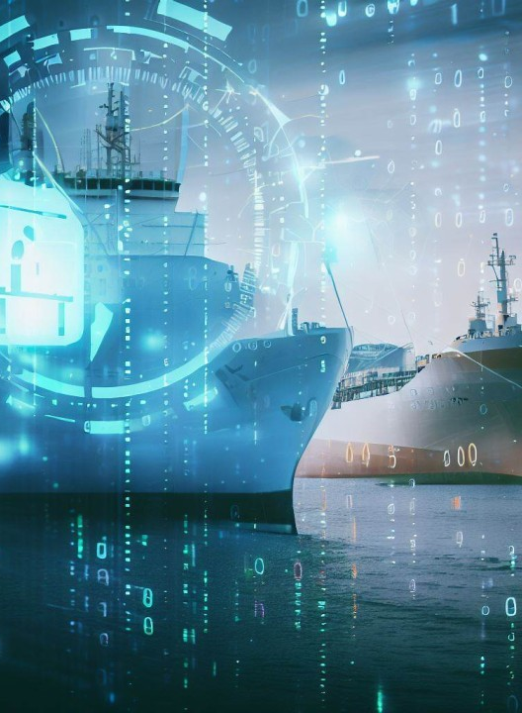
Resources: Books and Reference Materials
"European Cybersecurity Skills Framework": European Union Agency for Cybersecurity (ENISA) Publication
European Union Agency for Cybersecurity (ENISA). (2019). Cybersecurity culture guidelines: Behavioural aspects of cybersecurity. Retrieved from https://www.enisa.europa.eu.
Hanzu-Pazara, R., Raicu, G., & Zăgan, R. (2019). The Impact of Human Behaviour on Cyber Security of the Maritime Systems. Advanced Engineering Forum, 34, 267-274.
Wiederhold, B. (2014). The Role of Psychology in Enhancing Cybersecurity. Cyberpsychology, Behavior, and Social Networking, 17(3), 131-132.
Aşan, C. (2023). The Role of Cyber Situational Awareness of Humans in Social Engineering Cyber Attacks on the Maritime Domain. Mersin University Journal of Maritime Faculty. Link
Akpan, F., Bendiab, G., Shiaeles, S., Karamperidis, S., & Michaloliakos, M. (2022). Cybersecurity Challenges in the Maritime Sector. Network, 2, 123-138.
Endsley, M. R., & Jones, D. G. (2024). Situation Awareness Oriented Design: Review and Future Directions. International Journal of Human–Computer Interaction, 1-18.
Thackray, H., McAlaney, J., Dogan, H., Taylor, J., & Richardson, C. (2016). Social Psychology: An Under-used Tool in Cybersecurity.
Knox, B. J., Lugo, R. G., & Sütterlin, S. (2019). Cognisance as a human factor in military cyber defence education. IFAC-PapersOnLine, 52(19), 163-168.

Slide 66

Thank you
Office hours:
M-Th 3:00pm-4:30pm room C402
Please send all questions to:
gehad@example.com

