Slide 1

Cyber-security in the maritime sector
CSP002_SS_M
Human Centric and Secure Maritime Ecosystems
Presentation by:
Maria Lambrou

Slide 2


Human Centric and Secure Maritime Ecosystems
o1.
Goals: Who-What-Why you need to take this training
o2.
Training logistics: When-Where-How
o3.
Learning outcomes
o4.
Training outlines
o5.
Exercises details
o6.
Practical information and requirements
o7.
Registration information and contacts

Slide 3



Goals: Who-What-Why you need to take this training
WHO
WHAT
WHY
Maritime Business undergraduate and postgraduate students
Maritime cybersecurity technology essentials and risk management for today’s maritime student and future maritime professionals
Equipping participants with the knowledge and skills necessary to manage processes and teams, so as to protect critical systems and data

Slide 4



CSP Training Logistic: When-Where-How
WHEN
WHERE
HOW
Time schedule: 15th and 16th June 2024
ONLINE and ONSITE
@University of the Aegean, Chios Greece
Both Physical and Virtual

Slide 5

Value Propositions
Benefits to Participants
The module offers state of the art knowledge of cybersecurity technology and risk management aspects, pertinent for the maritime domain.
Regulatory, technology, and human factors are discussed as affecting strategic as well as operational aspects of a shipping company.
The level of the Training Module is Basic
  Rooted with European Cybersecurity Skills Framework
  Cutting-edge insights from industry-academic experts
  Knowledge and Skill development, also career planning advancement

Slide 6

WHO
Profile of Training Participants
Undergraduate students of Maritime Studies Programmes
Postgraduate students of Maritime Studies Programmes
PhD candidates, early career researchers in maritime studies, with no prior knowledge of cybersecurity or maritime cybersecurity

Slide 7
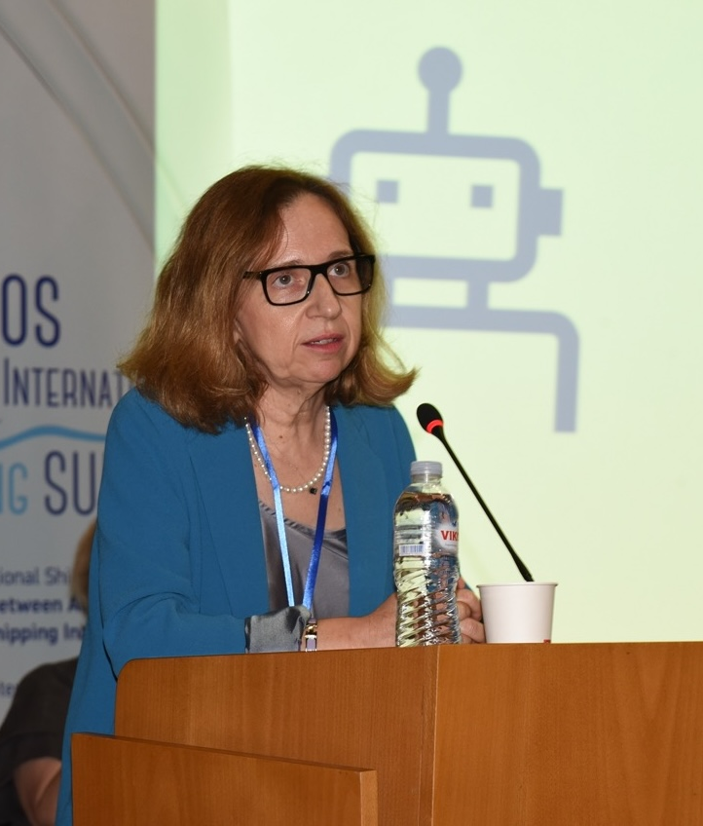
WHO
Profile of Trainer
Maria Lambrou is a Professor with the Department of Shipping, Trade and Transport, Business School, at the University of Aegean.
She holds a Diploma in Mechanical Engineering (Aristotle University of Thessaloniki, Greece), also an M.A. in Industrial Relations from Brunel University London, UK, and a Ph.D. in Computer Science (School of Electrical Engineering and Computer Science, NTUA, Greece). She has worked in numerous national and European research projects on communication networks technology, eBusiness, eGovernment and eLearning platforms.
Her current research focuses on digital entrepreneurship, digital transformation and capabilities building. She is merely interested in studying organizational transformation vis a vis data-driven decision making and machine learning enabled, algorithmic process management.
She held Academic Visitor positions at Imperial College London, University of Melbourne, Norwegian University of Science and Technology, Tokyo University of Marine Science and Technology. Currently, she has an active interest in how digital technology shapes the evolution of maritime organizations.

Slide 8

WHAT
Training Topics
Introduction to Maritime Cybersecurity
Cyber-security methodologies and tools: the fundamentals
Threats and vulnerabilities, attack targets in the maritime sector
Maritime Regulatory framework and compliance aspects
Vessel Cybersecurity
Cyber security-related, shipping company policy, plans and procedures
Risk Management of the Maritime Ecosystem
The Human Factor

Slide 9
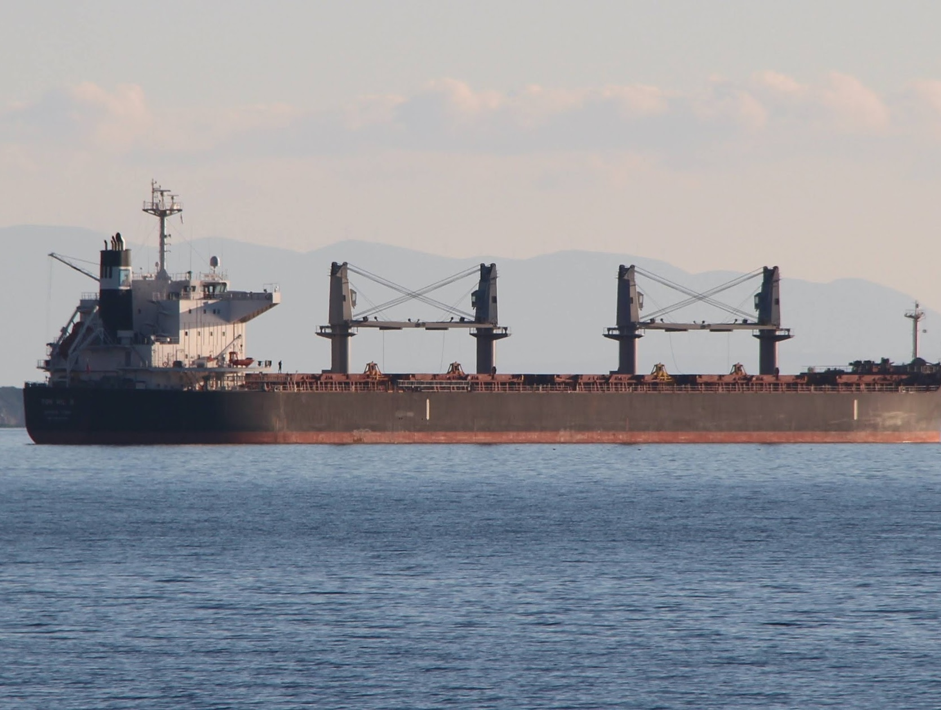
WHY
Learning Outcomes
Comprehend and articulate the key concepts and principles of maritime cybersecurity.
Understand the evolving cyber-threat landscape and the diverse range of cyberattacks.
Identify the cybersecurity threats, vulnerabilities, and risks to ships and maritime actors
Ability to design a secure information security architecture and plans that safeguard critical assets.
Ability to help and select appropriate security controls to protect against identified cybersecurity threats and risks.

Slide 10

Training Outline
Day-1
Topic-1: Introduction to Maritime Cybersecurity
The Landscape: stakeholders, threat actors, concerns
Regulations and recommendations
Topic-2: Cybersecurity
Objectives
Methodologies and tools
Cryptography
Hash functions
Security protocols
User authentication and access control
Compartmentalization and simplification
Intrusion detection and prevention
Topic-3: Basic concepts in cyber-defense
Topic-4: Attacks
Malware categories
Electronic warfare

Slide 11
Training Outline:
Day-2
Topic-6: Ship systems
Communication
Navigation
Operations
Passenger and crew infotainment
Topic-7: Cybersecurity incidents
Incidents affecting onboard systems
Incidents concerning land-based system
Topic-8: Measures
Measures for onboard systems
Measures for land-based system
Topic-5: Risk Management
The basic concepts
Frameworks, Plans, Procedures
Topic-5: The Human Factor
Awareness, Training, Cyber Security Culture

Slide 12
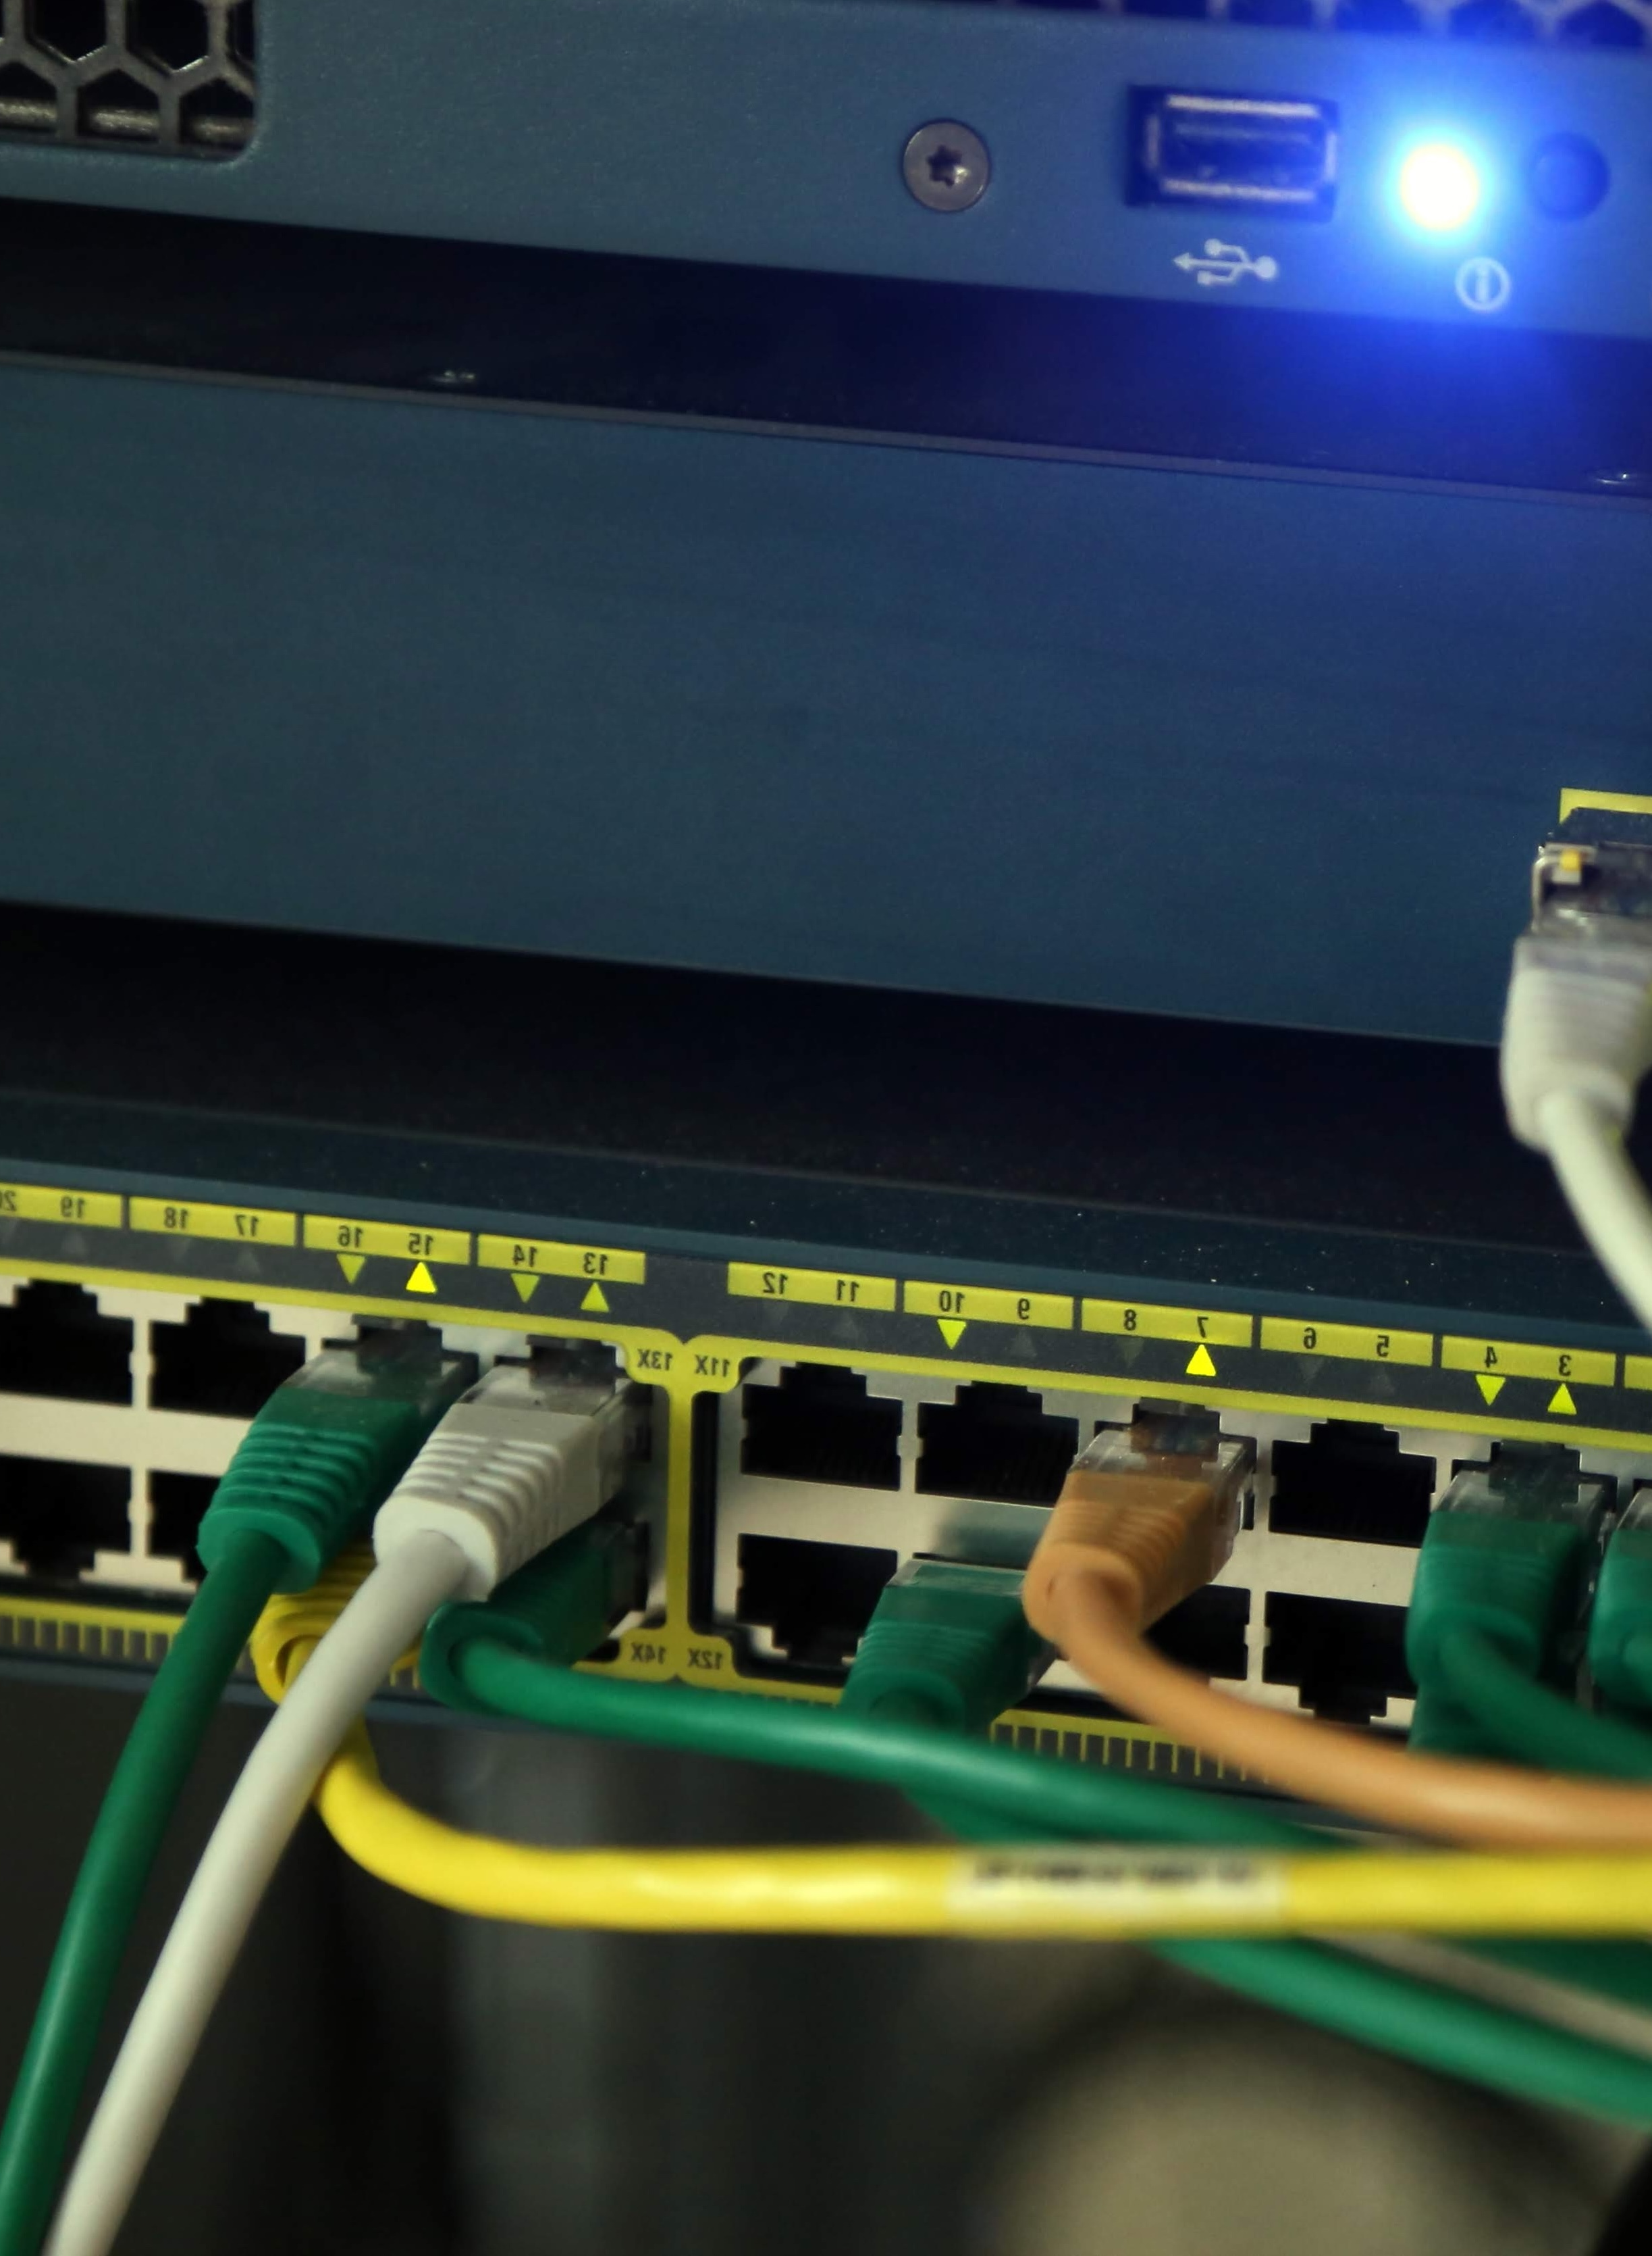
Maritime Cybersecurity
Cyber-security (or IT security) aims at the protection of computers, computer-controlled systems and networks from attacks by malicious actors.
Cybersecurity implies concepts, tools and practices suitable for defense against attacks generated by the human ingenuity.
The increasing digitization and reliance on IT also the emergence of MASS makes the shipping industry more vulnerable to cyber-attacks.
In the maritime domain, there are still many open questions regarding, inter alia, cyber-security measures, legal definitions and insurance.
The growing number of cyber-attacks and increasing relevance of cyber-security is challenging one of the oldest concepts of marine insurance contracts, the warranty of seaworthiness,

Slide 13
Maritime Cybersecurity Landscape
Source:

Slide 14

Maritime Cybersecurity Landscape
Source:

Slide 15

Maritime Cybersecurity Landscape
OT vs IT maritime cybersecurity
Are maritime IT systems cybersecure enough, already?
Maritime OT cybersecurity and safety: the crucial link
  Minimizing the risk of cyber-security related safety incidents

Slide 16
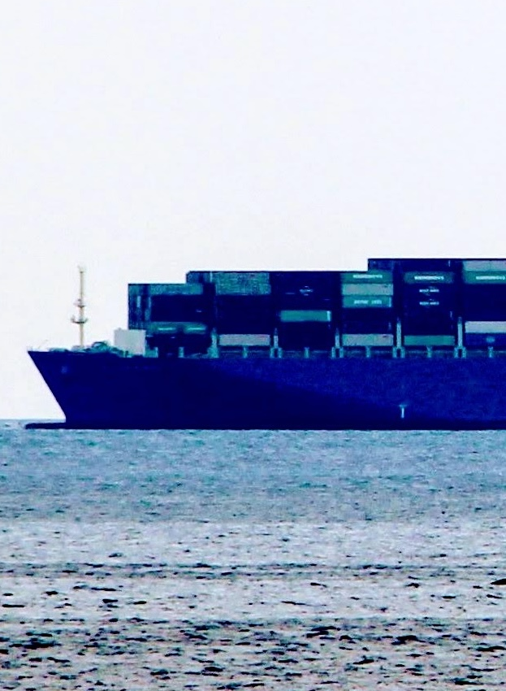
Maritime Cybersecurity Landscape
Source:

Slide 17
Maritime Regulatory Context and Compliance Aspects
Reframing regulations to address cybersecurity
new requirements and recommendations set out by the IMO and IACS
“creating industry standards that give organizations best practice guidelines to follow; develop a security posture that meets or exceeds regulatory requirements”

Slide 18
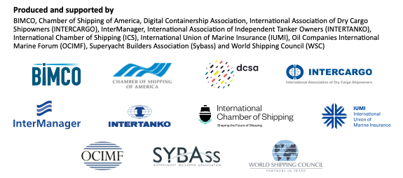
Maritime Regulatory Context and Compliance Aspects
Regulations and Recommendations

Slide 19
Maritime Regulatory Context and Compliance Aspects
Regulations and Recommendations
International Maritime Organization (IMO) adopted resolution MSC.428(98) on Maritime Cyber Risk Management in Safety Management System (SMS)
  encourages administrations to ensure that cyber risks are appropriately addressed in SMS no later than the first annual verification of the company’s Document of Compliance (DoC)
Digital Container Shipping Association’s (DCSA): “DCSA Implementation Guide for Cyber Security on Vessels v1.0”. DCSA’s guidelines are based BIMCO guidelines and the NIST framework.
The International Association for Classification Societies (IACS): “Recommendation on Cyber Resilience (No. 166)”; recommendations related to cyber resilience, subject to the requirements of a classification society, it applies to newbuild ships only but can also serve as guidance for existing ships.

Slide 20
Maritime Regulatory Context and Compliance Aspects
Cyber-seaworthiness (Schinas and Metzger, 2023)
A ship is considered to be cyber-seaworthy if:
the most relevant cyber-risks are addressed in the safety management system (SMS);
every crew member is trained on cyber-risks and system vulnerabilities for the systems they operate or maintain;
the hardware interfaces are physically protected;
each piece of software is protected from unauthorized access
through a network connection;
security solutions compliant with the best practice in the industry are in effect, including firewalls, anti-virus, and monitoring systems;
administrative, private, and recreative data is segregated from the data related to critical and non-critical operations of the ship;
all software embarked or used in devices that are in some way connected to a network or to other devices must be in the maintenance phase, that is, its manufacturer is providing the necessary updates, including the security ones, to keep this software operational and secure

Slide 21
Cybersecurity
Cyber-security (or IT security) aims at the protection of computers, computer-controlled systems and networks from attacks by malicious actors.
Cybersecurity implies concepts, tools and practices suitable for defense against attacks generated by the human ingenuity.
Security is not an exact science; it is rather a collection of ideas, methodologies, and tools.
A rather small number of basic concepts is used in cyber-security. Each concept appears in several tool variants and combinations.

Slide 22
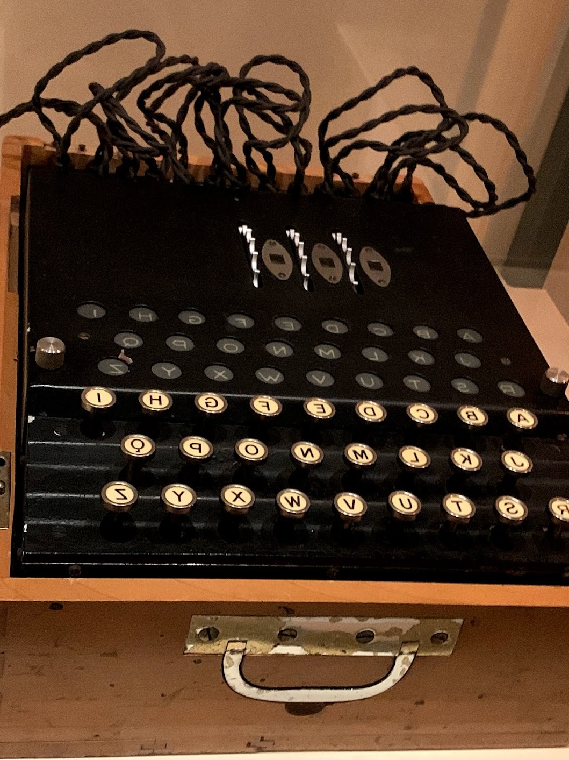
Cybersecurity basic concepts
Cryptography: A cryptographic algorithm takes as input any text and transforms it to a totally incomprehensible text. It can also perform the reverse transformation.
Hash functions take any text as input, and output an incomprehensible text of standard size, from which the original text cannot be retrieved.
Security protocols are rules that govern the behavior of various communicating entities that try to achieve a security related objective.
User authentication and access control are rules and measures that allow specific legal users to gain access to appropriate parts and functions of a system.
Compartmentalization and simplification of systems: By dividing a system into parts with barriers between them, and by allowing users to have access to the necessary part only, the overall security is increased. Also, by simplifying each part as much as possible, the behavior of this part can be better foreseen in various circumstances, including the presence of threats.
Search for abnormalities during operation: Compromised systems can be diagnosed by comparing their behavior to their usual or desired behavior.

Slide 23
Cryptography
In simple words cryptography converts a text message, which must be secretly communicated to a recipient, to incomprehensible gibberish.
The original text is usually called plaintext. The conversion process is called encryption. The rules used in encryption are collectively called code or cipher, and the outcome of the encryption is the ciphertext.
Encryption must be such that the recipient should be able to recover the plaintext from the ciphertext by using a reverse conversion, which is called decryption.
Ideally, only the legitimate recipient should know how to perform the decryption.
We shall use the name “Bob” for the message sender and “Alice” for the recipient (or vice versa).

Slide 24
Symmetric cryptography
In cryptography typically everybody knows the algorithm, i.e. the cipher.
The encryption/decryption algorithm uses an input parameter, which is called the “key”.
The key is only known to the legitimate communicating parties (Bob and Alice).
In symmetric cryptography the same key is used for encryption and decryption.
How to exchange keys safely is a problem in symmetric cryptography.
In Julius Ceasar’s cipher each letter in the plaintext was replaced by a letter three positions down the alphabet, e.g. "venividivici" was converted to "zhqlzlglzlfl".
Some ciphers rely on mathematical functions that transform the plaintext to ciphertext and vice versa.
However, modern ciphers mainly rely on ideas from card deck shuffling rather than mathematics.

Slide 25
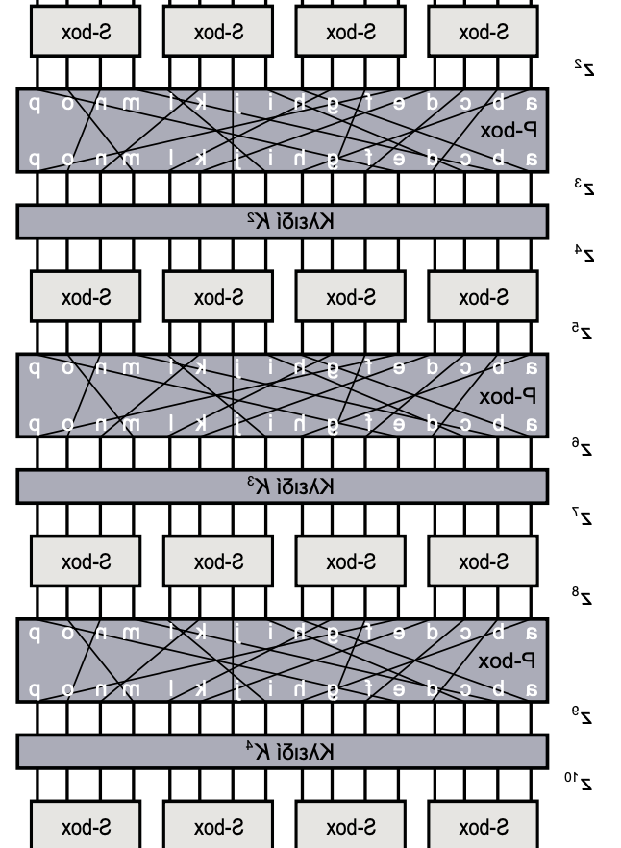
Symmetric ciphers
Modern ciphers rather rely on controlled shuffling. The Substitution-Permutation Network (SPN) is a fundamental concept used in block cipher algorithms
An SPN uses two types of “boxes,” which transform a short input bit sequence (block of bits) to an output bit sequence.
Substitution boxes, or S-boxes, perform substitution by mapping each input block to an output block according to a table. One-to-one substitution is necessary for invertibility.
Permutation boxes (P-boxes), perform permutation by rearranging bits. They take outputs from S-boxes and permute the bits, and further distribute their output bits to other S-boxes.
Repeated and extensive usage of these and similar techniques ensure a controlled transformation of a bit sequence of standard length (e.g. 256, or 512 or 1024 bits) that represents the plaintext to a bit sequence that represents the encrypted text.
The Advanced Encryption Standard (AES) is the current standard for symmetric cryptography. It is described in recommendations FIPS PUB 197 and ISO/IEC 18033-3.

Slide 26
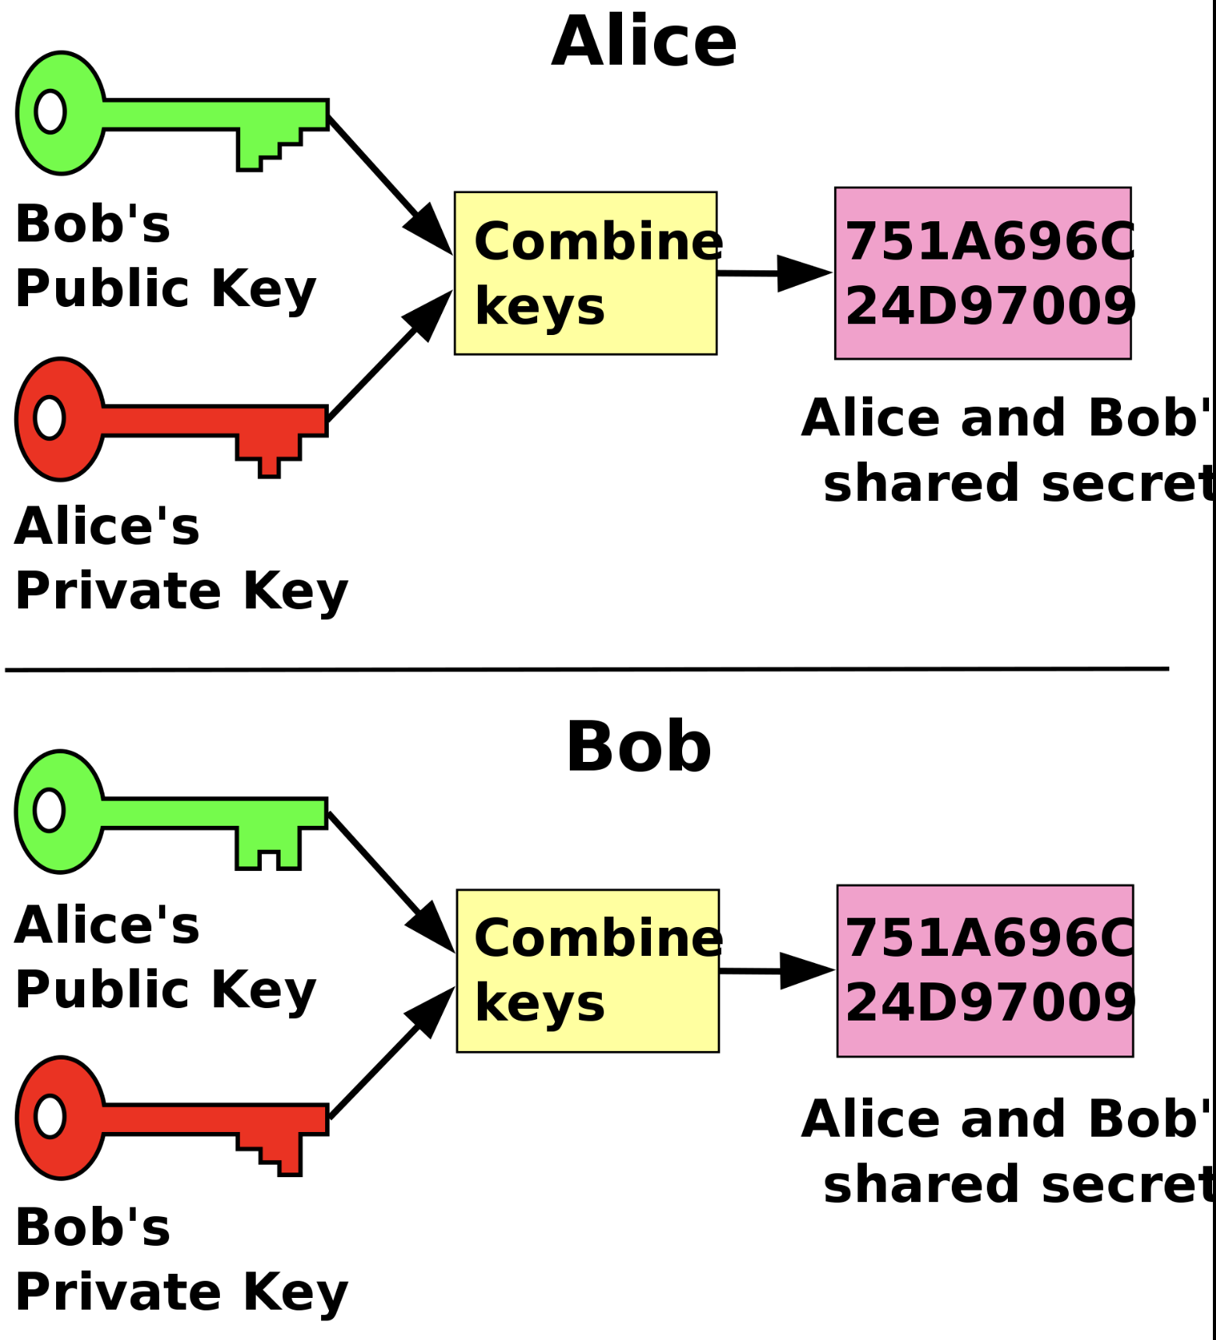
Asymmetric or public key cryptography
In 1976 Whitfield Diffie and Martin Hellman proposed an algorithm for key exchange.
Their method involves two keys for each of the communicating parties, a private key, which is obviously kept secret by each party, and a public key, which is announced to the other party or publicly.
Each party, by using its own private key in combinations with the other party’s public key, can compute a number.
The Diffie-Hellman method produces the same number for both parties, which is suitable for further usage as a key in a symmetric encryption scheme. Ideally, nobody else can compute this key.
Davidgothberg, Public domain, via Wikimedia Commons

Slide 27




Asymmetric or public key cryptography
Bob
Alice
In 1977 Ron Rivest, Adi Shamir, and Len Adleman proposed a scheme that uses different keys for encryption and decryption. The scheme is known as RSA from the initials of its inventors.
Assume that Alice has created a public and a private (secret) key.
Scenario 1: Bob can send her a secret message by using her public key for encryption. Only Alice can read this message, because only Alice knows the corresponding private key.
Scenario 2: Alternatively, Bob can encrypt a message by using his private key and publish it. Anybody can decrypt it by using Bob’s public key. However, the message must have originated from Bob, who owns the private key (and has created the correct public key).
plaintext
plaintext
Encrypt with
Alice’s public key
Decrypt with
Alice’s private key
Send to Alice
ciphertext
Scenario 1

Slide 28

Some remarks on asymmetric cryptography
Both the Diffie-Hellman and the RSA scheme exploit results from number theory, i.e. the area of mathematics that deals with integer numbers.
Despite their mathematical elegance, asymmetrical cryptography schemes imply heavy computation. The plaintext and the ciphertext are both bit strings, thus they are very long binary integers.
Processing long integers is a challenge not only for attackers, but also for the legitimate users of the Diffie-Hellman, the RSA and other similar schemes.
That is why in practical applications and protocols symmetric algorithms remain the workhorse of cryptography.
Nevertheless, the initial remote symmetric key exchange can be done by a Diffie-Hellman or similar scheme.
Whitfield Diffie at the Royal Society admissions day in London, July 2017

Slide 29
Hash functions
In 1676 Robert Hooke declared that he had discovered a new law of physics, yet he was not willing to announce the law. Instead he published a cryptic message, that would later prove his discovery. The message was ceiiinosssttuv.
In 1768 he published the law: ut tension sic vis (as the extension, so the force). The initial message consisted of the same letters in alphabetical order.
A hash function accepts as input a text of arbitrary length and produces a fixed length output text, often called a digest or hash code/value or, simply, hash.
Ideally a hash function cannot be inverted, i.e. the initial text cannot be retrieved from the hash. Also, it is (almost) impossible to find another text with the same digest.
Hooke’s book on Springs

Slide 30
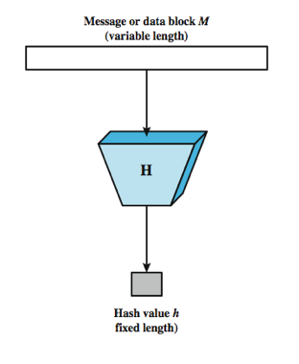
Hash function usage
A hash function can ensure text integrity. If the digest of a text is kept in a safe place, the text can later be checked for integrity by recomputing the digest and comparing with the past value. Antivirus software makes use of this technique.
Digests of user passwords can be stored in a file (for the log in process) instead of plain passwords. When the user tries to get access, the digest of the password is compared with the stored digest. The administrator or a hacker cannot deduce the passwords from the digests.
A hash function can serve as a signature, together with a public key algorithm. Bob can publish a text, together with the digest encrypted with his private key. Thus, recipients can verify the integrity of the text and that the sender is Bob.
The most widely used hash functions belong to the SHA (Secure Hash Algorithm) family, whose development started in 1993. The current version is SHA-3, which was finalized in 2015 and supports the creation of digests of length up to 512 bits.

Slide 31
Keyed Hash function
A hash function can be modified to accept a key. If Bob and Alice have exchanged a key, Bob can send Alice a text that can be checked for integrity by Alice, and at the same time only Bob can be the creator of the digest.
The simplest way of adding a key to a hash function would be to hash the composite string of the input text and the key, although this scheme is considered unsafe.
Recommendation RFC 2104 describes a more elaborate scheme of reinforcing any hash function with a key, which is known as HMAC (Keyed Hashing for Message Authentication).

Slide 32
Communication protocols and security protocols
A communication protocol is a set of rules that enable a group of communicating entities (at least two) to achieve a goal.
In other words, a communication protocols is a distributed algorithm, i.e. an algorithm which comprises steps that are executed by communicating entities. I
In each step an entity may start executing a task, after having received messages that are prerequisites or triggers for the execution of the task.
A security protocol is a set of rules used by the entities of a security system. The objective of a security protocol is to achieve a security related result.

Slide 33

Security protocol example
A protocol can describe message exchanges between the remote control and the car locking mechanism.
In the first version of the protocol the remote-control device emits a signal, which is recognized by the locking mechanism.
The valet attack can be performed by a parking employee (valet) that can record the signal. The employee can later reproduce the signal to trick the locking mechanism.
In a second-generation protocol the remote-control sends a pseudorandom number to the locking mechanism, and the number changes after every usage in some predefined manner. The car lock control mechanism must compute the same number and compare it with the incoming number.
A second-generation attacker will try to discover the algorithm that changes the number.

Slide 34
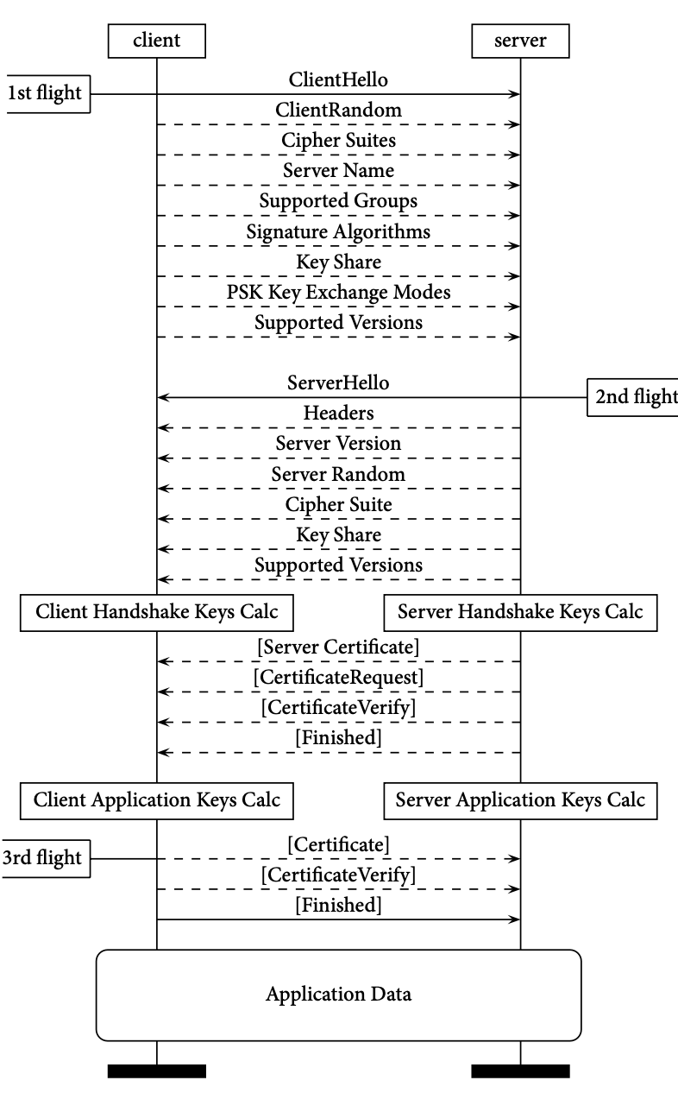
Secure communications
The Transmission Control Protocol (TCP) provides reliable data transfer between applications running on different machines. The SSL/TLS (Secure Sockets Layer / Transport Layer Security) protocol suite provides the additionally needed security and privacy.
The communicating parties rely on symmetric cryptography; therefore they must agree on a cipher that both can support, and of course keys must be exchanged before encrypted data transfer begins.
Since the first SSL versions in the 90s, and its subsequent development into TLS, the protocol has been extensively redesigned quite a few times in order to provide defense against various attacks. In this respect, the original communication-oriented protocol has been heavily reshaped by security considerations.
In view of the growing threats in all aspects of communication, this process exemplifies the life-cycle of several protocols that start as communication protocols and acquire plenty of security features, which mark their evolution towards security protocols.
TLS 1.3 handshake

Slide 35

Authentication
User authentication is a process that allows only authorized entities (individuals, applications, or services) to gain access to systems and resources. It involves two steps:
  Identification, in which the entity provides an identifier to the authentication control subsystem.
  Authentication, in which the entity provides a strong indication that proves the unique relationship of the identifier to the entity.
In the simplest kind of user authentication to a computer, the user provides a name and a password

Slide 36

Authentication technologies for humans
When a human user is involved, the proof may be
  something the user knows, e.g. a password,
  something the user has, e.g. a card token or a phone or a digital certificate, or
  something the user is, e.g. a fingerprint or an iris scan, or
  something the user does, e.g. handwriting, voice pattern.
Essential properties of the “proof” are uniqueness and secrecy: Nobody else knows the password, or is in possession of the same token, or has a similar fingerprint.
If the level of certainty is considered inadequate for an application, additional authentication data can be required (second factor authentication).

Slide 37
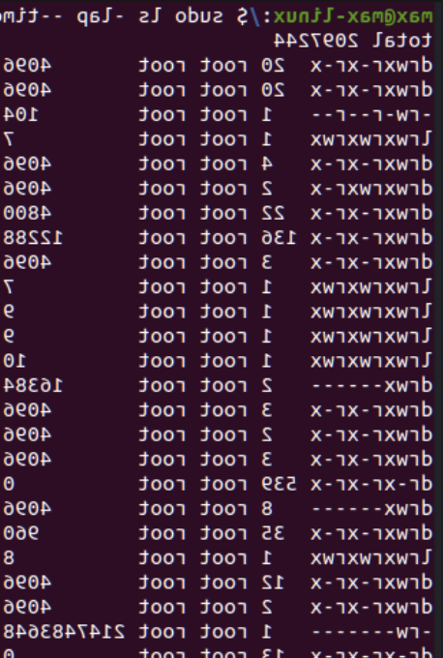
Access control
After an entity successfully finishes the authentication process, the entity gains access to system resources.
Access control determines the system resources that can be accessed and the type of access allowed for each resource.
For example, user A may have only read access to a file, while user B may have read, modify, and delete rights.
Access control can be implemented by using different approaches. In some systems each user is given explicit per resource access. In other systems access can be role based, i.e. a user belongs to one or more role groups (e.g. administrators, operators, common users), and users in the same group gain similar rights.

Slide 38
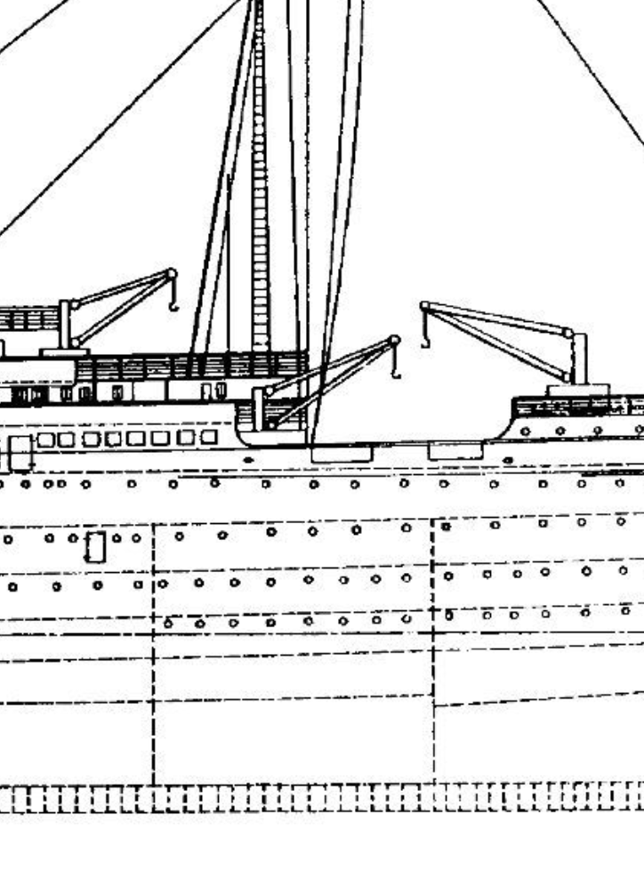
Isolation and compartmentalization
Isolation coupled with access control is an old security (and privacy) protection concept.
The first banking and airline networks used privately owned or leased links. Today, they use the Internet, albeit with additional protection. Critical industrial systems are still isolated from external communications.
Firewalls in a network scan data packets and allow or forbid entrance to specific areas and systems.
Before being installed in a computer, suspicious software can be tested in "sandboxes.”
In a military installation different users have different access rights to separate (possibly protected) spaces and resources according to their "clearance" (level of access rights).
Dividing networks in parts enables the defense to put control points, e.g. firewalls, between parts.

Slide 39
Simplification
A complex system that serves a purpose can be designed in different ways. Occam's razor is a codeword for the principle of using the simplest possible approach.
Simplicity may often be an economy objective, but it can also ensure less faults, more predictive behavior, and thus more security.
Simplification reduces the system’s attack surface, making it less susceptible to exploitation.
Programming languages can perform the same task with a variety of commands. A minimized set of commands ensures more controllable and more secure operating systems, and applications.

Slide 40

Intrusion detection
During a denial-of-service attack on an organization clients cannot access a service, and cybersecurity systems and personnel must react to protect and secure the organization’s assets and operations. The first step is to diagnose the cause of the disruption, and then take appropriate countermeasures.
However, not all attacks are easily and immediately detectable.
An intrusion detection system (IDS) collects data from various parts of a system and its environment and tries to detect abnormalities than might be due to malicious actors.
The IDS may inspect packets passing through links, server ports, and firewalls. It may record sequences of commands given in real time by users and applications or inspect log files that contain already recorded events.The IDS will then analyze the data and determine if an attack takes place, how it could possibly be repelled, and what damage has been done. It also provides an interface to human operators that will take further action.

Slide 41

Prevention
An Intrusion Prevention System (IPS) is a network security technology that continuously monitors network traffic for suspicious activity and takes proactive steps to prevent it.
The most common intrusion prevention system (IPS) is a firewall. A firewall is a network security device that monitors and controls incoming and outgoing network traffic.
It inspects data packets, and destroys packets that do not comply with rules, or destroys all packets except those that comply with rules.
A more general set of rules applied on data collected by various network sources can be used by a network IPS.
A host-based IPS will try to detect anomalies in a computer system, e.g. modification of files and other resources, user attempts to access areas outside their allowed range, or to gain root access etc.

Slide 42

Attacks
Defense is tailored to possible attacks; it can only defend against noticed known attacks. Perhaps the most successful attacks remain unnoticed, or get noticed extremely late.
System loopholes are called vulnerabilities.
There is a black market for vulnerabilities. The offer side comes from hackers, while the demand side comprises criminals, secret and military services, police, and big ΙΤ companies.
The majority of computer crime relies wholly or partially on human deception (social engineering) rather than advanced technology.
A common way of using social engineering is the usage alarming messages or pop-ups to scare victims into taking specific actions.
In the following we summarize common attack methodologies and tools.

Slide 43

Malware
A taxonomy of malware according to the methodology used for infecting machines includes the following types of code:
A virus is harmful code that is attached to a useful computer program and can reproduce itself by infecting other programs in the same or in other machines. Upon activation it can perform various malicious actions, e.g. distribute advertisements, send spam email, install bots, collect data, install ransomware, install spyware, remove critical files, etc.
A worm is self-sufficient harmful code that can reproduce itself and spread around.
A Trojan horse is non-self-reproducing harmful code that relies on social engineering (human error) for its spread. It may reside in a seemingly useful and attractive program that a user is compelled to download and execute.

Slide 44


Bots and botnets
A bot is a harmful computer program that accepts command from a master, and executes malicious actions.
Bots can be members of an organized group (botnet) and act in synchronization.
Some botnets may consist of hundreds of thousands of bots spread over an equal population of infected machines.
Traffic sent from a large bot population towards the same victim machine or network resource can implement a powerful denial of service attack.

Slide 45
Denial of service attacks
A denial of service (DoS) attack aims at the prevention of the provision of a service by obstructing critical resources, usually by flooding the communications of servers and/or by sending an excessive number of requests.
Although some DoS attacks impede critical components of a system, the bulk of DoS attacks do not require more skill than just the production of too much traffic.
By tracing the traffic flood in the network, the defense can possibly halt the attack and trace the traffic sources.
A botnet can generate the necessary amount of traffic by enlisting a large number of bots; in this way the traffic generated, and its sources are distributed, thus less traceable.
Such a distributed attack is called distributed denial of service (DDoS) attack.
A simple ping attack

Slide 46
Malware by intended effect
Adware sends (mostly unwanted) advertisements.
Spam software sends massive numbers of messages (in email and other messaging systems), possibly for malicious purposes.
Fishing messages compel users to perform actions that harm themselves, e.g. to open malicious webpages or download Trojan horses.
Spyware records a human user’s actions on a computer in order to collect sensitive data. Spyware can possibly consist of more than one components that use different methods to collect data. A keylogger records the sequence of keys pressed on the keyboard by using various methods, e.g. by infiltrating the keyboard software, by recording the (slightly different) sound of each key, by taking screenshot etc. Spyware can also use the camera and the microphone of a mobile phone or a laptop.

Slide 47
Malware by intended effect
A backdoor allows an unauthorized user to gain access to a system. Backdoors have been used by maintenance personnel in computers. Law enforcement and secret service are rumored to be able to use backdoors in certain devices, including mobile phones.
A rootkit is software that allows the control of a machine by a remote unauthorized user. A rootkit may include various malicious components, as well as means to eliminate the traces of the malicious actions. Some rootkits will even install antivirus software to the victim machine in order to prevent other malware to take control.
Ransomware encrypts critical data in a system and asks for ransom before they provide the decryption key.
Advanced persistent threat (APT) is a complex attack that uses as many methodologies, resources and tools are needed to achieve a goal. An APT can be afforded either by powerful criminal groups or by state agencies.

Slide 48

Electronic warfare
Electronic warfare refers to techniques used in military conflicts. The objective is to hinder the usage of the opponent's infrastructure or destroy it.
The obstruction of an adversary’s wireless communications is a classic objective in electronic warfare. A common method of obstruction is (apart from destroying antennas) through jamming, i.e. strong emissions on the adversary's wireless communications frequencies.
Defense includes frequency hopping, i.e. changing the transmission frequency in a pseudo-random way, burst communication, i.e. reducing signal duration, reducing power, limitation of its spatial properties with narrow directional emissions etc.

Slide 49
Electronic warfare: Satellite jamming and spoofing
Jamming devices can emit radio frequency signals that overpower the legitimate GPS signals at the receiver side. The aim of this attack is to render positioning inaccurate or unreliable.
Generation of false navigation satellite signals can cover an area (depending on the rogue signal power) and replace the legitimate signals. Positioning becomes false and navigation can be misled.
Both the jamming and the satellite signal replacement can be performed by local agents that cannot the sources of the signals.
The owners of a satellite system (states or groups of states) can selectively degrade their services. In the 1990s (and before May 1st 2000) GPS positional accuracy was selectively degraded by its owner, i.e. USA, which induced a pseudorandom error of up to 100 meters to common users, and on occasion could deny access to selected users. Russia, China, India, Japan, and the European Union subsequently developed their own satellite navigation systems.
Ships can always use alternative means of navigation (even sextants), if the problem is diagnosed.

Slide 50
Attack targets in the maritime sector
Business Information Systems and Freight Logistics Systems
Onboard and land-based operations
Cargo
Passengers and crew

Slide 51
Management and logistics
Maritime Logistics and Supply Chain (MLoSC) services are a primary target of attackers because of the usage of IT and because of the gains they can provide to criminals.
Attacks can directly target money transfers, can modify the transportation of goods, or aim at information collection for later exploitation. Another area of attacks on logistics is the usage of denial-of-service attacks, which can aim at the reputation and trust of a company or at asking for ransom.
Yet another objective is industrial spying.

Slide 52

Operations
Ships, ports and other related industrial installations include Industrial Control Systems (ICS).
SCADA (supervisory control and data acquisition) is a control system architecture that consists of software, hardware, and communication components. It may also incorporate sensors, and programmable logic controllers (PLCs).
SCADA systems can control loading and unloading systems, e.g. cranes, pipes etc. They can also reside in navigation, propulsion, and power generation of ships.
Traditionally ICSs have been stand-alone or have used internal ship communications (e.g. to connect bridge with engine-room).
However, recent SCADA systems have followed the trend towards integration in wider systems. Even in the years of isolation, attacks were possible.
In the renowned Stuxnet attack the Iranian Uranium enrichment facilities were infected by using a USB stick. The Stuxnet worm subsequently infected a great number of SCADA systems worldwide.

Slide 53
Attacks on SCADA systems
Modern attacks on SCADA use various approaches, e.g. network layer and transport layer flood attacks, spoofed DNS attacks, unauthenticated remote access, SQL injection, etc.
The effect on critical SCADA systems can be ship and port facility damage, annoyance, delay, and additional costs, so that the criminals hinder or delay transportation and ask for ransom.
A series of attacks that pertain to port operations aim at facilitating the loading and unloading of illicit goods in containers.

Slide 54
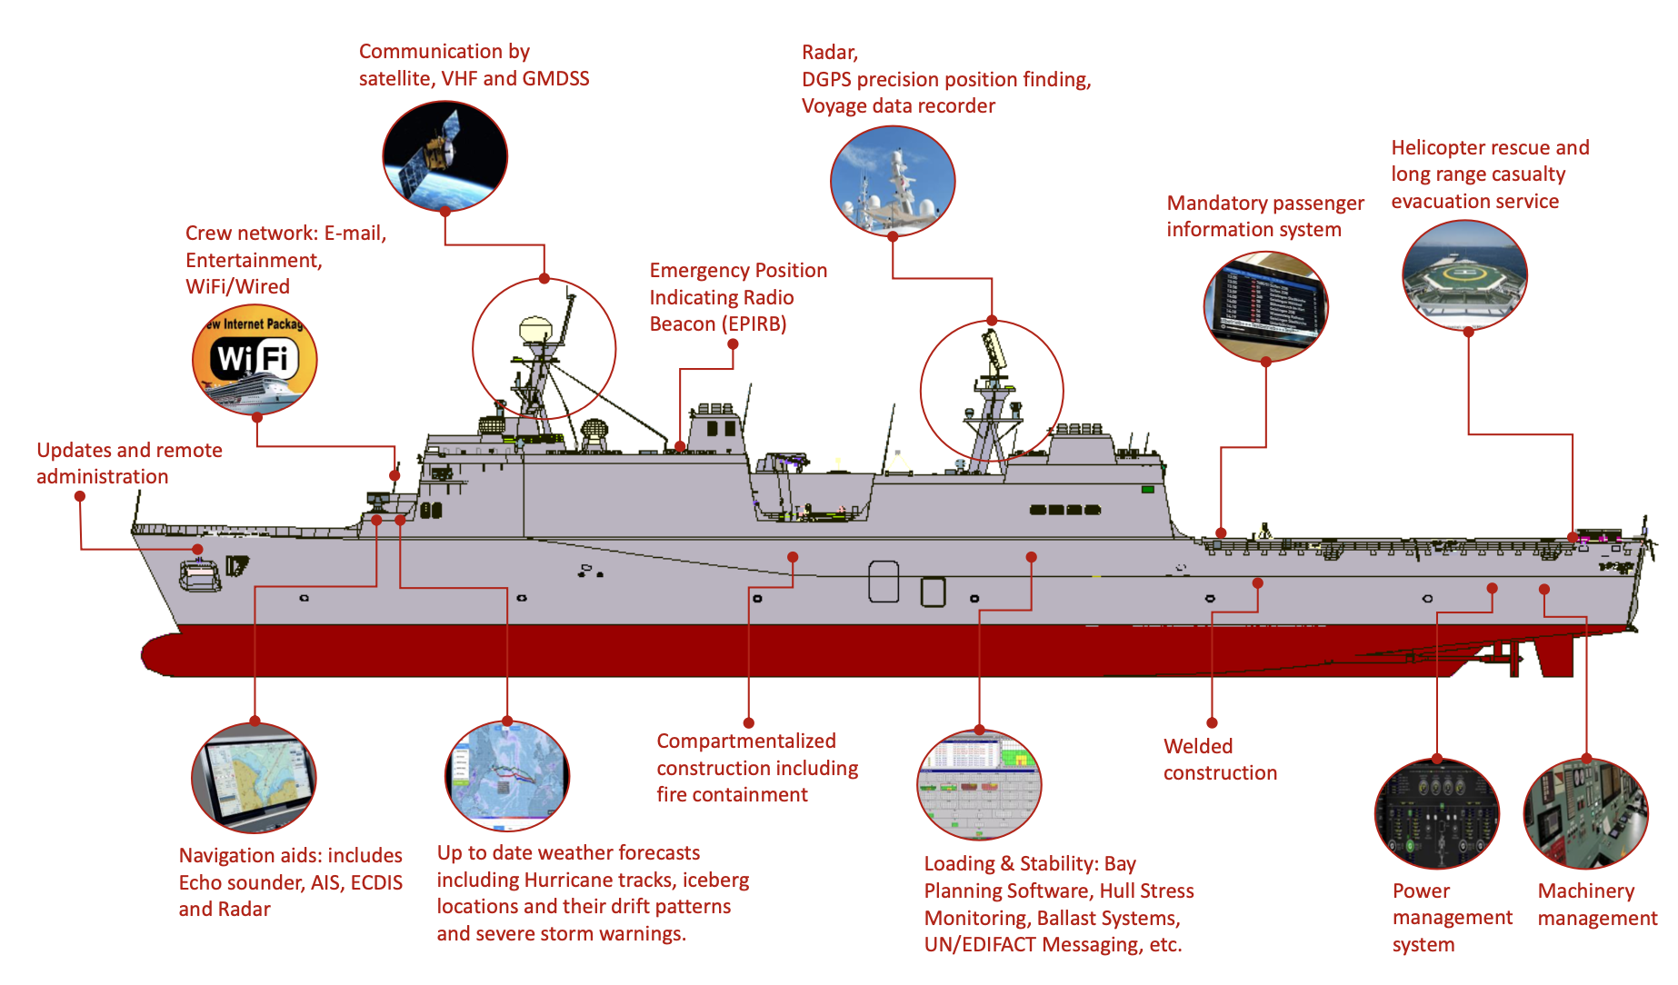
Operations: Onboard control and communication
Automatic Identification System (AIS),
Electronic Chart Display and Information System (ECDIS),
Satellite navigation (GPS, GLONASS, BeiDu, Galileo)
Global Maritime Distress and Safety System (GMDSS),
Voyage data recorder (VDR)
Image reference: Akpan, Frank, et al. "Cybersecurity challenges in the maritime sector." Network 2.1 (2022): 123-138. From CruisMapper. Cruise Ship Safety (https://www.cruisemapper.com).

Slide 55
Vessel Cybersecurity
Vulnerabilities of modern vessels and MASS (Akpan et al, 2022)

Slide 56
Vessel Cybersecurity
Vulnerabilities of modern vessels and MASS (Akpan et al, 2022)

Slide 57
Vessel Cybersecurity
Mitigation actions in modern vessels and MASS (Akpan et al, 2022)

Slide 58
Vessel Cybersecurity
Mitigation actions in modern vessels and MASS (Akpan et al, 2022)

Slide 59
Other targets of attacks
Cargo
  Misappropriation of valuable goods is a theoretical possibility
  However, most transportation related incidents pertain to the transfer of illicit goods along with legal items, e.g. in the same containers.
Passengers and crew
  Humans onboard ships can be passengers, crews, pilots, rescuers, and other visitors. A wider variety of personnel appears in ports and other land-based facilities.
  They can be the intended victim or the vehicle of an attack, as they operate industrial devices or carry personal devices that are connected to networks in ships, ports, vehicles, offices etc.

Slide 60
Cybersecurity attacks in the maritime sector
In a 2021 report¹ forty six “maritime cyber security incidents” have been reported in the eleven-year period 2010-2021. The total number of incidents is negligible as compared with the usual “land based” IT systems.
Most of the attacks were directed against the IT systems of shipping companies, carriers, contractors, and ports.
The administrative system of 6 ships have been attacked.
There is just one attack that affected the onboard control system: The US Coast Guard received a message that a large vessel was "experiencing a significant cyber incident impacting their shipboard network . Even in this case, the resulting onboard systems degradation did not hamper essential ship control.
Perhaps the most frequent type of attacks on operations was jamming or spoofing attacks against the positioning system of ships in an area, the attackers most probably being nearby states.
1 P. H. Meland, K. Bernsmed, E. Wille, Ø. J. Rødseth and D. A. Nesheim, "A retrospective analysis of maritime cyber security incidents," TransNav - The International Journal on Marine Navigation and Safety on Sea Transportation, vol. 15, no. 3, pp. 519-530, 2021.

Slide 61
Sample cybersecurity attacks in the maritime sector
A 2022 paper¹ presents several cybersecurity incidents:
A GPS jamming attack in South Korea in 2016 led to a collision of ships.
Another GPS jamming attack in the same area caused navigations issues on 280 ships.
A large container vessel lost its navigation system for several hours en route from Cyprus to Djibouti in 2017
The GPS system of a ship sailing in the Baltic Sea falsely showed its position on land, in 2018.
A serious malware attack on Maersk’s logistics halted its port operations in 76 locations in 2018.
A virus attack on the ECDIS of a brand new bulk carrier costed thousand of dollars in 2018.
A malware attack on onboard computers supplied by a US Navy contractor resulted in massive sensitive data theft in 2019.
The management systems of two ships were infected by the AZORult macro-virus, which came in a Word document as an email attachment.
An attack on IT system of the shipping company CMA CGM SA affected its logistics and customer services.
A Mespinoza/Pysa ransomware attack compromised operations in the port of Marseille in 2020.
A ransomware attack on Greek shipping companies (that spread through an IT consulting firm) took place in 2021. A few days after the attack one vessel was hijacked and six ships lost steering control.
An attack on password management in the port of Houston in 2022.
1 Akpan F, Bendiab G, Shiaeles S, Karamperidis S, Michaloliakos M. Cybersecurity Challenges in the Maritime Sector. Network. 2022; 2(1):123-138. https://doi.org/10.3390/network2010009

Slide 62

Connection with maritime crime
Most maritime cybersecurity incidents are related with good old maritime crime objectives, which they advance and enable further. The usual types of sea based/related illegal activities are:
Smuggling: Smuggling involves the clandestine transportation of are drugs, weapons, oil and fuel, and counterfeit items across borders, evading customs regulations and taxes.
Trafficking: In addition to transporting smuggled products, trafficking may also involve wildlife and humans.
Illegal fishing, which occurs when vessels fish without proper licenses or violate conservation measures or invade the EEZ (exclusive economic zone) of neighbouring countries.
Illegal (or semi-illegal) oil drilling, which occurs when a country or entity conducts oil exploration or extraction in an area belonging to the EEZ of another country or in an area that is disputed by a neighboring country. When oil is produced from a well in excess of the quantity permitted by rules, regulations, or orders, it is also considered illegal.
Piracy: Pirates hijack vessels, endangering crew members and disrupting maritime trade.

Slide 63
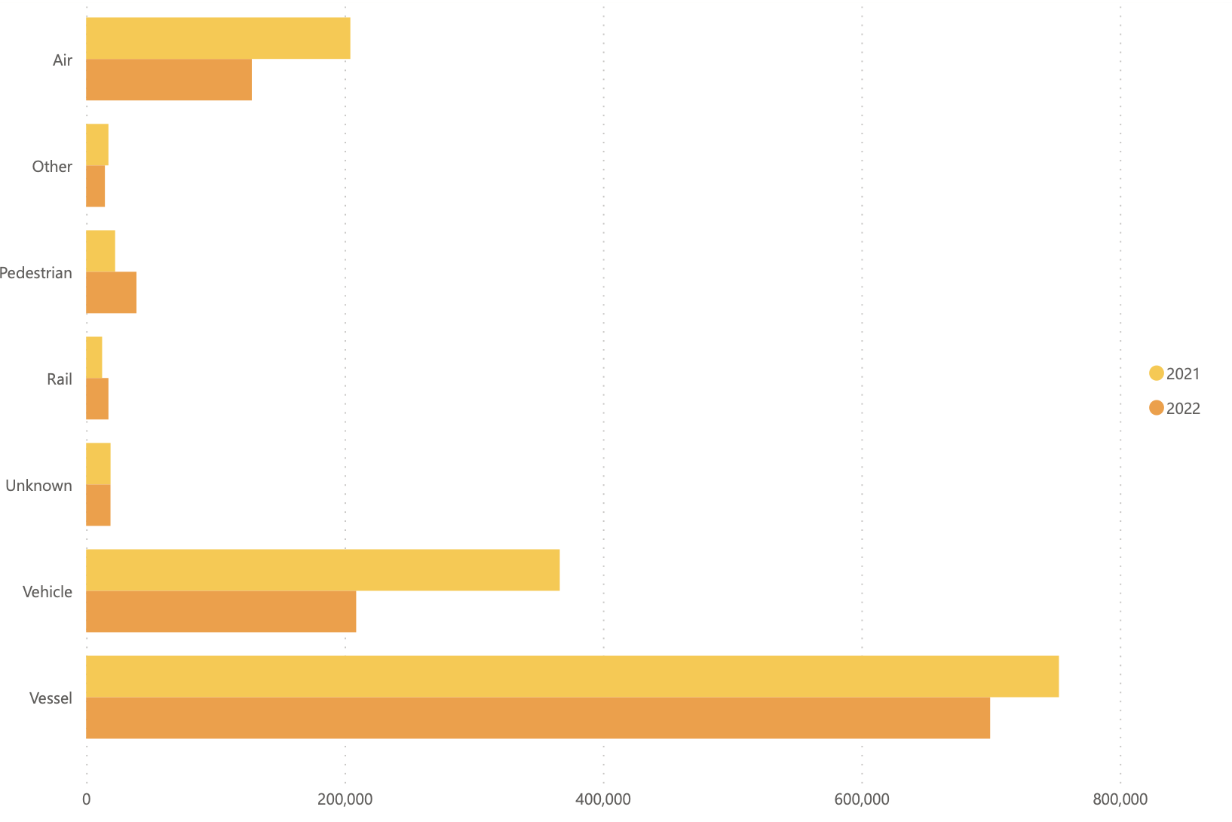
Smuggling
According to the 2022 Illicit Trade Report (ITR) of the World Customs Organization (WCO) sea is by far the most popular means of transport in terms of quantity.
Although all kinds of ships may be used for smuggling, container ships are the preferable choice of gangs.
In April 2023 Europol said more than 200 tons of cocaine have passed through the European Union’s two busiest ports.
A report by the agency revealed that the tactic has been growing since 2018, when the port of Rotterdam discovered that containers were missing.
In another area, the Information Fusion Center of Singapore, which collects Regional maritime security (MARSEC) incidents in the Southeast Asia and Indo-Pacific regions, has released 832 reported contraband smuggling incidents for 2023. These involve 203 incidents of domestic product smuggling, 201 incidents of drugs, 158 incidents of tobacco, and 272 incidents of other products. 258 small boats, 127 container vessels, 82 cargo vessels, 125 fishing boats, and 242 other types of vessels were involved.
A simple ping attack
World Customs Organization, "Illicit Trade Report 2022," WCO, 2023.

Slide 64

Smuggling illicit goods in containers
The criminals place their goods in their own or in other people’s containers. In both cases they must monitor the containers and retrieve the goods.
In container PIN code fraud an attacker obtains the unique code that allows them to collect a shipping container from a port terminal.
The criminals hack for relevant information the logistics systems of shipping companies, agents, freight forwarders, terminal operators et al.
Once the criminals retrieve the container by impersonating the legitimate recipient, they extract the contraband either in the port, or seize and finally abandon the container.
In 2022, approximately 96.0 million Twenty-foot Equivalent Units (TEUs) of containers were handled in main EU ports. This number does not include containers that were just passing through EU. Physical inspection is applied on about 2% of the containers on the average. When it comes to containers coming from South America the inspection rate rises to 10%. It is estimated that about 200 tons of cocaine arrive through the two major ports of Antwerp and Rotterdam.

Slide 65
The effect of port automation on smuggling
Illegal transportation is implemented by various personnel categories, which may include corrupt ship crew members, port employees, agents, crane operators, track drivers, members of local criminal groups, etc.
Port logistics support is necessary for criminals to locate the container during transportation or its exact position in container stacks in a port.
The integration and automation of transportation modes and logistics systems allow for more efficient and secure end-to-end transportation services.
More efficient container and employee inspection strategies (of the defense side) can benefit from artificial intelligence algorithms.
Also, simple security rules can offer significant security gains for the defense: For example, container related information can and should be given on a strict need to know basis.
However, integration and automation offer new opportunities to the criminals as well. Automation, optimization (and subsequent randomization) in high volumes of goods is often a perfect cover for illegal items.
Also, by properly hacking an integrated transportation system an attacker can achieve safe end-to-end delivery, and achieve savings, since certain criminal intermediaries will be unnecessary.
EU ports connected to the Trans-European Transport Network (TEN-T) are more attractive to criminals

Slide 66
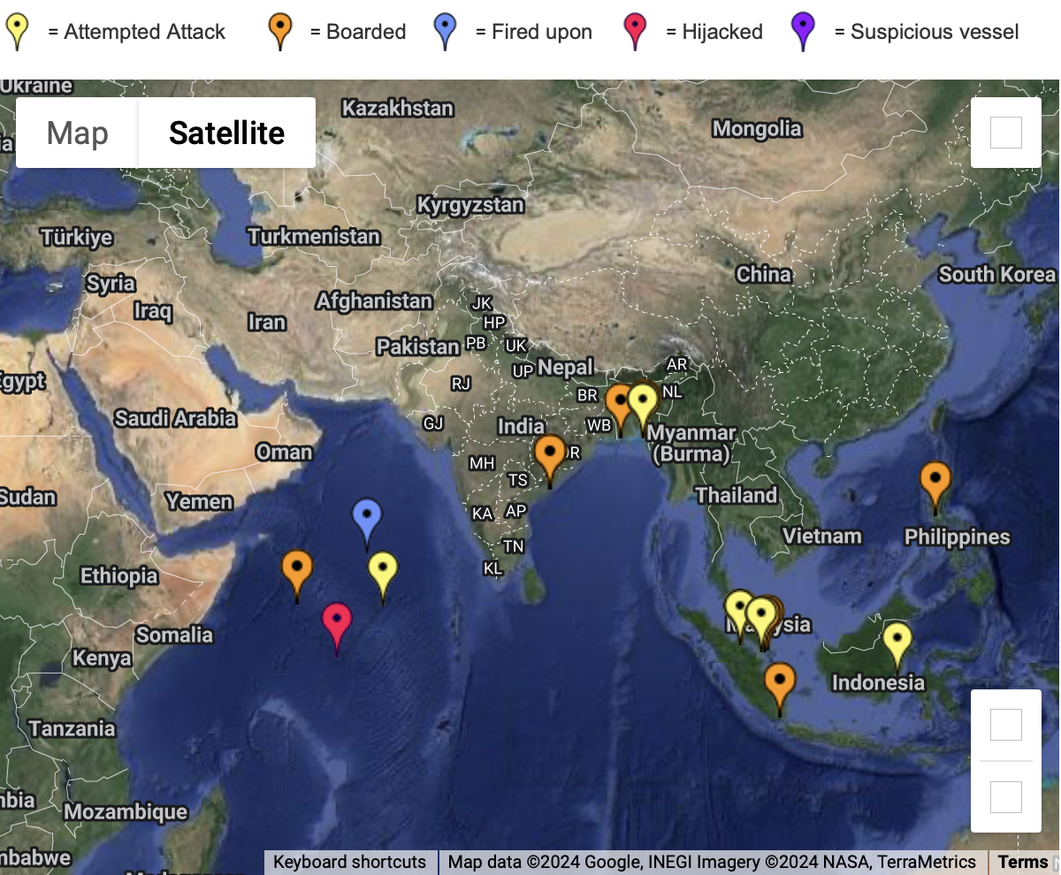
Piracy
Cyber-security breaches in vessels can be exploited by pirates. A successful cyberattack could disable critical operations, leaving the vessel stranded, its communication channels compromised, and its cargo information exposed. This scenario enables pirates to launch a physical attack with increased chances of success.
Conversely, the data collected through piracy can be further exploited by cybercriminals. Pirates often have access to sensitive commercial information, personal data of crew members, and details about shipping routes and cargo.
Selling this data on the dark web can be an additional business, further blurring the lines between cybercrime and traditional piracy.
The ICC Commercial Crime Services (CCS) is a UK based
international organization that focuses on combating
commercial crime. ICC offers a live global piracy map.

Slide 67
Inspection, boarding, and seizure incidents
The coast guard of a state can board and search a ship for illicit items within territorial waters. A chase can be completed in international waters.
Warships of any state can perform boarding, search and cargo seizure actions (in international waters) in cases of piracy and human trafficking.
Gray area boarding can occur in disputed territorial waters and in disputed exclusive economic zones (EEZ). Finally, some states choose to police areas broader than their nominal territorial waters or their (disputed or not) EEZ, regardless of the legality of their actions (which may fall in the area of state induced piracy).
The Red Sea, the Gulf of Aden, and the Black Sea nowadays host gray area boarding incidents and other assaults.

Slide 68
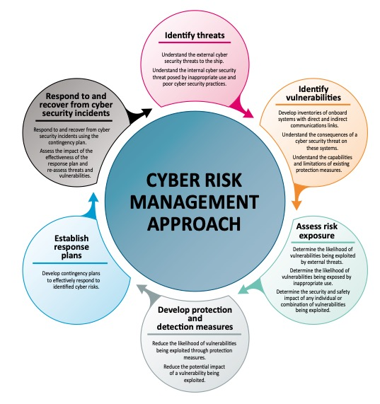
Cyber Security and Risk Management

Slide 69
Cyber Security and Risk Management
PDCA: a four-step management model for continuous
improvement of products, people, and processes (Kechagias et al. 2022)
Plan
Identify cybersecurity objectives
  Make an inventory of systems & software
  Execute cyber risk assessment
  Set Key Performance Indicators (KPIs) for cybersecurity
Do
  Establish cybersecurity policy & procedures
  Define roles & responsibilities
  Execute cybersecurity training
  Report cyber events & incidents
Check
  Evaluate the effectiveness of reaching objectives
  Analyze cyber incidents& event reports
  Execute internal audits of cybersecurity
Act
  Execute corrective & preventive actions
  Strive for continuous improvement

Slide 70
Cyber Security and Risk Management
Procedures and policy
Cyber Security Policy Statement
  Safeguard the confidentiality, integrity, and availability of Information, Information Systems, and IT / OT equipment.
  Promote the Safety and Security of persons and property within the Organization, both onboard and ashore.
Cyber Security Plan
Procedure Manuals

Slide 71
Cyber Security and Risk Management
Procedures and policy
Cyber Security Policy Statement
Cyber Security Plan
a comprehensive document which:
  Define the cybersecurity objectives
  Define required and prohibited actions
  Define duties and responsibilities
  Identify threats and vulnerabilities onboard and ashore
  Describe activity phases of cyber risk exposure assessment
  Present the adopted protection measures for cybersecurity control
  Present the contingency and incident res
Procedure Manuals

Slide 72
Cyber Security and Risk Management
Procedures and policy
Cyber Security Policy Statement
Cyber Security Plan
Procedure Manuals and policies
specific policies such as the hiring and termination policies, separation of duties, data classification, account disablement policy, access rights, business contingency plan or incident response plan, handling of third parties, etc.

Slide 73
Human Factor Aspects
Awareness, Training and Cybersecurity Culture
Talent shortages and workforce vulnerabilities
Awareness and training for all
“creating industry standards that give organizations best practice guidelines to follow; develop a security posture that meets or exceeds regulatory requirements”

Slide 74
Human Factor Aspects
Awareness, Training and Cybersecurity Culture
Ships, ports, and third-parties are often operating with rotating crews with different levels of cybersecurity understanding; not be fully familiar with the secure operation of the related systems and established cyber hygiene practices
Cybersecurity awareness training, education, and certification for the relevant parts of the vessel’s operation (crew, third- parties, ports, operators)
Cybersecurity awareness, education, and certification for all levels at the shipping company, including C-suite, shipping managers at various departments, IT Managers and CSOs

Slide 75

Bibliography
R. Anderson, Security engineering: a guide to building dependable distributed systems, Wiley, 2020.
W. Stallings and L. Brown, Computer Security, Pearson, 2023.
K. D. Mitnick and W. L. Simon, The Art of Deception - Controlling the Human Element of Security, Wiley, 2011.
E.-M. Kalogeraki, S. Papastergiou, H. Mouratidis and N. Polemi, "A Novel Risk Assessment Methodology for SCADA Maritime Logistics Environments," Applied Sciences, vol. 8, no. 9, 2019.
P. H. Meland, K. Bernsmed, E. Wille, Ø. J. Rødseth and D. A. Nesheim, "A retrospective analysis of maritime cyber security incidents," TransNav - The International Journal on Marine Navigation and Safety on Sea Transportation, vol. 15, no. 3, pp. 519-530, 2021.
European Maritime Safety Agency, "Annual overview of marine casualties and incidents," EMSA, Lisbon, 2023.
World Customs Organization, "Illicit Trade Report 2022," WCO, 2023.
The Security Steering Committee of the ports of Antwerp, Hamburg/Bremerhaven and Rotterdam, "Criminal Networks in EU Ports: Focus on the Misappropriation of Container Reference Codes in the Ports of Antwerp, Hamburg and Rotterdam," Europol, March 2023.
Akpan F, Bendiab G, Shiaeles S, Karamperidis S, Michaloliakos M. “Cybersecurity Challenges in the Maritime Sector”, Network, 2(1):123-138, 2022.
O.Schinas, D. Metzger, “Cyber-Seaworthiness: A Critical Review of the Literature”, Marine Policy, 15, 2023.
DNV Maritime Cyber Priority 2023 Report, dnv.com/cybersecurity

Slide 76

Thank you
Please send all questions to:
mlambrou@aegean.gr

