Slide 1



Communication in Cyber Incident Response
CyberHoT 9-10 September 2024, Pireaus, Greece
Dr. Ric Lugo, Prof. Paresh Rathod Dr. Kitty Kioskli
Estonian Maritime Academy Laurea University of Applied Sciences trustilio BV
Tallinn University of Technology trustilio BV

Slide 2




















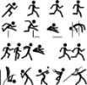
















Teacher Education (A.A.)
Family & Development (Bsc)
Health (Msc)
HF & CE/Performance (PhD)

Slide 3
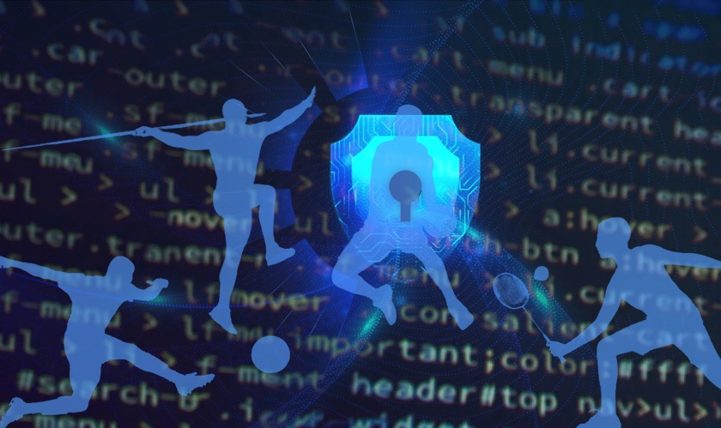
My Research and Consultancy
Human Factors
  Human-Computer Interaction, Human-Robotics Interaction
Cybersecurity performance and behaviours
  Cyber Defence
  Psychology
  Education and training
  Individual – team
  Communication
  Decision-making
  Other
Health
Performance

Slide 4
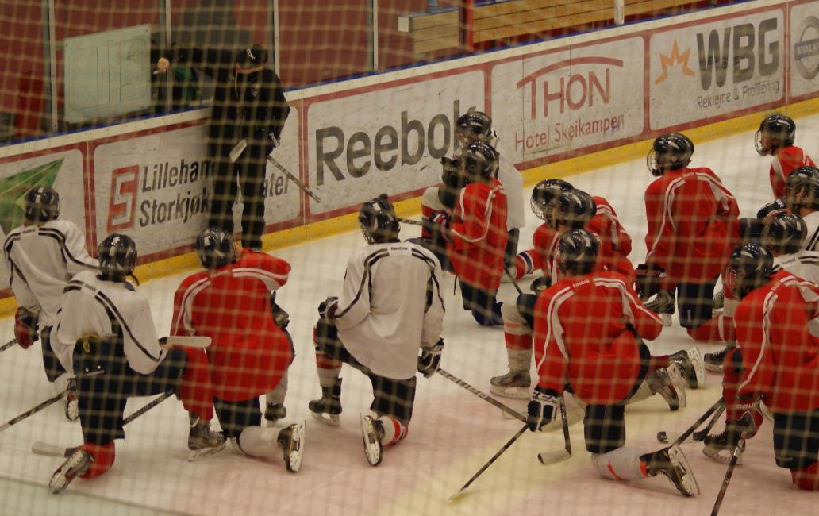




Slide 5

Acknowledgement
Co-funded by the European Union. Views and opinions expressed are however those of the author(s) only and do not necessarily reflect those of the European Union or HADEA. Neither the European Union nor the granting authority can be held responsible for them.
Project Agreement no. 101083594

Slide 6
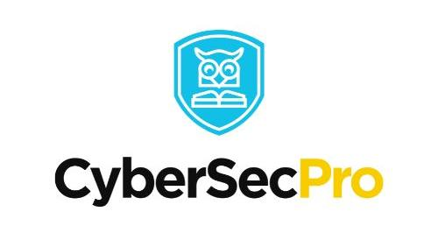

CyberSecPro
Digital Europe Program (01.01.23 – 31.12.2024)
Participants: 15 HEIs and 13 companies from 16 countries
Goals:
CyberSecPro aims to bridge the gap between degrees, working life, and marketable cybersecurity skill sets necessary in today’s digitalization efforts and provide examples of best practices for cybersecurity training programs.
CyberSecPro’s ambition is to enhance the role of the Higher Education Institutes (HEIs) in offering hands-on and working-life skills for driving a trustworthy digital transformation in critical sectors of the economy.

Slide 7
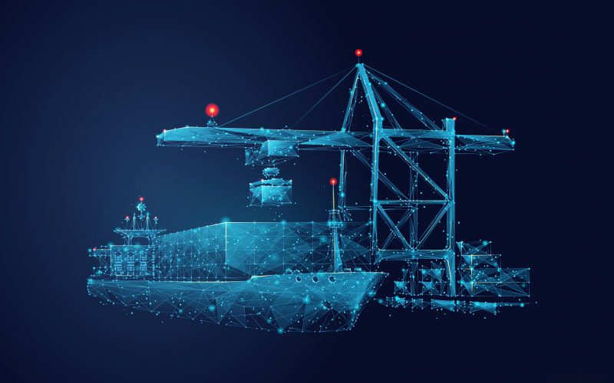


MariCybERA
Grant agreement ID: 952360
Three main topics:
  Maritime communication security
  Marine technology cyber security
  Human aspects of cyber security
https://maricybera.taltech.ee/team-2/
https://www.linkedin.com/company/maricybera-era-chair/

Slide 8


















Project ATHENA
Cyber resilience through engineer focused training
Advisory board members
Security advisory board
Notes:
Wide spectrum of OT security experts, users and academica

Slide 9
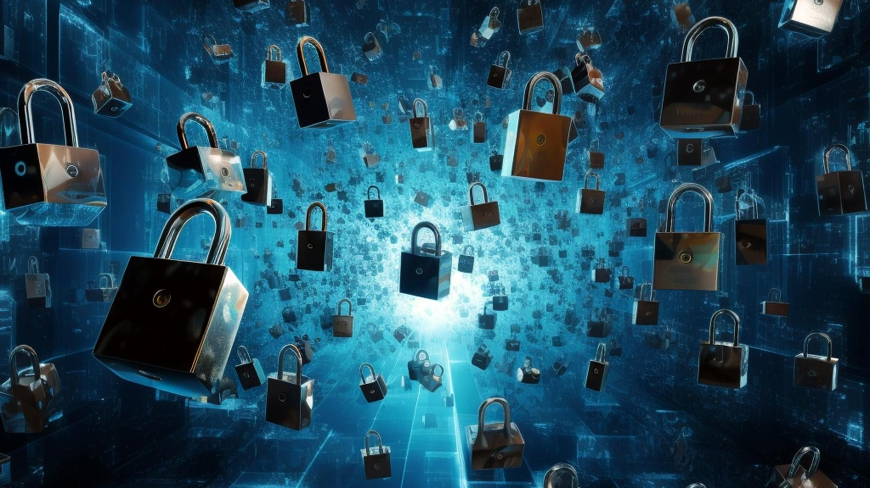
Today
What are you expecting to learn today?
How confident are you about this?
Situational Awareness (the human kind)
Shared Mental Modelling
Communication and Cybersecurity
  Practical aspects and challenges
Some research

Slide 10



Slide 11

What’s important to communicate in a crisis situation?

Slide 12

Did we answer?
What is known?
  Status
  Levels? (Individual, social, organisational)
  Business continuity
What is unknown?
  Do we know what we don’t know?
What are the projected outcomes?
  And how confident are we in those ‘predicitons’?

Slide 13

Challenges and Gaps in Integrating Human Factors
Complex environments like maritime systems face unique cybersecurity challenges.: The maritime sector's integration of digital twins and cybersecurity tools demands specialized threat modeling.
Integration of digital twins and cybersecurity tools requires comprehensive threat modeling including human insights.: Human factors must be considered in threat modeling to address the unpredictable nature of human behavior.
Training and standards often overlook nuanced human factors, leading to vulnerabilities.: Effective cybersecurity training should incorporate human factors to mitigate vulnerabilities arising from human errors.

Slide 14
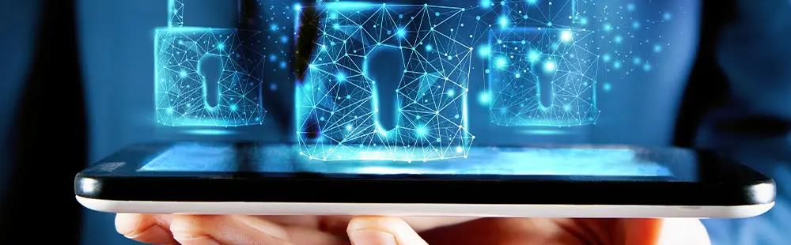
Objectives of Integrating Human Factors in Cybersecurity
Integrate a multidisciplinary team to address human factors in cybersecurity.: Includes experts from maritime operations, cybersecurity, and system engineering.
Develop and apply human factors expertise in IT/OT and OSINT frameworks.: Aims to improve cybersecurity practices by leveraging human insights.
Design and evaluate training environments leveraging human factors for better operational skills and team coordination in maritime systems.: Training environments should focus on practical skills and effective team coordination.

Slide 15
Cyber Crisis
A significant cybersecurity event that disrupts the normal operations of digital systems, leading to widespread impact on individuals, organizations, and society. - ENISA
Individual level
a cyber crisis can lead to loss of personal data, identity theft, financial loss, and a significant breach of privacy. Individuals may find their personal information compromised, leading to long-term repercussions on their financial and personal life
Organizational level,
cyber crisis can result in operational disruptions, financial losses, legal liabilities, and damage to the organization's reputation. Businesses and governmental organizations may face challenges in recovering from such crises, impacting their sustainability and the broader economy.
Societal level
cyber crisis can undermine public trust in digital infrastructures and institutions. It can disrupt essential services, such as healthcare, public utilities, and government services, affecting the daily lives of citizens and the functioning of society

Slide 16
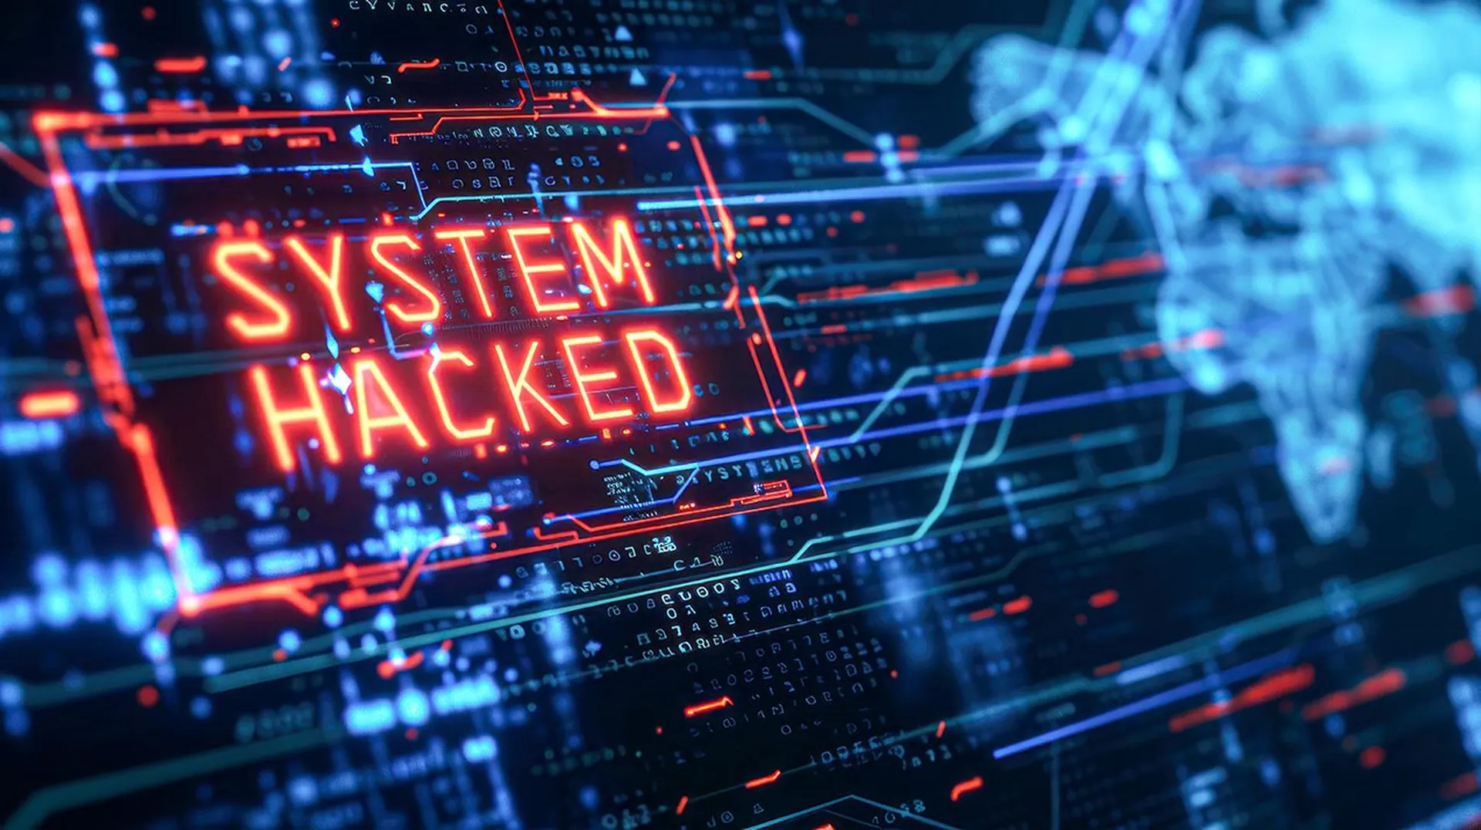
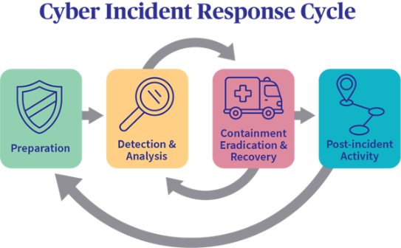
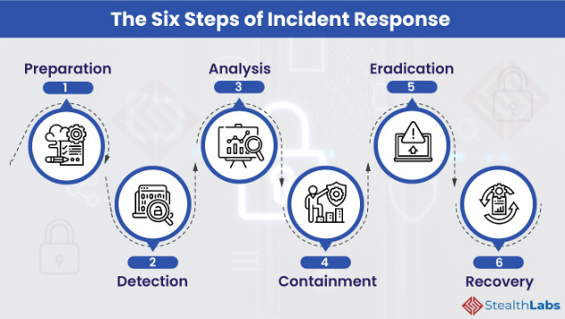
What is a cyber Incident
Proactive Capabilities
Responsive Capabilities

Slide 17

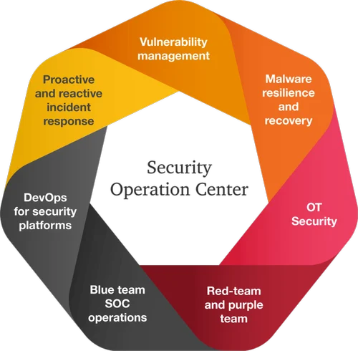
Security Operation Centers (SOCs)
Organizations assign their cybersecurity operations to SOCs
SOC teams cover multiple security activities and analyze
large and continuous streams of data
Technical tasks and decision-making assigned to different
positions in the SOC (Muniz et al., 2015)

Slide 18
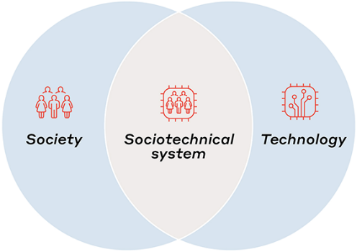
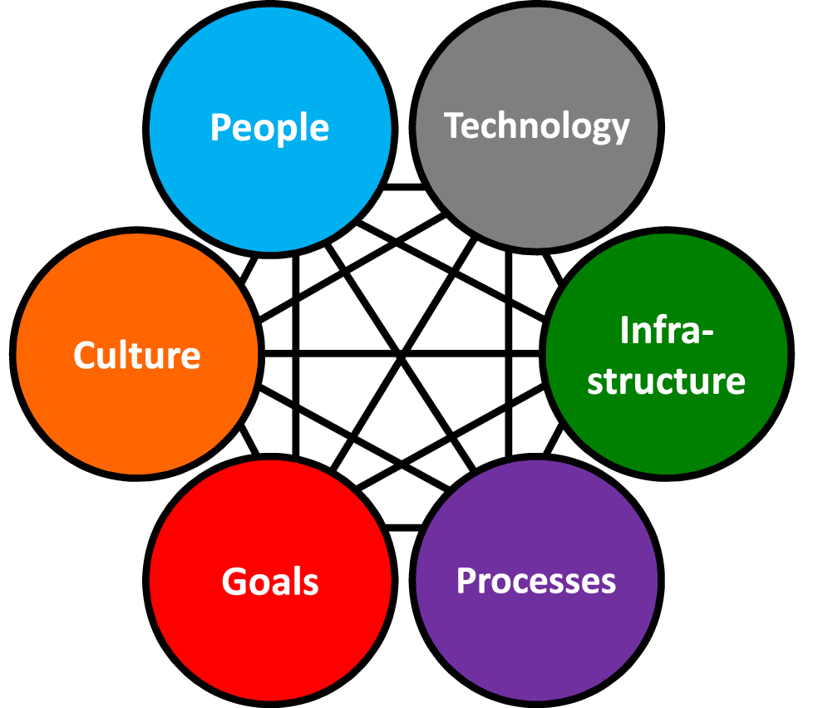
Socio-Technical Systems (STSs)
Cyber Operators (COs) = Technical personnel in SOCs
Face challenges spanning the cyber, physical, and social domain (Jøsok et al., 2016)
Human-machine and human-human interaction = STS
Cyber-physical working environment is subject to high rates of change and innovation
Whats in a STS?

Slide 19

Situation Awareness - Definition
“The perception of the elements in the environment within a volume of time and space, the comprehension of their meaning and the projection of their status in the near future.” (Endsley, 1988, S. 97)
Originally from aviation (pilots, air traffic control)
Nuclear facilities
Military domain
Train dispatching
Weather forecasting
Driving and automated vehicles
More recently: network security

Slide 20

Levels of SA
Level 1
Perception
Level 2
Comprehension
Level 3
Projection
Notes:
Situational awareness or situation awareness (SA) is the perception of environmental elements and events with respect to time or space, the comprehension of their meaning, and the projection of their future status.^{[1]}
It’s been recognized as a critical foundation for successful decision-making across a broad range of situations, in everday emergency situations, such as law enforcement, aviation, air traffic control, health care, military command and control operations, etc
Lacking or inadequate situation awareness has been identified as one of the primary factors in accidents attributed to human error.
SA is broken down into three segments: perception of the elements in the environment, comprehension of the situation, and projection of future status.^{[7]}
Three facets of SA have also been identified: SA states, SA systems, and SA processes (last two next week)
SA states refers to the actual awareness of the situation.
Objects L1): Awareness of various objects in the world, and their current status. Objects and their status may be indicative of particular situations (that they are about to occur, that they are ongoing, etc.). Then they are often referred to as cues.
Frames (L1): Awareness of what kind of situation is on-going, e.g. a runway incursion where an aircraft is about to collide with some object on the runway.
Implications L2): Awareness of objects within frames, of what their current status means in a particular situation. E.g. the implications of the current speed of the aircraft or network status for CS – gets connected to projection (l3)
Event horizon L3: An awareness of plans and events in time and space. It includes an awareness of what has happened (useful for diagnosis, to achieve SA, to frame situations). It also includes prognosis, an awareness of what might happen next. That includes on the one hand an awareness both of what might occur based on diagnosis and the current situation, and on the other hand on an awareness of current plans and intentions.
SA systems refers to the distribution of SA in teams and between objects in the environment, and to the exchange of SA between system parts. SA processes refers to the updating of SA states, and what guides the moment-to-moment change of SA. These two aspects will be taken up next week lecture
Metacognition
Metacognition is an awareness of one's own thought processes and an understanding of the patterns behind them
two components of metacognition: (1) knowledge about cognition and (2) regulation of cognitionsit
Control Situation awareness

Slide 21
Notes:
Inattentional blindness
¨24 radiologists to perform amiliar lung – nodule detection task
A gorilla 48x bigger than a nodule inserted in the last case
Even experts are vulnerable

Slide 22
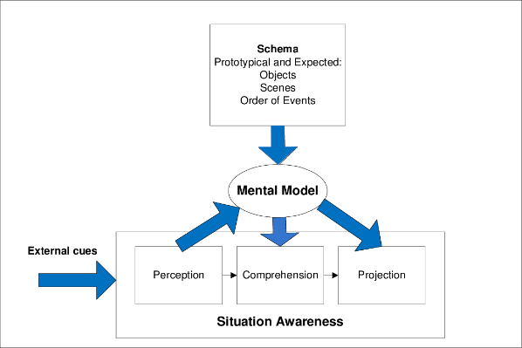
Mental Models
Mechanisms whereby humans are able to generate descriptions of system purpose and form, explanations of system functioning and observed system states, and predictions of future states. (Rouse & Morris, 1985).
Knowledge regarding which aspects of environment are relevant; identify critical cues, direct attention to these, classify information, making this process more efficient in large amounts of data.
Helps to integrate elements efficiently to form an understnading of their total meaning (Level 2) in terms of the goals.
Helps to project future states accurately and efficiently based on current states and dynamics. (Level 3)
(Endsley, 2000)
Level 1
Perception
Level 2
Comprehension
Level 3
Projection
Notes:
This then becomes metacognitive skills

Slide 23
Interrelationship between SA levels
Level 1
Perception
Level 2
Comprehension
Level 3
Projection
data-driven/ BU
goal-driven/ TD
Match patterns based on experience and accelerate L2 and L3.
Goal-driven filling of L1.
Iterative process to search and analyze goal-relevant data.
Highly efficient SA generation process.
Vulnerable to biases such as Anchoring and Confirmation Bias.

Slide 24


Slide 25

Research in Communication in CDX
Novices
Experts
Cyber-physical interactions facilitated by team communication and coordination demands and restricted by dissatisfaction with team performance.
Strategic – tactical decision making facilitated through Communication Demands but restricted through higher time-share demands.
Novices are dependent on communication interactions
  Difference task workloads and team-task workloads
Lugo, R. G., & Sütterlin, S. (2018, July). Cyber officer profiles and performance factors. In International Conference on Engineering Psychology and Cognitive Ergonomics (pp. 181-190). Springer, Cham.
“effective collaboration, experience, and functional role-specialization within the teams are important factors that determine the success of these teams in the competition and are important observational predictors of the timely detection and effective mitigation of ongoing cyber attacks. These results support theories of team maturation and the development of functional team cognition applied to mastering cybersecurity”
Experts need less communication
More experience requires less leadership
Buchler, N., La Fleur, C. G., Hoffman, B., Rajivan, P., Marusich, L., & Lightner, L. (2018). Cyber teaming and role specialization in a cyber security defense competition. Frontiers in psychology, 9, 2133.

Slide 26
Factors affecting SA in novices and experts
SA is demanding, frequently incomplete and erroneous
SA is fast, can be effortless, more complete, greater comprehension & projection
Novice Expert
Limited attention
Limited working memory
Schema of prototypical situations
Mental models of domain
Automaticity of processes
Learned skills (e.g. scan patterns, communications)

Slide 27
8 Other Threats to SA
Attentional tunneling (or: attentional narrowing)
  Attention can not be divided.
  Get hooked on particular features and inadvertently drop scanning.
  Mind the Gorilla.
Requisite memory trap
  Working memory overload.
  In particular auditory information.
Stressors
  Workload, anxiety, fatigue, etc.
  Time pressure, uncertainty, etc.
  Limits SA via limiting WMC and slowing down information processing, more likely attentional tunneling, disorganized scanning for elements and less attention to peripheral cues.
Data overload
  Volume and rate of change
  Limited bandwith of human sensory and information-processing mechanisms.
  Rate of data flow can be enhanced significantly by ergonomic user interfaces
Misplaced salience
  Some features (size, shape, movement, flashing lights, noise) are prioritized in sensory and attentional processing
  Overuse or inappropriate use degrades SA to other information
Errant mental models
  „representational error“
  A wrong mental model is applied
Out of the loop syndrome
  Automation can eliminate excessive workload, but can also lower SA by putting people out of the loop.
„take-over-time“ where automatisation fails or is not equipped to handle a situation

Slide 28
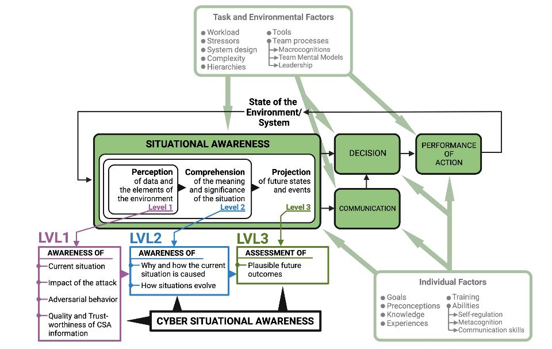
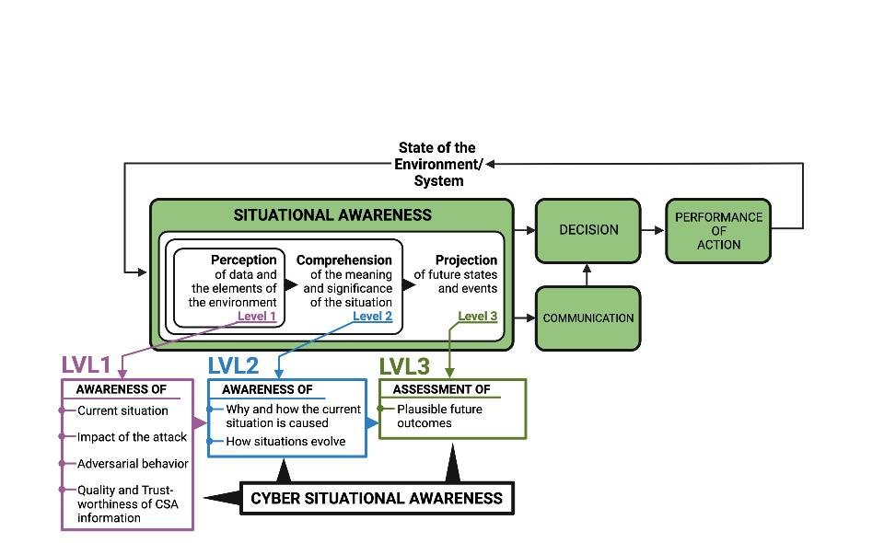
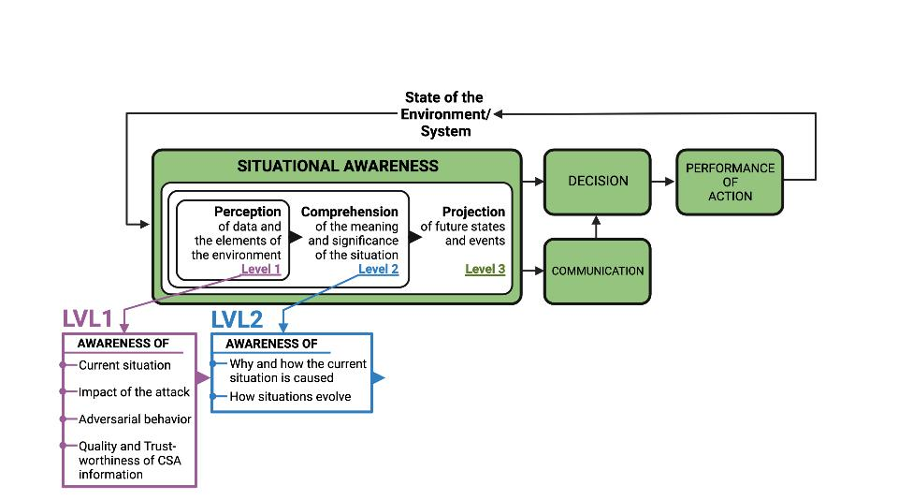
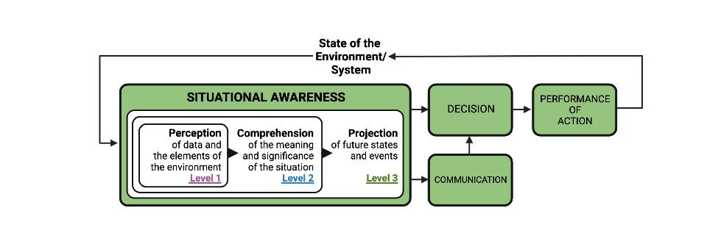
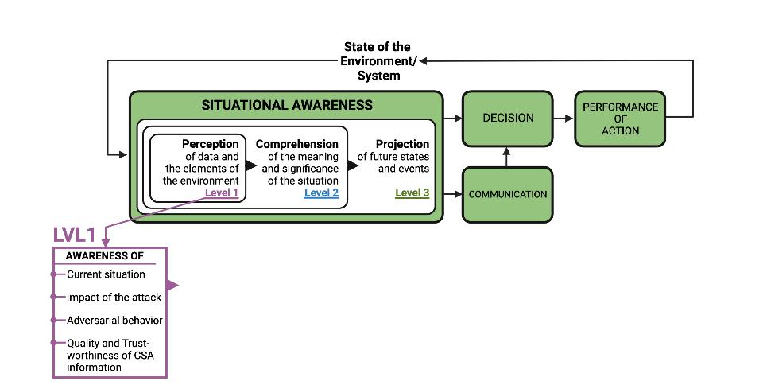
Situational Awareness and Cyber Situational Awareness
Stress
SA: bottom-up perceptual processes
going from concrete to abstract
CSA: starts with perceiving indicators of compromise
Already abstract
Stress
Endsley, 1995
Barford et al., 2009

Slide 29

Cogntive exploits and attack vectors
Notes:
Red Arrow: an attacker that wages a social engineering cyberattack against a victim's human cognition functions (i.e., the oval). The resulting behavior is associated to persuasion (i.e., an attack succeeds when a victim is persuaded to act as intended by the attacker).
Cognitive workload, via mechanisms such as inattentional blindness, can increase vulnerability to social engineering cyberattacks.
Stress may reduce one's ability to detect deception cues in social engineering cyberattack messages but the direct effects of acute stress on cybersecurity social engineering have not been examined.
Attentional vigilance, particularly the vigilance decrement, may be an important influence on susceptibility to social engineering attacks, but more research is needed.
Literature results are not conclusive on how personality may influence one's susceptibility to social engineering cyberattacks.
Domain knowledge helps reduce vulnerability to social engineering cyberattacks.Awareness and general technical knowledge do not necessarily reduce one's susceptibility to social engineering cyberattacks, perhaps because human cognition functions have not been taken into consideration. Self-efficacy, knowledge, and previous encounter of social engineering cyberattacks collectively reduce one's susceptibility to social engineering cyberattacks. In particular, costly phishing experiences would greatly reduce one's susceptibility to social engineering cyberattacks, while non-costly experiences do not.
But Stefan will discuss this
Gender does not have a big impact on the susceptibility to social engineering cyberattacks
Old people with higher education, higher awareness and higher exposure to social engineering cyberattacks are less susceptible to these attacks.
Culture affects privacy and trust attitudes, which indirectly affect one's susceptibility to social engineering cyberattacks.
Long term memory The success of social engineering cyberattacks is inversely related to their prevalence.
Training methods that ask people to consciously think about social engineering cyberattacks are unlikely to be very successful unless the learning reaches the point where it is a habit that, largely unconsciously, guides safer computer use behavior.
Message quality and message appeal, which reflect attacker effort (e.g., using contextualization and personalization), have a significant impact on the attacker's success.
An individual's capabilities in detection of social engineering cyberattacks are affected by their awareness of the threats, their cultural backgrounds, and their individual differences in trust/suspicion.

Slide 30
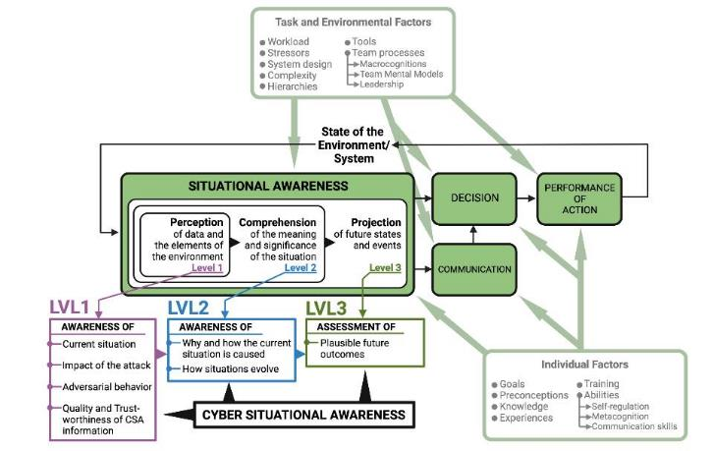

Back to reality
?

Slide 31

Accurate Recognized Cyber Picture (RCP) critical for Decision-Making
Decision-making based on human interaction requires shared situational awareness of the CTS
Cyber Situational Awareness (CSA) influence organizational control in its cyberspace
Barford et al. (2009) 7 criteria for CSA
  Awareness of the current situation
  Awareness of the impact of the attack
  Awareness of how situations evolve
  Awareness of adversarial behavior
  Awareness of why and how the current situation is caused
  Awareness of quality and trustworthiness of CSA info
  Assessment of plausible futures of the current situation

Slide 32
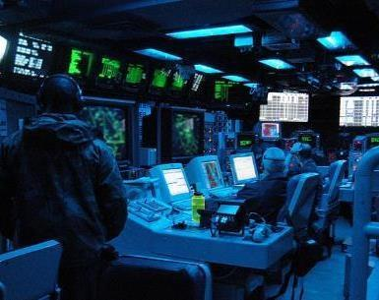
Accurate Recognized Cyber Picture (RCP) critical for Decision-Making
Accurate RCP cruical for CSA
RCPs consist of actively selected and actionable information specifically pertaining to CTS
COs investigate threats to create RCP → Share RCP (sRCP) with decision-maker
Cyber-to-physical relay of RCP is subject to many challenges

Slide 33
Situational Awareness vs Situational Understanding

Slide 34


Orient-Locate-Bridge – The role of Cognisance and Communication (Knox et al, 2018)

Slide 35

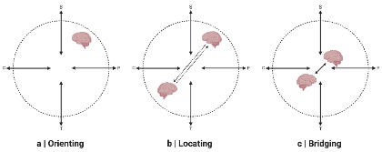
COs collaborative practices during RCP creation and sharing
COs communicate with other COs when tailoring RCPs to their clients
  Less common further up in SOC organizational hierarchy
  HS: Problems when DM and COs are located in different quadrants
  Beliefs and expectations affect sharing and absorption → RCP and CSA
Centralized/official systems are circumvented
  Information sharing between COs not incentivized

Slide 36


Slide 37



Slide 38

Decision Makers
IT

Slide 39
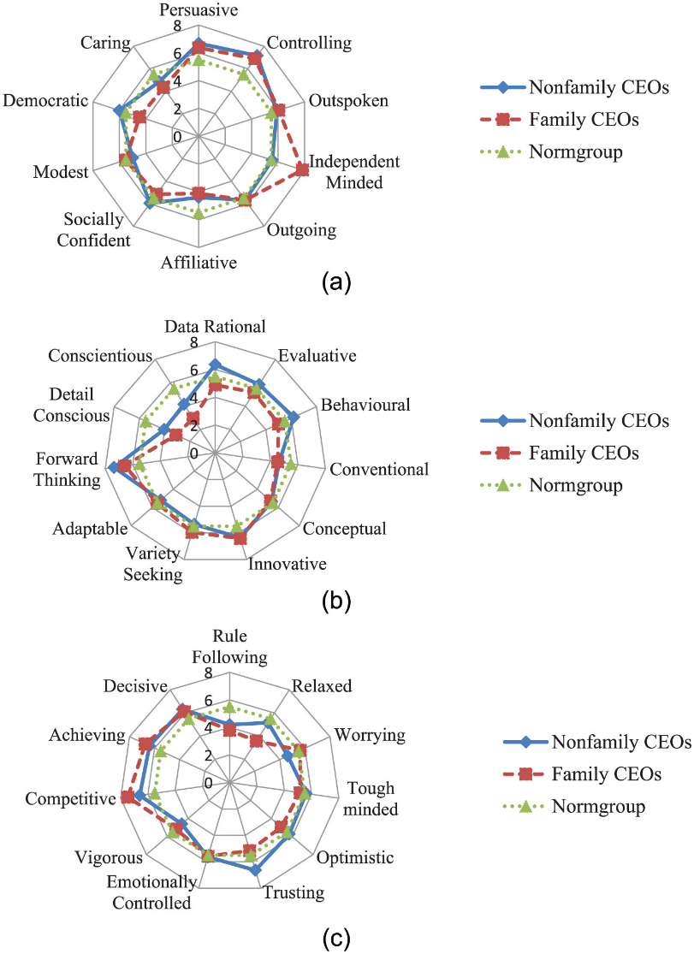


Slide 40
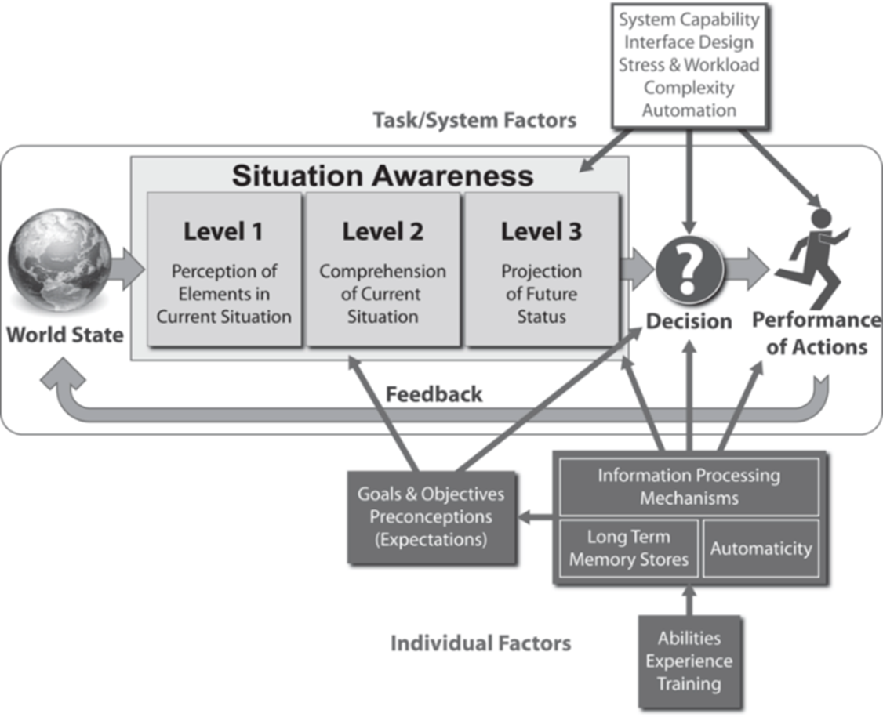
What to Communicate

Slide 41
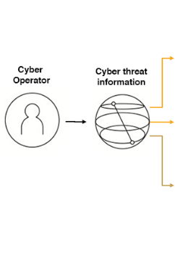

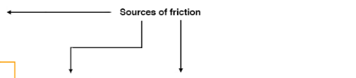
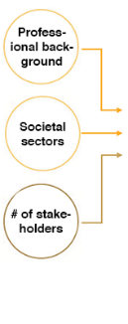
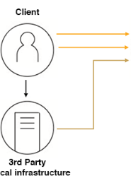

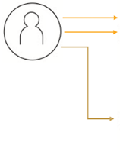

Let’s talk
Human communication in Cyber Threat Situations (CTSs)
Communication between humans at the core of cyber defense decision-making
Communication in CTSs is like a software design-problem
Communication must be modular (frictionless) enough to be useful for all stakeholders
HOW are you with communication?
How do you prefer to be talked to?
  Under pressure?
  CS attack?
How do SITREPS differ?
  CO→CO
  CO→CISO
  CISO→DM/Client

Slide 42




What to Communicate - SITREPS
Notes:
Attentional tunneling (or: attentional narrowing)
Attention can not be divided.
Get hooked on particular features and inadvertently drop scanning.
Mind the Gorilla.
Requisite memory trap
Working memory overload.
In particular auditory information.
Stressors
Workload, anxiety, fatigue, etc.
Time pressure, uncertainty, etc.
Limits SA via limiting WMC and slowing down information processing, more likely attentional tunneling, disorganized scanning for elements and less attention to peripheral cues.
Data overload
Volume and rate of change
Limited bandwith of human sensory and information-processing mechanisms.
Rate of data flow can be enhanced significantly by ergonomic user interfaces
Misplaced salience
Some features (size, shape, movement, flashing lights, noise) are prioritized in sensory and attentional processing
Overuse or inappropriate use degrades SA to other information
Errant mental models
„representational error“
A wrong mental model is applied
Out of the loop syndrome
Automation can eliminate excessive workload, but can also lower SA by putting people out of the loop.
„take-over-time“ where automatisation fails or is not equipped to handle a situation

Slide 43


Where in the Kill Chain is attack 1?
How critical is the system?
How severe was the attack?

Slide 44

Describe the activity you saw (specific but not overly detailed)
What type of incident do you think it was?
If you could suggest anything - which actions should be done?
L1
L2
L3

Slide 45

How high is the quality/trustworthiness of your threat information?
How urgent is it to take action?
How confident are you in the descriptions above (0-100%)?

Slide 46
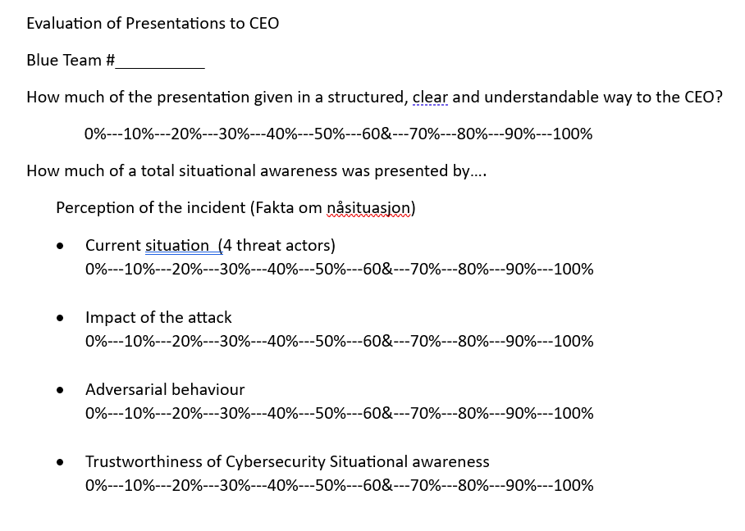
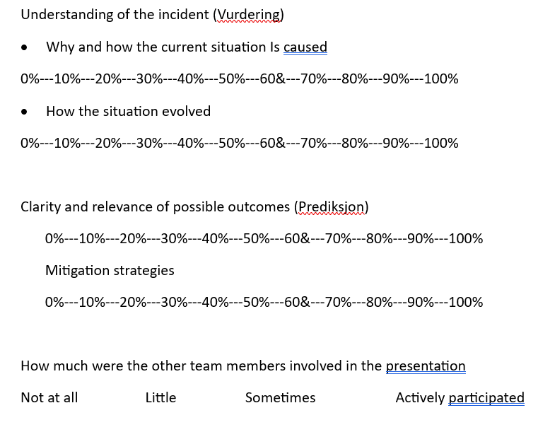

Slide 47
Using SMM for Mitigating CS Attacks
Before Attack
  Training
    Technical, behaviors, communication
During Attck
  Communication
After Attack
  Good communication helps maintain financial interestes
  Critical Incidence Review
    Create/update communication plan
Notes:
Before an Attack
employees and training (periodical), technology will not protect from an attack.
Make sure that your security team is trained periodically. It is also recommended that the best practices around spear phishing (the use of fraudulent emails aimed at specific users to launch an attack) so that your people know how to recognise suspicious emails, links and attachments which can harm your systems.
A trusting work environment coupled with busy people can easily lead to poor split-second decisions around opening emails and exposing your most critical systems to attack, regardless of the sophistication of security technology you’ve deployed. 91 percent of cyberattacks start with a spear phishing email, according to research from TechWorld. So, proactive and sustained education around security risks is critical. Hackers are constantly refining their “phishing” techniques to trick users and you need to not only alert them to the latest threat but remind them to keep security top-of-mind on top of all their other work.
Protecting users from making such damaging mistakes is a big win. So, make sure the C-suite understands the business risks and the significance of developing a proactive strategy. CISOs should also lobby for them to back education programs – financially and personally, by setting the best example of safe computing themselves.
During an Attack
During an attack, a lack of communications can really hurt. A breach of security is also a breach of trust, and it’s a vital component in customer and partner relations. Every headline about privacy and data breaches, any failure to protect your systems and data will damage your organisation and brand.
The difference between a breach being a minor bump or a major impact to your organisation and its market value, is communication.
Think for a moment, about the impact of proactive and prescriptive notifications for example, to all employees drastically increasing the damage from an attack by compromising even more IT equipment as employees link their laptops to the company network.
Alternate communications platforms, out of band, from the company’s infrastructure, for use during an attack may need to be established, especially if the regular telecommunication network and email systems are compromised, just like in the Sony Pictures hack. While quick and targeted communication with the relevant IT experts will be key, don’t forget you may also need frequent updates with management, legal, marketing, key stakeholders and partners to comply with regulations governing data privacy and security reporting.
After the Attack
History dictates that those organisations that handled communications well after a breach suffered only small fluctuations in stock price and customer confidence. Those that couldn’t get the message out, or bungled the message, suffered far greater and longer-lasting damage. Don’t leave this to chance in a crisis.
A sound post-attack communication plan must describe what happened as honestly and completely as possible. It will explain correction steps taken for all affected parties, and (as soon as possible) what is planned to prevent a recurrence. This is difficult to do in the middle of a crisis, so have a response plan in place. Also have a tested communication system to alert all stakeholders.

Slide 48
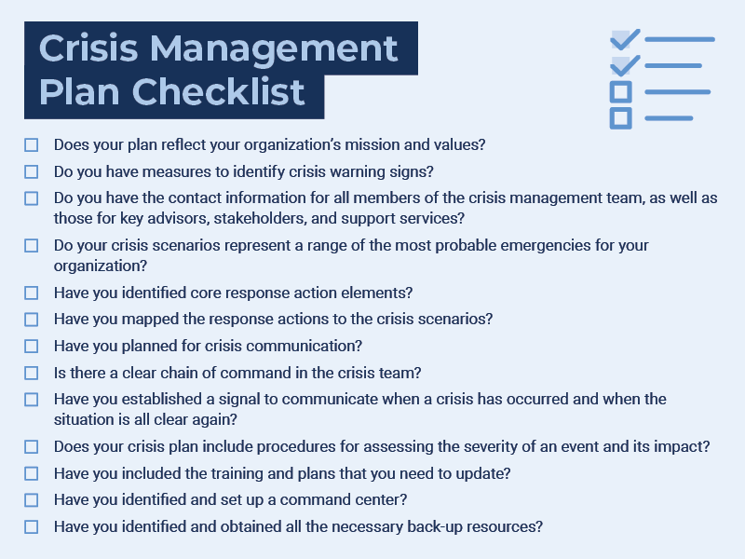

Crisis Communication
Communicators involved in crisis communication should follow these best practices:
Plan for crises in advance and be prepared for potential crisis situations.
Acknowledge the situation as soon as possible.
Choose to be transparent with all communication.
Remain truthful about an organization’s situation.
Prioritize company values and mission.
Notes:
Internal Communication Plan: Create systems and backup methods for members of the crisis management team to communicate with each other. Collect contact information for all team members as well as anyone they might need to call upon, including outside consultants and subject matter experts. You must also establish ways to disseminate urgent information to all employees, such as using a notification provider to send texts and automated calls or implementing a method for your employees to check in and report their safety and whereabouts. Determine how you will share sensitive news internally, such as a threat to the company’s viability or a loss of life. In addition, don’t forget to establish a schedule and mechanism for updates.
External Communication Plan: Define plans for communicating with the public and key external stakeholders. Appoint a spokesperson. Write detailed instructions, including whom you will notify (e.g., media outlets in a particular geographic area). Also, draft holding statements, the details of which you can fill in later, once you have the relevant information. Prioritize your strategic communication objectives and outline talking points. Make sure your plans align with other communication efforts. Be ready to create a special website or telephone line to answer consumer or community questions.
Crisis Communication
Crisis management isn’t a component of everyday communication, but it should still be a priority. Crises usually come without warning, so companies need to be prepared with communication plans that include clear messaging and tone. Additionally, crisis communication should outline how and when a company conveys its messaging.
To reach every audience, it’s best to incorporate multiple channels of communication into your crisis communication plan. While some audiences may have

Slide 49
Key Takeaways
Communication- - center of incident response
Cooperation
Culture
  Leadership and rolemodelling
  Thats another day

Slide 50
Today
Did you learn today?
How confident are you about this?
Situational Awareness (the human kind)
Shared Mental Modelling
Communication and Cybersecurity
  Practical aspects and challenges

