Slide 1



Social Engineering in Cybersecurity
CSP002: Human Factors in Cybersecurity
IPICS Summer School
Presentation by:
Ric Lugo, Kitty Kioskli, & Paresh Rathod , Stilianos Karagiannis
TalTech, trustilio, Laurea, PDM

Slide 2
Acknowledgement
Co-funded by the European Union. Views and opinions expressed are however those of the author(s) only and do not necessarily reflect those of the European Union or HADEA. Neither the European Union nor the granting authority can be held responsible for them.
Project Agreement no. 101083594

Slide 3

Agenda
Intro
Basic psychological principles
Principles of Social Engineering
Deepfakes
Use Energy, Maritime and Health Examples

Slide 4





















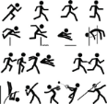













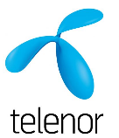

Teacher Education (A.A.)
Family & Development (Bsc)
Health (Msc)
HF & CE/Performance (PhD)

Slide 5
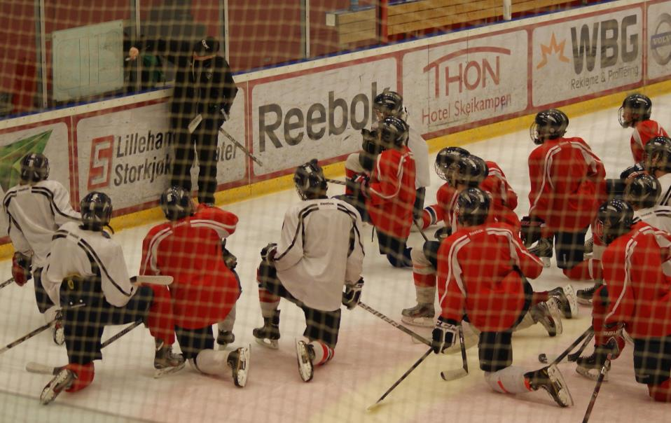




Slide 6

Expected Learning Outcomes:
Understand the Importance of Human Factors in Cybersecurity
Identify Specific Cybersecurity Risks and Vulnerabilities Related to Human Factors
Understand Social Engineering Processes and Exploits
Understand One’s Risks and Vulnerabilities
Notes:
Welcome to this training session on EU Cybersecurity Governance and Regulatory Compliance in the Energy Sector. The energy sector is a vital component of modern society, and its reliance on digital technologies is increasing. This makes it a prime target for cyberattacks.

Slide 7







Slide 8
Maritime Cyber Risk Assessment (MaCRA) framework
Scope Definition: Clearly defining the boundaries of the cyber risk assessment to include all relevant aspects of maritime operations, from onboard systems of vessels to port infrastructure and associated supply chain networks.
Threat Identification: Systematically identifying potential cyber threats that could affect maritime operations, considering the unique characteristics of the maritime sector and emerging cyber threat landscapes. Includes vessels, port systems, and supply chain operations.
Vulnerability Analysis: Examining maritime systems and processes to identify vulnerabilities that could be exploited by cyber threats, including technical weaknesses, procedural gaps, and human factors. I.E. penetration testing and security audits to uncover weaknesses.
Impact Assessment: Evaluating the potential consequences of cyber incidents on maritime operations, focusing on aspects such as safety, security, environmental impact, and economic losses.
Risk Evaluation: Combining the insights from threat identification, vulnerability analysis, and impact assessment to evaluate the overall cyber risk, prioritizing risks based on their likelihood and potential impact.
Mitigation and Response Strategies: Developing and implementing strategies to mitigate identified risks to acceptable levels, including technical solutions, policy measures, and training programs. Also, formulating incident response plans to enhance resilience and recovery capabilities.
Review and Continuous Improvement: Recognizing the dynamic nature of cyber threats and the maritime environment, the MaCRA framework advocates for regular reviews and updates to the risk assessment and mitigation strategies, fostering a culture of continuous improvement and adaptation.
Notes:
he Maritime Cyber Risk Assessment (MaCRA) framework is a structured approach designed to identify, analyze, and manage cyber risks in the maritime sector. It aims to safeguard maritime operations, including shipping, port management, and supply chain logistics, against cyber threats and vulnerabilities. The framework emphasizes a comprehensive understanding of the maritime operational environment, the identification of potential cyber threats, the analysis of system vulnerabilities, and the assessment of the potential impact of cyber incidents on maritime safety, security, and environmental protection. The MaCRA framework serves as a comprehensive guide for maritime organizations to systematically manage cyber risks, ensuring the resilience and security of maritime operations in the face of evolving cyber threats. Its Key components are:

Slide 9




Slide 10
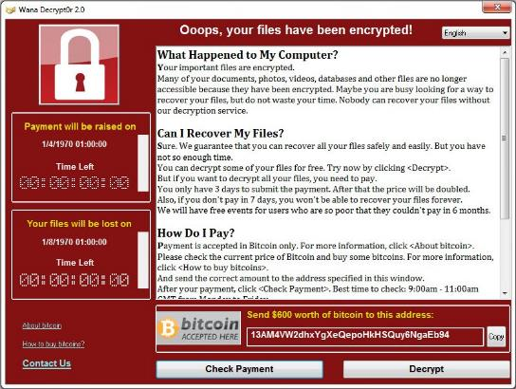
Cybercrimes
Cybercrime To Cost The World $10.5 Trillion Annually By 2025 ($3 trillion in 2015)
Newer forms to become more sophisticated and disruptive
  Deep fakes

Slide 11
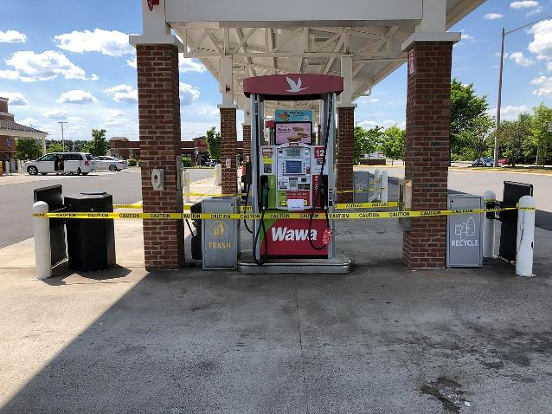

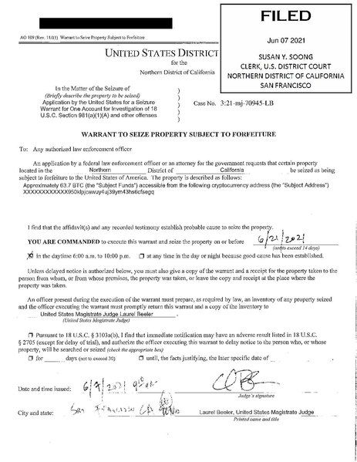
On May 7, 2021, Colonial Pipeline, an American oil pipeline system that originates in Houston, Texas, and carries gasoline and jet fuel mainly to the Southeastern United States, suffered a ransomware cyberattack that impacted computerized equipment managing the pipeline. The Colonial Pipeline Company halted all pipeline operations to contain the attack. Overseen by the FBI, the company paid the amount that was asked by the hacker group (75 bitcoin or $4.4 million) within several hours; upon receipt of the ransom, an IT tool was provided to the Colonial Pipeline Company by DarkSide to restore the system. However, the tool had a very long processing time to help get the system back up in time
The Federal Motor Carrier Safety Administration issued a regional emergency declaration for 17 states and Washington, D.C., to keep fuel supply lines open on May 9. It was the largest cyberattack on an oil infrastructure target in the history of the United States. The FBI and various media sources identified the criminal hacking group DarkSide as the responsible party. The same group is believed to have stolen 100 gigabytes of data from company servers the day before the malware attack.
On June 7, the Department of Justice announced that it had recovered 63.7 of the bitcoins (approximately $2.3 million) from the ransom payment.[
This was one of first high profile corporate cyber attacks which started from a breached employee personal password likely found on the dark web rather than a direct attack on the company's systems.

Slide 12
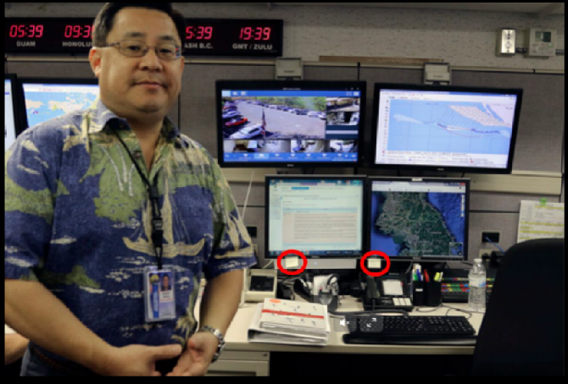

Slide 13
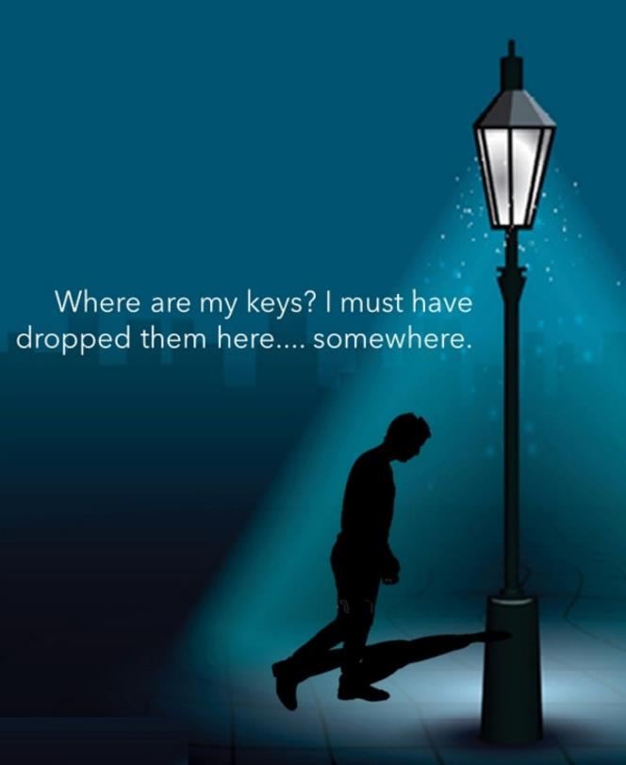
<3%
(Verizon, 2021)

Slide 14

Raise your hand if you have:
Clicked on a link (from anyone)
Have a complex passphrase (?)
Use the same password on different sites/apps
Haven’t changed your password in the last 30 days
Given your phone/pc to someone else to use
Have simple login to phone/pc
Not updated pc/phone in last 7 days

Slide 15
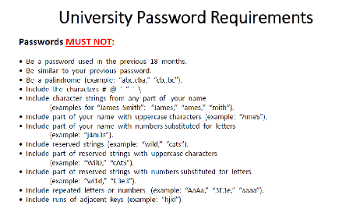
My Everyday!!!
Courtesy: Matthew Canham, University of Central Florida

Slide 16
„Knowledge never prevented
a single breach.“
(Carpenter & Roer, 2022)

Slide 17
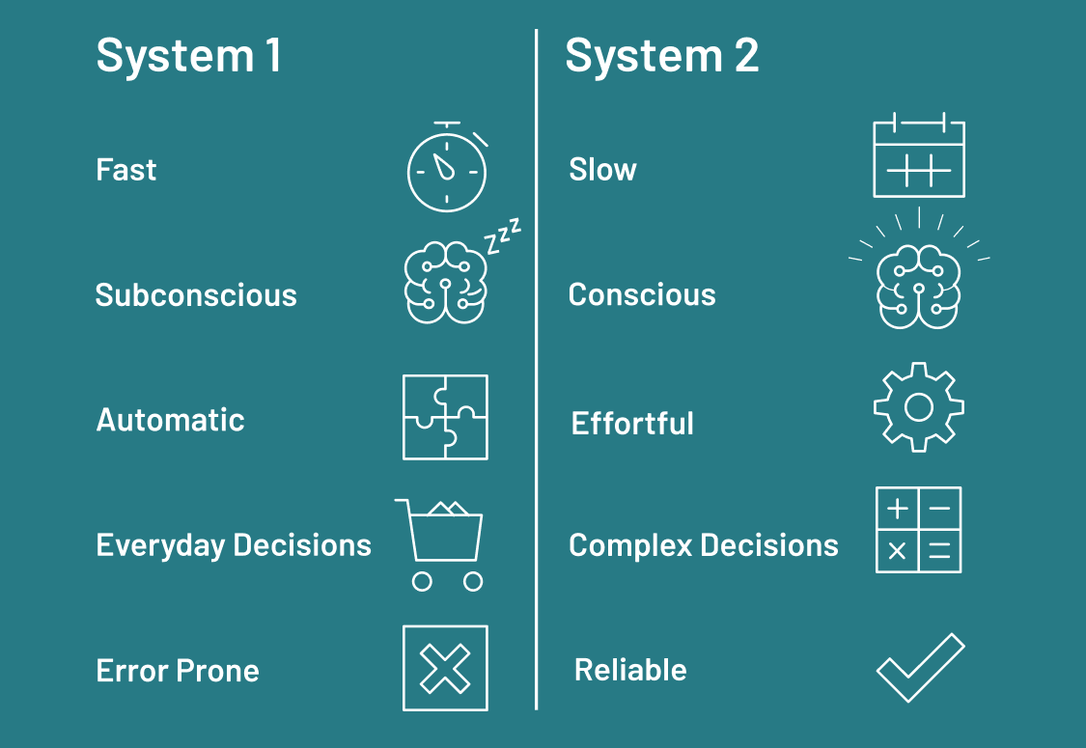


Slide 18

4 Horsemen of Social Cognition (Bargh, 2000)
Naïve researchers
  Use rational, scientific like approaches, cause-effect analysis to understand environment
Cognitive Misers
  Use the least possible for best result
Cognitive consistency
  We like what agrees with us
Motivated tacticians
  Several available strategies, and we choose from goals, needs, or other motives

Slide 19
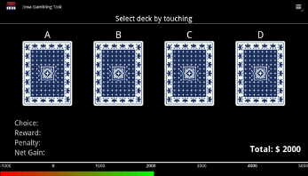
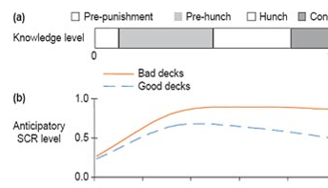
Intuitive Decision-Making
Fast (“quick & dirty”) decisions or tendencies towards decisions triggered by familiar cues.
Unconscious.
Mostly beneficial (evolutionary process).
Involving mostly subcortical brain structures and those involved in inner body perception (“interoception”)
Can be exploited
“Gut feeling”

Slide 20

Attitudes and Beliefs
Formation
Cognitive and Affective components
Primacy Recency effects
Exposure
Mere Exposure Effect
We like what we see more of
Fake News
Notes:
Scrolling primacy recency effect

Slide 21
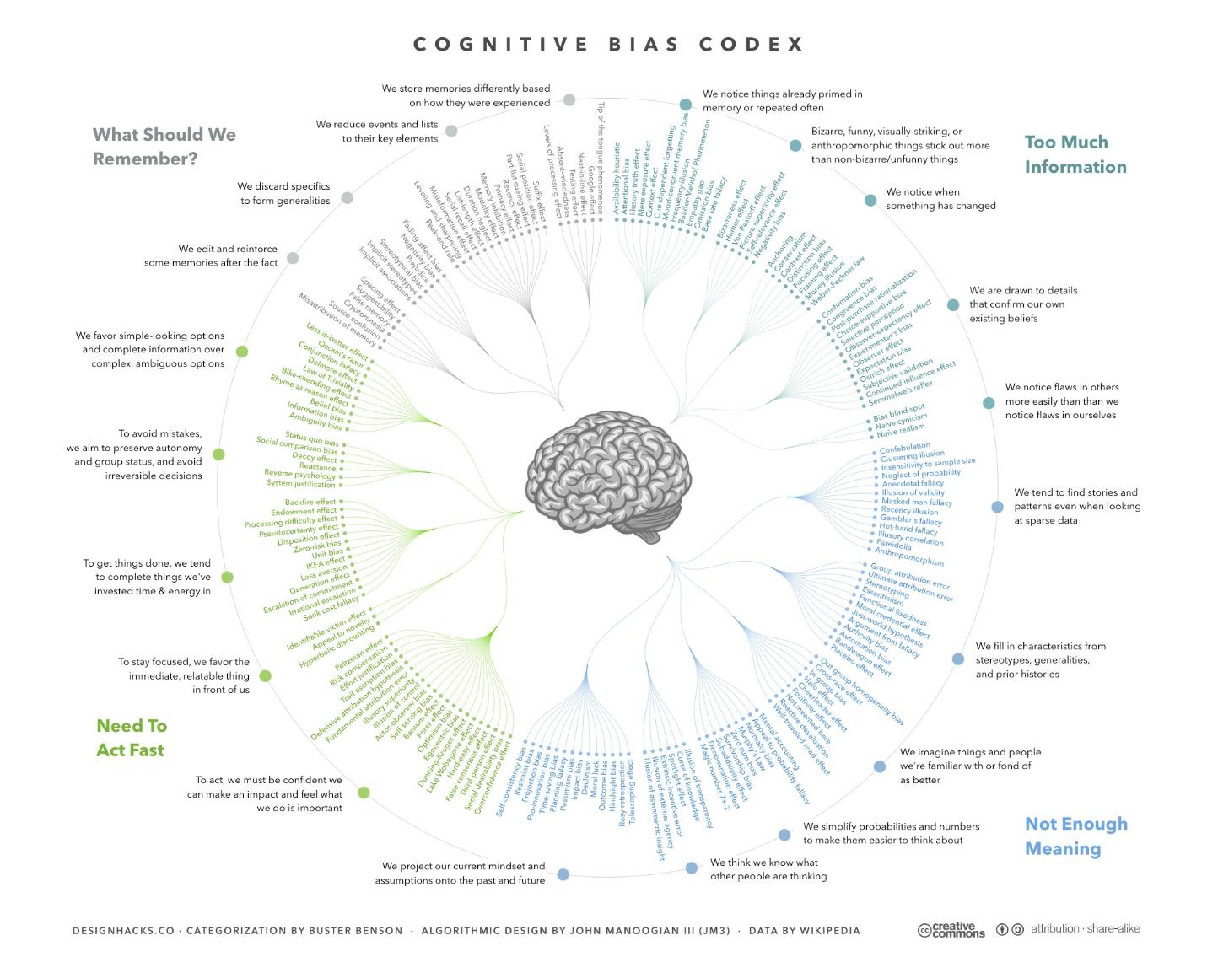

Slide 22

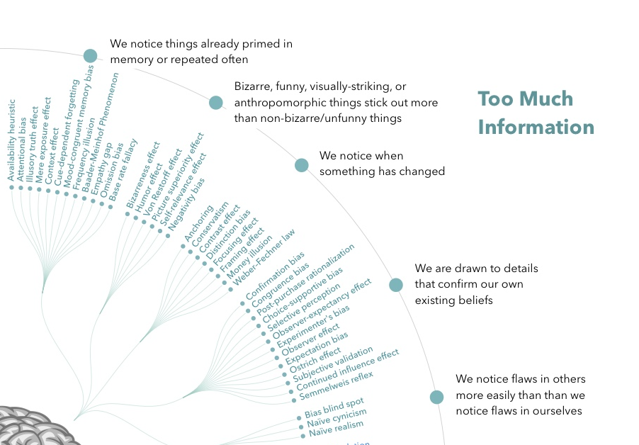
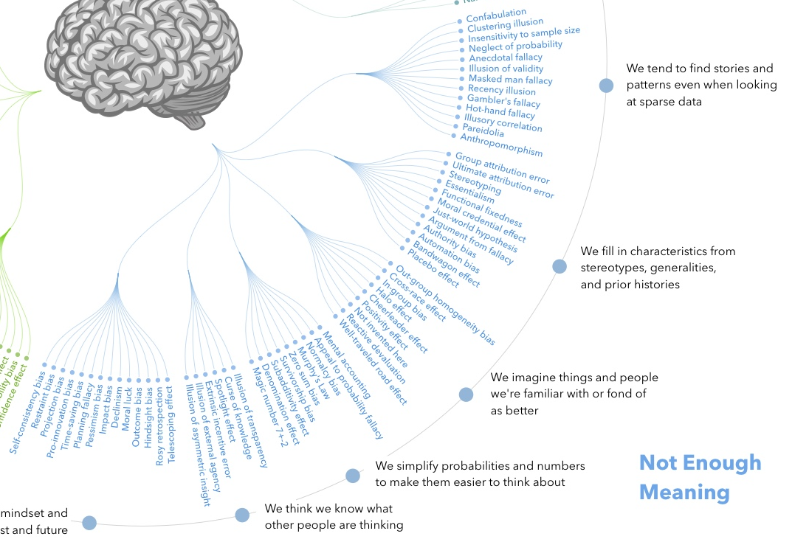
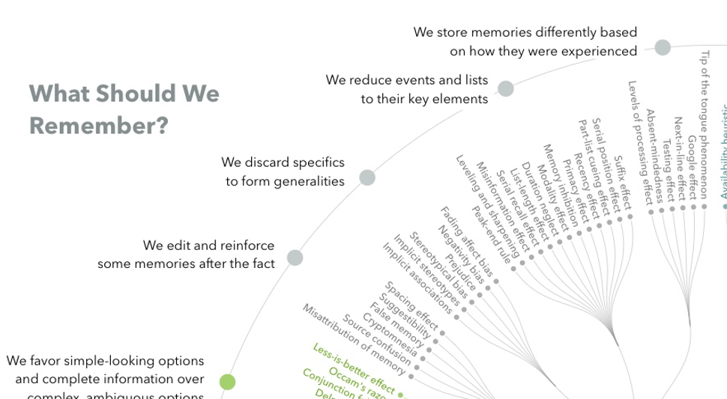

Slide 23
Interaction Paradigm
B= ƒ(P x S)

Slide 24
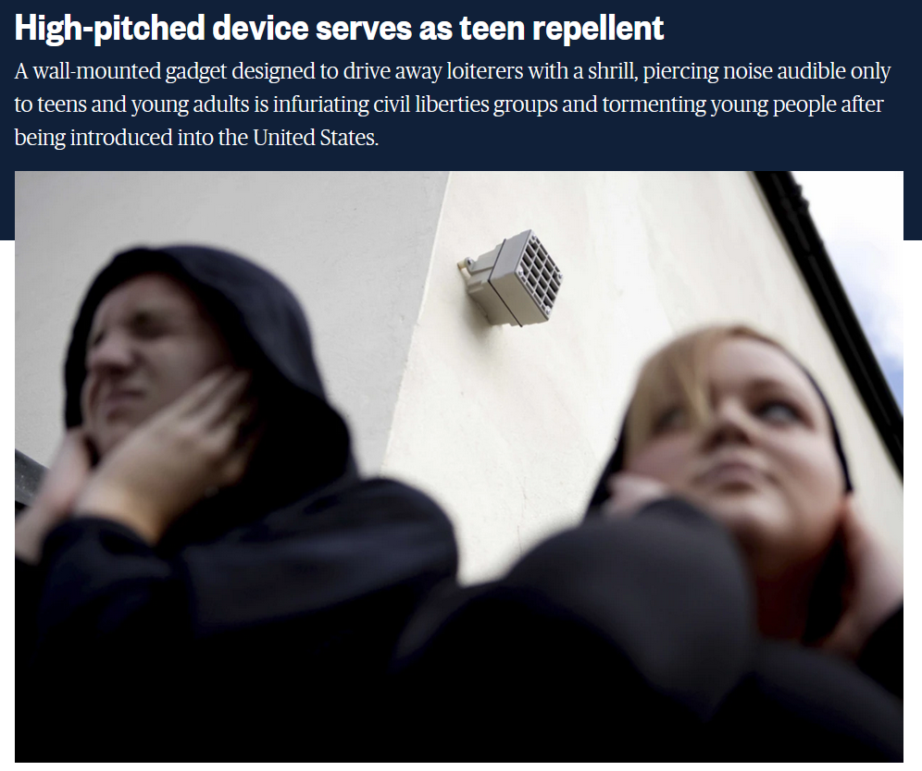

Slide 25
Social engineering
a manipulation technique that exploits human error to gain private information, access, or valuables. In cybercrime, these “human hacking” scams tend to lure unsuspecting users into exposing data, spreading malware infections, or giving access to restricted systems. Attacks can happen online, in-person, and via other interactions.
-Kapersky 2021
2 Goals:
Sabotage - disruption or corruption to cause harm
Theft - obtaining value (information, access, money)

Slide 26
Trust behaviours
Needed for functioning society
(Jones & Moncur, 2018)
3 beliefs:
  Ability - Based on available information or previous experience, the trustee's abilities and knowledge are interpreted. If an individual feels that someone is highly capable of performing the task at hand, they are more likely to share knowledge with that person.
  Benevolence - intentions are positive and good-natured
  Integrity - perceived adherence to personal and moral principles on the part of the tustee
Notes:
Jones, H. S., & Moncur, W. (2018). The role of psychology in understanding online trust. In Psychological and Behavioral Examinations in Cyber Security (pp. 109-132). IGI Global.

Slide 27
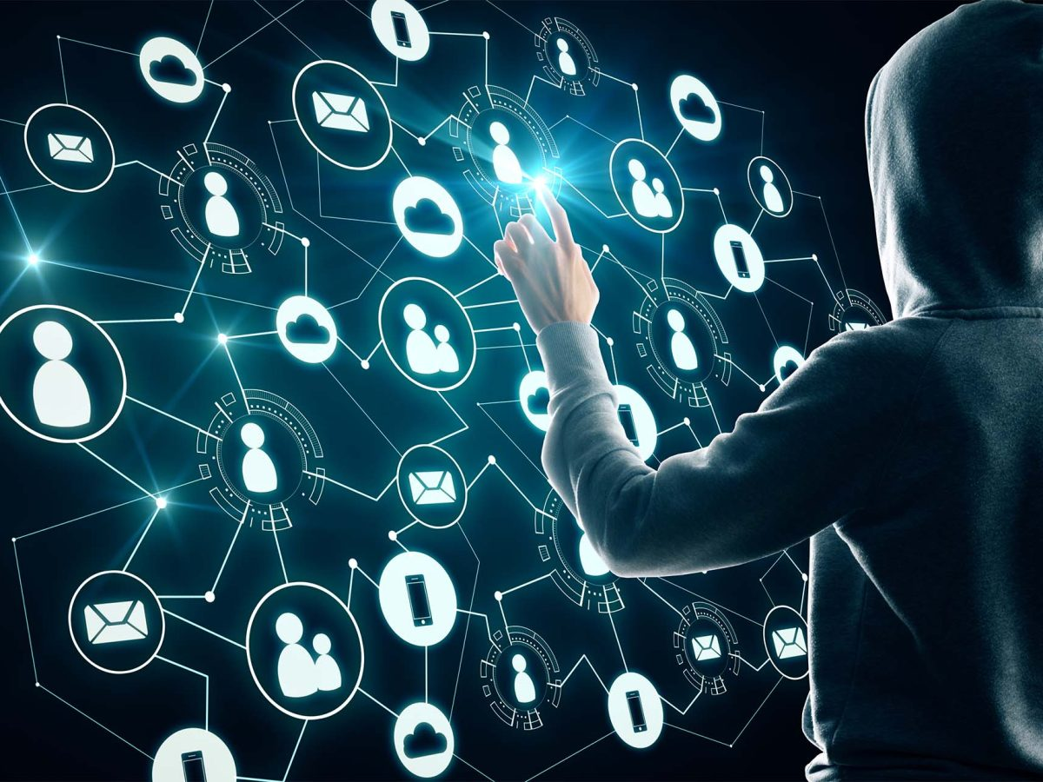
Social engineering and Cybersecurity
Most cyber attacks exploit human weaknesses, esp. our tendency to trust other people.
One of the most effective penetration attacks, responsible for or part of the vast majority of security breaches.
Design and application of deceitful techniques to deliberately manipulate human targets.
Primarily used to induce victims towards disclosing confidential data, or to perform actions that breach security protocols, unknowingly infecting systems or releasing classified information.
Main point in applying SE attack vectors is to avoid CS systems and need to overcome technological countermeasures.
CSP002: Human Factors in Cybersecurity
Notes:
SE

Slide 28

Main Categories of Social Engineering
Hunting:
  Execute SE attacks through minimal interaction with the target.
  Once target has been achieved, communication will be terminated.
  Most common methodology
Farming:
  Establish a relationship with victim in order to extract information for a longer period of time.
  Win personal trust (not generic basic human-to-human trust).
  Risk grows on both sides during the process.
  Less frequently used
Notes:
Grundsätzlich unterscheiden wir zwei grundverschiedene Formen des SE – Hunting und Farming.
Beim Jagen ist der Kontakt eher nur kurz und einmalig, beim Farming säht der Social Engineer über längeren Zeitraum das Vertrauen dass das Opfer in ihn investiert. Beim Thema Insider Threats spielt dies eine größere Rolle – ist aber zahlenmäßig wesentlich unbredeutender als Hunting, da sich der farmende SE ja dabei auch einem wesentlichen Risiko aussetzt, wenn er über längere Zeit und häufige Online oder Offline Kontakte mit dem späteren Opfer kommuniziert und dabei zwangsläufig Spuren hinterlässt.

Slide 29
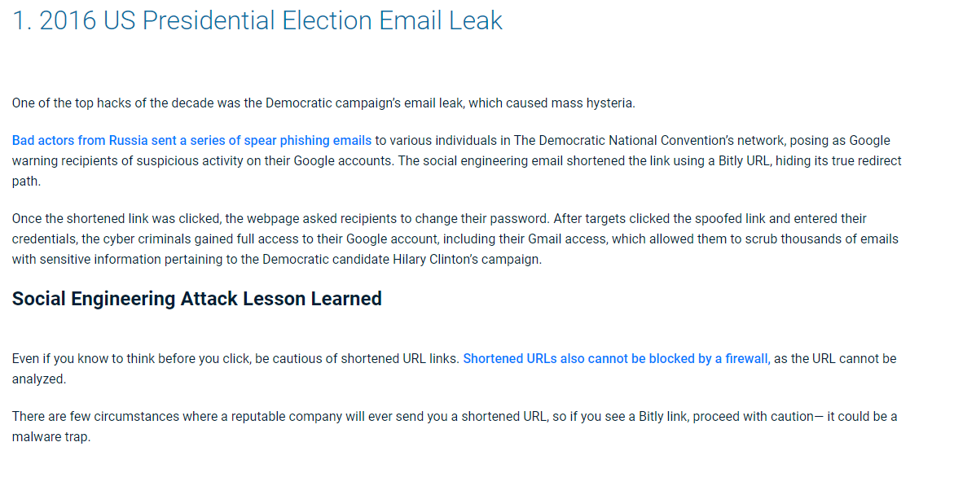
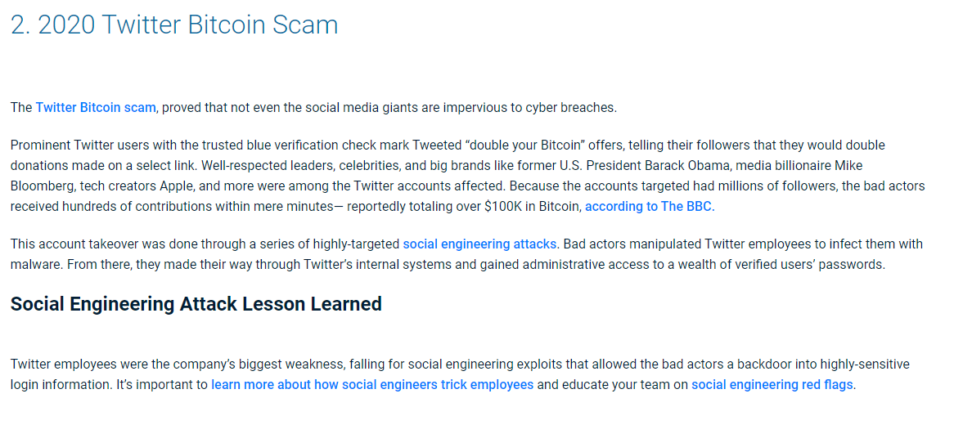
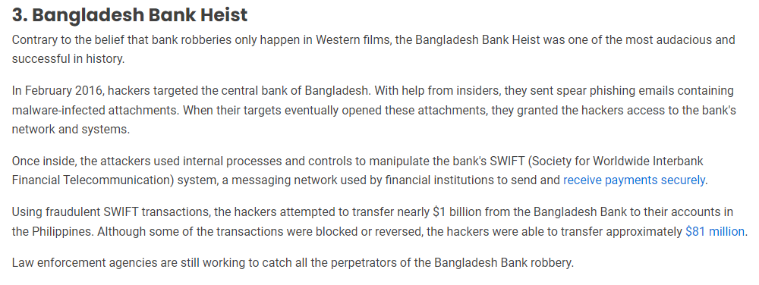

Slide 30

Mouton et al. (2016)

Slide 31

Mouton et al. (2016)

Slide 32

Familiar examples

Slide 33



Confirmshaming
Shame: The ‘Master’ emotion. Holds social bonds together (Scheff, 2002)
Notes:
Ein Beispiel aus dem beliebten Spiel Candy Crush.
Scham ist eine besonders wirkungsvolle Emotion – sie signalisiert Reue und halt soziale Verbindungen aufrecht – vermeidet aus der Gruppe ausgestoßen zu werden.

Slide 34
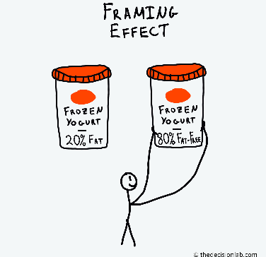
Framing Effects
The framing effect is when our decisions are influenced by the way information is presented. Equivalent information can be more or less attractive depending on what features are highlighted.
Induce system 1, more peripheral evaluations
Biases
Notes:
The most common framing draws attention to either the positive gain or negative loss associated with an option. We are susceptible to this sort of framing because in accordance with “prospect theory,” we tend to avoid certain losses. A loss is perceived as more significant, and therefore more worthy of avoiding, than an equivalent gain. The way something is framed can influence our certainty that it will bring either gain or loss. This is why we find it attractive when the positive features of an option are highlighted instead of the negative ones.
“Heuristics” or mental shortcuts might also play a role. Due to the availability heuristic, we favor information that is easily understood and recalled. Options and information that is framed this way are favored over those that aren’t. The affect heuristic may cause us to favor information and options that are framed to elicit an immediate emotional response. Research has shown that framing relies on emotional appeals and can be designed to have specific emotional reactions.

Slide 35



Influence: Consistency and Commitment
& Mere Exposure effects
Notes:
Bakshy, E., Messing, S., & Adamic, L. A. (2015). Exposure to ideologically diverse news and opinion on Facebook. Science, 348(6239), 1130-1132.
Facebook algorithms and consumer choices were measured to see what decided the content shown in feeds. Humans made more ideological consistent choices. Seeing cross-cutting content relative to ideologically consistent content is 5% for conservatives and 8% for liberals. Clicking: comparing the likelihood that an individual clicks on a cross-cutting content relative to a consistent content to be 17% for conservatives and 6% for liberals, a pattern that is consistent with prior research, but is somewhat counterintuitive

Slide 36


Forced Choices

Slide 37

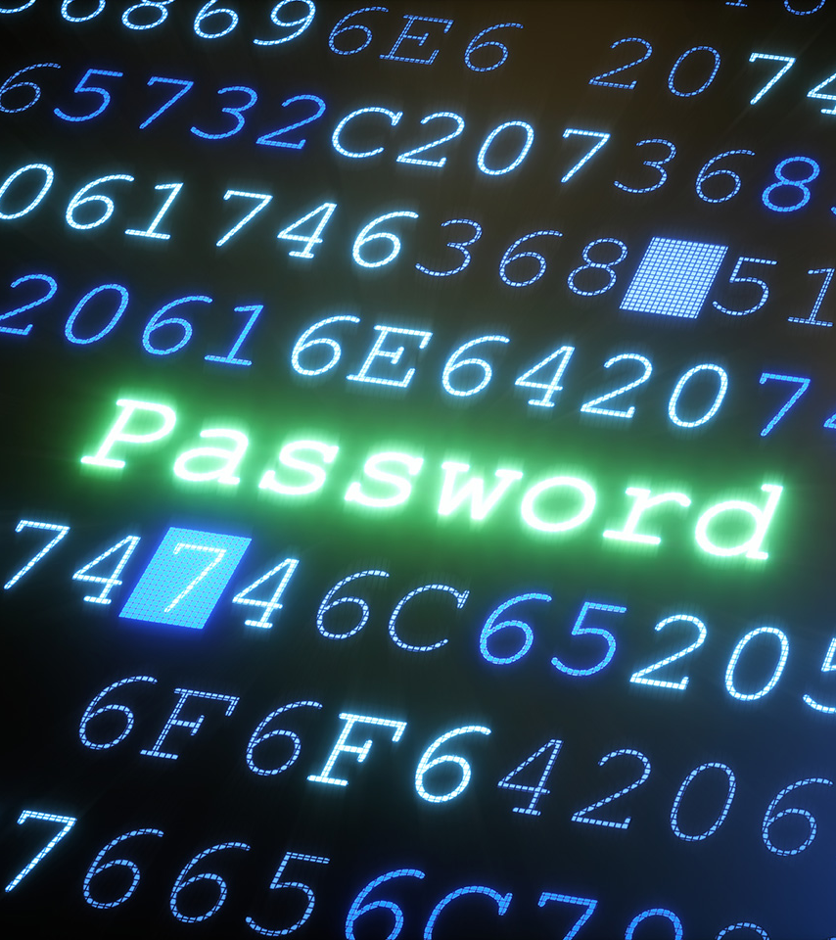
Scratch my back,
I scratch yours
(Happ et al., 2016)
9 out of 10 people reveal personal information to online strangers when given some chocolate
  4 out of 10 within 2 minutes
  Stronger when given right before asking for passwords (50%)
Risk factors:
  Men
  Younger age

Slide 38
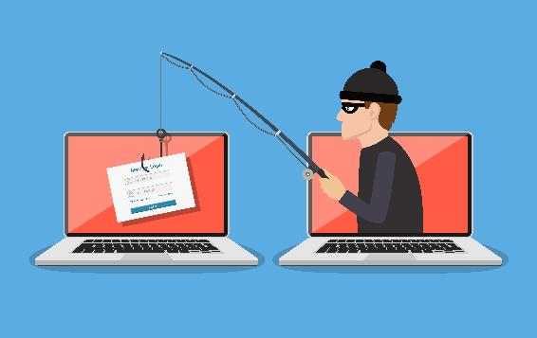
Let’s og Phishing

Slide 39
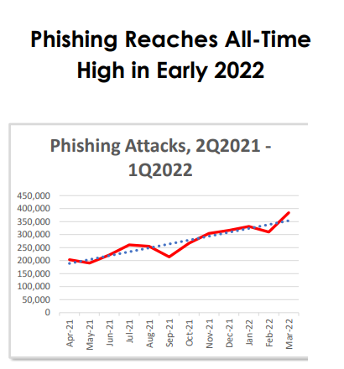

Phishing as most common attack vector
Founded in 2003, the Anti-Phishing Working Group (APWG) is a not-for-profit industry association focused on eliminating the identity theft and frauds that result from the growing problem of phishing, crimeware, and e-mail spoofing. Membership is open to qualified financial institutions, online retailers, ISPs, solutions providers, the law enforcement community, government agencies, multi-lateral treaty organizations, and NGOs. There are more than 2,000 enterprises worldwide participating in the APWG.
https://apwg.org/trendsreports/
Notes:
When you read articles or chapters on the subject of phishing, you will notice that most of them start with several paragraphs about how serious the situation is and how much it has worsened. Actually, only the figures change from year to year, the wording (definition of phishing and seriousness of the problem) sometimes seems very repetitive. However, this is due to the fact that it is necessary to describe this topic sufficiently for a wider audience that does not necessarily have the prior knowledge.The Anti-Phishing Working Group report provides you with the latest figures on a quarterly basis.Translated with DeepL.com (free version)

Slide 40
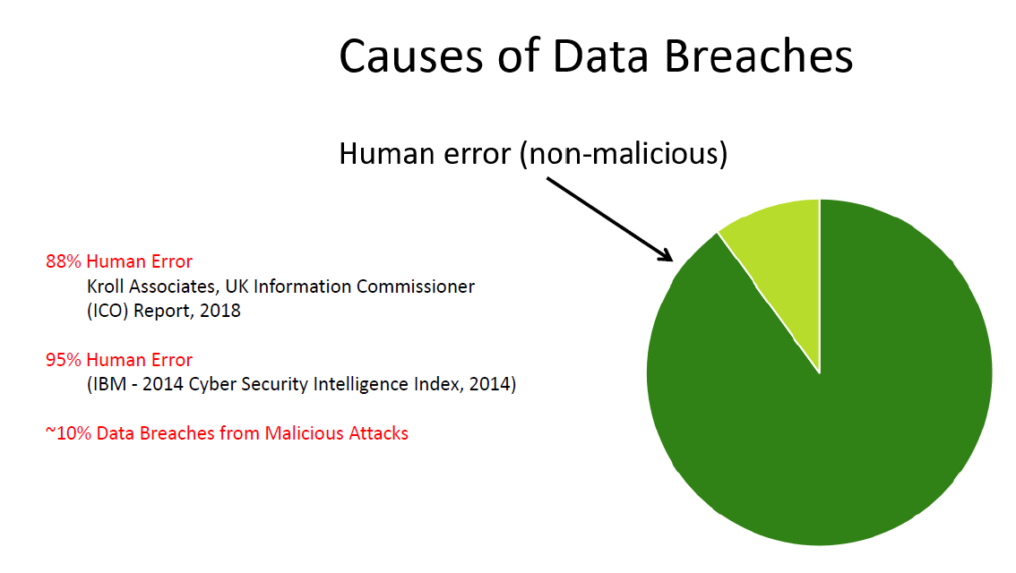
Canham (2019)

Slide 41
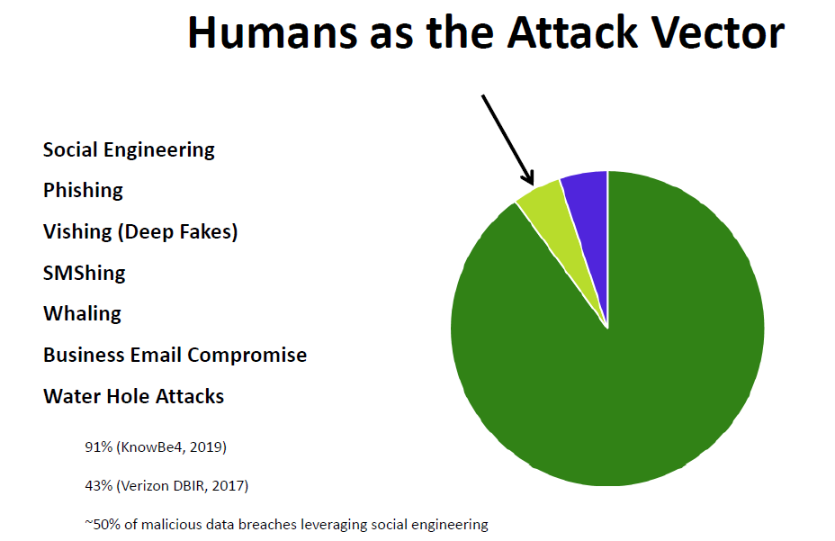
Canham (2019)
Notes:
Watering hole is a computer attack strategy in which an attacker guesses or observes which websites an organization often uses and infects one or more of them with malware. Eventually, some member of the targeted group will become infected.^{[1][2][3]} Hacks looking for specific information may only attack users coming from a specific IP address. This also makes the hacks harder to detect and research.^{[4]} The name is derived from predators in the natural world, who wait for an opportunity to attack their prey near watering holes.^{[5]}

Slide 42
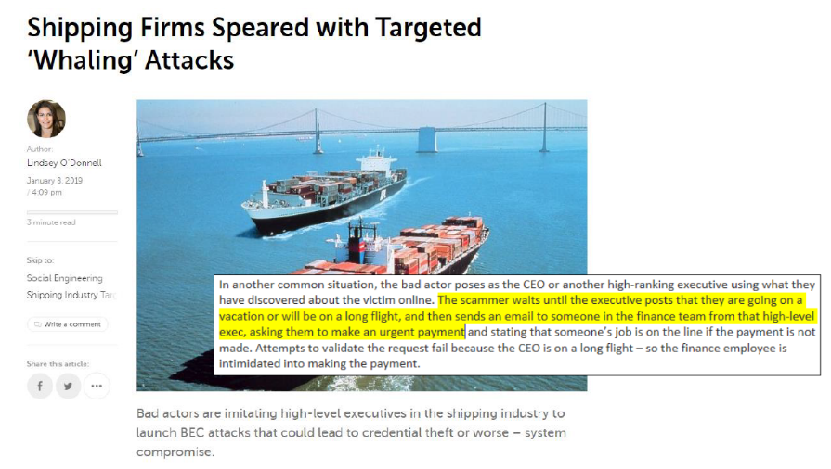
Canham (2019)

Slide 43


What is SE?
Similar to the term “Dark Patterns”, the term “Social Engineering” did not develop as a result of systematic research, but as a loose description used in the IT community to describe psychological effects with relevance for cyber security. The attempts to define the term occured years after they had spread. Instead of SE, one could say “deception of a person to gain an advantage”.
Other examples for attempted definitions:
“Any act that influences a person to take an action that may or may not be in their best interest.” (social-engineer.org, 2017)
“Social engineering, in the context of information security, refers to psychological manipulation of people into performing actions or divulging confidential information” (wikipedia.org, 2017)
Goal: gain unauthorized access to systems or information to commit acts such as fraud, network intrusion, industrial espionage, or identity theft.

Slide 44
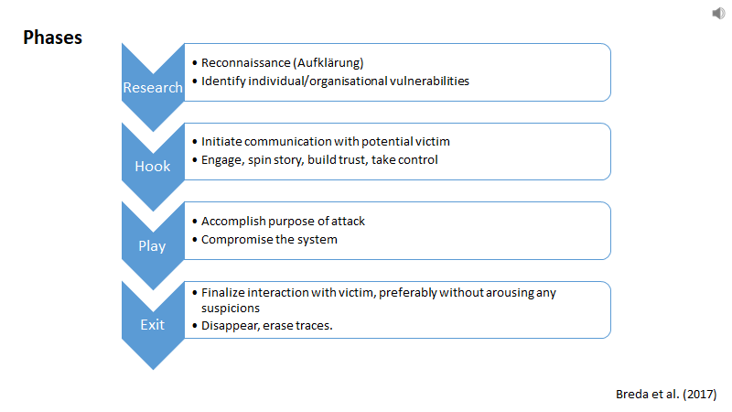
Social Engineering Attack Framework
Notes:
Mouton, F., Leenen, L., & Venter, H. S. (2016). Social engineering attack examples, templates and scenarios. Computers & Security, 59, 186-209.
This process can take place in a single email or over months in a series of social media chats or face-to-face interaction. Concludes with an action you take, like sharing your information or exposing yourself to malware.
Many employees and consumers don't realize that just a few pieces of information can give hackers access to multiple networks and accounts. By masquerading as legitimate users to IT support personnel, they grab your private details — like name, date of birth or address. From there, it's a simple matter to reset passwords and gain almost unlimited access. They can steal money, disperse social engineering malware, and more.

Slide 45
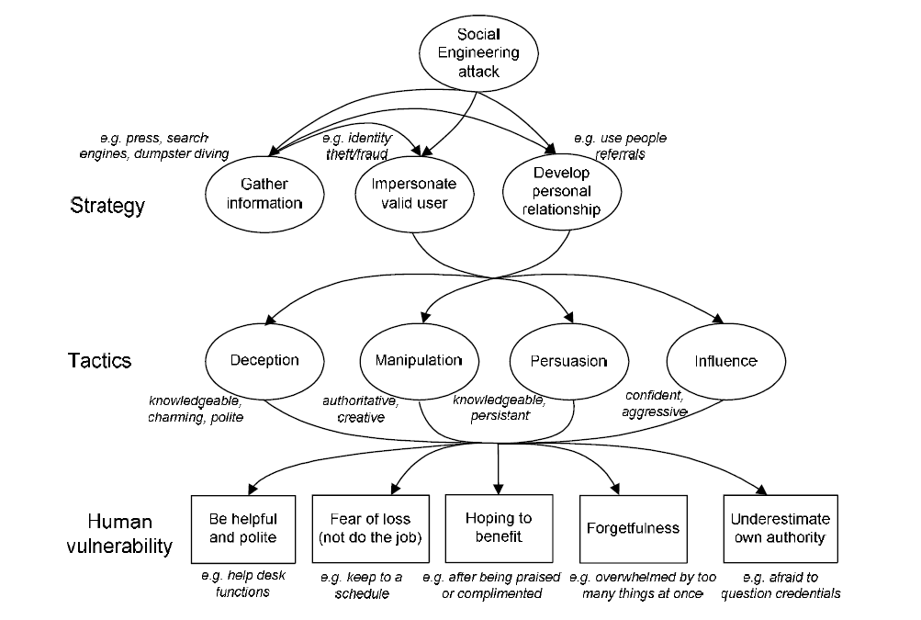
Social Engineering

Slide 46

Stajano & Wilson principles
Distraction
Divert attention buy keeping victim busy with a burdensome and important task. Example: fill in online forms.
Social compliance
Following authority (comp. Cialdini’s consistency&commitment). Example: spearfishing a subordinate by impersonating a leader.
Herd principle
Use majority of others as reference point. Example: Rate someone’s credibility by number of friends - fake account.
Dishonesty
Victims can not complain if they broke the rules. Example: Prepaid card generator.
Need and Greed
Exploiting victim’s current needs, greeds, or interests. Example: Fake password manager.
Time
Like “scarcity” -> Setting people under time pressure hinders System-2 engagement. Example: Various phishing mail ex.

Slide 47

Applying Persuasion techniques in SE/Phishing
Cialdinis (2007) techniques of persuasion
Reciprocation
Consistency
Liking
Social Proof
Scarcity
Authority
Notes:
Bei solchen Gesprächstechniken – aber auch bei soziotechnischen Angriffen wie simplen Phishing-Emails geht es immer auch um die Überzeugungskraft. Wir müssen ja dazu bewegt werden, etwas zu tun und zu entscheiden.
Wie aber überzeugt man Menschen – mal ganz generell gesehen?
Hier gelten die sechs Prinzipien die Cialdini 2007 publiziert hatte als die best Auflistung von Überzeugungsstrategien bei Menschen.
Die ersten erfordern eher einen Dialog und einen besseren Austausch, als der durch bspw. Phishing-Mails möglich ist. Die letzten drei sind sehr gut auf Phishing Mails anwendbar.
Social Proof heißt: Jmd anderes hat schon draufgeklickt
Scarcity: Etwas ist besonders rar, geht bald zur Neige
Authority: Anweisung kommt von jmd auf einer höheren Hierarchiestufe
Schauen Sie sich das auf der folgenden Folie verlinkte Video an und machen Sie sich selbstständig Notizen zu den jeweiligen Techniken – diese werden Ihnen immer und immer wieder implizit oder explizit begegnen, daher ist es besser diese nicht nur passiv zu „konsumieren“ sondern das Gehörte selbst hier bspw im Notizbereich von ppt selbst zu notieren.

Slide 48
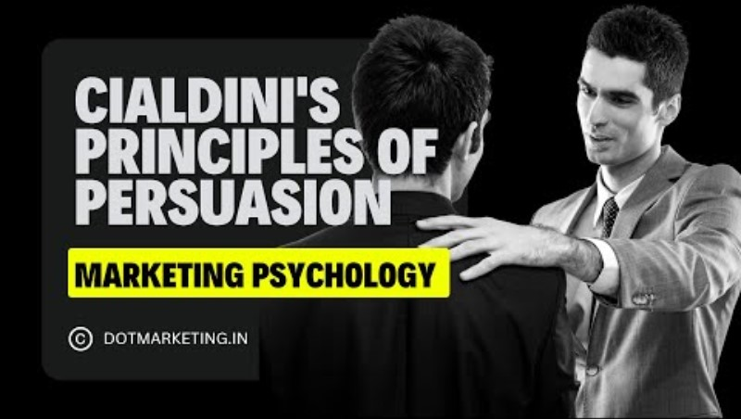
CSP002: Human Factors in Cybersecurity
Notes:
Schauen Sie sich bitte das komplette Video an – diese hier dargestellten Prinzipien werden nicht nur in Phishing, sondern generell in fast allen SE-Ansätzen verfolgt!
Die drei Prinzipien Social Proof (im Video: Consensus), Scarcity und Authority spielen bei Phishing, wo die bidirektionale Interaktion nicht gegeben ist, eine entscheidendere Rolle.
Das Video dauert knapp 12 Minuten und ist hier nur als Tipp zu verstehen (für die Wiederholung außerhalb der Veranstaltungszeit).

Slide 49
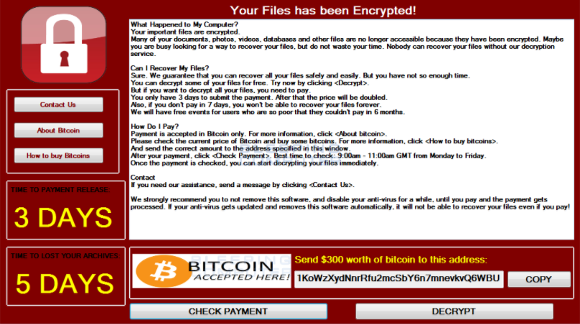
Let’s Try!!!
Reciprocation
Consistency
Liking
Social Proof
Scarcity
Authority

Slide 50

Cogntive exploits and attack vectors
Notes:
Red Arrow: an attacker that wages a social engineering cyberattack against a victim's human cognition functions (i.e., the oval). The resulting behavior is associated to persuasion (i.e., an attack succeeds when a victim is persuaded to act as intended by the attacker).
Cognitive workload, via mechanisms such as inattentional blindness, can increase vulnerability to social engineering cyberattacks.
Stress may reduce one's ability to detect deception cues in social engineering cyberattack messages but the direct effects of acute stress on cybersecurity social engineering have not been examined.
Attentional vigilance, particularly the vigilance decrement, may be an important influence on susceptibility to social engineering attacks, but more research is needed.
Literature results are not conclusive on how personality may influence one's susceptibility to social engineering cyberattacks.
Domain knowledge helps reduce vulnerability to social engineering cyberattacks.Awareness and general technical knowledge do not necessarily reduce one's susceptibility to social engineering cyberattacks, perhaps because human cognition functions have not been taken into consideration. Self-efficacy, knowledge, and previous encounter of social engineering cyberattacks collectively reduce one's susceptibility to social engineering cyberattacks. In particular, costly phishing experiences would greatly reduce one's susceptibility to social engineering cyberattacks, while non-costly experiences do not.
But Stefan will discuss this
Gender does not have a big impact on the susceptibility to social engineering cyberattacks
Old people with higher education, higher awareness and higher exposure to social engineering cyberattacks are less susceptible to these attacks.
Culture affects privacy and trust attitudes, which indirectly affect one's susceptibility to social engineering cyberattacks.
Long term memory The success of social engineering cyberattacks is inversely related to their prevalence.
Training methods that ask people to consciously think about social engineering cyberattacks are unlikely to be very successful unless the learning reaches the point where it is a habit that, largely unconsciously, guides safer computer use behavior.
Message quality and message appeal, which reflect attacker effort (e.g., using contextualization and personalization), have a significant impact on the attacker's success.
An individual's capabilities in detection of social engineering cyberattacks are affected by their awareness of the threats, their cultural backgrounds, and their individual differences in trust/suspicion.

Slide 51
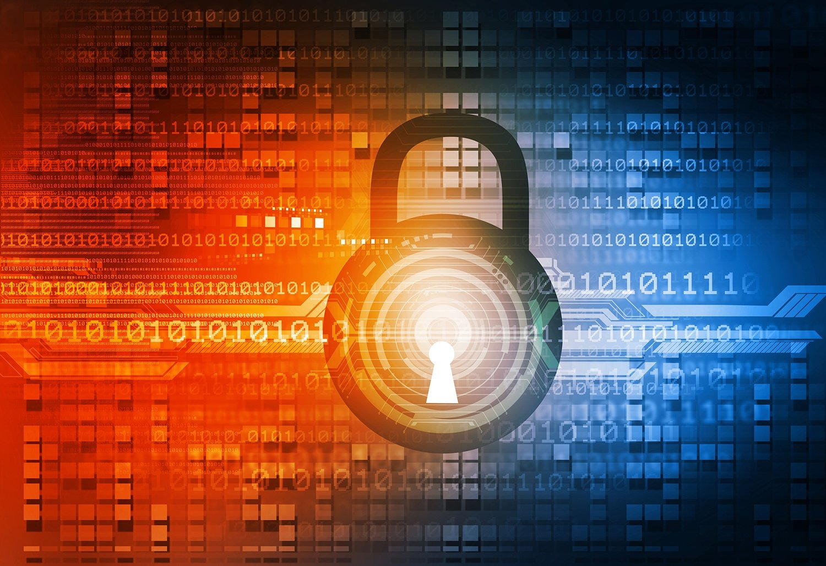


Slide 52

(very) little examples

Slide 53

Notes:
The combination of the search terms cyberpsychology and personality yields 54,700 results in Google Scholar.Everything from online dating, gambling addiction, behavior in anonymous chat rooms to, of course, cybersecurity behavior or misconduct has already been investigated.So the probability of being confronted with any results and claims or articles is very high. Therefore, we will spend some time (2 sessions) to shed some more light on this topic.Since we want to cover various topics in cyberpsychology and thus computer science, the selection will inevitably appear somewhat broad.Translated with DeepL.com (free version)

Slide 54
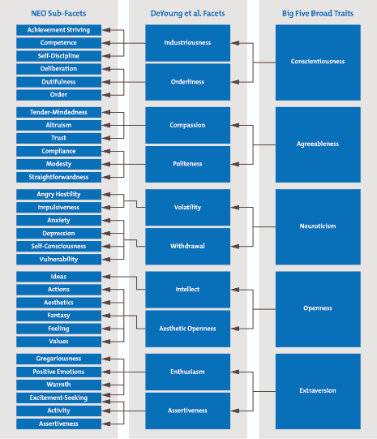
Individual Vulnerabilities
Personality - a person’s relatively stable feelings, thoughts, and behavioural patterns
OCEAN/ FFM/ Big 5
(Costa & McRae, 1990)
Females higher in N & A
Bigger differences in egalitarian cultures
Notes:
DeYoung et al, 2007: These 10 facets were proposed in 2007 by psychologists Colin DeYoung, Lena Quilty and Jordan Peterson in their paper, "Between Facets and Domains: 10 Aspects of the Big Five." This version of the model is known as the Big Five Aspects Personality Test
Neuroticism is the tendency to feel that reality is a problem and to experience readily unpleasant emotions. People that possess high levels of neuroticism are generally sad and sometimes hot tempered Extraversion is the tendency to seek out the company of others and reflects energy and positive emotions in one’s personality. Extraverted personalities often seek excitement and tend to be dominant. Openness is the desire to seek out new experiences without anxiety and an appreciation of different ideas and beliefs. Individuals that exhibit high levels of openness revel in fantasy and appreciate art and nature. Agreeableness is a measure of the quality of the relationships a person has with others. If a person has a high level of agreeableness, they are compassionate and cooperative rather than antagonistic and suspicious. They believe that people they interact with are generally good intentioned and honest. Finally, conscientiousness focuses on self-discipline, dutiful action, and a respect for standards and procedures. These people are known for their prudence and common sense
Recent studies, however, have shown that our personalities do change beyond this age. Another study by Srivastava, Gosling, and Potter (2003) found that Conscientiousness and Agreeableness changed through early and middle adulthood. They also found that Neuroticism declined in females over time, while staying relatively stable in males. They report that their findings could be attributed to a variety of developmental influences such as experience in different areas that correlate with attainment of certain ages.

Slide 55

Notes:
Parrish Jr, J. L., Bailey, J. L., & Courtney, J. F. (2009). A personality based model for determining susceptibility to phishing attacks. Little Rock: University of Arkansas, 285-296.
Personal factors are those that either cannot be changed or are extremely difficult to change and include gender, culture, and age. Experiential factors are those that shape an individual’s personality because of a past event or experience. The Big-Five personality profile classifies the personality differences of individuals among five broad factors as previously discussed. The framework proposes that each of these factors has a role to play with regards to the susceptibility of an individual to a phishing attack.
Kids increase A!
Non tech vs tech. Neg experiences
2 aspects : Susceptibility & Time for takedown
Dawson & Stewart 2018 - Moderating effects. Culture (UK vs USA), Age
a social influence, conformity, obedience, reactance, resistance and authority (Lindsey, 2005; Weatherby et al., 1999) b commitment, affection, normative, continuance, commitment and affective commitment (Allen and Meyer, 1990) c trust and vulnerability (Gendall, 2005) d threat (Pyszczynski et al., 1997)

Slide 56
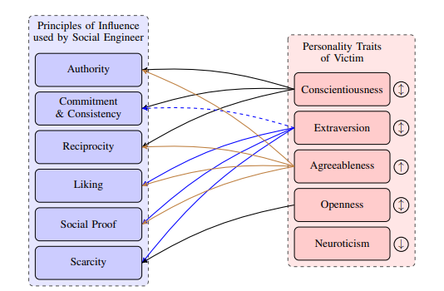
Social Engineering Personality Framework (SEPF)
Attack:
C: rules
E: Excitement
A: Many ways in…
O: Scarcity - restrict freedom
N: Protective factors
Notes:
C. SE that exploits rules makes C more vulnerable - i.e. Commitment and consistency, reciprocity & authority. Inoculated against social proofing, liking, scarcity
A: information if a social engineer established a trust relationship. Regarding the principles of influence, we expect an increased vulnerability towards authority, reciprocity, liking, and social proof.

Slide 57

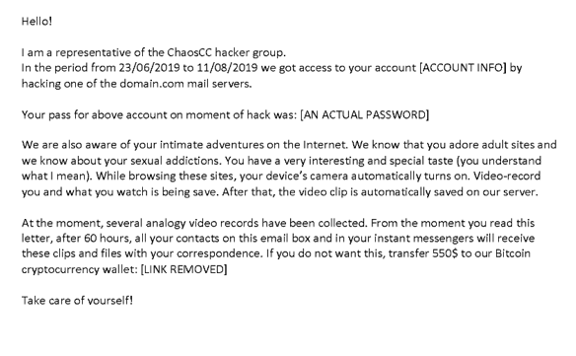
I know what you did last summer

Slide 58

Phishing
Similarity
Familiarity

Slide 59
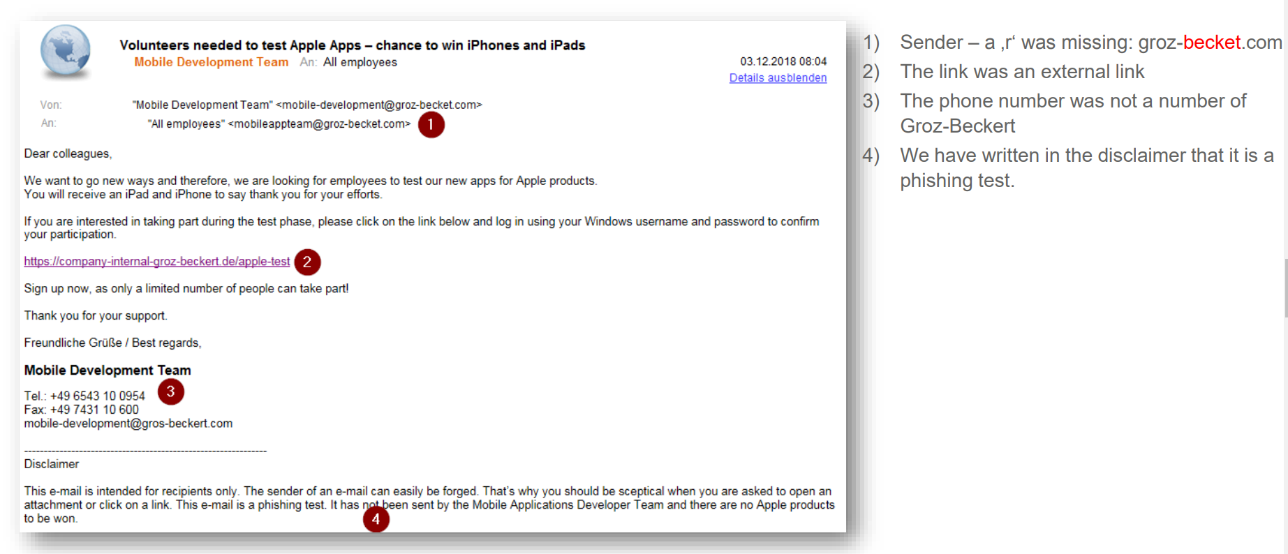

Social Engineering – Phishing example

Slide 60
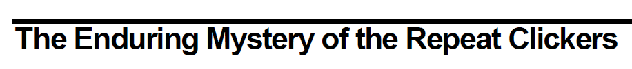
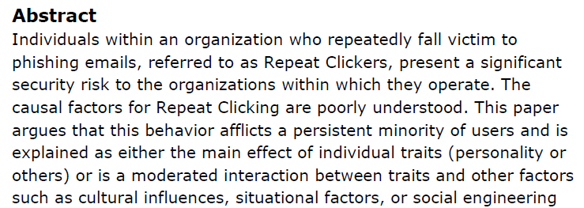
Canham et al. (2019)
Notes:
19 month , 20 campaigns

Slide 62

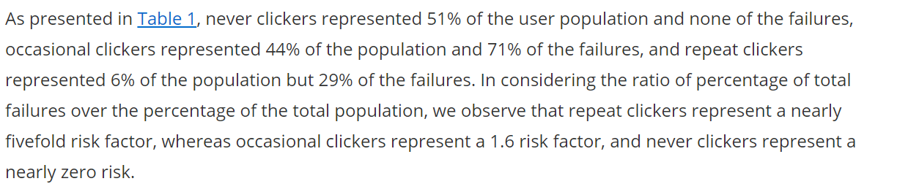
Phishing mails
Canham, 2019; The Enduring Mystery of the Repeat Clickers

Slide 63
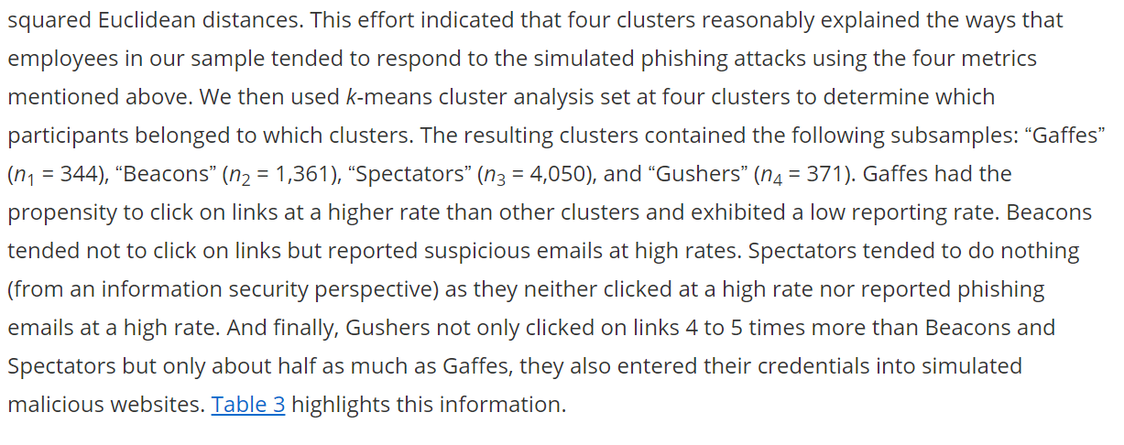

Slide 64

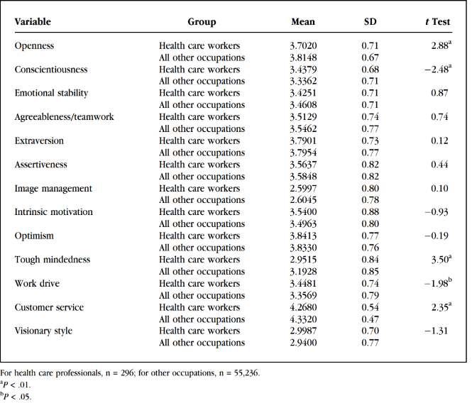
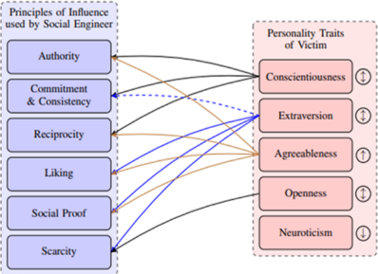
Healthcare worker profiles
Females are 70% of healthcare workforce
Females higher in Neuroticism, Agreeableness, warmth (an extraversion facet) and openness to feelings
Men higher assertiveness (a facet of extraversion) and openness to ideas
Gender differences largest in egalitarian cultures
Notes:
Richardson, J. D., Lounsbury, J. W., Bhaskar, T., Gibson, L. W., & Drost, A. W. (2009). Personality Traits and Career Satisfaction of Health Care Professionals. The Health Care Manager, 28(3), 218–226. doi:10.1097/hcm.0b013e3181b3e9c7

Slide 65
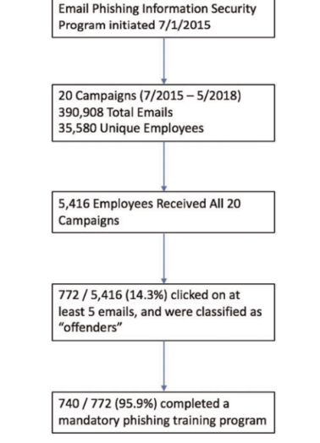
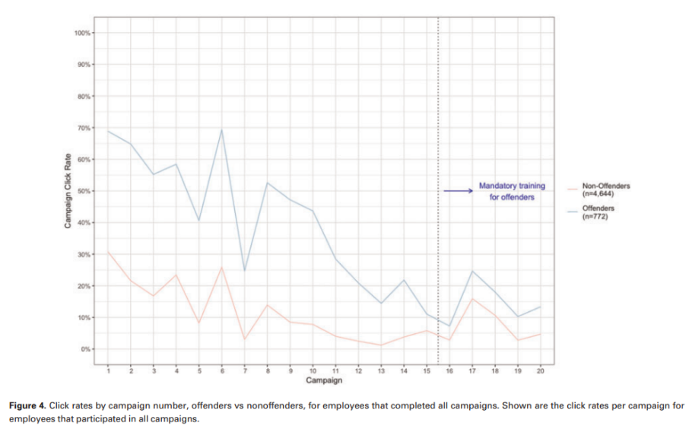
Healthcare workers and repeat clicking (Gordon et al., 2019)
Notes:
Gordon, W. J., Wright, A., Glynn, R. J., Kadakia, J., Mazzone, C., Leinbach, E., & Landman, A. (2019). Evaluation of a mandatory phishing training program for high-risk employees at a US healthcare system. Journal of the American Medical Informatics Association, 26(6), 547-552.
click rates are alarmingly high, but generally improve with repeated simulated phishing campaigns.
the mandatory training program for employees who clicked on 5 or more simulated phishing campaigns itself did not have a meaningful impact on click rates—the “offenders” remained more likely to click on phishing emails than nonoffenders did, with click rates between 10% and 25% post-training.
The real-time training (provided after an employee clicked on any phishing simulation) may have been more effective at narrowing the gap between offenders and
Because it only takes 1 successful phishing attack to cause substantial damage to a healthcare organization, these click rates (with or without training) are highly concerning.

Slide 66
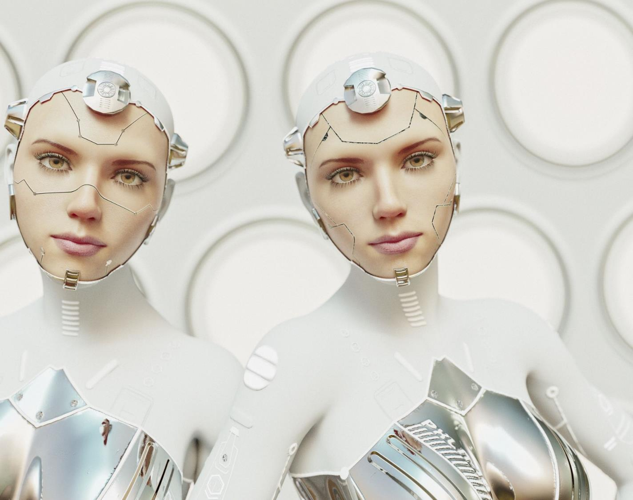
Individual differences
The susceptibility towards DP effects is no own personality characteristic.
The psychological effects are manifold. DPs consist of series and combinations of a wide range of psychological mechanisms.
The susceptibility towards particular mechanisms and manipulations can be partially personality-dependent (e.g. agreeableness, conformity, IT-literacy, narcissism).
Strong contributors to DP effects are situational/contextual influences: time pressure and stress facilitate superficial cognitive styles and the perceived relevance of the process determines how much cognitive work I am willing to invest in careful reading and conscious-reflective deciding. Example: Mobile phone usage is more likely to happen under time pressure, while doing something else (walking, travelling, working) when having less cognitive resources available. The smaller screen adds to the cognitive effort by making navigating more difficult.
CSP002: Human Factors in Cybersecurity
Notes:
Narzissmuss -> Research Gate > Daten -> sozialer Vergleich
Frage der Intention-Behavior-Gap
Perception-Preparedness
Bsp für die Kombination: LOSS of SOCIAL contacts bei FB, nachdem man in ein Roach-Motel-Manier sich zur Kündigung vorgearbeitet hat.
Tools: App die DP in meinen installierten Apps gespeichert hat und in vereinfachter Sprache erklärt, meine Wünsche abfragt – Implikationen von Entscheidungen erklärt und eine Schritt-für-Schritt-Anleitung bietet.

Slide 67
Dark Patterns
“Dirty tricks designers use to make people do stuff”
Harry Brignull (2010)
“Interface design choices that benefit an online service by coercing, steering, or deceiving users into making decisions that, if fully informed and capable of selecting alternatives, they might not make.”
Mathur et al. (2019)
“Weaponized usability”

Slide 68

The relationship between Dark Patterns and Cybercrime
Dark Patterns trigger psychological processes which make us vulnerable to malicious intentions (cognitive exploits)
This logic is well-known from illegal social engineering techniques, such as phishing emails
Phishing emails apply the same principles of persuasion
The question of when DP are legal or not and to which extent it is practiced is merely a question of culture, legal frameworks and law enforcement

Slide 69
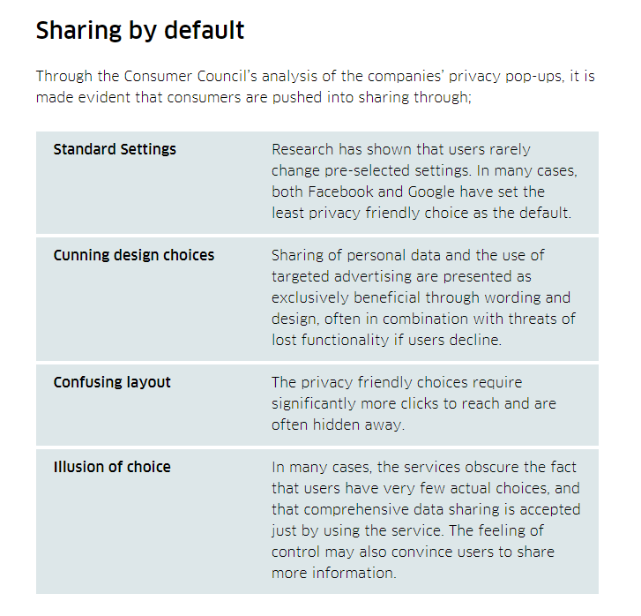

The «Roach Motel»
Facebook
(Norwegian Consumer Protection Agency, 2019)
Notes:
Vor allem sog. Roach Motel.
Aber auch Verlustaversion („lost functionality if users decline“ – siehe „cunning design choices“).

Slide 70
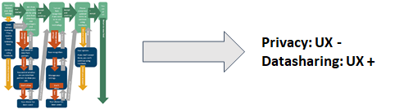
Dark Pattern- Mechanism
Usability = easiness and pleasantness of use.
Learnability (How quickly can I learn it?)
Efficiency (How quick will I reach my goal?)
Memorability (Easyness of use after a time of absence.)
Errors (How often do I do sth wrong and how easy can I correct myself?)
Satisfaction (How pleasant is the use?)
Mechanism of Dark Patterns
Cognitive Dissonance (Festinger, 1957)
Social Cognition (Bargh, 2000)
Persuasion (Cialdini,1984)
Notes:
Dark Patterns are interface design choices. They determine which information we get about our options to act, and how we think about them.
The online service providing the pages steers us into making decisions that are in the provider’s interest.
In many cases, we are nudged to make decisions we would have not otherwise made.
Rules and principles of usability are applied. As always in usability, the goal is to make the user experience more comfortable. In this case, the most comfortable (quickest, easiest) option leads to decisions that are in the interest of the provider, for example by sharing personal data or buying a product.
Today we will talk about these psychoogical processes and how Dark Patterns use these against us.
Cognitive Diss is when 2 cognitions are conflicting and how we rationalize the conflict to ease the uneasiness we feel when this happens. Or example: I smoke- this is harmful to my body andwill gi

Slide 71
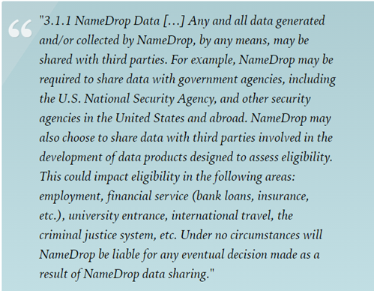
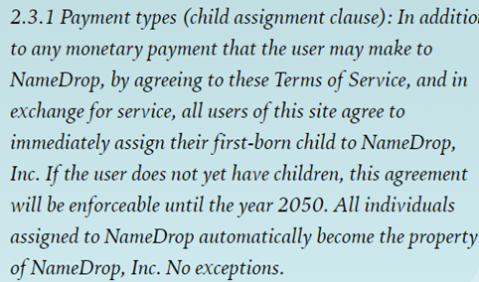
Cognitive Dissonance - Cognitive Misers
How long does it take t read a privacy policy (PP)?
Terms of Service (TOS)?
Notes:
●Obar, J. A., & Oeldorf-Hirsch, A. (2020). The biggest lie on the internet: Ignoring the privacy policies and terms of service policies of social networking services. Information, Communication & Society, 23(1), 128-147.●
●Researchers at two universities conducted a study where they asked students to join a fictitious networking website, and as part of the process, asked the participants to agree to terms of service that included the following:
●Terms of use ca. 30 min (privacy policy) & ca 15 Terms of Service: Avg reading time: 77 sec (PP) & 51s TOS
●N=543
●Qualitative findings suggest that participants view policies as nuisance, ignoring them to pursue the ends of digital production, without being inhibited by the means. Implications are revealed as 98% missed NameDrop TOS ‘gotcha clauses’

Slide 72


The New Challenge: Deep Fakes
In “conventional” SE attacks low-tech attacks meet unprepared “brains”
In an evolving SE landscape, AI-based DF become the new powerful threat
While the same principles apply, the information is now conveyed by a person of authority or trust, rather than from “outside” and only in written/unpersonal form, making the application of the same principles more convincing.

Slide 73



Slide 74

Political ideology is not only a set of beliefs. Sets of beliefs, attitudes and cognitive patterns are hardwired and have neuronal correlates responsible for cognitive processes such as attention, emotional reactions to certain stimuli and priorities (subjective value) of competing goals, etc. Thus, it is only logic to conclude that stable political-psychological traits can be found in the processing of perceptual characteristics of politically relevant content.

Slide 75


Deepfake in Social Engineering
Conservatism:
Greater sensitivity to threatening stimuli
Liberals Vs Conservatives: Psychological Differences Between Brains (businessinsider.com)
DFs allow cybercriminals to impersonate other individuals
Few individuals have the technical tools and background needed to detect DFs
People will have to rely on their DF detection skills to avoid Social Engineering
The associated cost of DF scams was estimated to exceed 250 million USD in 2020

Slide 76



Knowledge-driven perception
Notes:
B or 13? Horse or Seal?
These pictures were presented for 400msec and the perception of viewers could be influenced by previous exposure. One of the possible interpretations was previously related to something nice and pleasant, whereas the other with something neutral. [give example on how that was done - Lexical Decision Task LDT]
One could argue that participants saw both and only chose to report the one they thought the experimenter wanted to hear - this alternative explanation, however, was dismissed after eye-tracking measurements assessing the first so-called “saccade” (eye-movemenet and fixation) which cannot be consciously controlled predicted their choice.
This may be one first evidence of motivational influences on perception.
The short presentation time in the previous experiment was followed by a longer time people had to report. So it is not entirely clear whether the process influencing the perception is a very early one of visual perception, or a later, higher cognitive one, of personal judgment. One way to to find out whether the effect is a very basic, early one is to use the concept of binocular rivalry.

Slide 77



Notes:
Here the coloured goggles made one of the two superimposed images invisible. Only one of the images was previously associated with financial gain, and this one was dominant.
So, what influences the perception? Our wishes and goals –

Slide 78

Device choice
Situational awareness reduced due to screen size and multitasking?
0,41 SD
Notes:
Der Unterschied wirkt in der Grafik moderat – wir nutzen nicht Bauchgefühle für sowas. In der Normalverteilung entspricht das Areal um den Mittelwert plusminus 1SD 68% der Bevölkerung, wir haben es also hier bei 0,41 SD durchaus mit einem substanziellen teil der Population zu tun, der zusätzlich hiervon beeinflusst wird. Nach allgemeiner Konvention von 1988 spricht man hier von einem mittelstarken Effekt.
Interpretation:
- mit größerem Bildschirm (PC) wurden im Durchschnitt mehr Videos korrekt erkannt
- kleinster Bildschirm (Smartphone) hat im Durchschnitt am wenigsten erkannt
- Effektstärke zwischen PC & Smartphone ist am stärksten (0,41) , d.h. hier unterscheiden sich die Mittelwerte am meisten
(- Standardabweichung bei Tablet am höchsten -> eventuell wegen unterschiedlicher Größe?)

Slide 79

Is the individual skill in deep fake recognition related to the viewers’ personal political orientation?
Social conservatism was negatively correlated with DF recognition skills (r=.27, p<.05).
Agreement with individual statements was negatively correlated with DF recognition skills (r=.35, p<.05).
The effect remained unchanged, when controlled for age.

Slide 80






A Parent’s Love

Slide 81
Now we Focus On You
81

Slide 82


The „master switch“
Notes:
By the way, here are two small screenshots of emails I received from the research network site "academia.edu" - a social network for people with an interest in research. You can only access the site if you have a paid account - which I don't - but the email doesn't tell you who became aware of your naturally extremely high quality, groundbreaking and world-changing research. These emails are legitimate, not phishing, but dark patterns work along the same lines. As I said, narcissists are not uncommon in academic professions and are a secure source of income.-> It should not be too difficult to use OSINT methods to assess narcissism or identify the most narcissistic person within a public-facing organization. E.g. obvious effort to appear in public, website maintenance, dress, formality (title, email signatures), private websites, - often in combination with extraversion (more data is available, and less distrust of others is expected, as well as more need for recognition by others).>90% hit rate in a UCF study: leaked exam questions from "professorial accounts" (misdirected email)

Slide 83

The Role of IT Background for Metacognitive Accuracy, Confidence and Overestimation of Deep Fake Recognition Skills
Stefan Sütterlin, Ricardo G. Lugo, Torvald F. Ask, Karl Veng, Jonathan Eck, Jonas Fritschi, Muhammed-Talha Özmen, Basil Bärreiter, Benjamin J. Knox.
Faculty of Computer Science, Albstadt-Sigmaringen University, Germany
Faculty of Health, Welfare and Organisation, Østfold University College, Norway
Centre for Cyber and Information Security, Norwegian University of Science and Technology, Norway
Cyber Warfare Centre, Norwegian Armed Forces Cyber Defence, Norway
HCI International – Augmented Cognition (Best Paper)
28.06.2022

Slide 84



Perceived competence -> basis of risk assessment and subsequent decision-making
Metacognitive accuracy
.
We know that, but why do we not measure it?

Slide 85


Surprising (?) Findings
In phishing simulations, persons with IT-background performed similar to persons without IT-background. When participants where informed about the upcoming simulations, persons with IT-background showed a relative decline compared to Non-IT participants.
.
Notes:
Jampen, D., Gür, G., Sutter, T., & Tellenbach, B. (2020). Don’t click: towards an effective anti-phishing training. A comparative literature review. Human-centric Computing and Information Sciences, 10(1), 1-41

Slide 86
Our research on deepfake recognition skills
IT professionals not better than non-professionals to detect DFs
IT professionals tend to be overconfident in their DF detection abilities
Sütterlin et al., 2022

Slide 87

Results
There were no significant differences in DF recognition (DF videos rated as authentic) for IT and non-IT (H = 0.08(2), p = .774, η2 = -.003) or CS and non-CS professionals (H = .21(1), p = .649, η2 = -.003).

Slide 88
Performance and (Over-)confidence
„Knowledge never prevented
a single breach.“
(Carpenter & Roer, 2022)

Slide 89

Females showed higher DF recognition scores.
Females show lower overconfidence levels.

Slide 90

Summary & Discussion
Having relevant education or IT-background is not per se a protective factor.
Knowledge about technical glitches/cues of DF is not activated, where a heuristic cognitive style is employed.
Self-assessment accuracy is a relevant predictor for actual performance.
Females show better MC accuracy and higher actual performance, most likely due to more systematic cognitive processing (and more comprehensive assessment – data not shown here).
Feedback mechanisms are required to detect security risks and mitigate them with individualised training.
Future studies should actively manipulate task-related self-efficacy in a randomized controlled design (currently ongoing study).

Slide 91



Slide 92



Slide 93
Phishing countermeasures
Counter-measure | Approach
Filtering | Analyze all incoming email messages and filter them based on their class: phishing or legitimate
Education of users | Train employees to protect them from falling victim to phishing attacks and prevent possible information leaks
Web filtering | Analyze browsed websites and identify possible phishing sites in order to warn the user or completely block access to the suspected sites
Website take-downs | Take down the phishing site to prevent potential victims from accessing such websites (usually by external parties such as law enforcement agencies (LEAs) or hosting service providers).
Notes:
FILTERING:
Phishing countermeasures can be applied at several stages during an attack. Considering
the general attack model in Fig. 2, a technical filtering solution could be deployed
in Step 2 (e.g., [20]). Such solutions process and analyze all incoming email messages
and, based on rules or ML, classify them as either phishing or legitimate. ML filtering
techniques have become state of the art and the classification of phishing website (e.g.,
[34–38]) can be used for blacklists. Such approaches can prevent a phishing message
from reaching the target user, but attackers can use ML techniques as well (e.g., [39]) for
bypassing such AI detection systems. Furthermore, ML based countermeasures can be
further adapted and optimized for different operational environments to improve performance
and combat implementation challenges. A recent example is [40] where the
authors have implemented an anti-phishing virtual network function at the edge of the
network with embedded robust machine learning techniques for phishing detection.
EDUCATION:
Never works 100% either. Resource consuming (competition with other tasks and priorities such as productivity)
WEB FILITERING
TAKE-DOWN: too slow – on average 62hrs

Slide 94


Evasion attacks: Advanced evasion attacks and mitigations on practical ML‐based phishing website classifiers - Song - 2021 - International Journal of Intelligent Systems - Wiley Online Library
[1412.6572] Explaining and Harnessing Adversarial Examples (arxiv.org)
Notes:
Web phishing is a major cyber threat and have reached a record volume.
It has been widely used to steal personal information such as login credentials. In addition, people nowadays prefer online shopping, which aggravates the harms of phishing attacks in practice.
Consequently, phishing attackers are able to gain a (vast) amount of money via phishing websites.
To detect phishing attacks, various anti‐phishing solutions have been proposed, such as blacklists, similarity‐, and machine learning (ML)‐based approaches. However, blacklist is ineffective in detecting 0‐day attacks3 ; similarity‐based approaches being capable of detecting 0‐day attacks, have limited scalability and accuracy. ML‐based ones are not only scalable and accurate, but can also detect 0‐day attacks, hence have been widely studied and deployed in industrial browsers (e.g., Chrome and Edge11).
Slight modifications not changing the functionality and appearance are possible to trick the filters ML-based classifiers.

Slide 95







Slide 96

Awarego 2023

Slide 97








Are we vulnerable (AwareGo 2023)

Slide 98


Awarego 2023

Slide 99







Slide 100


Connect with CyberSecPro: How to register and other practical information
Website:
  www.cybersecpro-project.eu
X (Twitter): https://twitter.com/CyberSecPro_eu
LinkedIn: https://www.linkedin.com/company/cybersecpro-euproject/

Slide 101

Thank you
Please send all questions to trainers

