Slide 1



Human Factors and Energy Sector Cybersecurity
CSP002_SS_E
Presentation by:
Dr. Ricardo G. Lugo, TalTech
Dr. Kitty Kioskli, trustilio
Prof. Paresh Rathod

Slide 2


Slide 3


CSP002_S_M: Human Factors of Energy Sector Cybersecurity
o1.
Goals: Who-What-Why you need to take this training
o2.
Training logistics: When-Where-How
o3.
Learning outcomes
o4.
Training outlines
o5.
Exercises details
o6.
Practical information and requirements
o7.
Registration information and contacts

Slide 4



Goals: Who-What-Why you need to take this training
WHO
WHAT
WHY
Open to all
Foundation understanding of Human Factors for cybersecurity in energy sector
Equipping participants with the knowledge and skills necessary to understand how human aspects influence in energy sector cybersecurity

Slide 5
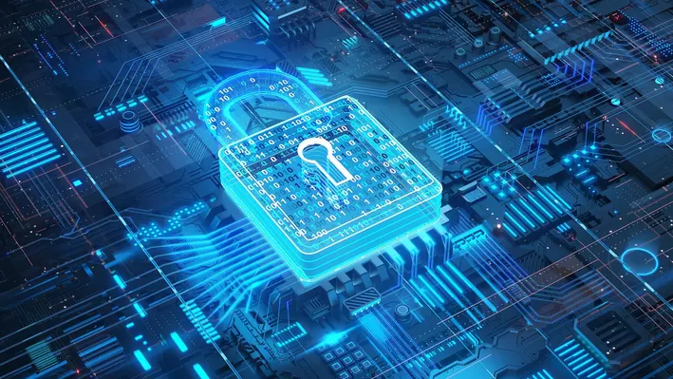
Background Knowledge and Prerequisites
Background knowledge:
Basic understanding of computers and networking
Familiarity with common internet security threats and vulnerabilities
Awareness of cybersecurity
Prerequisites:
None

Slide 6

Technical Tools and Other Requirement
Technical Tools
Computer with Internet Access
Web Browser
Other Requirements
Awareness of Internet Security Practices / Willingness to Learn and Experiment / Active Participation
CSP Training Module Name: Human Factors in Cybersecurity for Energy Sector

Slide 7

Value Propositions
Benefits to Participants
Level of Training Module: Basic / Advance
Cybersecurity Professional Training
Hands-on and Practical Skills Development
Rooted with European Cybersecurity Skills Framework
Cutting-edge insights from industry-academic experts
Helps with skills development and career advancement

Slide 8

WHO
Profile of Training Participants
Managers and Leaders
Working-life professionals
SMEs and Public Sector Employees
Cybersecurity practitioners and enthusiasts
Students

Slide 9

WHO
Profile of Trainer
Dr. Ricardo Lugo, Senior Researcher, Estonian Maritime Academy, TalTech
Dr. Kitty Kioskli, CEO & Cofounder of trustilio BV
Prof. Paresh Rathod, Laurea University of Applied Sciences

Slide 10

WHAT
Training Topics
Introduction to Human Aspects of Energy Sector Cybersecurity
Psychological and Social Factors in Energy Sector Cybersecurity
Human Vulnerabilities in Energy Sector Cybersecurity
Organisational Culture, Communication, and Cybersecurity
Communication and Collaboration Across Domains
Decision Making at Strategic, Operational, and Tactical Levels
Training, Awareness, and Communication Programs for Energy Sector Personnel
Future Trends, Challenges, and the Role of Communication

Slide 11

WHY
Learning Outcomes
Knowldge
Gain an understanding of the psychological, social, and organizational elements that shape cybersecurity actions within the Energy Sector.
Understand the critical role of communication and teamwork in bolstering energy sector cybersecurity across different sectors.
How decision-making frameworks are used at strategic, operational, and tactical levels within energy sector cybersecurity.
Recognize the profiles and strategies of adversaries targeting energy sector operations.
Evaluate human-related threats and vulnerabilities in energy sector contexts.

Slide 12

Evaluation method
Outline the evaluation elements and assessment process
Evaluation Element | How | Notes
Multiple Choice Quizzes | Online Quizzes

Slide 13

Importance of Human Factors:
Overview of Energy Sector Cybersecurity
Importance of cybersecurity in energy sector operations.
Unique cybersecurity challenges in the energy sector.
Role of human factors in energy sector cybersecurity.
Identified Threats:
IT/OT conversion
Low priority and confidence
2023: 250+ 3rd party breaches
Examples that will be used:
  Ukranian Power Grid Attack 2015
  Colonial Pipeline
  Stuxnet
Notes:
In today's interconnected world, cybersecurity has become a cornerstone of the energy sector.
The sector faces unique challenges, including the IT/OT integration, reliance on digital technologies and the specific threats targeting energy sector ssets. Understanding these challenges is crucial, as human factors often play a pivotal role in both the creation and mitigation of cyber risks. By exploring these aspects, we set the stage for a comprehensive approach to enhancing cybersecurity of the energy sector.
The Ukrainian power grid cyberattack in December 2015 showcased a rare occurrence of tangible damage resulting from a cyber incident. Hackers infiltrated the operational systems of Ukrainian power utilities through spear-phishing, leveraging human vulnerabilities. They utilized the BlackEnergy malware to access and control the systems connected to the power grid, causing widespread power outages. These attacks were well-planned, highlighting vulnerabilities in Industrial Internet of Things (IIoT) environments and stressing the need for robust cybersecurity measures within industrial control systems. The attacks were also accompanied by a denial of service to customer call centers, compounding the disruption and making it difficult for customers to report outages​ (ZDNet)​​ (MITRE ATT&CK)​.
The Colonial Pipeline attack, another significant breach, led to substantial disruptions in fuel supply across the eastern United States. In May 2021, a ransomware attack by a group called DarkSide caused the company to shut down approximately 5,500 miles of pipeline. This led to a spike in gas prices, panic buying, and a state of emergency declared by the U.S. government. The attack was a stark reminder of the vulnerabilities in critical infrastructure and the cascading effects such breaches can have on society and the economy.
Stuxnet, discovered in 2010, was a sophisticated computer worm designed to target and disrupt Iran's nuclear program. It specifically targeted Siemens industrial control systems, causing the fast-spinning centrifuges to tear themselves apart. Stuxnet was notable for being one of the first known worms to target industrial systems specifically and demonstrated a high level of sophistication, including multiple zero-day exploits. The consequences of the Stuxnet attack went beyond physical damage to the centrifuges; it marked a significant escalation in cyber warfare, showing that cyberattacks could cause physical destruction and have geopolitical implications. All with a USB stick

Slide 14
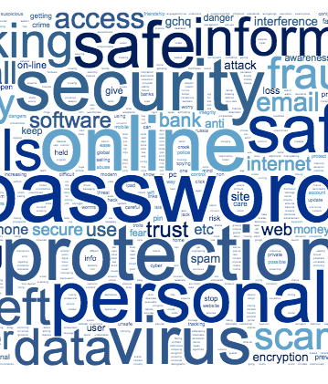
Importance of Human Factors:
Human Factors in Cybersecurity
Definition and significance of human factors in cybersecurity.
Common human errors contributing to cybersecurity breaches.
Strategies to mitigate human-related risks.
Notes:
Human factors in cybersecurity refer to the range of human behaviours, decisions, and interactions that can impact the security of information systems. These include both inadvertent actions, such as misplacing a security badge or choosing a weak password, and deliberate actions, like insider threats. Examples of common human errors include using the same password across multiple systems, clicking on phishing email links, or failing to update software with security patches. To mitigate these risks, strategies such as comprehensive awareness training, regular security audits, the implementation of two-factor authentication, and the use of password managers can be highly effective. By addressing these human elements through targeted strategies, understanding their implications, and implementing robust security policies, we can significantly enhance our defenses against cyber threats, creating a more resilient cybersecurity environment within maritime operations.

Slide 15

Importance of Human Factors:
Psychological Implications
Psychological aspects influencing cybersecurity behaviours.
The effect of cognitive biases on security decisions.
Implementing psychological principles to enhance cybersecurity measures.
Notes:
By understanding the nuanced domain of psychological factors influencing cybersecurity for the energy sector, we will explore for example how psychological processes can both enhance and compromise our cybersecurity efforts."
For safeguarding critical infrastructure, the recognition of human factors in cybersecurity is indispensable. The energy sector, with its complex systems and high stakes, is particularly susceptible to the subtle yet profound impact of cognitive biases.
Example: Confirmation Bias: In the context of cybersecurity in the energy sector, this bias can manifest when operators or analysts dismiss irregular system data that contradicts the norm. This bias typically expedites daily operations and decision-making by reducing cognitive load and enabling quick responses based on established knowledge. However, it also poses significant risks. For instance, dismissing alerts from new security systems as false positives can lead to missed detections of actual cyber threats.
Another example is Optimism Bias: This bias can be seen when IT staff deploy new network components assuming they will perform securely without additional testing. This bias is beneficial as it drives the adoption of innovative technologies and can foster a forward-thinking approach within the team. Yet, it also makes the sector vulnerable to new threats because it may lead to underestimating the security implications of new technology integrations, resulting in insufficient protective measures. But Optimism Bias is beneficial ihe context of proactive threat hunting within energy management systems. This bias encourages security teams to assume they can identify and mitigate threats faster than attackers can exploit vulnerabilities, leading to a proactive security posture and potentially preempting significant breaches.
So having a deep understanding of psychological principle, such as biases enables, us to craft more resilient cybersecurity strategies. By integrating this knowledge, we can better design training programs and develop policies that not only mitigate the risks associated with these biases but also harness their benefits to enhance cybersecurity framework.
Therefore it is important to critically analyze how these psychological dimensions impact cybersecurity and incorporate this understanding into operational protocols and strategic initiatives, thereby reinforcing defenses and ensuring the resilience of our critical energy infrastructures.

Slide 16

Importance of Human Factors:
Social Influence
Impact of social dynamics on cybersecurity practices.
Role of organizational culture in shaping cybersecurity behaviours.
Importance of social engineering awareness.
Notes:
Social dynamics within the maritime domain can significantly influence cybersecurity practices. For example, the presence of a strong safety culture on a vessel can encourage crew members to prioritize cybersecurity as part of overall safety measures. Peer influence is another potent factor; when leading crew members demonstrate a commitment to cybersecurity practices, it sets a norm that others are likely to follow. Organizational culture, defined as the shared values, beliefs, and norms within a maritime organization, can greatly facilitate or hinder cybersecurity behaviours. A culture that values transparency and open communication can facilitate the sharing of information about potential cyber threats and encourage reporting of security incidents. Conversely, a culture characterized by a lack of emphasis on cybersecurity training and awareness can lead to complacency and decreased vigilance among crew members. Examples of how organizational culture impacts cybersecurity in the maritime domain include the implementation of regular cybersecurity drills, which can foster a proactive security stance, and the integration of cybersecurity into routine safety meetings, which emphasizes its importance. On the other hand, a culture that stigmatizes the reporting of security mistakes can lead to underreporting of incidents, significantly decreasing the organization's ability to respond to and mitigate cyber threats effectively.

Slide 17
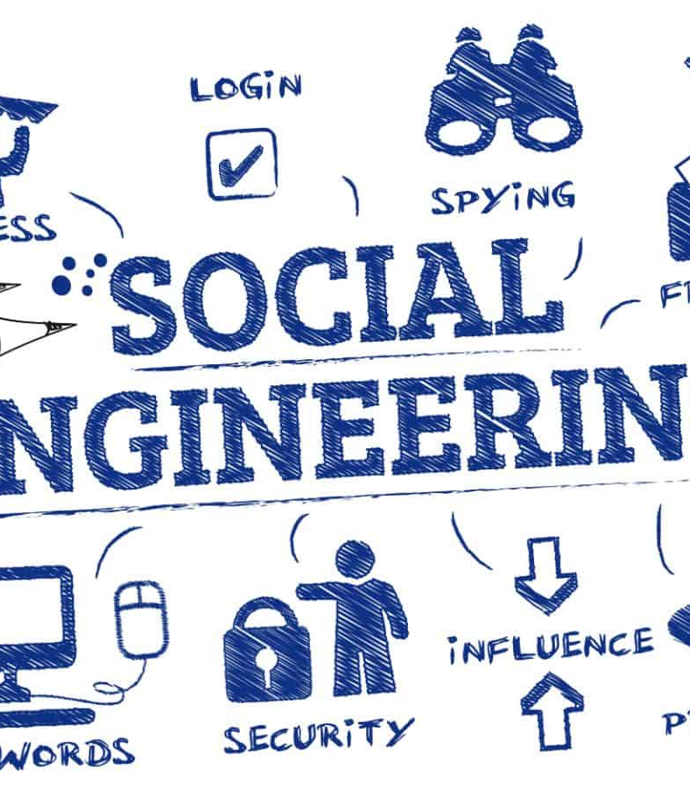
Importance of Human Factors:
Social Engineering
Importance of social engineering awareness.
Social Engineering
  Reciprocity; Commitment and Consistency, Social Proof; Authority; Liking; Scarcity
  Example:
    Smart Grid Technology
    Predictive Maintenance Systems
Notes:
Social engineering in the context of cybersecurity refers to the manipulation of individuals into divulging confidential or personal information that may be used for fraudulent purposes. It's a tactic that relies heavily on human interaction and often involves tricking people into breaking standard security procedures. Social engineering attacks are particularly insidious because they exploit human nature rather than technological vulnerabilities.
One of the foundational frameworks for understanding how social engineering works is Robert Cialdini's six principles of influence, which are often leveraged in these attacks:
Reciprocity: People tend to return a favour. In a social engineering context, an attacker might offer 'helpful' information or a gift to the target with the expectation that the target will feel obliged to offer something valuable in return, such as access to a restricted system.
Commitment and Consistency: Once people commit to an action or stance, they're more likely to follow through with it. Attackers might first get a small, seemingly innocent commitment from their target, which leads to larger commitments that compromise security.
Social Proof: People tend to do things they see others doing. In social engineering, this might involve an attacker pretending to be part of a group that the target trusts, inducing the target to act in a way consistent with the group's perceived actions or norms.
Authority: People tend to obey authority figures. Attackers may pose as senior executives or IT personnel to extract sensitive information or gain access to restricted areas.
Liking: People are more easily influenced by those they like. Attackers might build a relationship or rapport with their target before attempting to exploit that relationship for malicious purposes.
Scarcity: Perceived scarcity will generate demand. For example, an attacker might create a false sense of urgency by claiming that immediate action is needed to prevent a dire consequence.
In the energy sector, social engineering attacks could assume various sophisticated forms:
Email Phishing: Cybercriminals might send emails masquerading as reputable energy regulators or contractors, prompting employees to click a link that redirects to a harmful website or to divulge login details under the pretext of a 'mandatory security verification.'
Impersonation: threat actors may impersonate grid inspectors or cybersecurity auditors and contact facility operators via phone or email, coercing them to disable security protocols for a supposed 'routine compliance inspection', exploiting the principle of authority and urgency.
Urgent Patches: Exploiting the scarcity and authority principles, attackers might disseminate fictitious notifications about critical software patches for operational technology systems, making staff to hastily apply unverified updates that could introduce malware into the control systems.
Comprehending these tactics and the essence of social engineering is vital for energy companies to develop robust training and consciousness programs. These initiatives help staff recognize and thwart such ploys, safeguarding sensitive data and maintaining the integrity of vital operational systems.
The integration of IT and OT in the energy sector, while providing numerous benefits, also opens up vulnerabilities that hackers can exploit. Here’s how the two examples given could be targeted by cyberattacks:
Example 1: Smart Grid Technology
The integration of IT and OT is exemplified in the deployment of smart grid technology. Smart grids utilize IT systems to collect data from various points on the network, including consumption data from smart meters at customer premises. This data is then used by OT systems to manage and control the distribution of electricity more efficiently, respond to changing electricity demands in real-time, and integrate renewable energy sources effectively. The IT components facilitate communication and data analysis, while the OT components ensure the physical delivery of power.
Spear Phishing: An attacker could send a targeted phishing email to grid operators or maintenance staff, disguised as an update from a trusted system vendor. The email would ask the recipient to click on a link to update grid management software, but instead, it installs malware that disrupts the grid's operations or allows the attacker to gain unauthorized access.
Pretexting: Cybercriminals might pose as utility auditors and contact customer service representatives, requesting sensitive information about the grid or access credentials. By fabricating a convincing story that they require this information for regulatory compliance checks or system upgrades, they could trick employees into providing access to secure systems.
Example 2: Predictive Maintenance Systems
Another example is predictive maintenance in power generation facilities. Here, IT systems are used to analyze data from sensors attached to turbines and other critical equipment (OT). These IT systems leverage advanced analytics and machine learning to predict potential failures before they occur, schedule timely maintenance, and thus minimize downtime. By integrating IT data analytics with operational technology, energy companies can optimize maintenance cycles, improve safety, and extend the lifespan of their equipment.
Impersonation/Baiting: Here, an attacker could impersonate a technical support specialist from a predictive maintenance software provider. They contact plant operators claiming there is an urgent need to perform a system check or install a critical update, which, in reality, is a malicious program designed to sabotage the OT systems.
Quid Pro Quo Attacks: An attacker could offer maintenance staff a new tool or help with system optimization in exchange for their login credentials or direct access to the predictive maintenance systems. Believing they are receiving legitimate support, employees might unknowingly grant access to critical infrastructure systems.
These social engineering tactics exploit human tendencies to trust and the desire to comply with requests from authority figures or seemingly legitimate sources. In both examples, the energy sector's reliance on complex and specialized IT/OT systems creates opportunities for attackers to craft credible stories and scenarios that can deceive even experienced personnel.
To mitigate these risks, energy sector entities must foster a culture of security awareness, implement strict verification processes for any changes to system configurations or software updates, and conduct regular social engineering awareness training to help staff identify and respond to such tactics.

Slide 18
Importance of Human Factors:
Social Engineering
Ransomware
Scarcity and reciprocity
CSP Training Module Name: Human Factors in Cybersecurity for Maritime
Notes:
Ransomware attacks, a form of malicious software designed to block access to a computer system or files until a sum of money is paid, often leverage psychological tactics to increase their effectiveness. Two such tactics are the principles of scarcity and reciprocity, which are deeply rooted in human psychology and frequently exploited in social engineering contexts.
Scarcity Principle in Ransomware
Urgency and Time Limits: Ransomware attacks often include a countdown timer or a strict deadline by which the ransom must be paid. This creates a sense of scarcity regarding the time available to resolve the situation without losing access to critical data permanently. The scarcity principle suggests that people value resources more when they are less available, making the data or system access seem more valuable and increasing the likelihood of compliance with the ransom demand.
Limited Offers for Decryption Keys: Attackers might claim that the decryption key is only available for a limited period or that its price will increase after a certain deadline. This artificial scarcity pressures victims into acting quickly out of fear of losing their last chance to recover their files.
Reciprocity Principle in Ransomware
Fake Promises of Data Return: In leveraging reciprocity, attackers often promise to return access to the encrypted data upon payment of the ransom. The idea is that if the victim 'complies' with the attacker's 'request' for payment, the attacker will reciprocate by restoring access to the data. This exploitation of the reciprocity principle relies on the victim's hope and belief in a fair exchange, even though there is no guarantee that the attacker will honour the agreement.
'Free' Decryption of a Few Files: Some ransomware operators offer to decrypt a small number of files for free as a 'goodwill gesture' or 'proof' that they can indeed decrypt the data. This action exploits the reciprocity principle by providing something of value upfront with the expectation that the victim will feel compelled to reciprocate by paying the ransom to recover the remainder of their files.
In both cases, the attackers rely on the inherent human response to these psychological triggers. The principle of scarcity creates a heightened sense of value and urgency around the data or access being held ransom, while the principle of reciprocity plays on human tendencies for fair exchange and reciprocation, even in the context of an adversarial interaction. Understanding these underlying psychological tactics can help individuals and organizations better prepare for and respond to ransomware attacks, emphasizing the importance of scepticism, critical evaluation of the situation, and adherence to established protocols for incident response instead of reacting impulsively to the attackers' manipulations.

Slide 19


(very) little examples

Slide 20

Psychological and Social Factors in Energy Sector Cybersecurity
Understanding Human Psychology
Cognitive biases and their impact on cybersecurity.
Psychological theories relevant to cybersecurity behaviour.
Designing cybersecurity systems with human psychology in mind.
  Situational Awareness (Endsley, 1998)
An interface redesign that reduced user errors based on psychological research.
Notes:
Incorporating psychological principles into the cybersecurity framework of the energy sector can markedly improve the robustness of defence mechanisms. Recognizing cognitive biases is essential; for example, 'optimism bias' might lead an energy technician to overlook the likelihood of a cyber-attack, while 'confirmation bias' could cause them to ignore critical security warnings that contradict their existing beliefs regarding network safety. These biases can lead to hazardous behaviours, such as neglecting to implement security updates or underestimating the complexity of social engineering tactics that mimic credible communications from energy regulators or suppliers.
To address these issues, it is crucial to apply psychological concepts such as 'self-efficacy' and 'metacognition'. Self-efficacy, the belief in one's capabilities to achieve a task, greatly impacts how individuals comply with cybersecurity measures. Higher self-efficacy could result in diligent security practices, such as frequent software updates and adherence to stringent protocols. On the other hand, lower self-efficacy may cause a delay or disregard for essential cybersecurity measures. Metacognition, the ability to analyse one's own thinking processes, helps individuals in the energy sector to critically assess and adjust their actions in the face of cyber threats, ensuring biases are acknowledged and addressed.
In the design of cybersecurity systems for the energy sector, integrating these psychological insights is imperative. For instance, by adopting the principles of situational awareness, as outlined by Mica Endsley, which include comprehending the current conditions, anticipating future scenarios, and understanding the implications for the organization's objectives. Ensuring that information about cyber threats and system integrity is communicated clearly and promptly can cultivate a heightened sense of situational awareness among staff, enabling them to make well-informed and timely decisions.
Ergonomic design also plays a vital role. Systems should be user-friendly and resonate with human instincts to reduce the likelihood of mistakes. For example, creating interfaces that facilitate secure procedures naturally, or crafting alert systems that effectively retain attention without causing desensitization, helps ensure that personnel remain alert and proactive regarding cybersecurity measures. By weaving the principles of self-efficacy, metacognition, and situational awareness into the ergonomic design of cybersecurity solutions, the energy sector can lessen the risk of cyber threats and enable employees to become integral to the cybersecurity resilience of their organization.

Slide 21

Psychological and Social Factors in Energy Sector Cybersecurity
Social Dynamics and Cybersecurity
Influence of social norms and peer behaviour on individual cybersecurity practices.
The role of leadership in fostering a security-conscious culture.
  Role Modelling (Bandura, 1988)
Social factors in cybersecurity training and awareness programs.
Notes:
In the energy sector, the style of leadership profoundly influences cybersecurity behaviors and outcomes. An authoritative leadership approach, marked by rigid adherence to protocols and hierarchical communication, may guarantee swift enactment of cybersecurity measures but could also inhibit transparent communication and innovative approaches to cybersecurity challenges. On the other hand, a transformational leadership style, which energizes and propels employees through a common goal, might cultivate proactive cybersecurity behaviors and a culture of ongoing learning and enhancement. Nonetheless, without definitive procedures and accountability, it could lead to irregularities in cybersecurity adherence.
Bandura's theory of social learning and role modeling is highly applicable in this context. Leaders in the energy sector act as exemplars for their teams. Their commitment to cybersecurity, active participation in current security measures, and comprehensive understanding of cyber threats are likely to instill corresponding values and actions among their staff. This influence can notably strengthen the cybersecurity defenses of an energy facility or organization.
The impact of leadership extends to education and awareness programs. A leader who values continuous learning in cybersecurity is key to advocating for and implementing exhaustive training initiatives, ensuring they stay current with emergent threats and best practices. Such a leader might also promote simulation-based training and practical exercises to enhance real-world awareness and competencies among the workforce. Conversely, a leader who regards cybersecurity training as merely a formal requirement rather than a fundamental component of operational integrity might dedicate inadequate resources to these programs or neglect to ensure compliance, thus impairing the workforce's capacity to deal effectively with cyber incidents.
In conclusion, leaders within the energy sector must find equilibrium, nurturing a culture that simultaneously insists on strict adherence to cybersecurity protocols and advocates for openness, novelty, and perpetual progress. Through embodying principles of effective cybersecurity management and role modeling constructive behaviors, leaders can exert a substantial effect on the cybersecurity ethos and robustness of energy sector operations.

Slide 22

Psychological and Social Factors in Energy Sector Cybersecurity
Enhancing Security Through Psychology
Psychological strategies to increase security protocol adherence.
Behavioural change techniques applied to cybersecurity.
The role of motivation and rewards in enhancing cybersecurity behaviours.
Real-world example: A rewards program that successfully increased cybersecurity vigilance among crew members.
Future BCT using AI
Notes:
Enhancing security through psychology in the energy sector involves comprehending and addressing the human elements that influence cybersecurity. By integrating psychological principles, energy organizations can customize their cybersecurity strategies to take into account the behaviors, motivations, and attitudes of their personnel.
For instance, routine psychological evaluations can help pinpoint potential insider threats before they materialize. Educational programs that incorporate behavioral psychology can boost adherence to security protocols by stressing the individual and shared advantages of strong cybersecurity practices.
In the energy sector, applying psychological strategies for behavior change includes the strategic use of behavior change techniques (BCTs), designed to influence and alter human behavior. For cybersecurity in energy, BCTs could involve techniques such as motivational interviewing, goal setting, feedback, and rewards to foster compliance and proactive security behaviors among staff and management.
Motivation and Rewards: Understanding what drives individuals allows energy organizations to tailor their cybersecurity programs to encourage preferred behaviors. For example, rewards could be used to reinforce adherence to IT security protocols. Employees might receive acknowledgment or tangible rewards for consistent best practices, such as frequent password updates or completing cybersecurity training.
Real-World Application: A practical example could be an energy company initiating a 'Cybersecurity Leader' program, where employees who demonstrate exemplary cybersecurity habits are recognized. This not only encourages others to adhere to security protocols but also cultivates a competitive yet cooperative environment where cybersecurity is seen as a collective duty.
For effective BCT implementation, energy companies can:
Educate: Provide extensive training that explains the rationale behind cybersecurity measures, increasing employees' comprehension and acceptance.
Empower: Encourage employees to take responsibility for their cybersecurity through participatory workshops, where they can propose improvements to existing protocols.
Enable: Supply the necessary tools and resources for secure behaviors, like user-friendly software for reporting suspicious activities.
Engage: Create a platform for employees to share their experiences and tactics for overcoming cybersecurity obstacles.
Kumar et al. (2018) address security attacks on energy infrastructure and the importance of global security coordination to mitigate threats
Integrating psychology into cybersecurity efforts within the energy sector can result in a more secure and resilient industry. The behavioural approaches and the recognition of individual motivations are fundamental to fostering a culture of cybersecurity that supports the sector's overall protective measures.
Kumar, V., Prasad, J., & Samikannu, R. (2018). A critical review of cyber security and cyber terrorism - threats to critical infrastructure in the energy sector. Int. J. Crit. Infrastructures, 14(1/2), 101-119.

Slide 23
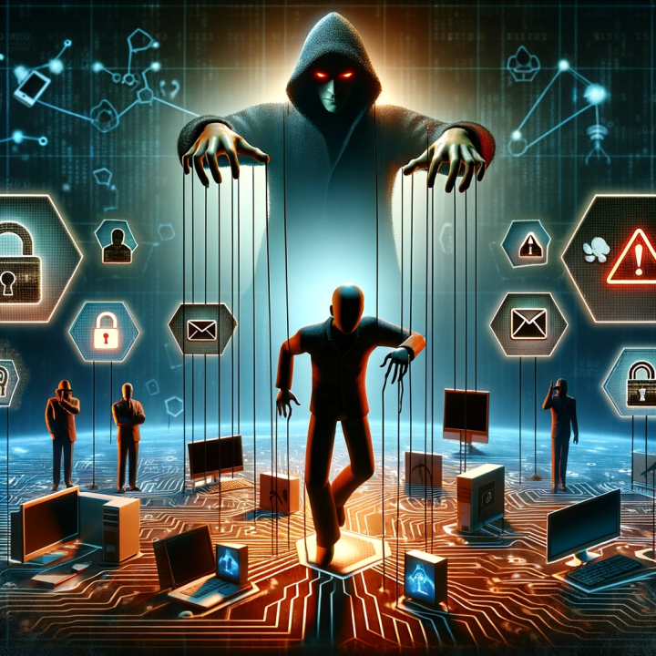
Psychological and Social Factors in Energy Sector Cybersecurity
Addressing Social Engineering Threats
Understanding social engineering tactics from a psychological perspective.
Training personnel to recognize and respond to social engineering attacks.
Building a culture of scepticism, vigilance and verification.
Real-world example: A company's response to a spear-phishing campaign targeting maritime executives.
Notes:
Social engineering attacks, which manipulate individuals into compromising security unwittingly, are becoming increasingly sophisticated in the maritime domain. Initially, these attacks often took the form of simple phishing emails, where attackers masqueraded as reputable entities to lure crew members into revealing sensitive information. However, as awareness and training around these tactics have improved, attackers have evolved their strategies to include more advanced techniques such as spear-phishing, where attacks are highly personalized to the target, and 'deep fakes,' which use AI-generated audio and video to impersonate trusted individuals convincingly.
The continuous evolution of social engineering attacks necessitates adaptive and continuously updated training programs in maritime cybersecurity. Traditional training modules may not suffice in the face of novel threats like AI-driven social engineering, where attackers leverage machine learning to analyse and mimic communication patterns, making fraudulent requests appear more legitimate than ever before. As these threats become more sophisticated, training programs must evolve to include awareness of these emerging technologies and their potential misuse in social engineering campaigns.
Developing scepticism, vigilance, and verification skills is paramount in combating these advanced threats. Crew members should be trained to approach every request for sensitive information or action with a healthy dose of scepticism, regardless of the apparent source. Vigilance can be enhanced through regular training exercises that simulate real-world scenarios, including the latest social engineering tactics. Verification processes should be ingrained in the organizational culture, such as double-checking requests through alternate communication channels or implementing multi-factor authentication to verify the identity of individuals requesting access or information.
Incorporating these principles into maritime cybersecurity training involves not just imparting knowledge but also fostering a mindset that values questioning and verification. Interactive workshops, gamified learning experiences, and regular drills can help develop these critical skills, ensuring that crew members are not only aware of the risks but also equipped to respond proactively. By embracing a culture of continuous learning and adaptation, maritime organizations can stay one step ahead of social engineering threats, safeguarding their operations in an ever-evolving cybersecurity landscape.

Slide 24

Human Vulnerabilities in Energy Sector Cybersecurity
Identifying Human Vulnerabilities
Common human vulnerabilities in energy sector cybersecurity contexts.
The role of user behaviour analytics in identifying risky behaviours.
Strategies for mitigating human vulnerabilities.
Real-world example: Incident involving an exploited vulnerability due to poor password practices.
Notes:
In the energy sector, human vulnerabilities can arise from routine operations, similar other domains, leading to inadvertent compromises in cybersecurity. Such vulnerabilities may include the mishandling of credentials, where employees reuse passwords across different systems or share them insecurely, and the improper management of email communications, which are susceptible to phishing attempts. Additionally, connecting personal devices to energy systems without appropriate security can introduce cyber threats.
Behavioural analytics serve as an essential tool, allowing for the monitoring and analysis of employee behaviour to spot patterns indicating potential security risks. Unusual access to critical systems or multiple failed login attempts can be red-flagged for further investigation, thus enabling a proactive stance in identifying and addressing risks before they result in security breaches.
Mitigation strategies in the energy sector should go beyond training and incorporate technical and procedural safeguards. The implementation of role-based access controls can limit access to essential systems and information, reducing the possibility of misuse. Regular updates and patches to software are crucial, especially given the increased reliance on digital systems for energy management and distribution.
A well-defined incident response protocol is critical, outlining steps for isolating affected systems to contain cyber threats, reporting procedures to enable prompt action, and mechanisms for post-incident analysis to avoid recurrence. Establishing a culture of skepticism, vigilance, and verification can promote the questioning of anomalies and reporting of potential threats, thereby enhancing the cybersecurity posture of energy organizations.
In conclusion, tackling human vulnerabilities in the energy sector necessitates a holistic approach that integrates behaviour analytics with technical solutions, underpinned by an organizational culture dedicated to cybersecurity. This vigilance and adaptability to new threats are imperative for protecting the sector's vital operations against the constant risk of cyber-attacks.
The significance of behavioural analytics in cybersecurity for the energy sector is underscored in research such as that by Bwangah (2023), who explores the role of behavioural evidence in digital forensics, stressing the importance of including human factors in cybersecurity frameworks
Bwangah, M. L. (2023). Behavioural Analytics in Cyber Security for Digital Forensics Application. International Journal of Computer Science and Information Technology.

Slide 25
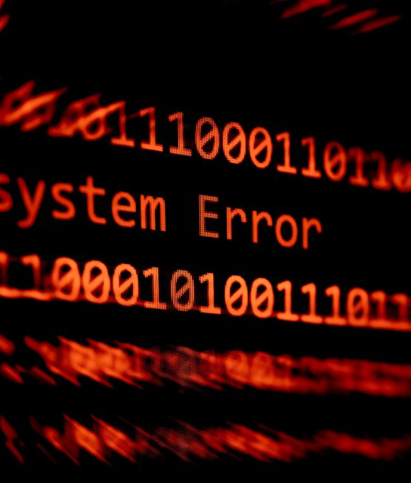
Human Vulnerabilities in Energy Sector Cybersecurity
Impact of Human Error
Types of human errors and their consequences for cybersecurity.
Methods for reducing errors, such as simplification of systems and processes.
Importance of error reporting and management systems.
Notes:
In the energy sector, human error has been identified as a significant vulnerability that can lead to cybersecurity incidents, much like the maritime domain. A relevant example is the Ukraine power grid attack in 2015, where suspected cybercriminals managed to remotely access and control the grid's operating systems, leading to widespread power outages. The attackers utilized spear-phishing emails to plant malware that gave them access, highlighting how human error in clicking malicious links can have catastrophic effects.
To prevent such incidents, energy companies have started simplifying their systems and processes, aiming to reduce the cognitive load on their employees and decrease the likelihood of mistakes. This can involve implementing user-friendly interfaces for complex control systems and automating routine cybersecurity checks to ensure consistency and accuracy.
Policies that create an environment where employees can report errors without fear of reprisal are also key. These policies enable energy companies to learn from near-misses and adapt their systems to improve resilience against future cyber threats.
An example of an energy company taking such measures is the implementation of a simplified interface for their electrical grid control systems, paired with regular cybersecurity awareness training for all staff to foster a culture of vigilance and responsibility.
Research by Szádeczky and Bederna (2023) discusses use cases of incidents affecting energy service providers, highlighting the cascading financial effects of cyber incidents and the critical need for a comprehensive approach to cybersecurity (Szádeczky & Bederna, 2023). Additionally, the work of Evans et al. (2019) on human error-related information security incidents reinforces the importance of addressing human factors to prevent such vulnerabilities in critical sectors like energy (Evans et al., 2019).
In summary, by simplifying operational systems and endorsing policies that encourage the open reporting of errors, energy organizations can mitigate the risks of human error, thereby strengthening their cybersecurity posture and resilience against cyber threats.
Szádeczky, T., & Bederna, Z. (2023). The Economic Measurement of Cyber Incidents. Periodica Polytechnica Social and Management Sciences.
Evans, M., He, Y., Maglaras, L., & Janicke, H. (2019). HEART-IS: A novel technique for evaluating human error-related information security incidents. Comput. Secur., 80, 74-89.

Slide 26

Human Vulnerabilities in Energy Sector Cybersecurity
Training to Reduce Human Error
Role of targeted training programs in addressing specific human vulnerabilities.
  Simulation
  Gamification
  Scenario based learning
  Continuous learning
The importance of simulation and drills in reinforcing correct behaviours.
Continuous improvement of training programs based on incident feedback.
CSP Training Module Name: Human Factors in Cybersecurity for Maritime
Notes:
Effective training programs are essential for bolstering cybersecurity awareness and preparedness forthe energy sector,and these could include:
Simulation-Based Training: Programs with simulations of cyber-attacks on control systems can equip staff with the skills to identify and counteract threats. For instance, simulations might mimic a phishing attack on an employee's email to teach recognition of dubious emails and the response procedures required.
Gamified Learning Platforms: Using game mechanics in cybersecurity training can make learning more engaging and memorable. An energy-sector-specific program might use a game in which employees earn rewards for correctly handling virtual cybersecurity threats.
Scenario-Based Workshops: By presenting actual cybersecurity scenarios, workshops can help employees grasp the context and consequences of cyber threats in the energy domain, such as securing communications between the power grid and control centers.
Continuous Learning Programs: With the ever-changing landscape of cyber threats, ongoing education programs are essential. This could involve periodic updates and training on the latest threats and defenses, possibly through regular webinars or newsletters.
These training initiatives, combined with the streamlining of complex systems, significantly lower the risk of human errors that lead to security breaches. Cultivating a culture of continuous learning and vigilance helps organizations protect their critical operations from cyber threats.
Research has identified hands-on experience and real-life simulations as preferred training methods, with simulation-based solutions seeing substantial research and development efforts. Chowdhury and Gkioulos (2021) present findings that indicate the effectiveness of training solutions that offer high levels of real-life fidelity and the development of team skills, with a particular focus on the aviation, energy, and nuclear sectors (Chowdhury & Gkioulos, 2021). This literature review examined the state-of-the-art in cybersecurity training offerings, with a specific focus on critical infrastructure protection in the aviation, energy, and nuclear sectors. The review identified a preference for training solutions that provide hands-on experience and promote team skills development, favouring simulation-based solutions for their high level of real-life fidelity.
Chowdhury, N., & Gkioulos, V. (2021). Cyber security training for critical infrastructure protection: A literature review. Comput. Sci. Rev., 40, 100361
The Department of Energy and Argonne National Laboratory (Illinois USAhave developed extensive educational competitions designed to enhance cyber workforce development for the Energy Sector, utilizing hands-on training to increase the effectiveness and interest in cybersecurity careers within the sector (Joyce, Day, & Evans, 2018). It discusses the development of an educational competition aimed at enhancing the cybersecurity workforce in the energy sector. This competition is part of a broader effort to provide hands-on training and increase interest in cybersecurity careers within this critical area. The program aims to bring real-world applicability to training through engaging formats that emphasize actionable security skills. The paper highlights the success of the program in generating enthusiasm and developing competencies in cybersecurity among participants.
Joyce, A., Day, S., & Evans, N. (2018). Educational Competitions to Boost the Cyber Workforce-Development. 2018 National Cyber Summit (NCS), 34-37.

Slide 27

Human Vulnerabilities in Energy Sector Cybersecurity
Enhancing Situational Awareness
Importance of situational awareness in preventing human errors.
  Endsly
    Perception
    Comprehenssion
    Projection
Tools and technologies to support situational awareness in cybersecurity.
  Adapeted viualisations
Integrating situational awareness into daily operations and decision-making.
Notes:
Enhancing situational awareness is critical in the energy sector's cybersecurity, especially considering human factors. Endsley's model of situational awareness provides a structured approach to understanding and enhancing this vital competency within the energy domain, focusing on the perception of elements, comprehension of their meaning, and projection of their future status.
Endsley's Model Applied to Energy Sector Cybersecurity:
Perception: At this initial level, energy sector professionals need to detect key information such as unusual network activity or unauthorized access attempts to grid control systems. Technologies like intrusion detection systems (IDS) can assist by alerting staff to potential cybersecurity threats.
Comprehension: Understanding the meaning behind the perceived information is critical. For energy sector employees, this could mean interpreting an IDS alert as indicative of a potential malware attack aimed at disrupting the power grid. Effective cybersecurity training is vital here to ensure staff can accurately assess and understand cyber threats.
Projection: The final level involves anticipating what might happen next based on the current situation. In the energy sector, this might involve an operator predicting that a malware attack, if left unchecked, could lead to a shutdown of part of the grid, endangering energy supply.
Supporting Situational Awareness Through Visualization in the Energy Sector:
Enhanced Perception: Visualization systems can augment perception by displaying data, such as real-time network activity or integrity checks of grid systems, in formats that are easy to recognize. For example, a dashboard might use color-coded alerts to signify the status of grid components, enabling operators to quickly identify issues.
Aiding Comprehension: These systems contribute to comprehension by presenting integrated data from various sources in a coherent visual representation. For instance, a visualization tool that combines cyber threat data with grid operation metrics can help operators understand the context of cyber threats relative to the energy infrastructure.
Facilitating Projection: Visualization tools that model scenarios and analyze trends can assist operators in anticipating the outcomes of cyber threats. This foresight aids in informed decision-making and the initiation of proactive cybersecurity measures.
Energy Sector Example:
In the energy sector, an example of a system enhancing situational awareness is a grid management platform integrating cybersecurity alerts with operational data. This integration ensures that operators are aware of both the physical and cyber aspects of grid operations. For instance, if the system displays an alert regarding a cyber intrusion that could affect the operational technology controlling power distribution, the staff can promptly assess the threat to the grid's stability and take necessary actions.
By utilizing tailored visualization systems, energy organizations can significantly improve situational awareness, equipping their staff with the necessary tools to address the complex cybersecurity challenges within the energy sector. These systems transform raw data into actionable insights, enabling better monitoring, decision-making, and response to cyber threats.

Slide 28
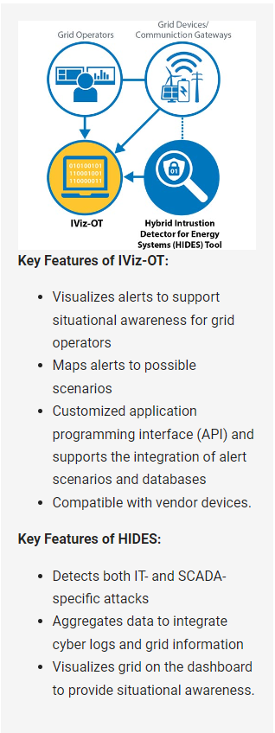
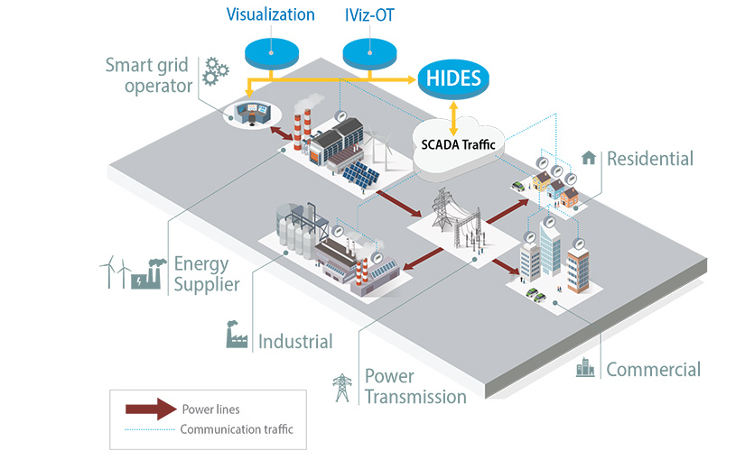
Enhancing Situational Awareness
Notes:
The National Renewable Energy Laboratory (NREL in USA) has developed IViz-OT, a cybersecurity tool that enhances situational awareness for grid operators. This tool helps visualize and interpret threats by integrating cybersecurity alerts with operational data, providing an in-depth understanding of potential grid anomalies. IViz-OT works in tandem with the Hybrid Intrusion Detector for Energy Systems (HIDES) to process and log information, translating complex alerts into simple scenarios for easier comprehension by operators. This collaborative tool aims to give a comprehensive view of both cyber and physical grid data to help prevent and manage potential cybersecurity incidents.
But Human aspects are important in using the IViz-OT tool. The ability of grid operators to effectively interpret the visual data presented, to recognize patterns indicating potential threats, and to make quick decisions based on this information – all parts of Endsleys SA model. This requires operators to have a strong understanding of both the cybersecurity landscape and the operational technology (OT) of the grid. The tool aims to assist by transforming complex cybersecurity data into actionable insights, but the human element—operators’ knowledge, experience, and judgment—is crucial in responding to potential incidents and ensuring grid resilience.

Slide 29
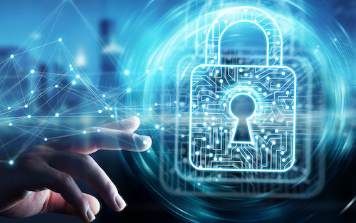
Organizational Culture, Communication, and Cybersecurity
Role of Organizational Culture
Definition and impact of organizational culture on cybersecurity.
Characteristics of a strong cybersecurity culture.
  Values (Lencioni, 2002)
  Adherence and compliance
Strategies for cultivating a positive cybersecurity culture.
  Psychological Safety in the Workplace
Notes:
Organizational culture within the energy sector can be understood through several distinct levels, each uniquely contributing to an organization's cybersecurity posture.
Organizational Values in the Energy Sector
Core: Fundamental beliefs and values widely accepted and practiced within an organization form its core. For energy companies, a culture that emphasizes safety, security, and vigilance is crucial. For example, a company that upholds the belief 'every employee is a cybersecurity defender' creates an environment where security practices are integral to daily operations.
Aspirational: These represent the ideals an organization aims for, such as leading the sector in cyber resilience or having no cybersecurity incidents. Aspirations guide efforts towards improving cybersecurity capabilities and promote continuous advancement.
Permission-to-Play: This level includes the basic behaviors and norms expected of all organization members—'the rules of the game.' In cybersecurity, this could mean adhering to protocols like regular software updates and not engaging with suspicious emails. These norms ensure foundational cybersecurity across the company.
Accidental: Traits that have formed over time without deliberate efforts by leadership. While these can be beneficial, they can create vulnerabilities, such as a culture of bypassing security measures for convenience. Addressing these traits is vital to strengthen cybersecurity defenses.
Adherence and Compliance
Adherence involves voluntary, belief-driven actions, where employees follow cybersecurity practices out of conviction in their importance. In contrast, compliance may stem from a desire to fulfill external requirements, which might not foster a deep commitment to cybersecurity principles.
Psychological Safety
Creating an environment where employees feel secure to take risks, admit mistakes, ask questions, and propose new ideas without fear of negative consequences is essential. In the energy sector, psychological safety can lead to timely reporting of security incidents, sharing insights on potential threats, and effective collaboration on solutions.
Benefits of Psychological Safety
A strong cybersecurity culture that values psychological safety leads to greater resilience against threats, as issues are likely to be addressed swiftly. It also fosters innovation and enhances job satisfaction, contributing to a more alert and conscientious workforce.
Energy organizations that prioritize cybersecurity best practices, ensure compliance through genuine understanding and commitment, and promote psychological safety significantly bolster their defenses against cyber threats.
relevant example: the energy sector is the cybersecurity culture at a power utility company where, post a spear-phishing incident that nearly compromised the grid, a cultural transformation was undertaken. Leaders emphasized the importance of individual responsibility for cybersecurity, and employees were encouraged to openly discuss vulnerabilities and participate in regular cybersecurity training and simulation exercises.
Huang & Pearlson (2019) showed that organizational cybersecurity is not solely dependent on advanced technology but requires the active engagement of all organizational members to effectively mitigate risks. Leadership plays a pivotal role in shaping and aligning the organization’s culture with overarching security objectives. The authors propose a model that describes the multifaceted nature of organizational cybersecurity culture, considering factors that influence its development and methods for its evaluation. A case study of Liberty Mutual's "culture of data protection" is used to illustrate how a committed leadership can foster a culture conducive to cybersecurity. This model serves as a guide for managers to understand and cultivate a mature cybersecurity culture within their organizations, which is increasingly important in a digital landscape where cyber threats are evolving rapidly.
Huang, K., & Pearlson, K. E. (2019). For What Technology Can't Fix: Building a Model of Organizational Cybersecurity Culture. Proceedings of the 52nd Hawaii International Conference on System Sciences.

Slide 30

Organizational Culture, Communication, and Cybersecurity
Effective Cybersecurity Communication
Principles of effective communication in cybersecurity.
Overcoming barriers to effective cybersecurity communication.
Role of transparent communication in incident response.
Post cybersecurity incident
Notes:
In the energy sector, effective communication is essential for maintaining robust cybersecurity measures. It involves the prompt and clear exchange of information about potential threats, security protocols, and incident response plans among all personnel.
Defining Effective Communication: Within the context of cybersecurity, effective communication means accurately conveying pertinent information to the appropriate personnel swiftly and understandably. For instance, a cybersecurity analyst detecting a threat to a power grid must communicate the problem and necessary actions to the grid operators clearly and without ambiguity.
Communication Difficulties: Communication challenges often stem from the complex technical nature of cybersecurity information and the varied expertise of stakeholders. Technical staff familiar with cybersecurity language may find it difficult to communicate risks to senior management who may prioritize operational continuity and safety, leading to misinterpretation and delays in critical decision-making.
Overcoming Communication Barriers in the Energy Sector:
Training and Awareness: Cross-training sessions where both decision-makers are informed about basic cybersecurity concepts and technical staff are coached in effective communication skills can narrow the knowledge divide.
Visualization Tools: Visual aids, such as dashboards that concisely represent cybersecurity threats and their operational impacts, can demystify complex information.
Common Language: Establishing a shared set of terminologies can mitigate misunderstandings and facilitate better dialogue.
Regular Updates: Structured briefings and reports that synthesize cybersecurity data into actionable insights help keep stakeholders informed without overwhelming them.
Liaison Roles: Individuals who comprehend both cybersecurity and the energy industry can act as intermediaries, translating technical risks into business impacts.
Real-Life Event: A notable real-life event that illustrates the importance of effective communication in the energy sector is the 2015 Ukraine power grid cyberattack. Attackers deployed phishing emails to compromise the system, leading to a significant power outage. But effective communication played a crucial role in both identifying the attack and mitigating its effects. When the attack was detected, prompt internal communication within the affected energy companies affected allowed for a quick assessment and understanding of the scope of the breach.
Incident Detection and Internal Alerting: As soon as the intrusion was identified, it was critical that the cybersecurity team communicated the breach to the operational staff managing the grid. This internal alert system ensured that those responsible for maintaining the grid's integrity were informed quickly.
Cybersecurity Teams to Operational Staff: When cybersecurity teams detected suspicious activity indicative of a cyberattack, they immediately alerted the operational staff responsible for the grid. They communicated the nature of the threat and the systems that were potentially compromised.
Coordination of Response Efforts: The different teams involved in the power grid's operations, including IT, cybersecurity, and grid operators, coordinated their response through effective communication channels. This coordination was vital to isolate the infected systems and prevent the spread of the malware.
External Communication with Government and Regulatory Bodies: Communicating with external entities, such as government agencies, regulatory bodies, and other utilities, was essential to raise awareness of the threat, share intelligence, and understand the broader impact.
Grid Operators to Emergency Response Teams: Grid operators informed emergency response teams about the outages and the need for immediate action to isolate compromised systems and switch to manual operation where necessary.
Energy Companies to Government Agencies: Energy companies communicated with government and cybersecurity agencies to report the incident. They provided details about the attack's impact and sought guidance on mitigating the risks and preventing the escalation of the situation.
Information Sharing Among Energy Sector Entities: Affected companies communicated with other energy sector entities in Ukraine and internationally, sharing details about the malware used in the attack, which was later identified as BlackEnergy. This helped other companies to scan their systems for similar vulnerabilities
Public Communication: Clear and accurate communication with the public helped manage the expectations of the affected populations and provided instructions on how to deal with the power outages, thus reducing panic and confusion.
Communication to the Public: To manage the public's reaction and provide updates, the energy companies issued statements through the media explaining the situation, the expected time to restore services, and advising on what to do during the power outage.
Post-Incident Communication: Post-Incident Debriefing: After the incident, there was communication between the affected companies, cybersecurity experts, and government bodies to analyze how the attack happened, its consequences, and to share learnings. They discussed the effectiveness of the response and how to improve strategies for future incidents.
The specificity of the communications involved clear descriptions of the problems, instructions for immediate actions, requests for assistance, and updates on the status of the situation. These communications were essential for a coordinated response and recovery from the cyberattack.
Mukherjee (2019) emphasizes the crucial role of cybersecurity in ensuring the security of the energy sector, which is not only vital for energy security but also for the strength of the nation and its economy. Mukherjee highlights the alarming increase in successful cyber-attacks on the energy sector and underscores that cybersecurity is often not given the due importance in corporate strategy until a breach occurs. He found that, despite the presence of cybersecurity cells and officers within large corporations, the absence of detailed technical knowledge and understanding of cyber world intricacies at the board level often limits effective cybersecurity implementation. Energy companies are prime targets due to the essential services they provide, and while threats are high, the risks may not be fully appreciated until a substantial attack takes place. Therefore, a real shift in perception and policy is required to prevent potential catastrophic events is necessary.
Mukherjee, S. (2019). Implementing Cybersecurity in the Energy Sector. Information Systems & Economics eJournal.

Slide 31

Organizational Culture, Communication, and Cybersecurity
Leadership in Cybersecurity Culture
Building cybersecurity leadership at all levels of the organization.
  Vertically AND horizontally
Notes:
Leadership is fundamental in fostering a robust cybersecurity culture within the energy sector, extending beyond mere protocol enforcement to embody a proactive, well-informed stance that influences every level of an organization.
Leadership's Role in Energy Sector Cybersecurity:
Effective leadership in cybersecurity goes beyond hierarchical command structures to create an environment where all employees are empowered to actively participate in cybersecurity measures. Leaders in the energy sector must prioritize cybersecurity through strategic planning, resource allocation, and daily operations, modelling behaviour that underscores its critical role in organizational success and safety.
Building Leadership at Every Level:
Empowering Technical and Operational Staff: in the energy sector, it's crucial to equip technical and operational staff with the knowledge and authority to make informed decisions about cyber risks promptly.
Cybersecurity Champions in Facilities: Identifying cybersecurity champions within various departments of energy companies can promote awareness and ensure cybersecurity measures are understood and followed.
Cross-Functional Cybersecurity Teams: Collaboration among IT, operations, security, and other relevant departments is critical for a unified approach to cybersecurity that aligns with both operational needs and organizational strategy.
Continuous Professional Development: Regular training and professional development opportunities for all staff in cybersecurity help maintain up-to-date knowledge on threats and defence strategies.
Recognition and Incentives: Acknowledging and rewarding proactive behaviours and initiatives reinforces the importance of cybersecurity and motivates continuous engagement.
Leadership Training Programs: Specialized training programs can help develop leaders who understand not only the technicalities of cybersecurity but also how to cultivate a security culture and communicate risks effectively.
By promoting leadership in cybersecurity at every level, energy organizations can establish a strong, proactive culture capable of facing the unique cybersecurity challenges of the energy sector. This broad approach to leadership ensures that cybersecurity is integral to all aspects of operations, thus enhancing resilience and protecting critical infrastructure.
Real-Life Example:
After the incident, Ukrainian energy companies, along with international partners, initiated extensive cybersecurity reforms. These included establishing clear communication protocols, cross-departmental cybersecurity teams, and continuous training programs for grid operators to recognize and respond to cyber threats effectively. The incident highlighted the necessity for leadership at every level to build a resilient cybersecurity culture within energy organizations.

Slide 32
Organizational Culture, Communication, and Cybersecurity
Fostering Collaboration and Trust
Defining Collaboration and Trust: Collaboration in the energy sector involves the sharing of information, resources, and best practices to enhance collective cybersecurity defenses. Trust underpins these collaborative efforts, ensuring that shared information is reliable and that partners will act responsibly with shared data and insights.
Importance of trust and collaboration in cybersecurity efforts.
  Information Sharing
  Joint Cybersecurity exercises
Techniques for building trust within and across teams.
  Alliances, partnerships
Collaborative approaches to cybersecurity problem-solving.
Real-world example: Cross-departmental collaboration project that strengthened overall cybersecurity posture.
Notes:
In the energy sector, cooperation and trust are essential for a strong cybersecurity posture. The integrated nature of energy operations, which involves power plants, grids, and service providers, requires a collaborative cybersecurity approach. This cooperation reaches beyond internal teams to encompass external parties like other energy firms, regulatory agencies, and cybersecurity experts.
Defining Collaboration and Trust:
In the context of energy, collaboration means the exchange of information, capabilities, and proven methods to bolster collective cybersecurity defences. Trust is crucial to these cooperative efforts, ensuring that the information exchanged is dependable and that partners will handle shared insights and data responsibly.
Real-World Examples:
Response to the Ukraine Power Grid Attack: Following the 2015 cyberattack on the Ukrainian power grid, the energy industry saw an increased effort in collaboration. The incident prompted energy companies to share details of the attack with others in the sector, enhancing the collective understanding and preparation for similar threats.
Energy Sector ISACs: Information Sharing and Analysis Centers (ISACs) in the energy sector provide a forum for utilities, government entities, and stakeholders to exchange threat intelligence and collaborate on cybersecurity best practices. The Electricity Information Sharing and Analysis Center (E-ISAC), for example, plays a pivotal role in enhancing industry-wide cybersecurity resilience.
Techniques for Enhancing Cooperation and Trust:
Joint Cybersecurity Drills: Running joint drills that involve various stakeholders, including utility companies, regulatory bodies, and government entities, can improve collaborative responses to cyber incidents. These simulations help refine communication and action plans.
Cybersecurity Partnerships: Establishing partnerships or alliances focused on cybersecurity in the energy sector facilitates ongoing collaboration. These alliances can help in setting up common frameworks for intelligence sharing and developing collective initiatives.
Building Trust Mechanisms: Formal agreements, such as Memorandums of Understanding (MoUs), can set explicit collaboration terms and build trust. Regular transparency reports and audits further reinforce the commitment to cybersecurity.
Cross-Industry Partnerships: Collaborations with sectors outside of traditional energy, such as technology and cybersecurity companies, can introduce innovative solutions to address the unique challenges of the energy sector.
Community Initiatives: Organizing forums and workshops on cybersecurity within the energy sector can cultivate a sense of community and a shared goal of strengthening security measures.
Learning from these approaches and examples, the energy industry can reinforce its collective security against cyber threats. Collaboration and trust not only improve incident response capabilities but also foster a proactive, resilient cybersecurity culture crucial for protecting critical energy infrastructure.

Slide 33
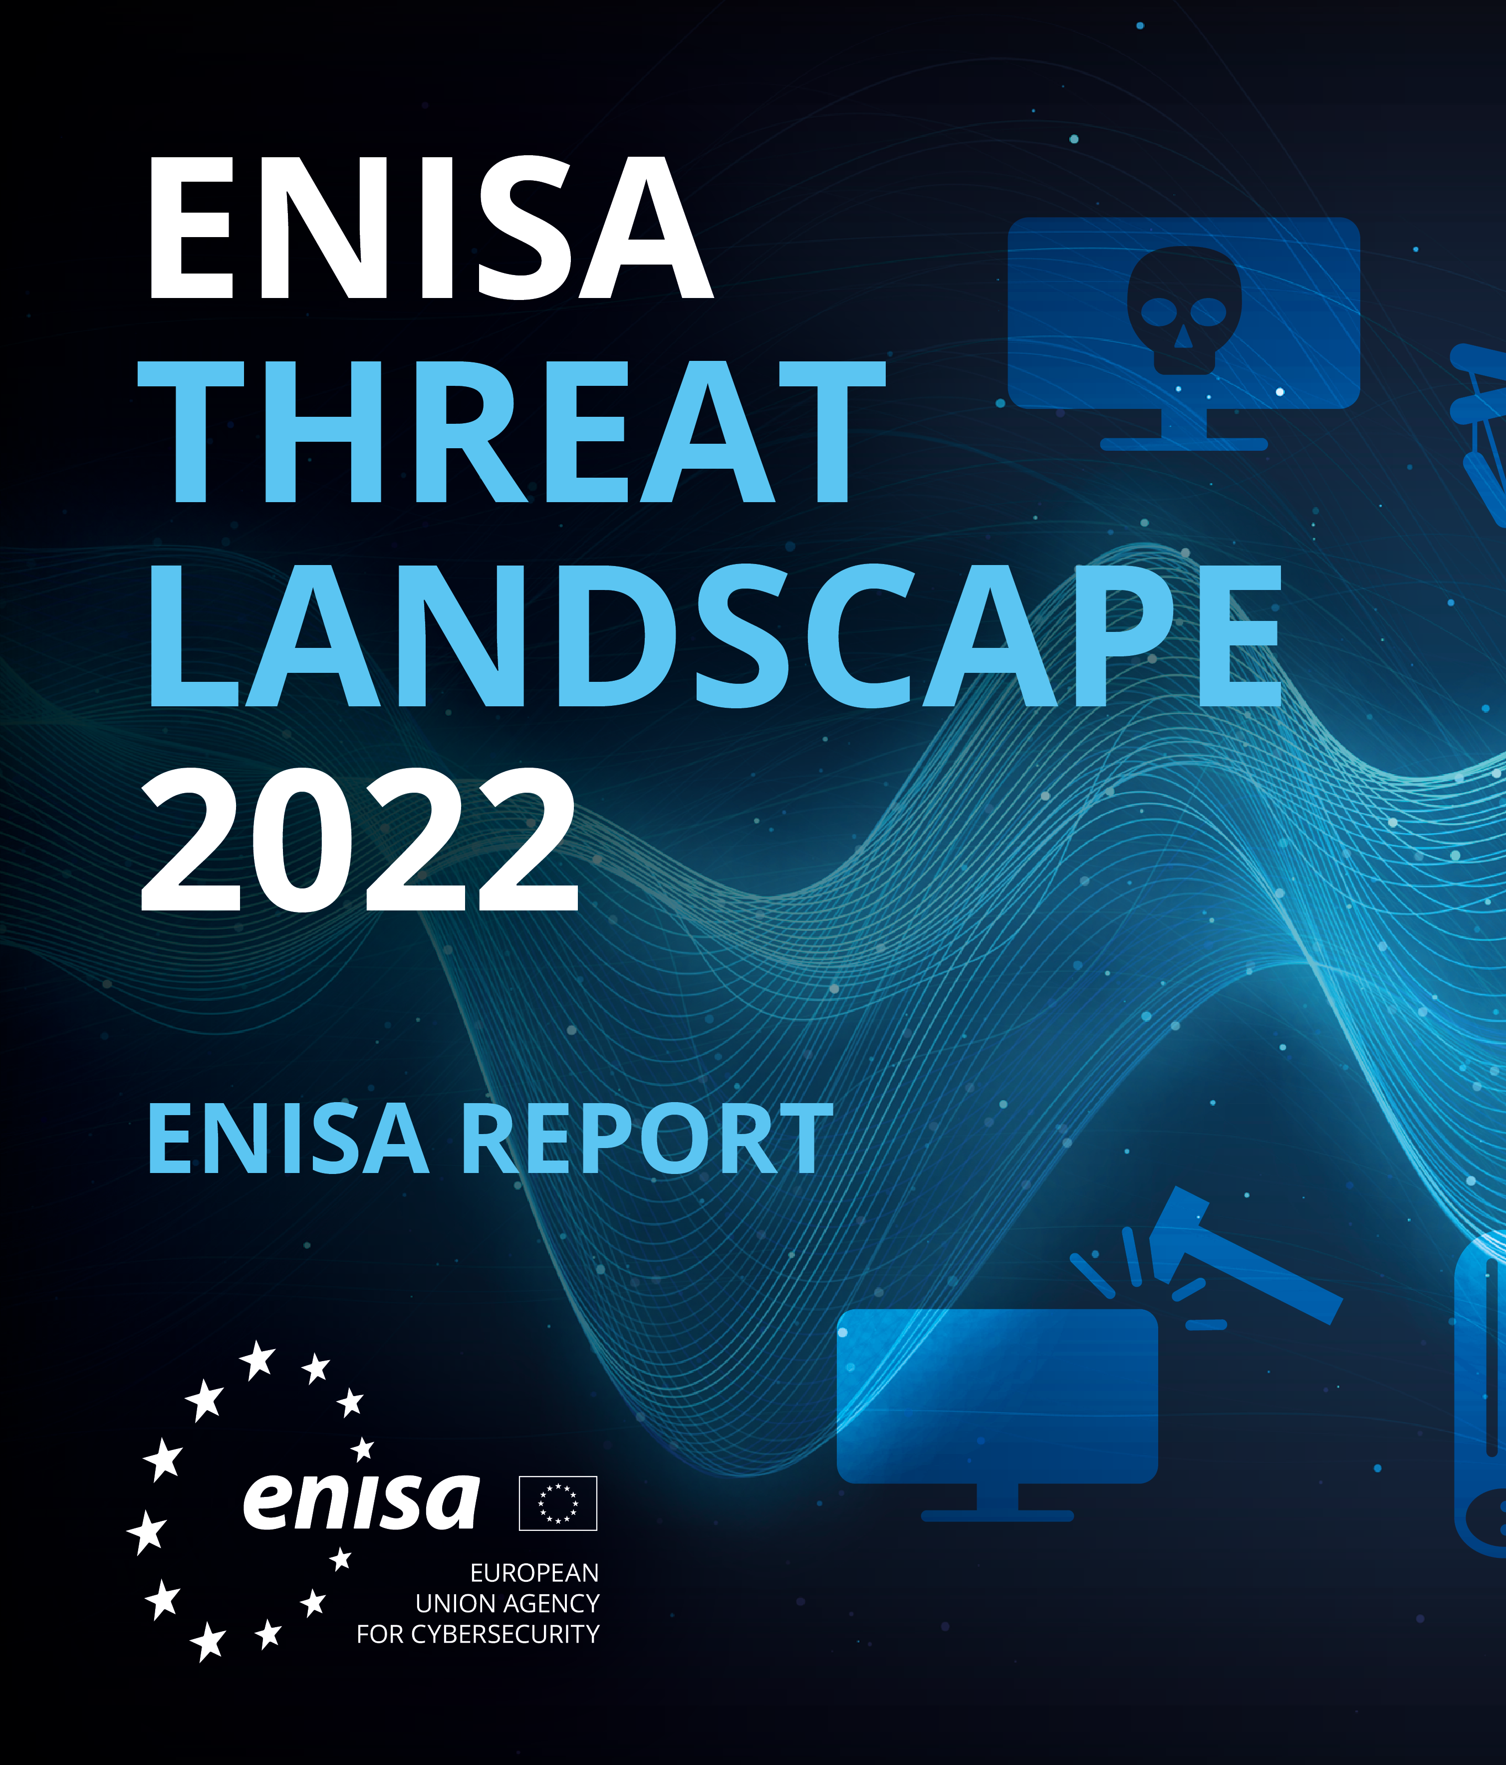
Communication and Collaboration Across Domains
Cross-Domain Cybersecurity Challenges
Challenges and opportunities in cross-domain cybersecurity collaboration.
Importance of interoperability and shared standards.
  ENISA, NIS 2
Strategies for effective cross-domain communication.
Notes:
Cybersecurity challenges in the energy sector often arise from integrating operational technology (OT) with information technology (IT), involving numerous stakeholders, and the critical nature of energy infrastructure operations. These challenges call for a collaborative approach across different domains and industries.
Real Energy Sector Examples of Cross-Domain Challenges:
Energy Grid Cyber Incidents: Energy grids employ a combination of OT and IT to manage energy distribution and data analytics. A cyber incident that targets this integration, like the Ukrainian power grid attack in 2015, highlights the cross-domain challenges. The attack on Ukraine's power grid led to significant operational disruptions, showing the cascading effects that can result from IT vulnerabilities impacting OT.
Vulnerabilities in Smart Grid Technology: Smart grids rely on digital systems for efficient operation, which are at risk of cyber threats. Incidents like the Stuxnet worm, which targeted control systems in 2010, emphasize the need for cross-domain collaboration between software providers, cybersecurity experts, and energy regulators to secure such technologies.
EU's NIS Directive and Energy Sector: The EU's Directive on the Security of Network and Information Systems (NIS Directive) plays a critical role in raising the level of cybersecurity in the EU's critical infrastructure, including the energy sector. It provides a framework for member states to bolster their cybersecurity defenses and encourages collaboration across different sectors to manage cyber risks effectively.
Energy Sector Example of Cross-Domain Collaboration: A real-life example of cross-domain collaboration within the energy sector can be seen in the response to the cyberattacks against the Ukrainian power grid. Post-attack, the energy companies involved worked closely with cybersecurity firms, hardware and software providers, and government agencies to recover their systems and reinforce their cyber defenses. This collaborative effort spanned across IT security, OT, and government bodies, highlighting the effective mobilization of diverse expertise and resources in responding to cybersecurity challenges.
The cross-domain approach, supported by frameworks such as the NIS Directive, not only aids in incident response but also helps establish robust and proactive cybersecurity practices. By encouraging collaboration across various domains, the energy sector can strengthen its defences against the evolving landscape of cyber threats.

Slide 34
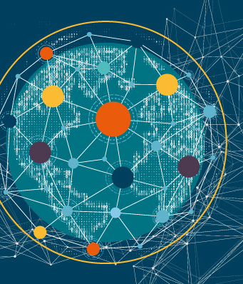
Communication and Collaboration Across Domains
Building Collaborative Networks
The role of professional networks and alliances in enhancing cybersecurity.
Benefits of public-private partnerships in cybersecurity initiatives.
  ESCO
Leveraging expertise across domains for comprehensive cybersecurity solutions.
Notes:
In the energy sector, the creation of strong collaborative networks is vital to improve cybersecurity resilience. These networks, including public-private partnerships, industry groups, and international cooperation, serve as a foundation for exchanging vital threat intelligence, best practices, and technological solutions throughout the energy ecosystem.
Key Strategies for Building Collaborative Networks in the Energy Sector:
Public-Private Partnerships: The formation of public-private partnerships is key for connecting government cybersecurity initiatives with the energy industry's needs. These partnerships support the exchange of timely threat intelligence and help to synchronize response strategies across the public and private sectors.
Industry Associations and Energy ISACs: Involvement with industry associations and Energy Information Sharing and Analysis Centers (ISACs) allows organizations to share and gain access to cybersecurity information specific to the energy sector. These entities promote cooperative problem-solving and the creation of joint initiatives to enhance cybersecurity defenses.
International Collaborations: Partnerships facilitated by groups like the European Union Agency for Cybersecurity (ENISA) enable energy stakeholders to access a wider range of expertise and resources. Such international collaborations contribute to the establishment of uniform cybersecurity standards and practices, which are crucial for addressing global cyber threats.
Real-Life Example:
A concrete instance of an effective collaborative network in the energy sector is the Cybersecurity Risk Information Sharing Program (CRISP), a partnership between the U.S. Department of Energy, the Electricity Information Sharing and Analysis Center (E-ISAC), and private energy companies. This initiative allows for the sharing of information about cyber threats and vulnerabilities, which can be used to protect critical infrastructure.
For example, following the 2015 cyberattack on Ukraine's power grid, utility companies in the United States, through CRISP and other information-sharing mechanisms, were able to share information about the incident and bolster their own defences, demonstrating the value of collaborative efforts across borders and industries.
Through active engagement in collaborative networks, the energy sector can significantly strengthen its collective cybersecurity framework. The exchange of information and resources in these networks fosters a cohesive and forward-thinking approach to cybersecurity, positioning the energy industry to effectively confront and mitigate evolving cyber threats.

Slide 35
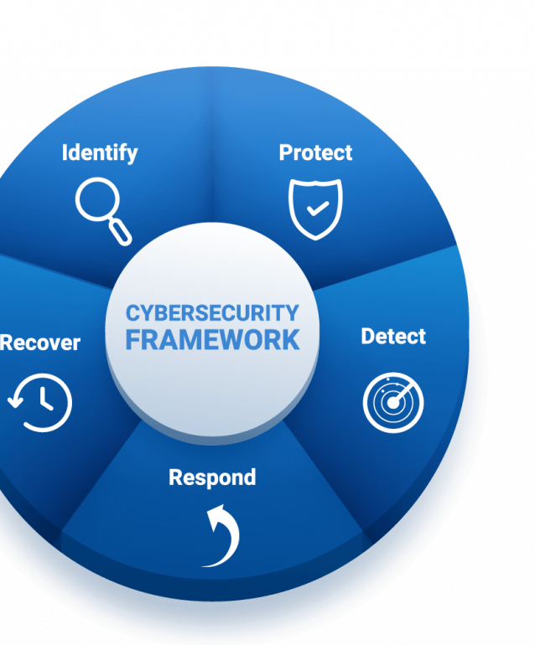
Communication and Collaboration Across Domains
Collaborative Incident Response
Principles of collaborative incident response planning.
Importance of clear roles and communication channels during incidents.
Benefits of joint exercises and simulations.
  Decision-making under pressure
  Cultural aspects
Locked-Shields and Energy Sector
Notes:
Incorporating human factors into collaborative incident response strategies is crucial for enhancing cybersecurity preparedness in the energy sector. The intricate and interconnected nature of energy systems, along with the diverse group of stakeholders, calls for an in-depth understanding of how human behaviors, decision-making processes, and team dynamics impact incident response.
Communication and Coordination: Effective incident response in the energy sector is dependent on clear communication and seamless coordination among operators, regulatory bodies, cybersecurity teams, and other stakeholders. Understanding human factors like language barriers, cultural differences, and stress-related communication breakdowns is essential in crafting protocols that facilitate precise and actionable information exchange during cyber incidents.
Decision-Making Under Pressure: Cyber incidents in the energy sector demand rapid decision-making in high-stress situations. Stress, cognitive overload, and fatigue can adversely affect the quality of decisions. Through training programs that mimic real-world scenarios, energy personnel can hone the ability to make informed decisions swiftly, even under pressure.
Team Dynamics and Leadership: The success of collaborative incident response in the energy sector also hinges on team dynamics and leadership. Effective leaders must understand crisis leadership principles, such as maintaining team morale, effective delegation, and fostering collaborative problem-solving, to enhance the team's overall response capabilities.
Cultural and Organizational Diversity: The energy sector comprises a variety of organizations, each with distinct cultures and procedures. Recognizing and respecting this diversity is key to ensuring that all entities collaborate effectively towards a shared objective.
Ukraine power grid cyberattack. During this event, human factors played a pivotal role in the incident response. Teams had to communicate quickly and effectively under stress, make rapid decisions, and work cohesively despite the high-pressure situation. In the aftermath, the energy companies involved and Ukrainian authorities worked with international cybersecurity experts to restore systems and strengthen defences, a process that required coordination across diverse organizational cultures and international borders.
This scenario underlines the importance of human dynamics in the energy sector's cybersecurity readiness. By learning from such events and conducting exercises that emphasize human aspects of incident response, energy organizations can better prepare to handle cybersecurity incidents effectively.

Slide 36

Communication and Collaboration Across Domains
Overcoming Barriers to Collaboration
Common barriers to effective cybersecurity collaboration and how to overcome them.
The role of trust and transparency in collaborative efforts.
Best practices for sustaining long-term collaborative relationships.
Port of San Diego incident
Notes:
collaboration, especially in industries as critical as maritime, overcoming common barriers is essential for robust defence mechanisms. These barriers often include a lack of shared standards, mismatched security protocols across different organizations, and a deficiency in clear communication channels. To overcome them, establishing unified security frameworks, actively engaging in joint cybersecurity exercises, and forming dedicated communication platforms for threat intelligence sharing are key steps.
Trust and transparency are the cornerstones of effective collaborative efforts. Within the maritime sector, this involves open sharing of threat intelligence, transparent reporting of incidents, and a commitment to collective security rather than competitive secrecy. Trust is built through consistency in actions, adherence to agreed-upon protocols, and the mutual understanding that security is a shared responsibility.
In the energy sector, sustaining long-term collaborative cybersecurity relationships is essential for resilience. It requires maintaining consistent communication, providing mutual support during crises, and aligning strategic goals. Frequent meetings, workshops, and joint exercises can strengthen these partnerships, while recognizing contributions and celebrating successes builds a community and shared purpose.
The Importance of Collaboration:
A clear demonstration of this necessity came with the 2015 cyberattack on the Ukrainian power grid. The incident brought to light multiple barriers to effective cybersecurity collaboration, the need for trust and transparency, and best practices for long-term partnership maintenance.
Overcoming Barriers:
The incident revealed challenges like inconsistent communication protocols, differing cybersecurity readiness levels among stakeholders, and organizational challenges. To address these barriers, there must be a unified approach to communication, routine combined cybersecurity exercises, and a mutual understanding of the roles and responsibilities of all parties involved.
Trust and Transparency:
It highlighted the importance of trust and transparency in a collaborative response, which was crucial in the cooperation between the energy companies, cybersecurity experts, and government agencies. For effective information sharing, it is vital to establish protocols that balance the confidentiality of sensitive data with the need to share critical threat intelligence.
Sustaining Relationships:
Also, the attack showed best practices in sustaining collaboration, including conducting regular joint cybersecurity exercises, sharing response plans, and keeping an ongoing dialogue among stakeholders. In response to the attack, Ukrainian energy companies not only worked to restore their systems but also to bolster partnerships with government bodies and the international community, laying the groundwork for joint defence against future cyber threats.
The Ukrainian grid attack serves as an instructive case study for the energy sector, underscoring the importance of being proactive in maintaining strong collaborative ties. These efforts are key to ensuring a swift and effective response when cyber threats emerge.

Slide 37

Decision Making at Strategic, Operational, and Tactical Levels
Strategic Decision Making
Overview of strategic decision-making in energy sector cybersecurity.
Long-term planning and policy development for robust cybersecurity frameworks.
Integration of cybersecurity into overall business strategy.
Real-world example: An energy sector company's strategic decision to adopt a zero-trust architecture.
Notes:
Strategic decision-making in energy sector cybersecurity is about defining long-term objectives and creating in-depth strategies to shield energy infrastructures from cyber threats. This requires an overarching perspective on the organization's goals, the potential cyber risks it faces, and the resources dedicated to cybersecurity measures.
For instance, an energy utility might decide to conduct a comprehensive cybersecurity overhaul across its operational technology. This could involve implementing state-of-the-art intrusion detection systems, updating legacy control systems to more secure versions, and rolling out extensive staff training programs. Such a strategic decision, motivated by the utility's aim to ensure consistent service delivery and protect critical infrastructure, reflects a deep-seated commitment to a forward-looking cybersecurity stance that dovetails with the larger goals of the organization.
This type of strategic planning is vital in the energy sector due to the critical nature of its services and the potential consequences of disruptions. Proactive cybersecurity investment not only safeguards against immediate threats but also contributes to the long-term resilience and reliability of energy systems.

Slide 38

Decision Making at Strategic, Operational, and Tactical Levels
Operational Decision Making
Role of operational decisions in maintaining day-to-day cybersecurity.
Operational responses to identified threats and vulnerabilities.
Coordination between cybersecurity teams and other operational units.
Real-world example: An operational decision to isolate a compromised system on a vessel, preventing a wider breach.
Notes:
Operational decision-making in the energy sector concerns the everyday actions taken to safeguard cybersecurity and ensure the ongoing stability of operations. This involves choices about enforcing security policies, responding to security incidents, and distributing resources for continual cybersecurity activities.
For example, an operational decision within a power utility company might involve organizing a drill that simulates a cyberattack on the grid. This exercise would test the readiness of the operational team and the robustness of the company's cyber defense mechanisms. Through these drills, potential weaknesses can be discovered and addressed, which is crucial for continuously enhancing the defenses against new and evolving cyber threats.

Slide 39

Decision Making at Strategic, Operational, and Tactical Levels
Tactical Decision Making
Nature of tactical decisions in responding to immediate cybersecurity threats.
Tools and techniques for effective tactical decision-making, including incident response teams and real-time threat intelligence.
Importance of agility and flexibility in tactical decisions.
Real-world example: Rapid tactical response to a ransomware attack on a port's cargo management system.
Notes:
Tactical decision-making in energy sector cybersecurity involves making prompt, informed decisions to counteract specific cyber incidents. These decisions often need to be executed quickly and under pressure, based on an immediate understanding of the threat and activation of established response plans.
For example, when a utility's SCADA system is targeted by a ransomware attack, tactical decisions must be taken swiftly. The initial response could involve segmenting the compromised parts of the network, initiating emergency protocols to ensure continuity of energy supply, and engaging with key parties like cybersecurity response teams, law enforcement, and other utilities as part of a coordinated response. This response reflects the immediate and practical actions required to limit the impact of the attack and to expedite a return to normal operational status.

Slide 40

Decision Making at Strategic, Operational, and Tactical Levels
Integrating Decision Levels
Ensuring coherence and alignment between strategic, operational, and tactical decision-making levels.
Mechanisms for feedback and learning across decision-making levels.
Role of leadership in bridging gaps between different decision-making levels.
Real-world example: Integrated decision-making framework that enabled a seamless response to a coordinated cyber-physical attack.
Notes:
In each of these decision-making levels, the integration of effective communication, collaboration, and a thorough understanding of the maritime operational environment is crucial. By aligning strategic, operational, and tactical decision-making with the unique challenges and dynamics of the maritime domain, organizations can enhance their cybersecurity posture and resilience against cyber threats. Integrating strategic, operational, and tactical decision-making levels is crucial for a cohesive and effective cybersecurity posture. This integration ensures that high-level objectives guide daily operations and that real-time insights from the ground influence strategic planning.
Achieving coherence between the levels requires clear communication channels and shared understanding across all levels of decision-making. For example, strategic decisions to invest in advanced cybersecurity technologies must be clearly communicated and understood by operational teams responsible for implementing these technologies and by tactical teams who will use them in response to immediate threats.
Effective integration also relies on establishing feedback loops that allow insights and experiences from operational and tactical levels to inform strategic planning. For instance, if tactical teams frequently encounter a specific type of cyber threat, this information should feed back to the strategic level to adjust overall cybersecurity strategies or allocate more resources to address this threat.
In the energy sector, the importance of integrating different levels of decision-making—strategic, operational, and tactical—is well exemplified by the response to the Colonial Pipeline ransomware attack in May 2021.
Strategic Level: Following the attack, the Colonial Pipeline Company underwent a thorough assessment of its cybersecurity systems and protocols. At the strategic level, they recognized the need to fortify their cybersecurity infrastructure and decided to invest in enhanced technologies and partnerships with cybersecurity firms.
Operational Level: The company operationalized these new cybersecurity measures across its entire operations. This included updating their systems, strengthening network defences, and integrating robust protocols into their daily processes. It also involved extensive training for staff on new systems and security procedures to ensure everyone was adept at the upgraded cybersecurity practices.
Operational and Tactical Level: Operationally and tactically, the company’s quick actions, such as shutting down the pipeline operations to contain the attack, were critical. The immediate decisions to mitigate the attack's impact included isolating the affected network segments and restoring operations with minimal disruption.
The Colonial Pipeline response to the ransomware attack highlights the need for proactive strategic planning, operational agility in implementing cybersecurity enhancements, and tactical acuity in real-time incident management. These combined efforts at different decision-making levels are crucial to improving the resilience of energy infrastructure against cyber threats​.

Slide 41
Training, Awareness, and Communication Programs for Energy Sector Personnel
Importance of Training and Awareness
The critical role of continuous training and awareness in maritime cybersecurity.
Elements of effective cybersecurity training programs for maritime personnel.
The impact of awareness programs on reducing human error and enhancing security culture.
, NIS 2
Notes:
In the maritime industry, the significance of training and awareness cannot be overstated, as they are critical components of a robust cybersecurity posture. Comprehensive training ensures that all personnel, from the deck to the boardroom, understand the cyber threats they face, know how to recognize the signs of a cyber incident, and are equipped with the skills necessary to respond effectively. Awareness initiatives keep cybersecurity at the forefront of everyone’s mind, fostering a culture where security becomes second nature.
Training programs in the energy sector need to be comprehensive, covering topics ranging from recognizing phishing attempts to safeguarding critical control systems. Tailored to the various roles within the organization, these programs should instruct staff on how to act decisively during cybersecurity incidents.
Regular awareness campaigns involving updates, visual reminders, exercises, and interactive learning are vital to maintain cybersecurity vigilance. Such initiatives reinforce training, help retain crucial knowledge, and ensure that all personnel remain aware of the shifting cybersecurity landscape.
Creating a culture of cybersecurity within an energy company means instilling a sense of personal responsibility for cyber safety in every employee. It's about empowering them to take action, from reporting anomalies to adhering to protocols during security events.
For instance, the Colonial Pipeline Company's response to the ransomware attack in 2021 exemplified the deployment of such training and awareness principles. After the attack, they heightened their focus on staff education, ensuring that employees could identify cyber threats and respond appropriately.
European Commission has adopted the first-ever EU network code on cybersecurity specifically for the electricity sector. This act represents a critical step to improve the cyber resilience of EU energy infrastructure and services, offering a high common level of cybersecurity for cross-border electricity flows. The network code establishes a systematic process for cybersecurity risk assessments in the electricity sector, aligning with mechanisms in horizontal EU legislation like the revised Network and Information Security Directive (NIS2)​. The implementation of the NIS 2 Directive in the energy sector calls for extensive updates to training programs. Entities must inform staff about new risk management strategies, the significance of addressing supply chain vulnerabilities, and the obligations of incident reporting. Trainings should enable a flow of information within the industry while respecting data protection laws and encourage involvement with national and EU-wide cybersecurity authorities.
Such measures aim to foster a cybersecurity culture that's not only robust but also aligned with regulatory requirements, ensuring that all levels of energy sector operations are resilient against cyber threats.

Slide 42
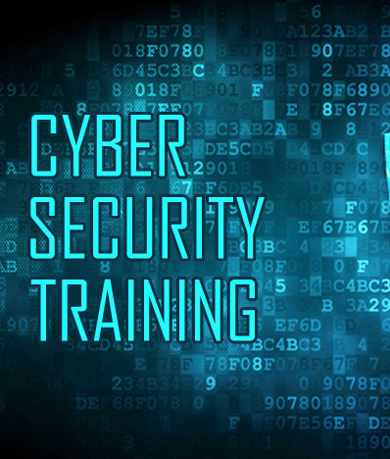
Training, Awareness, and Communication Programs for Energy Sector Personnel
Enhancing Communication for Cybersecurity
Best practices for communicating cybersecurity policies and incidents to energy sector personnel.
The role of clear, consistent communication in fostering a proactive cybersecurity stance.
  Clear Messaging
  Timely Information Flow
  Actionable Intelligence
Strategies for overcoming communication barriers in diverse and dynamic energy sector environments.
  Multichannel communication
  Feedback
Notes:
Enhancing communication for cybersecurity in the energy sector is vital to effectively manage cyber threats. Establishing and upholding clear, prompt, and practical communication pathways is essential for quick distribution of cybersecurity information.
Clear Messaging: It's essential to simplify complex cybersecurity details into messages that all staff can understand. For instance, rather than expounding on the intricacies of a cyber threat, the focus should be on essential actions such as restricting use of certain devices or specific operations on the network.
Timely Information Flow: Rapid dissemination of information is crucial. Protocols must define the urgency of communication, like instant alerts to IT teams and relevant personnel upon detection of a threat.
Actionable Intelligence: Communications should offer straightforward guidance on necessary actions. For example, if a security loophole is detected in network infrastructure, the message should include explicit risk mitigation steps like switching to backup systems or applying updates.
Multi-Channel Communication: Leveraging diverse communication methods ensures no message is missed. This can include email, SMS, internal notifications, or physical postings in common areas within facilities.
Feedback Mechanism: A system for reciprocal communication where feedback is sought and utilized should be in place. Setting up a hotline or a dedicated channel for reporting suspicious activity can help gauge the efficacy of cybersecurity practices.
Industry Example: Reflecting on the energy sector, after the Colonial Pipeline cyber incident, there was an industry-wide push for better communication protocols. Bulletins and advisories were sent out with actionable steps, circulated through various channels like industry associations and direct communications, to reach a wide audience and enhance sector-wide cyber preparedness. This model of communication is integral to safeguarding critical energy infrastructure.

Slide 43
Training, Awareness, and Communication Programs for Energy Sector Personnel
Designing Effective Training Programs
Principles for designing engaging and impactful training programs.
  Habits, Self-efficacy, Metacognition
Incorporating adult learning theories and methodologies in cybersecurity training.
Use of simulations and drills in reinforcing learning and preparedness.
Real-world example: A energy sector academy's use of VR simulations to train cadets on cybersecurity protocols.
Notes:
Designing effective cybersecurity training programs in the energy sector is about more than information transfer; it's about instilling strong habits, building confidence, and enhancing critical thinking skills with tailored feedback. Regular practice through simulations and drills is key, embedding cybersecurity protocols into daily routines until they become instinctive.
Such simulations boost self-efficacy among staff, giving them the conviction to face actual cybersecurity issues. Success in complex, simulated cyber scenarios builds this confidence. Drills that prompt staff to reflect on their actions improve learning retention.
Personalized feedback during these drills is essential. Similar to traditional energy industry exercises, immediate feedback in cybersecurity training allows for targeted learning opportunities, enabling staff to refine their actions and reinforce effective techniques.
Advancements in VR and AR technologies offer immersive training experiences. For instance, the aviation sector's use of VR for security training provides pilots with realistic emergency practice and instant feedback. Adapting such technologies, energy sector personnel could engage in VR-based cyberattack simulations, tackling scenarios like phishing attempts on the organization's network or unauthorized access attempts. Adaptive feedback during these simulations would offer constructive insights, ensuring continuous skill enhancement and upholding a culture of cybersecurity vigilance.

Slide 44
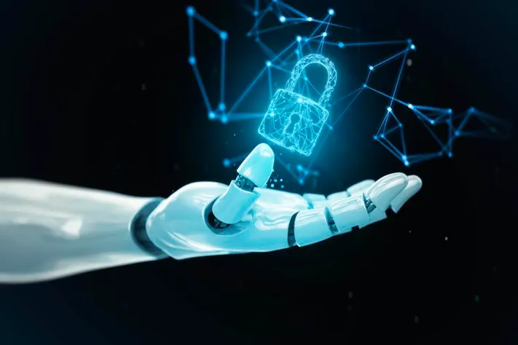
Future Trends, Challenges, and the Role of Communication
Emerging Cybersecurity Trends
An overview of emerging trends in cybersecurity, including AI, machine learning, and IoT.
The implications of these trends for energy sector cybersecurity strategies.
Preparing for future cybersecurity challenges through innovation and adaptability.
Real-world example: Adoption of AI-based threat detection systems on smart ships.
Notes:
n the energy sector, the integration of Artificial Intelligence (AI) is becoming increasingly prominent, particularly in enhancing the efficiency and reliability of operations. For example, Vistra Energy has deployed AI models across its power-generation units, resulting in significant efficiency improvements and cost savings, while also contributing to the company's carbon reduction goals. These AI initiatives are part of a broader transformation toward sustainable and inclusive growth within the sector​ (McKinsey & Company)​.
AI is revolutionizing the energy industry by enabling predictive maintenance, which improves system efficiency and energy security. The technology allows for the identification and resolution of potential problems before they disrupt operations. For instance, AI is used to analyze real-time data, detect and repair faults using monitoring, and apply thermographic and analytical technology. The potential for AI to make renewables more cost-effective and attractive is also noted, pointing toward a future where AI could contribute to greater efficiency across the entire energy sector​ (Home of Energy News)​. https://energydigital.com/articles/predictive-ais-role-in-transforming-the-energy-industry
The Scottish energy software firm POWWR and NTT DATA have highlighted the role of predictive AI in increasing the reliability of energy systems by informing when assets are at risk and need preventative maintenance. This predictive capability is combined with other data like weather and traffic to optimize the dispatch of engineers to the site. Additionally, the use of AI for predictive forecasting in energy consumption patterns has been noted as crucial for addressing the imbalance between supply and demand​ (Home of Energy News)​.
Overall, these developments suggest a significant trend toward adopting AI-driven solutions in the energy sector to create a more resilient, efficient, and sustainable energy ecosystem.

Slide 45

Future Trends, Challenges, and the Role of Communication
Addressing Future Cybersecurity Challenges
Anticipating and mitigating new types of cyber threats in the energy sector sector.
The importance of staying ahead of the curve through research and collaboration with cybersecurity experts.
Challenges posed by the increasing complexity and connectivity of energy sector operations.
Notes:
As the energy sector become more complex and interconnected, new cybersecurity challenges will emerge. Proactively addressing these challenges requires a comprehensive approach that includes investing in advanced security solutions and fostering a culture of innovation. Collaborative efforts to develop proactive defence mechanisms can help mitigate the risks posed by future cybersecurity threats

Slide 46

Future Trends, Challenges, and the Role of Communication
The Evolving Role of Communication
The critical role of effective communication in addressing future cybersecurity challenges.
Enhancing cross-sector and cross-border communication for a unified response to cyber threats.
Leveraging new communication technologies and platforms for better threat intelligence sharing.
Real-world example: Iviz-OT.
Notes:
The role of communication in cybersecurity will become increasingly critical as the threat landscape evolves. Effective communication can enhance threat intelligence sharing and facilitate coordinated responses to cyber incidents. Leveraging new communication technologies and platforms, as well as fostering cross-sector collaborations, can significantly improve the energy sector's ability to anticipate and respond to emerging cyber threats
The National Renewable Energy Laboratory (NREL in USA) has developed IViz-OT, a cybersecurity tool that enhances situational awareness for grid operators. This tool helps visualize and interpret threats by integrating cybersecurity alerts with operational data, providing an in-depth understanding of potential grid anomalies. IViz-OT works in tandem with the Hybrid Intrusion Detector for Energy Systems (HIDES) to process and log information, translating complex alerts into simple scenarios for easier comprehension by operators. This collaborative tool aims to give a comprehensive view of both cyber and physical grid data to help prevent and manage potential cybersecurity incidents.
But Human aspects are important in using the IViz-OT tool. The ability of grid operators to effectively interpret the visual data presented, to recognize patterns indicating potential threats, and to make quick decisions based on this information – all parts of Endsleys SA model. This requires operators to have a strong understanding of both the cybersecurity landscape and the operational technology (OT) of the grid. The tool aims to assist by transforming complex cybersecurity data into actionable insights, but the human element—operators’ knowledge, experience, and judgment—is crucial in responding to potential incidents and ensuring grid resilience.

Slide 47

Future Trends, Challenges, and the Role of Communication
Preparing for the Future
Strategic planning and investment in cybersecurity capabilities to prepare for future challenges.
The role of leadership in fostering a forward-looking cybersecurity culture.
Importance of global cooperation and information sharing in strengthening energy sector cybersecurity resilience.
Industrial Automation and Control Systems (IACS)
Notes:
Preparing for the future of cybersecurity requires a multifaceted approach that includes strategic planning, leadership commitment, and global cooperation. By embracing a culture of continuous learning and staying engaged with international cybersecurity efforts, organizations can develop resilient defences capable of withstanding the cybersecurity challenges of tomorrow
Markopoulou (2022) explored the implications of EU cybersecurity regulations on the energy and water sectors, with a focus on smart meter systems. The analysis reveals that the rapid deployment of smart technologies presents both opportunities and complications, particularly in
. The study critiques the current legal frameworks and their effectiveness in the face of new threats. The author suggests improvements to make the energy and water sectors more cyber resilient, acknowledging the need for robust protection measures amid increasing cyber incidents. This work offers insights into the intricacies of EU regulatory frameworks and their impact on critical infrastructure sectors
Markopoulou, D. (2022). Tackling cybersecurity challenges in the energy and water sectors in the context of the cybersecurity and sectoral regulatory frameworks: the case of smart metering systems in the new digitalised environment. International Review of Law, Computers & Technology, 37(1), 52-77
Human-centric Introduction to a Complex Cybersecurity Standard":
Industrial Automation and Control Systems (IACS) are integral to critical infrastructures like power and water treatment plants. Given the rise in cyberattacks, there is a vital need to protect these systems. The IEC-62443 standard series addresses this by providing guidelines for IACS cybersecurity. The human factor is crucial in implementing and managing cybersecurity controls prescribed by this standard. The paper offers a practical approach to train users in understanding and applying essential concepts of IEC-62443, such as zones and conduits, defense in depth, and security levels, emphasizing the importance of a human-centric approach to cybersecurity education (Eißler et al., 2023).
Eißler, J., Schuba, M., Höner, T., Hack, S., & Neugebauer, G. (2023). Human-centric introduction to IEC-62443 cybersecurity standard: A practitioner’s guide. In Advances in Human Factors in Cybersecurity. AHFE 2022. Advances in Intelligent Systems and Computing, vol 1332. Springer.

Slide 48
Evaluation method
Outline the evaluation elements and assessment process
Evaluation Element | How | Notes
Multiple Choice Quizzes | Online Quizzes

Slide 49

Resources: Books and Reference Materials
"European Cybersecurity Skills Framework": European Union Agency for Cybersecurity (ENISA) Publication
European Union Agency for Cybersecurity (ENISA). (2019). Cybersecurity culture guidelines: Behavioural aspects of cybersecurity. Retrieved from https://www.enisa.europa.eu.
Hanzu-Pazara, R., Raicu, G., & Zăgan, R. (2019). The Impact of Human Behaviour on Cyber Security of the Maritime Systems. Advanced Engineering Forum, 34, 267-274.
Wiederhold, B. (2014). The Role of Psychology in Enhancing Cybersecurity. Cyberpsychology, Behavior, and Social Networking, 17(3), 131-132.
Aşan, C. (2023). The Role of Cyber Situational Awareness of Humans in Social Engineering Cyber Attacks on the Maritime Domain. Mersin University Journal of Maritime Faculty. Link
Akpan, F., Bendiab, G., Shiaeles, S., Karamperidis, S., & Michaloliakos, M. (2022). Cybersecurity Challenges in the Maritime Sector. Network, 2, 123-138.
Endsley, M. R., & Jones, D. G. (2024). Situation Awareness Oriented Design: Review and Future Directions. International Journal of Human–Computer Interaction, 1-18.
Thackray, H., McAlaney, J., Dogan, H., Taylor, J., & Richardson, C. (2016). Social Psychology: An Under-used Tool in Cybersecurity.
Knox, B. J., Lugo, R. G., & Sütterlin, S. (2019). Cognisance as a human factor in military cyber defence education. IFAC-PapersOnLine, 52(19), 163-168.

Slide 50

Thank you
Please send any questions to:
Ricardo.Lugo@taltech.ee

