Slide 1



Cybersecurity Essentials and Management for the Health Sector
CSP001_W_H
PRESENTATION BY:
PROF. NINETA POLEMI, PARESH RATHOD & DIMITRIS KOUTRAS

Slide 2



Slide 3

CyberSecPro Training Module-1: Cybersecurity Essentials and Management for the Health Sector
Trainers: Prof. Nineta Polemi, Dr. Paresh Rathod & Dimitris Koutras

Slide 4
Meet the Trainers
Prof. Nineta Polemi
Dr. Paresh Rathod
Dimitris Koutras
Professor from Cyber Sec Lab, University of Piraeus, specializing in cybersecurity.
Thematic RDI leader at Laurea University, focusing on cybersecurity advancements.
Technical Expert in IoT protocol security, contributing practical insights.
Trainers: Prof. Nineta Polemi, Dr. Paresh Rathod & Dimitris Koutras

Slide 5

Value Propositions
Benefits to Participants
Level of Training Module: Basic / Advance
Cybersecurity Professional Training
Hands-on and Practical Skills Development
Rooted with European Cybersecurity Skills Framework
Cutting-edge insights from industry-academic experts
Certificate of the completion
Helps with skills development and career advancement
Trainers: Prof. Nineta Polemi, Dr. Paresh Rathod & Dimitris Koutras

Slide 6
Syllabus Overview
1
Topic-1
2
Topic-2
Introduction to Healthcare Cybersecurity Essentials.
Common Cybersecurity Threats in Healthcare.
3
Topic-3
4
Topic-4
Best Practices for Patient Data Protection.
Managing Cybersecurity Risks Effectively.
Trainers: Prof. Nineta Polemi, Dr. Paresh Rathod & Dimitris Koutras

Slide 7
Syllabus Overview
5
Topic-5
6
Topic-6
Essential Cybersecurity Controls for Healthcare IT Systems and Devices
Building a Secure Culture within Your Organization
7
Topic-7
8
Topic-8
Ethical and Professional Challenges in
Healthcare Cybersecurity
Cybersecurity Governance for Healthcare
Organizations
Trainers: Prof. Nineta Polemi, Dr. Paresh Rathod & Dimitris Koutras

Slide 8
Syllabus Overview
9
Topic-9
10
Topic-10
Cybersecurity Compliance and Regulations for Health Sector
Case Studies and Practical Exercises
Trainers: Prof. Nineta Polemi, Dr. Paresh Rathod & Dimitris Koutras

Slide 9

Module Benefits
Comprehensive Knowledge
Practical Skills
Industry Relevance
Develop skills to protect information and systems.
Stay relevant with up-to-date industry practices.
Gain a thorough understanding of healthcare cybersecurity.
Trainers: Prof. Nineta Polemi, Dr. Paresh Rathod & Dimitris Koutras

Slide 10
Target Audience
Healthcare Managers
IT Professionals
Medical Staff
Managers overseeing patient data security.
IT experts in the healthcare sector.
Medical staff handling sensitive information.
Trainers: Prof. Nineta Polemi, Dr. Paresh Rathod & Dimitris Koutras

Slide 11
Enrollment Process
Registration
1
Sign up for the CyberSecPro Training Module-1 at Website: www.cybersecpro-project.eu
2
Orientation
Attend an orientation to understand the module's scope.
Participation
3
Participate in the interactive training sessions.
Trainers: Prof. Nineta Polemi, Dr. Paresh Rathod & Dimitris Koutras

Slide 12
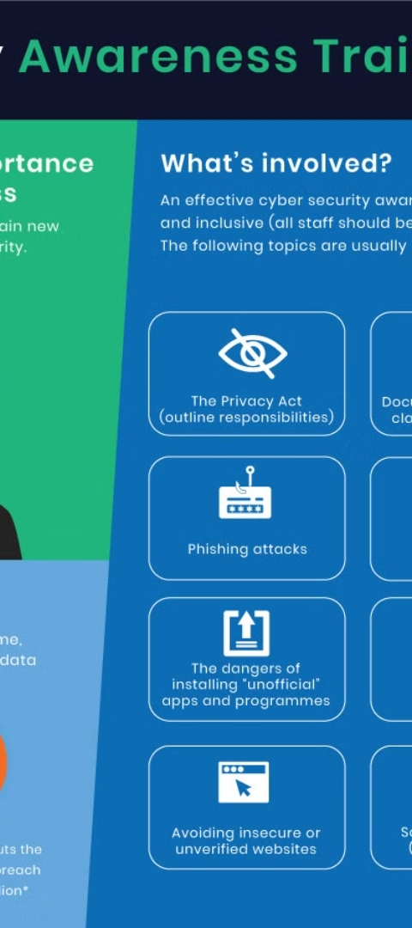
Training Methodology
1
Interactive Learning
2
Expert Guidance
Engage in interactive sessions for better retention.
Learn from experts with real-world experience.
3
Hands-on Approach
Practice with tools and scenarios used in healthcare.
Trainers: Prof. Nineta Polemi, Dr. Paresh Rathod & Dimitris Koutras

Slide 13



Learning Outcomes
Knowledge Base
Expand your knowledge base in cybersecurity.
Skill Set
Enhance your skill set for data protection.
Confidence
Build confidence in managing cybersecurity issues.
Trainers: Prof. Nineta Polemi, Dr. Paresh Rathod & Dimitris Koutras

Slide 14

Module Features
Customized Content
Interactive Modules
Content tailored for the healthcare sector.
Modules designed for interactive learning.
Support Materials
Access to extensive support materials.
Trainers: Prof. Nineta Polemi, Dr. Paresh Rathod & Dimitris Koutras

Slide 15
Course Duration
2
5
10
Days
Hours/Day
Topics
The course spans over Two Days of training.
Five hours of daily interactive sessions.
Ten comprehensive topics covered.
Trainers: Prof. Nineta Polemi, Dr. Paresh Rathod & Dimitris Koutras

Slide 16
Healthcare Cybersecurity Essentials
1
Understanding Basics
Grasp the core concepts of cybersecurity in healthcare.
2
Recognizing Importance
Learn why cybersecurity is crucial in the health sector.
3
Applying Knowledge
Use this knowledge to safeguard health information.
Trainers: Prof. Nineta Polemi, Dr. Paresh Rathod & Dimitris Koutras

Slide 17

Cyber Threats and Vulnerabilities
Identify Threats
Learn about the most common cyber threats in healthcare.
Analyze Vulnerabilities
Understand where healthcare systems are most at risk.
Preventive Measures
Discover how to prevent breaches and secure data.
Trainers: Prof. Nineta Polemi, Dr. Paresh Rathod & Dimitris Koutras

Slide 18
Protecting Patient Data
Privacy First
Secure Access
Compliance
Adopt practices that prioritize patient privacy.
Ensure secure access to patient information.
Maintain compliance with health data protection laws.
Trainers: Prof. Nineta Polemi, Dr. Paresh Rathod & Dimitris Koutras

Slide 19
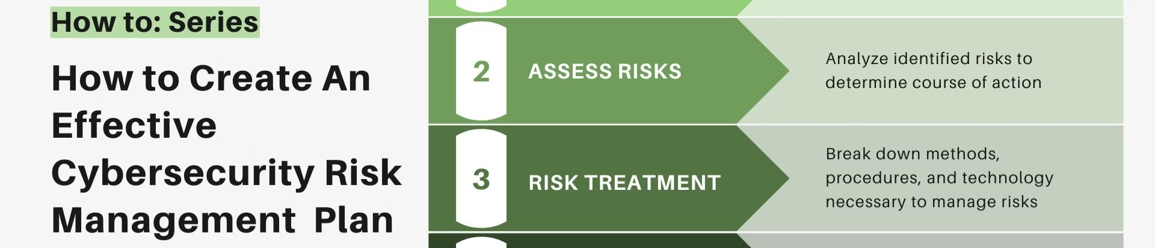
Risk Management
Assessment
1
Conduct thorough cybersecurity risk assessments.
2
Mitigation
Implement strategies to mitigate identified risks.
Continual Review
3
Regularly review and update security measures.
Trainers: Prof. Nineta Polemi, Dr. Paresh Rathod & Dimitris Koutras

Slide 20
Cybersecurity Controls
IT Systems
Medical Devices
Best Practices
Essential controls for healthcare IT systems.
Securing connected medical devices effectively.
Adopting industry best practices for cybersecurity.
Trainers: Prof. Nineta Polemi, Dr. Paresh Rathod & Dimitris Koutras

Slide 21

Building a Secure Culture
1
Education
2
Policies
Train staff on the importance of cybersecurity.
Develop clear policies for data security.
3
Engagement
Encourage proactive engagement in security practices.
Trainers: Prof. Nineta Polemi, Dr. Paresh Rathod & Dimitris Koutras

Slide 22

Ethical Challenges
Professional Conduct
Addressing ethical conduct in cybersecurity.
Decision Making
Navigating complex ethical decisions.
Integrity
Maintaining integrity while handling sensitive data.
Trainers: Prof. Nineta Polemi, Dr. Paresh Rathod & Dimitris Koutras

Slide 23

Governance in Healthcare
Leadership
Frameworks
Accountability
Role of leadership in cybersecurity governance.
Implementing governance frameworks effectively.
Ensuring accountability at all levels.
Trainers: Prof. Nineta Polemi, Dr. Paresh Rathod & Dimitris Koutras

Slide 24
Compliance and Regulations
Understanding Laws
Adhering to Standards
Continuous Update
Learn about laws regulating health sector cybersecurity.
Adhere to standards for compliance and regulations.
Stay updated with evolving cybersecurity regulations.
Trainers: Prof. Nineta Polemi, Dr. Paresh Rathod & Dimitris Koutras

Slide 25

Case Studies
1
Real-world Scenarios
2
Lessons Learned
Analyze real-world cybersecurity incidents in healthcare.
Understand the lessons learned from past breaches.
3
Preventive Actions
Discuss actions taken to prevent future incidents.
Trainers: Prof. Nineta Polemi, Dr. Paresh Rathod & Dimitris Koutras

Slide 26

Practical Exercises
Simulations
Engage in simulations of cybersecurity attacks.
Response Planning
Develop and practice incident response plans.
Hands-on Training
Gain hands-on experience with security tools.
Trainers: Prof. Nineta Polemi, Dr. Paresh Rathod & Dimitris Koutras

Slide 27
Training Resources
Books & Publications
Online Materials
Mentorship
Curated list of essential readings.
Access to online resources and materials.
Guidance from experienced professionals.
Trainers: Prof. Nineta Polemi, Dr. Paresh Rathod & Dimitris Koutras

Slide 28

Assessment and Certification
1
Continuous Assessment
Assessments throughout the course to gauge understanding.
2
Final Exam
A comprehensive final exam to test knowledge.
3
Certification
Receive certification upon successful completion.
Trainers: Prof. Nineta Polemi, Dr. Paresh Rathod & Dimitris Koutras

Slide 29

Networking Opportunities
1
Peer Interaction
2
Expert Access
Interact and network with peers in the field.
Gain access to industry experts and leaders.
3
Community Building
Build a community of cybersecurity professionals.
Trainers: Prof. Nineta Polemi, Dr. Paresh Rathod & Dimitris Koutras

Slide 30

Post-Training Support
Follow-Up Sessions
Attend follow-up sessions to reinforce learning.
Q&A Forums
Participate in Q&A forums for ongoing support.
Updates
Receive updates on the latest in cybersecurity.
Trainers: Prof. Nineta Polemi, Dr. Paresh Rathod & Dimitris Koutras

Slide 31


References and Sources
Content for Teaser Video: The content of this teaser video is based on the CyberSecPro project's Work Package 3 Deliverables with valuable contributions from CyberSecPro partners.
Language Expertise: The deliverable D3.1 underwent rigorous linguistic proofreading. This involved utilizing Grammarly AI and the meticulous review by a native English speakers.
Multimedia Content: Any used engaging images, videos, and audio were sourced from the Pictory, Getty images and other open stock multimedia database.
Partner Collaboration: We acknowledge the contributions of our CyberSecPro partners, including the trainer photos featured in the program.
Learning Materials: The training materials for this CyberSecPro module were supplied by a listed trainer, and due credit is given to the authors.
Creative credit: Video teaser created using these resources by European Cybersecurity Professional Paresh Rathod.
Materials of the training created using academic, research literatures and Open Education Material(OEM) with due credits to authors

Slide 32

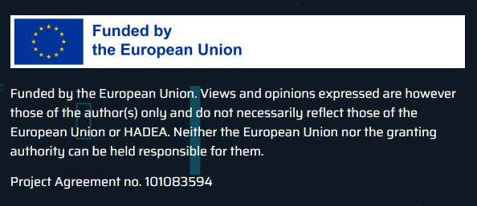
Connect with CyberSecPro: How to register and other practical information
Website: www.cybersecpro-project.eu
X (Twitter): https://twitter.com/CyberSecPro_eu
LinkedIn: https://www.linkedin.com/company/cybersecpro-euproject/

Slide 33

Thank you
Please send all questions to:
paresh.rathod@laurea.fi

