Slide 1


Cybersecurity Essentials and Management for Maritime
CSP001_W_M
Presentation by:
Nineta Polemi
Paresh Rathod

Slide 2


Slide 3

Value Propositions
Benefits to Participants
Understand the importance of ethical conduct and professionalism in maritime cybersecurity.
Foundational Knowledge and Taxonomy of Maritime Cybersecurity
Maritime Threats and Vulnerabilities
Maritime Cybersecurity Risk Management
Human Factor Considerations in Maritime Cybersecurity
Secure Architecture Design and Implementation for Maritime Systems
Security Controls Selection and Implementation for Maritime Environments
Data Security and Privacy by Design for Maritime Operations
Cybersecurity Governance for Maritime Organizations
Maritime Cybersecurity Compliance and Regulations

Slide 4

WHO
Profile of Training Participants
Managers and Leaders
Working-life professionals
SMEs and Public Sector Employees
Cybersecurity practitioners and enthusiasts

Slide 5

WHO
Profile of Trainers
Nineta Polemi is a cybersecurity Professor in the University of Piraeus-UNIPI- (Cyber Security Lab, Dept. of Informatics) and CTO/ Co-Founder of Trustilio. She served (2017-2020) as Programme Manager and Policy Officer in the European Commission DG (CONNECT H1 Unit entitled ’Cybersecurity Technologies and Capabilities’). She has obtained her Ph.D. in Applied Mathematics (Coding Theory) from The City University of New York (Graduate Center). She held teaching and research positions in The City University of New York (Queens & Baruch Colleges), State University of New York (Farmingdale), Université Libre de Bruxelles (ULB)-Solvay Brussels School-. She has over 150 publications in security (e.g. port security, maritime security, maritime supply chain security) has organised numerous scientific and policy international cybersecurity scientific events. She has received many research grants (NATO, IEEE) and awards (NSA, MSI Army Research Office IEEE, CYNY, Hellenic Ministry of Maritime, Hellenic National Defense General) and has participated as Project and Technical Manager in more than 60 cybersecurity international, EU and national R&D and commercial projects. She serves as external expert/reviewer/consultant in ENISA, E.C.(DG CNECT, DG HOME), FORTH, Focal Point.
Paresh Rathod is a seasoned technocrat, cyber expert, innovator, educator, and thought leader with a passion for creating a safer digital world, services, and solutions. Honoured with the meritorious knighthood medal by the President of the Republic of Finland, Dr Rathod serves as the Head of Research and Innovation at Trustilio BV in the Netherlands, and a Thematic Leader (Cyber RDI) - Educator (ICT) at Laurea, Finland. Dr Rathod's contribution extends beyond his academic and corporate roles including the European Cybersecurity Organisation (ECSO, Brussels), where he co-chaired the working group, and the European Union's Cybersecurity Agency (ENISA), where he served as an expert-rapporteur in AHWG for the European Cybersecurity Skills Framework development work. Paresh's scientific innovation and scholarly work have been presented at multiple seminars, workshops, international conferences, journals, and forums. He has trained over 10,000 professionals and higher education students in Europe, demonstrating his commitment to knowledge sharing and skills development. Notably, Paresh Rathod has been involved in EU innovation projects like ABC4EU, MOBI, MACICO, SATERISK, ECHO, CyberSecPro, DYNAMO, ARCSAR, EU-HYBNET, EU CISE 2020, CYCLOPES, CUSTODES, NERO and AI-ARC, shaping the future of cybersecurity and cutting-edge technologies. He has contributed to initiatives like CAL4INO, ECOLHE and DIG4LIFE, promoting digital transformation in Europe. He brings his expertise and experience to bear as a senior advisor to many businesses and organisations, providing strategic guidance and helping them succeed.

Slide 6


Background Knowledge and Prerequisites
Background knowledge:
Basic understanding of computers systems
Familiarity with common vulnerability and security threats databases
Familiarity with cybersecurity certifications and critical sectors
Awareness of cybersecurity
Prerequisites:
None

Slide 7

TOPICS
MARITIME ECOSYSTEM
MARITIME ASSETS –CLASIFICATION
BASIC CONCEPTS OF SECURITY
CYBER HYGIENE

Slide 8
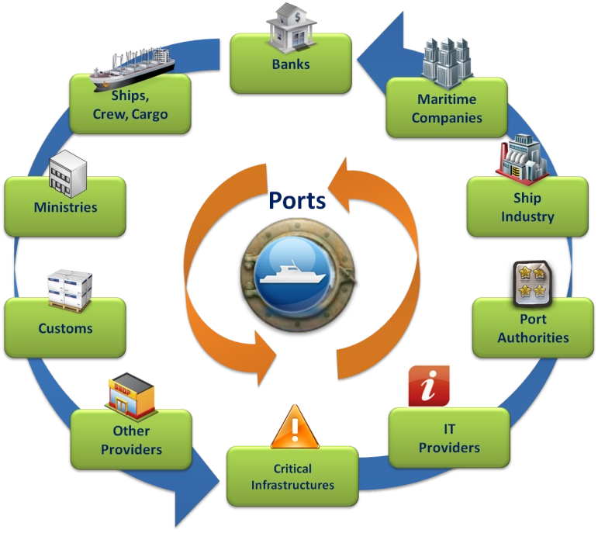
MARITIME COMPLEX ECOSYSTEM

Slide 9

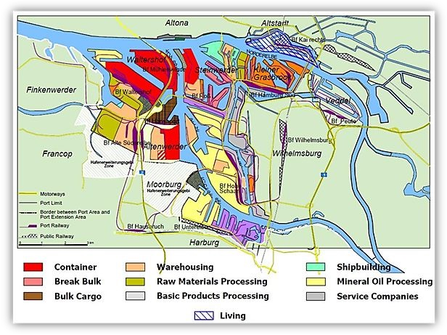
Port:
A very complex environment
Port security: Extremely port specific

Slide 10

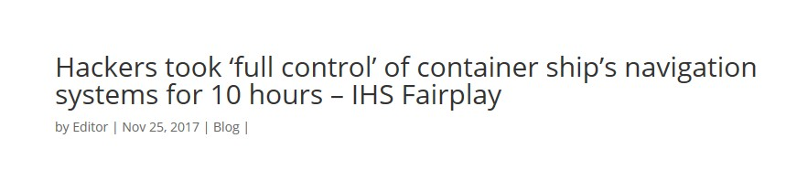
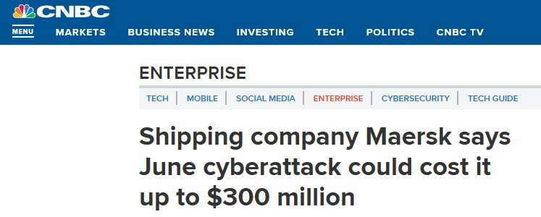
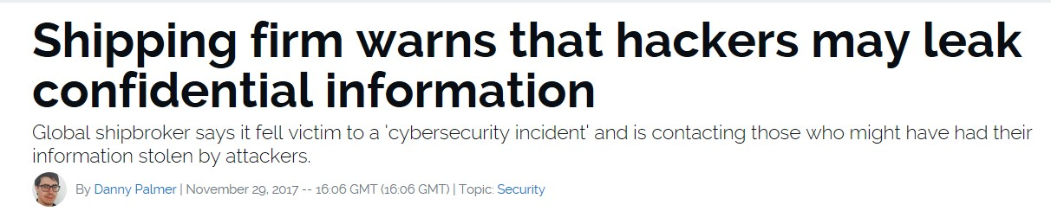
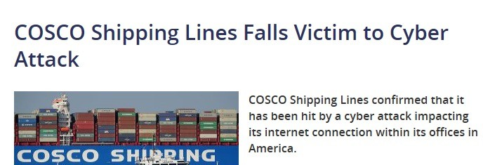
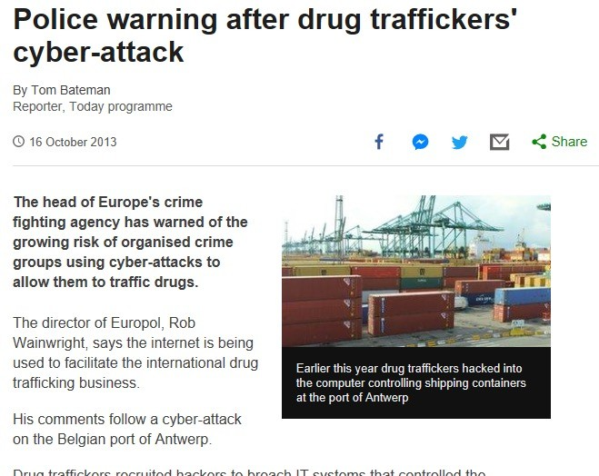
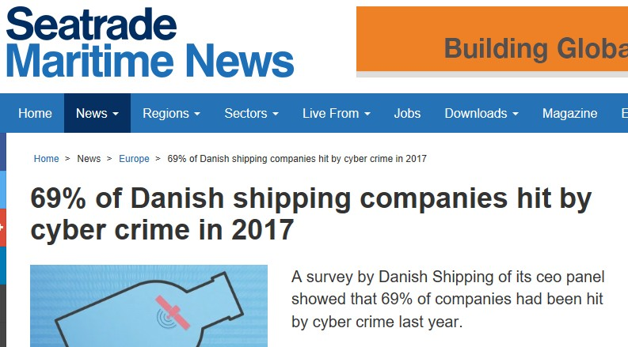
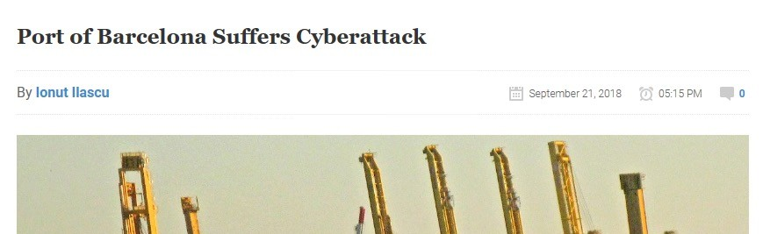

Mediterranean Shipping Company (MSC)-
2020- malware attack
THE MARITIME SECTOR IS UNDER ATTACK!
Maersk Petya Ransomware-2017
James Fisher and Sons Pls (UK )
Phishing attack 2019
5
Sources: ENISA ,
Cyber Security in the Maritime Industry: A Systematic Survey of Recent Advances and Future Trends

Slide 11
LATEST INCIDENTS
6_2017 MALICIOUS SOFTWARE ALLEGEDLY UNLEASHED BY THE RUSSIAN MILITARY ON UKRAINE SPREAD AROUND THE WORLD AND DISRUPTED OPERATIONS AT SHIPPING GIANT MAERSK, COASTING THE COMPANY AN ESTIMATED $300 MILLION. MAERSK WAS HIT AS PART OF A GLOBAL CYBER ATTACK NAMED PETYA
7_2023 THE PORT OF NAGOYA IN TOBISHIMA IN THE CENTRAL JAPAN PREFECTURE OF AICHI, WHICH REMAINS UNABLE TO LOAD AND UNLOAD CONTAINERS AFTER RUSSIA-BASED HACKERS ATTACKED ITS COMPUTER SYSTEM.

Slide 12
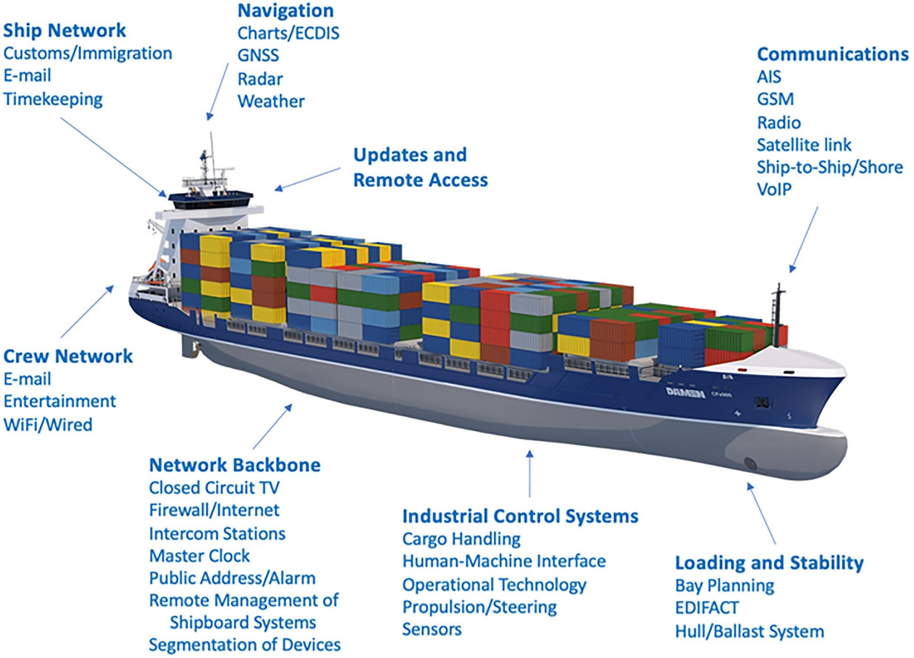
SHIPBOARD TECHNOLOGIES
Source: Atlantic Council

Slide 13
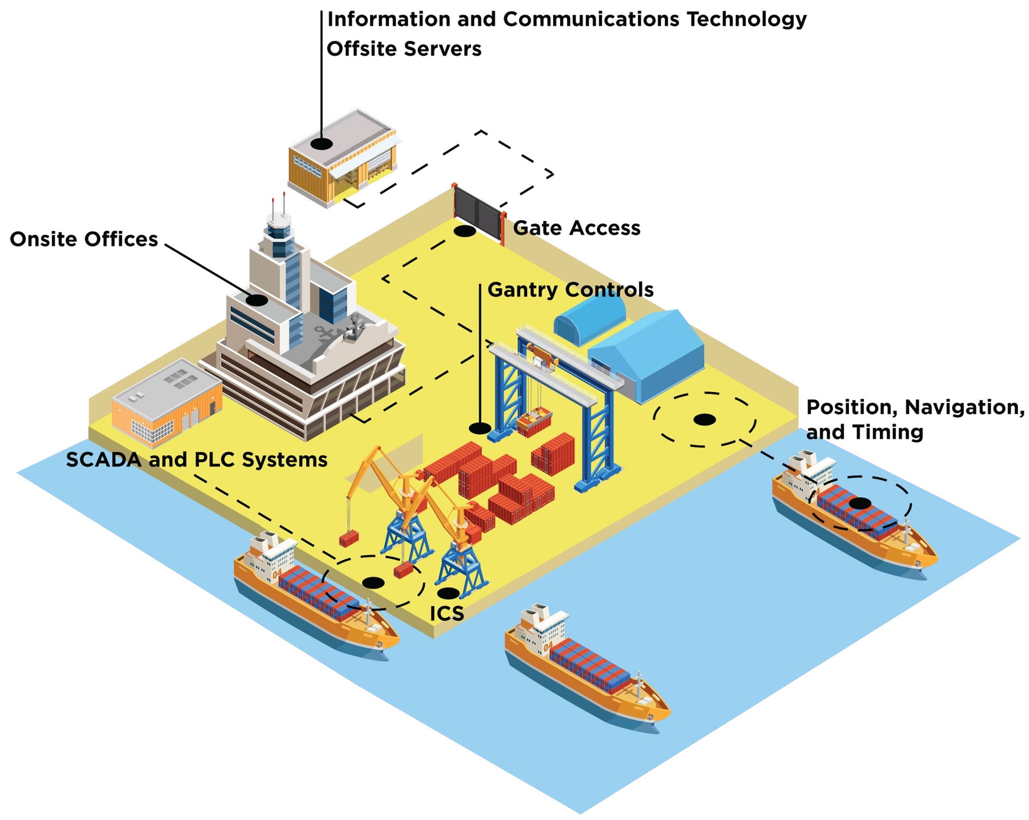
BASIC PORT TECHNOLOGIES
Created by Atlantic Council

Slide 14
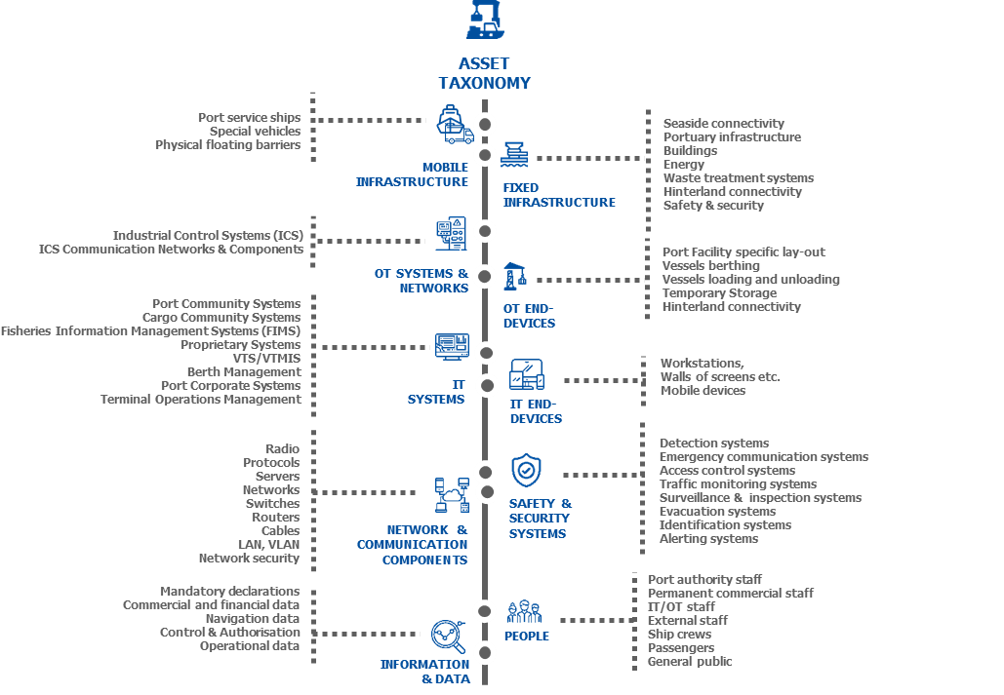

MARITIME ASSETS – ATTACK SURFACE
Positioning systems
Electronic Chart Display and Information System (ECDIS)
Engine Control and monitoring systems Global Maritime Distress and Safety System (GMDSS)
Automatic Identification System (AIS) Maritime ICS SCADA
9 Maritime and Cybersecurity: the work of ENISA

Slide 15
ISO 27001
Confidentiality
Making asset accessible only to those authorized to use it.
Integrity, authenticity
Safeguarding accuracy, identity, completeness of asset + processing
methods.
Availability, non-repudiation
Ensuring that asset is available when required and it is not denied.

Slide 16







IT SYSTEM
Users/ Procedures
(physical users, smart objects, security processes)
Data & Data processes
(ad-hoc, proprietary, Big data, data analytics/ management,/training models)
Domain/sectoral e/m-Services
(e-health, e-invoicing, logistics, e-procurement ..)
IT Applications & Technologies
(ML/AI, IoT, servers, ERPs, smart appliances)
Telecom
(networks, satellites, routers, optical fibers, telecom devices..)
Infrastructure
(buildings, terminals, gates, data centers)

Slide 17


SECURITY VS SAFETY
Security (cyber security):
ensure the confidentiality,
authenticity, integrity, , availability, non- repudiation of all assets in all layers of the IT system.
Security
Safety (physical security): ensure the access control, integrity and availability of the assets in the two layers (1st, 6th).
Safety

Slide 18
THREATS AND ATTACKS
LOSS OF AVAILABILITY
DENIAL OF SERVICE , WIRETAPPING, KEY STEALTH, INSERTION, SESSION HIJACKING, NETWORK ROUTING, HIDDEN
CHANNEL
LOSS OF INTEGRITY
  KEY GUESSING, CRYPTANALYTIC ATTACKS
LOSS OF AUTHENTICITY
  UNAUTHORIZED ACCESS, SITE IMPERSONATION
CLIENT-SYSTEM INTRUSION (VIRAL INFECTION, BACKDOOR INSTALLATION, INFORMATION STEALING,
FORGED/UNVOLUNTARY USER ACTIONS, COMMAND EXECUTION)
LOSS OF CONFIDENTIALITY
  ESPIONAGE PERSONAL, CORPORATE, NATIONAL AND MILITARY
  DATA & INFORMATION BREACH
LOSS OF NON-REPUDIATION
  KEY GUESSING, CRYPTANALYTIC ATTACKS

Slide 19
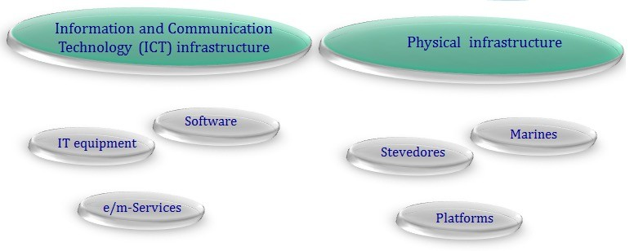
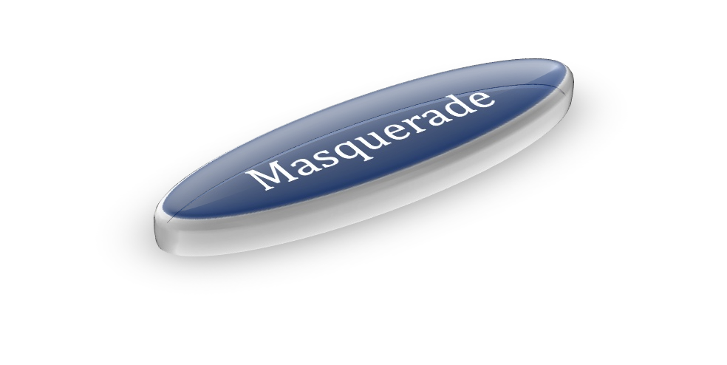
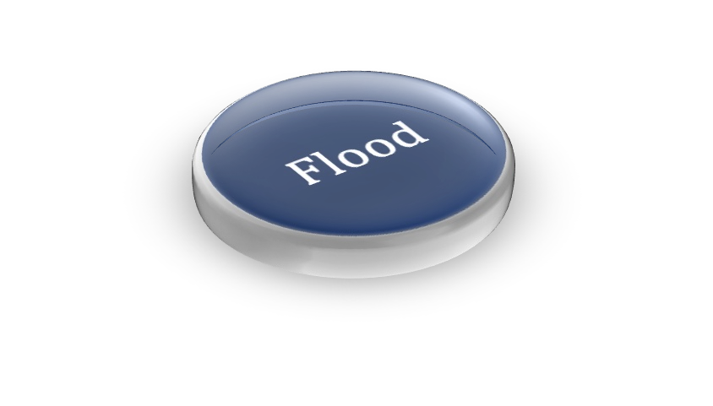
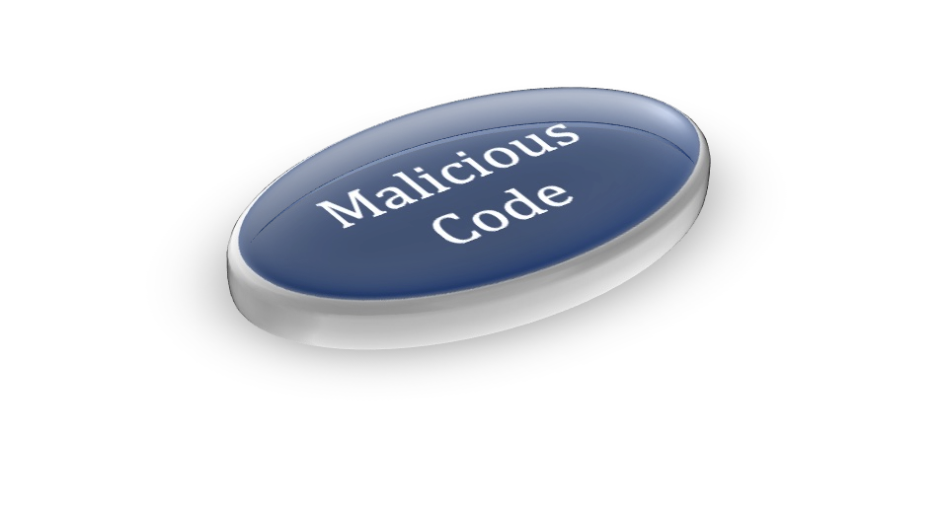
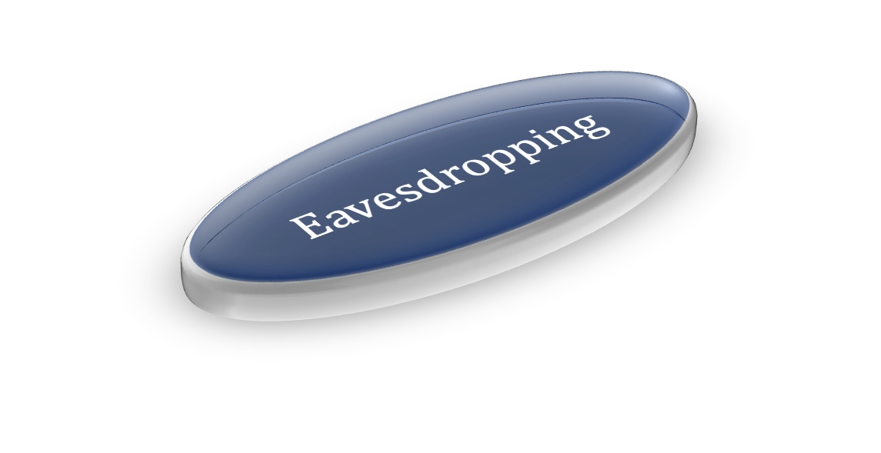

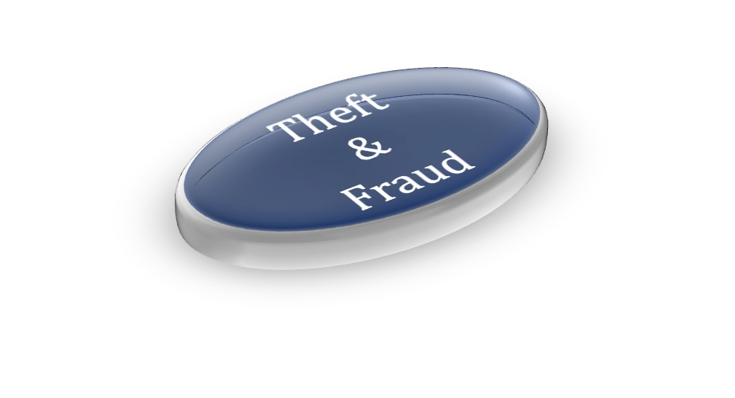
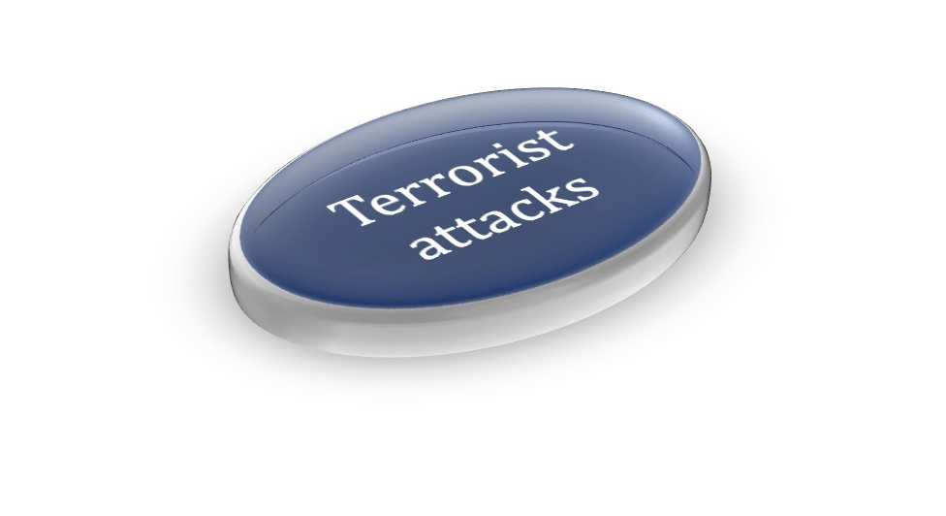

HACKED

Slide 20
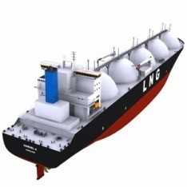
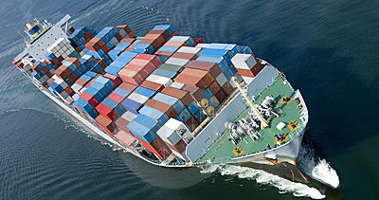
HACKED
GPS SPOOFING
UNAUTHORIZED ACCESS TO ON-BOARD MOBILE DEVICES
MANIPULATION OF BILL OF LADING
SIGNALS JAMMING, MONITORING
TARGETED ACCESS ON AUTOMATED TERMINAL INFRASTRUCTURES (E.G. ELECTRONIC GATES, RFIDS IN CONTAINERS, CAMERAS, SURVEILLANCE SYSTEMS)
SPEAR PHISHING, DOS,…….
SUCCESSFUL ATTACKS: MAERSK, PORT OF BARCELONA US PORTS ( LONG BEACH, SAN DIEGO),
AUSTAL, ROYAL NAVY OF OMAN
HACKED

Slide 21
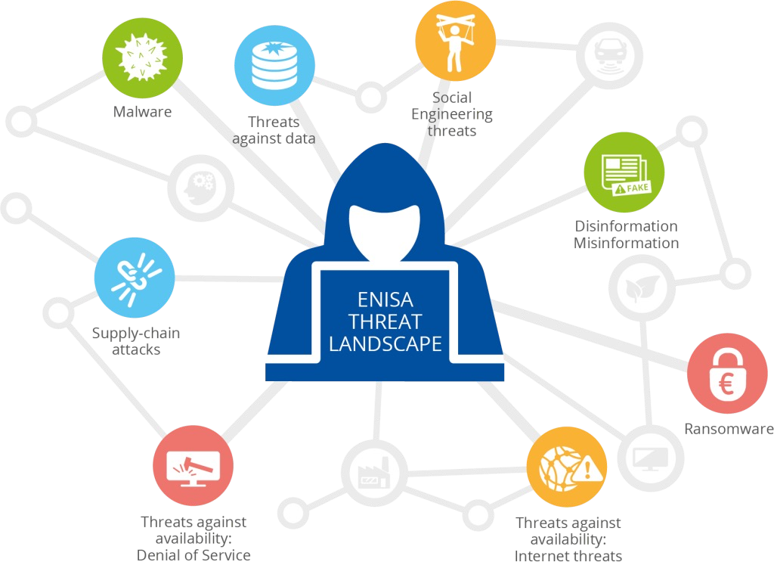
THREAT LANDSCAPE 2022
Source: ENISA 2022

Slide 22
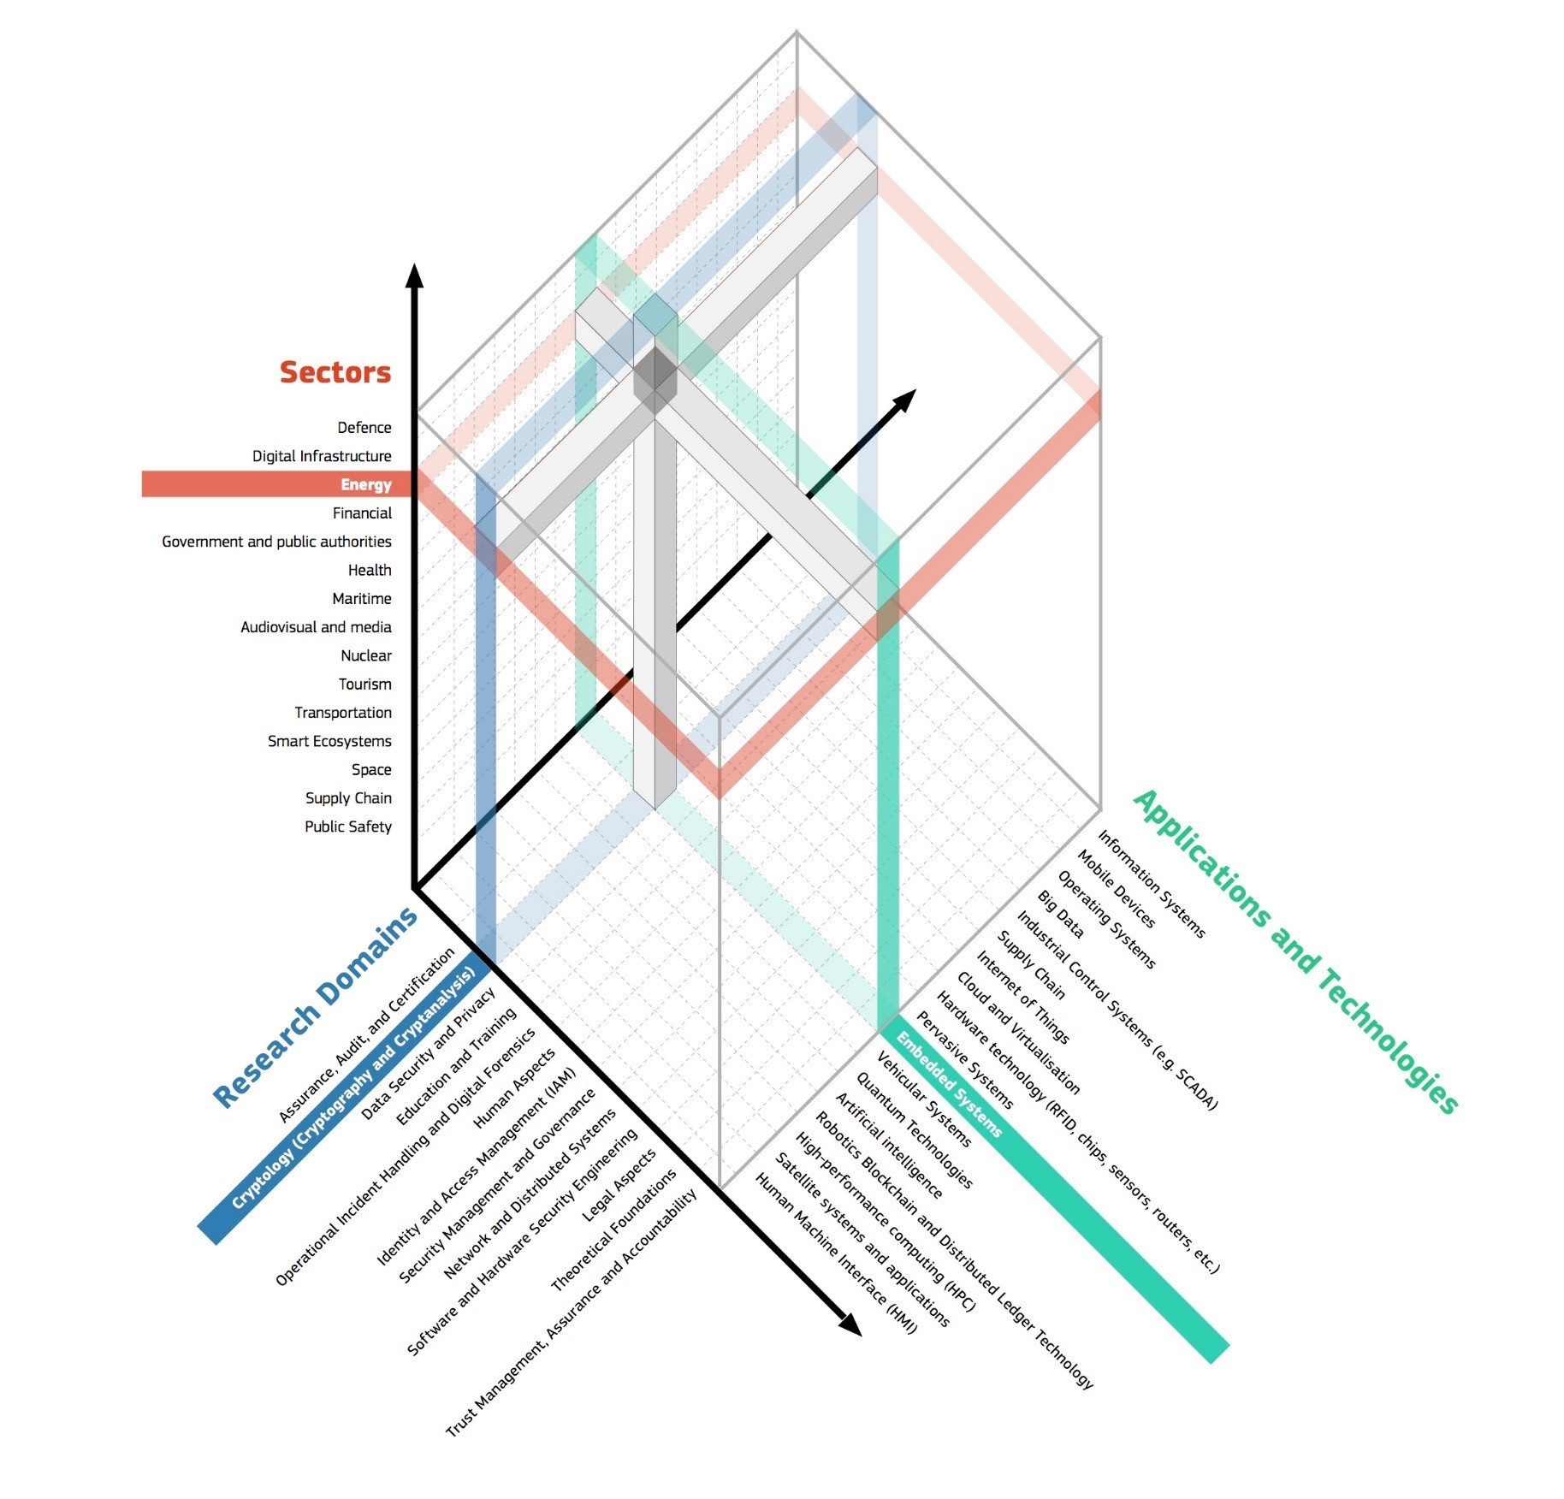
CYBERSECURITY TAXONOMY (JRC/DGCNECT)
Digital signatures
Asymmetric cryptography and cryptanalysis
Symmetric cryptography and cryptanalysis
Hash functions
Key management
Message authentication
Random number generation
Cryptanalysis methodologies
techniques and tools
Quantum cryptology
Post-quantum cryptology
Mathematical
foundations of cryptography

Slide 23
DEFINITIONS
Αsset | Anything that has value to the organization
Threat Threat level Impact level | Potential cause of an unwanted incident, which may result in harm to the ICT system or the organization Frequency of occurrence Consequences of threat (if occurs)
Countermeasure/ Control | The action(s) (software, procedure, technique) to protect an asset from a threat to be exploited
Vulnerability Vulnerability level | A weakness of an asset that can be exploited by the threat How much exposed is the asset(s) to the threat
Risk level | Combination of threat level, impact level and vulnerability level

Slide 24
INTERRELATION OF TERMS
Threats
exploit
Vulnerabilities
increase
increase
compromising
protect against
reduce
Risk
to
Information assets
Controls
met by
increase
have
indicate
Security requirements
Value

Slide 25
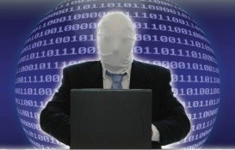
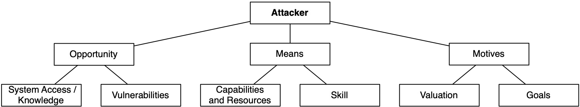
(Source: ENISA 2020)
“attack potential” which is defined in ISO/IEC 18045

Slide 26
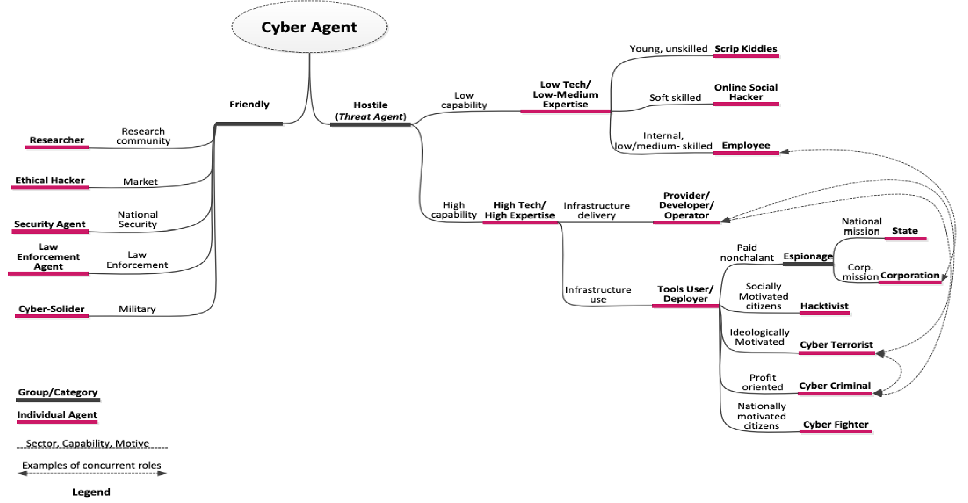
TAXONOMY OF THREAT AGENTS
(Source: ENISA, Marinos 2013)

Slide 27
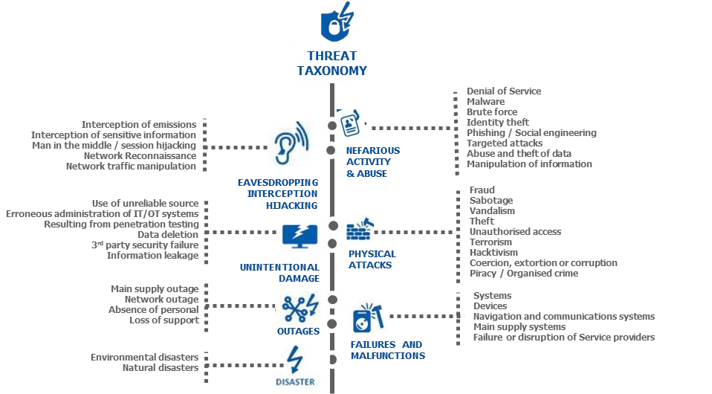
MARITIME CYBER THREAT LANDSCAPE
22 Maritime and Cybersecurity: the work of ENISA

Slide 28
Ransomware | Discovery | People, IT Systems, IT end-devices, Network & Communication Component etc.
 | Lateral Movement | People, IT Systems, data, etc.
 | Collection | Vessel berthing/ Security and safety services, people, support service Temporary storage and staying services Distribution and transfer services, etc.
 | Command and Control | IT Systems, data, Vessel berthing/ loading and unloading services, Distributio and transfer services, Mobile/ Infrastructure, OT Systems & Networks, etc.
 | Exfiltration | IT end-devices, IT systems, Network & Communication Components, o OT Systems & Networks, etc.
 | Impact | IT Systems, IT end-devices, Network & Information and data, etc. | Communication | Component
Malware | Breach on security | IT end-devices, IT systems, Information and Data etc.
Social Engineering | Reconnaissance | People, IT systems, Authorities services, Security services, Security System etc.
 | Resource Development | People, IT systems, Authorities services, Security Systems, Information an Data etc.
 | Initial Access | People, IT / OT Systems etc.
 | Execution | People, IT systems, etc.
 | Resource | IT Systems, Mobile/Fixed Infrastructure, etc.
Threats | Development
against | Defence Evasion | IT systems, IT end-devices, Network & Communication Components, etc.
availability | Impact | IT Systems, Mobile/Fixed Infrastructure, Vessel berthing services, Vess
(DDoS) |  | loading/unloading/Distribution and transfer service
23

Slide 29
WHAT WE MEAN BY CYBER HYGIENE
NO REAL CONSENSUS ON WHAT CYBER HYGIENE MEANS OR HOW CAN BE ACHIEVED.
CYBER HYGIENE IS THE CYBERSECURITY EQUIVALENT TO THE CONCEPT OF PERSONAL HYGIENE IN PUBLIC HEALTH LITERATURE.
ENISA STATES THAT "CYBER HYGIENE SHOULD BE VIEWED IN THE SAME MANNER AS PERSONAL HYGIENE AND, ONCE PROPERLY INTEGRATED INTO AN ORGANIZATION WILL BE SIMPLE DAILY ROUTINES, GOOD BEHAVIORS, AND OCCASIONAL CHECKUPS TO MAKE SURE THE ORGANIZATION'S ONLINE HEALTH IS IN OPTIMUM CONDITION".

Slide 30

WHY IT IS IMPORTANT?
MAINTAIN GOOD CYBER HEALTH
CAN HELP DETECT CERTAIN ISSUES BEFORE THEY EVOLVE TO MORE SERIOUS
CHALLENGING THREAT LANDSCAPE
  LOSS OF DATA
  MISPLACED DATA
  SECURITY BREACHES
PROVIDES A UNIFIED RESPONSE AND CREATES STRONG CULTURE

Slide 31
MAIN CHALLENGES
DIVERSITY OF HARDWARE: COMPUTERS, MOBILE DEVICES, CONNECTED DEVICES, HARD DRIVES, AND CLOUD STORAGE
OUTDATED SOFTWARE: SOFTWARE APPLICATIONS MUST HAVE SECURITY PATCHES APPLIED REGULARLY TO PREVENT KNOWN VULNERABILITIES.
OLD SECURITY SOFTWARE: ANTIVIRUS SOFTWARE AND OTHER SECURITY SOFTWARE MUST BE KEPT UP TO DATE TO KEEP PACE WITH THE EVER-CHANGING THREAT LANDSCAPE.
BAD HABITS: SETTING WEAK PASSWORD, CONVENIENCE OVER SECURITY

Slide 32
WHAT WE MEAN BY CYBER HYGIENE
NO REAL CONSENSUS ON WHAT CYBER HYGIENE MEANS OR HOW CAN BE ACHIEVED.
CYBER HYGIENE IS THE CYBERSECURITY EQUIVALENT TO THE CONCEPT OF PERSONAL HYGIENE IN PUBLIC HEALTH LITERATURE.
ENISA STATES THAT "CYBER HYGIENE SHOULD BE VIEWED IN THE SAME MANNER AS PERSONAL HYGIENE AND, ONCE PROPERLY INTEGRATED INTO AN ORGANIZATION WILL BE SIMPLE DAILY ROUTINES, GOOD BEHAVIORS, AND OCCASIONAL CHECKUPS TO MAKE SURE THE ORGANIZATION'S ONLINE HEALTH IS IN OPTIMUM CONDITION".

Slide 33
WHY IT IS IMPORTANT?
MAINTAIN GOOD CYBER HEALTH
CAN HELP DETECT CERTAIN ISSUES BEFORE THEY EVOLVE TO MORE SERIOUS
CHALLENGING THREAT LANDSCAPE
  LOSS OF DATA
  MISPLACED DATA
  SECURITY BREACHES
PROVIDES A UNIFIED RESPONSE AND CREATES STRONG CULTURE

Slide 34
MAIN CHALLENGES
DIVERSITY OF HARDWARE: COMPUTERS, MOBILE DEVICES, CONNECTED DEVICES, HARD DRIVES, AND CLOUD STORAGE
OUTDATED SOFTWARE: SOFTWARE APPLICATIONS MUST HAVE SECURITY PATCHES APPLIED REGULARLY TO PREVENT KNOWN VULNERABILITIES.
OLD SECURITY SOFTWARE: ANTIVIRUS SOFTWARE AND OTHER SECURITY SOFTWARE MUST BE KEPT UP TO DATE TO KEEP PACE WITH THE EVER-CHANGING THREAT LANDSCAPE.
BAD HABITS: SETTING WEAK PASSWORD, CONVENIENCE OVER SECURITY

Slide 35
MAIN TIPS FOR PERSONAL CYBER HYGIENE
USE THE RIGHT TOOLS FOR CYBER HYGIENE
  INSTALL REPUTABLE ANTIVIRUS AND MALWARE SOFTWARE
  USE NETWORK FIREWALLS
  USE MULTI-FACTOR AUTHENTICATION
  EMPLOY DEVICE ENCRYPTION
BE THOROUGH, BE ACCURATE WITH CYBER HYGIENE
  SET STRONG PASSWORDS
  KEEP YOUR HARD DRIVE CLEAN
  SECURE YOUR ROUTER
MAKE CYBER HYGIENE PART OF YOUR ROUTINE
  UPDATE SOFTWARE REGULARLY
  BACK UP REGULARLY

Slide 36
ORGANISATIONAL CYBER HYGIENE
MUCH LARGER ATTACK OPPORTUNITIES
MORE DIFFICULT CONTROL
POOR OR LACK OF VENDOR RISK MANAGEMENT
BOYD (BRING YOUR OWN DEVICE)

Slide 37
CYBER HYGIENE CHALLENGES FROM BYOD
HEIGHTEN RISK OF DATA LEAKAGE
EXPOSE VULNERABILITIES
COMBINE PERSONAL DATA AND CORPORATE DATA
INCREASE INFILTRATION OF MALWARE
EXPAND IT INFRASTRUCTURE

Slide 38
ENISA
NIST
FIVE KEY CONTROL OBJECTIVES
PROTECT THE PERIMETER
PROTECT THE NETWORK
PROTECT INDIVIDUAL DEVICES
USE THE CLOUD IN A SECURE MANNER
PROTECT THE SUPPLY CHAIN FOUNDATIONAL CYBER HYGIENE TASKS
HAVE A RECORD OF ALL SOFTWARE/HARDWARE SO YOU KNOW WHAT YOUR ESTATE LOOKS LIKE
UTILISE SECURE CONFIGURATION / HARDENING GUIDES FOR ALL DEVICES
MANAGE DATA IN AND OUT OF YOUR NETWORK
SCAN ALL INCOMING EMAILS
MINIMISE ADMINISTRATIVE ACCOUNTS
REGULARLY BACK UP DATA AND TEST IT CAN BE RESTORED
ESTABLISH AN INCIDENT RESPONSE PLAN
ENFORCE SIMILAR LEVELS OF SECURITY ACROSS THE SUPPLY CHAIN
ENSURE SUITABLE SECURITY CONTROLS IN ANY SERVICE
standard set of best practices that every organization should apply:
Know What You Have:
Educate the Human Element:
Assure Data Integrity
Limit the Social Element
Detect and Patch Vulnerabilities
Apply Least Privilege:
Ultimately, organizations should keep in mind that maintaining cyber hygiene is a business problem, not an IT problem.

Slide 39
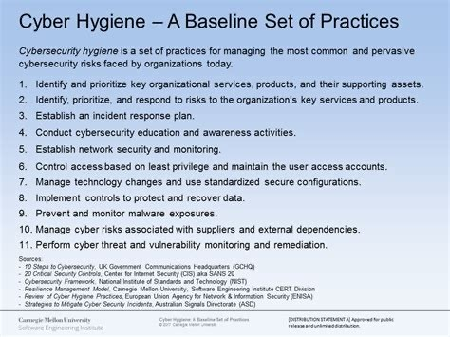

Slide 40
SOME TELEWORKING CYBER HYGIENE ADVICE
USE CORPORATE (RATHER THAN PERSONAL) COMPUTERS
CONNECT TO THE INTERNET VIA SECURE NETWORKS; AVOID OPEN/FREE NETWORKS.
AVOID THE EXCHANGE OF SENSITIVE CORPORATE INFORMATION (E.G. VIA EMAIL) THROUGH POSSIBLY INSECURE CONNECTIONS.
LOCK YOUR SCREEN IF YOU WORK IN A SHARED SPACE
DO NOT SHARE THE VIRTUAL MEETING URLS ON SOCIAL MEDIA OR OTHER PUBLIC CHANNELS
DON’T USE PUBLIC WI-FI
ALWAYS PROTECT YOUR WORK WITH A PRIVACY SCREEN

Slide 41

THANK YOU FOR YOUR ATTENTION
PROFESSOR NINETA POLEMI
DPOLEMI@GMAIL.COM SKYPE: NINETA.POLEMI LINKEDIN: DR NINETA POLEMI

Slide 42

7_2_24, 9:15-9:45, 9:45-11:00
SECURITY MANAGEMENT
CYBERSECURITY RISK MANAGEMENT METHODOLOGY
PROFESSOR NINETA POLEMI
UNIVERSITY OF PIRAEUS, CYBERSECURITY RESEARCH LAB, CTO & CO-FOUNDER OF TRUSTILIO BV
DPOLEMI@GMAIL.COM
, HTTPS://WWW.LINKEDIN.COM/IN/NINETAPOLEMI/

Slide 43
TOPICS
RISK ASSESMENT CONCEPTS
STEP BY STEP RISK ASSESMENT
ISMS
TECHNICAL VOLUNERABILITIES

Slide 44
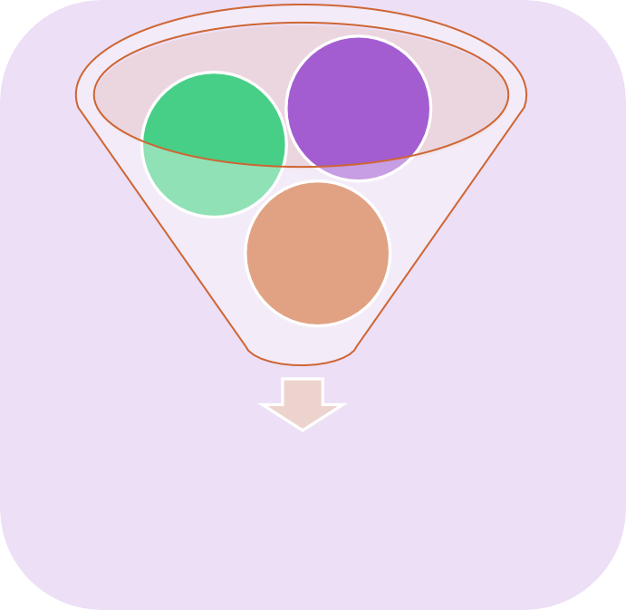

Risk Level
Impact level
Threat Level
Vulnerability Level
Risk Level
Risk Analysis
Countermeasures
Risk Management
Goal of Risk analysis: Assess the risks, i.e. Evaluate Risk levels, R(j,i), of all asset Αj for all possible threats Ti.
Goal of Risk Management: Categorize risks (Risk - reduction/retention/avoidance/transfer); Treat risks i.e. Manage (modify, increase, develop, implement, re-evaluate, ) countermeasures to reach the
“acceptable risk level”.

Slide 45
Security Management (SM)
Risk Management (RM)
Risk Analysis (RA)
Security Reporting
Context Establishment
Risk Identification
Risk Estimation
Risk Treatment
Monitor/Adjust
SLA security management
General considerations
Identification of assets
Selection of risk assessment methodology
Categorize risks
Identification of threats
Basic Criteria
Assessment of threat level
Select countermeasures
Internal/External Audit
Identification of existing countermeasures
Scope & boundaries
Assessment of impact level
Implement countermeasures
Identification of vulnerabilities
Training
Organization for RM
Identification of impacts
Risk level estimation
Evaluate- countermeasures
Recommendations

Slide 46
MARITIME CYBER THREAT LANDSCAPE
41 Maritime and Cybersecurity: the work of ENISA

Slide 47
Ransomware | Discovery | People, IT Systems, IT end-devices, Network & Communication Component etc.
 | Lateral Movement | People, IT Systems, data, etc.
 | Collection | Vessel berthing/ Security and safety services, people, support service Temporary storage and staying services Distribution and transfer services, etc.
 | Command and Control | IT Systems, data, Vessel berthing/ loading and unloading services, Distributio and transfer services, Mobile/ Infrastructure, OT Systems & Networks, etc.
 | Exfiltration | IT end-devices, IT systems, Network & Communication Components, o OT Systems & Networks, etc.
 | Impact | IT Systems, IT end-devices, Network & Information and data, etc. | Communication | Component
Malware | Breach on security | IT end-devices, IT systems, Information and Data etc.
Social Engineering | Reconnaissance | People, IT systems, Authorities services, Security services, Security System etc.
 | Resource Development | People, IT systems, Authorities services, Security Systems, Information an Data etc.
 | Initial Access | People, IT / OT Systems etc.
 | Execution | People, IT systems, etc.
 | Resource | IT Systems, Mobile/Fixed Infrastructure, etc.
Threats | Development
against | Defence Evasion | IT systems, IT end-devices, Network & Communication Components, etc.
availability | Impact | IT Systems, Mobile/Fixed Infrastructure, Vessel berthing services, Vess
(DDoS) |  | loading/unloading/Distribution and transfer service
42

Slide 48












































Asset Interdependencie s
Total Impact Assessment
Pha
Phase 1: Cartography
E-services Criticality
Asset Identification
Phase 2: Impact Assessment
Personal Impact Assessment
Group Impact Assessment
Phase 3: Threat Analysis
Threats Identification
Threat Assessment
Phase 4: Vulnerability Analysis
Theoretical Vulnerability Assessment
Practical Vulnerability Assessment
Risk Level Estimation
Selection of
Final Vulnerability Assessment
Vulnerability Identification
Phase 5: Risk Analysis
Risk Value Calculation
Recommend Countermeasures
Phase 6: Countermeasures
Countermeasures
Phase 7: Security Reporting

Slide 49














Asset Interdependencie s
Phase 1: Cartography
E-services Criticality
Asset Identification
Legal Representative
Legal Representative
Management
1. Critical e-services Identification
2. Participants Identification
3. Users Identification
Administrators
Local Users
5. H/W and S/W Identification/ Dependencies
4. Data assets Identification

Slide 50




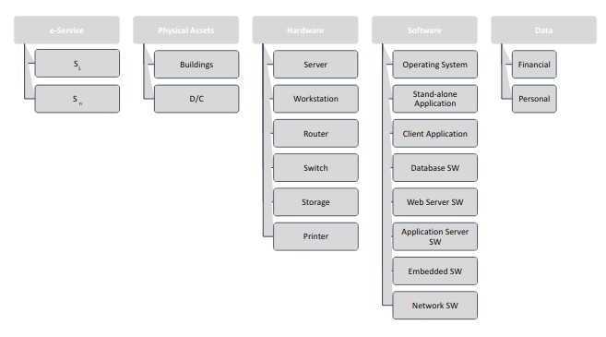
Asset Interdependencie s
Phase 1: Cartography
E-services Criticality
Asset Identification

Slide 51





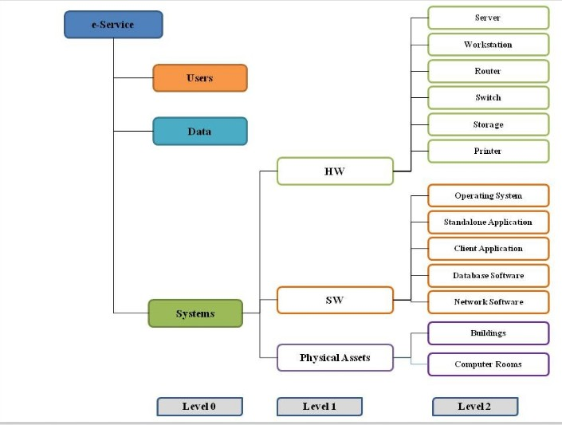
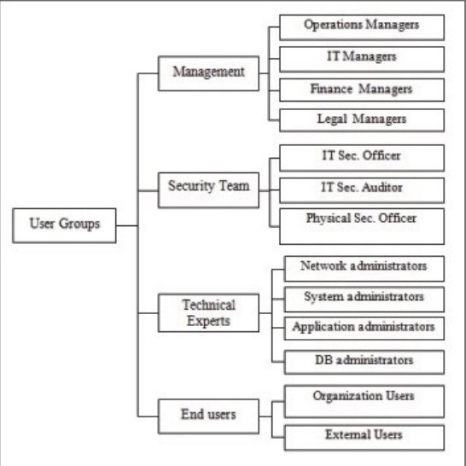
Asset Interdependencie s
Phase 1: Cartography
E-services Criticality
Asset Identification
Asset model
User Model

Slide 52





Total Impact Assessment
Phase 2: Impact Assessment
Personal Impact Assessment
Group Impact Assessment
Impact level | Value | Description | Financial loss
Very High (VH) | 5 | Catastrophic Impact | > 10.000.000 €
High (H) | 4 | Significant Impact | < =10.000.000 €
Medium (M) | 3 | Moderate Impact | <=1.000.000 €
Low (L) | 2 | Low Impact | <= 100.000 €
Very Low (VL) | 1 | Minor Impact | <= 10.000 €

Slide 53






Phase 3: Threat Analysis
Threats Identification
Threat Assessment
Threat level | Description
Very High (VH) | Once every month
High (H) | Once every four months
Medium (M) | Once every year
Low (L) | Once every three years
Very Low (VL) | No more than once every 10 years

Slide 54





Phase 3: Threat Analysis
Threats Identification
Threat Assessment
Threat scale |  |  | Description of threat level
Threat class | Value Range (%) | Defaul t Value (%) | History of incidents | Intuition & knowledge | Social Information
Very High (5) | (80- 100] | 100 | This threat was realized more than once in the last year (12 month period). | This threat is expected to occur within the assets of the business partner with very high probability (more than 80% probability) | This threat is expected to occur within the assets of the business partner with very high probability (more than 80% probability)
High (4) | (60-80] | 80 | This threat was realized once in the last 1 year (12 month period). | This threat is expected to occur within the assets of the business partner with high probability (61-80% probability) | This threat is expected to occur within the assets of the business partner with high probability
 |  |  |  |  | (61-80% probability)
Medium (3) | (40-60] | 60 | More than one incident of this threat was realized in the last 2 years. | This threat is expected to occur within the assets of the business partner with medium probability (41-60% probability) | This threat is expected to occur within the assets of the business partner with medium probability
 |  |  |  |  | (41-60% probability)
Low (2) | (20-40] | 40 | At most one incident of this threat was realized in the last 2 years. | This threat is expected to occur within the assets of the business partner with low probability | This threat is expected to occur within the assets of the business partner with low probability

Slide 55










Practical Vulnerability Assessment
Phase 4: Vulnerability Analysis
Vulnerability Identification
Theoretical Vulnerability Assessment
Final Vulnerability Assessment
Impact level | Description
High (H) | The likelihood of the worst case scenario is > 66%
Medium (M) | The likelihood of the worst case scenario is between 33% - 66%
Low (L) | The likelihood of the worst case scenario is < 33%

Slide 56






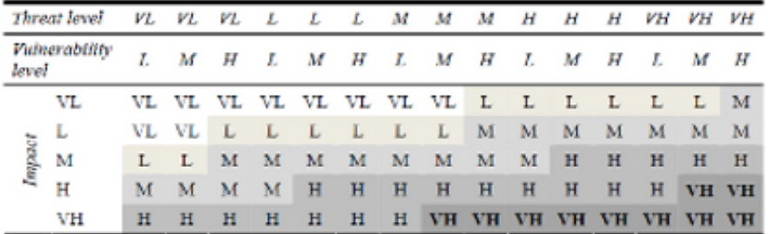
Phase 5: Risk Analysis
Risk Value Calculation
Risk Level Estimation
Impact level | Value | Description
Very High (VH) | 5 | If R ≥ 5.000.000
High (H) | 4 | 150.000 ≤ R < 5.000.000
Medium (M) | 3 | 10.000 ≤ R < 150.000
Low (L) | 2 | 1.000 ≤ R < 10.000
Very Low (VL) | 1 | R < 1.000

Slide 57
SO
Adversary with specific pp
Risk= Threat x Vulnerability x Impact x Adversary’ psychological profile
Depending of his pp he uses
There are therefore 5 essential components of a threat model:
Attack Technique
Adversary (hacker)’s profile
Threat
Attack technique (to exploit the threat) will depend on score of psychological profile (pp) (the one with higher pp score will be capable to
select a sophisticated attack and
Vulnerability (Weakness) I
Impact (Consequences) (higher pp will imply higher impact)
To Exploit:
Vulnerability
Which has consequences that will depend on the pp
(Kioskli, K., Polemi N., 2020)
Impact
On the:
Digita
l asset(s)
or the
entire IT system(s)

Slide 58






Recommend Countermeasures
Phase 6: Countermeasures
Selection of Countermeasures
An RM methodology recommends a large number of appropriate countermeasures for each asset that has been evaluated with Very High (VH) risk in previous Phase 5 or those assets that the members of the Security Team and the Governance decide to protect. The proposed countermeasures are divided into groups according to the type of threats and the assets they are able to protect.

Slide 59

Phase 7: Security Reporting
At this final Phase the following security reports will be generated using the results of all above Phases:
Asset model report
Impact assessment report
Threat assessment report
Vulnerability assessment report.
Risk assessment report- Risk Treatment report
Security Policy

Slide 60
ISMS: a systematic approach for establishing, implementing,
ma
operating, monitoring, reviewing, maintaining and improving an organization’s information security to achieve business objectives. It is based on a risk assessment and the organization’s risk acceptance levels designed to effectively treat and manage risks. Analysing requirements for the protection of information assets and applying appropriate controls (ISO2700X)

Slide 61

SE
ISO 27002 FOR THE IMPLEMENTATION AND MANAGEMENT OF CONTROLS
NIST2020 SECURITY AND PRIVACY CONTROLS FOR ICT SYSTEMS
SANS TOP 20 (20 MOST IMPORTANT CONTROLS)
UCI
CIS CONTROL LIST

Slide 62
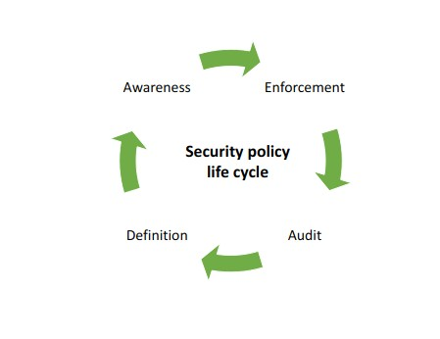
Rules, directives and practices that govern how assets, are managed, protected and distributed within an organization and its ICT systems. [ISO/IEC PDTR 13335-1 (11/2001)].
ity

Slide 63
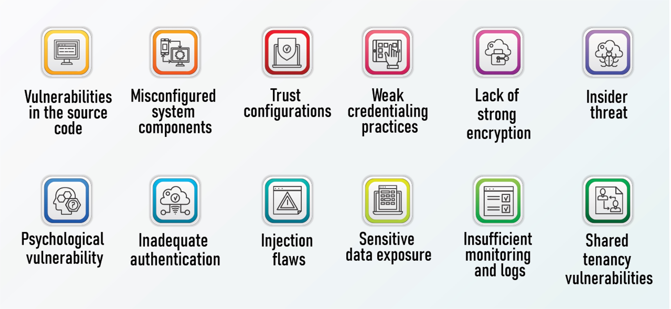
COMMON VULNERABILITIES

Slide 64

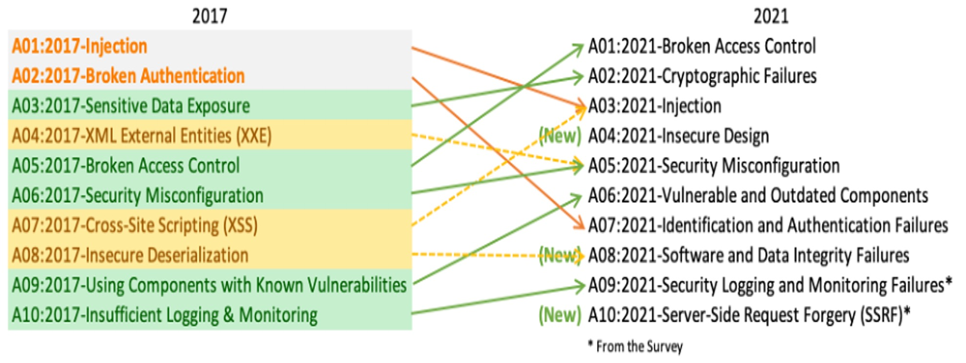
OWASP TOP 10 SECURITY RISKS & VULNERABILITIES
BROKEN ACCESS CONTROL
1.
2. CRYPTOGRAPHIC FAILURES
3.
4.
5.
6.
7. IDENTIFICATION AND AUTHENTICATION FAILURES
8.
9.
INJECTION
INSECURE DESIGN
SECURITY MISCONFIGURATION
VULNERABLE AND OUTDATED COMPONENTS
SOFTWARE AND DATA INTEGRITY FAILURES
SECURITY LOGGING AND MONITORING
FAILURES
10.
SERVER-SIDE REQUEST FORGERY
Last Update September 2021:Details
2022 CWE Top 25 Most Dangerous Software Weaknesses
OWASP top 10 PDF detailed

Slide 65


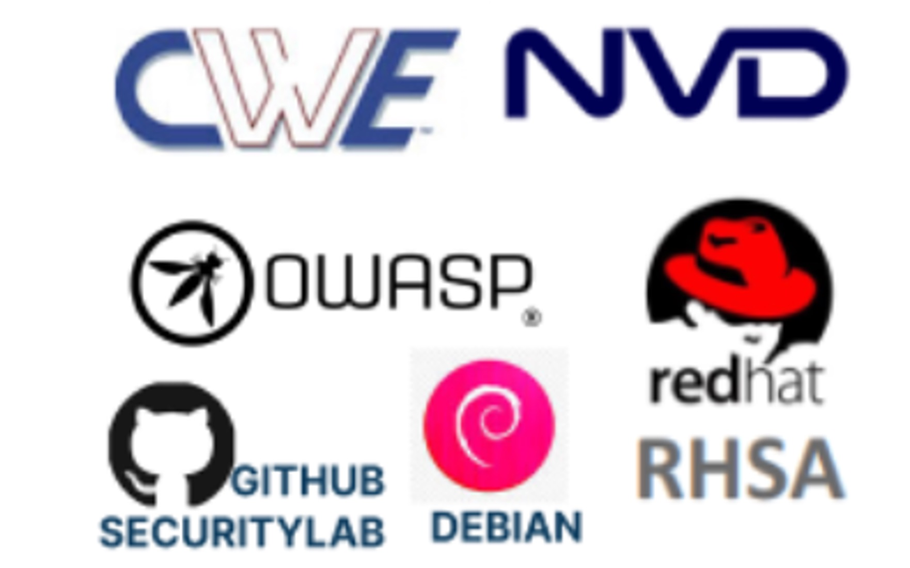
VULNERABILITIES DATABASES AND LISTS
CWE : COMMON WEAKNESS ENUMERATION
A COMMUNITY-DEVELOPED LIST OF SOFTWARE & HARDWARE WEAKNESS TYPES
CVE COMMON VULNERABILITIES ENUMERATION NVD NATIONAL VULNERABILITY DATABASE
OSWAP : THE OWASP TOP 10 IS A STANDARD AWARENESS DOCUMENT FOR DEVELOPERS AND WEB APPLICATION SECURITY. IT REPRESENTS A BROAD CONSENSUS ABOUT THE MOST CRITICAL SECURITY RISKS TO WEB APPLICATIONS.
SECLISTS.ORG SECURITY MAILING LIST ARCHIVE GITHUB SECURITY LAB
DEBIAN
REDHAT RHSA

Slide 66
THANK YOU FOR YOUR ATTENTION
PROFESSOR NINETA POLEMI
DPOLEMI@GMAIL.COM SKYPE: NINETA.POLEMI LINKEDIN: DR NINETA POLEMI

