Slide 1



Topic 8 & 9 EU Cybersecurity governance and regulatory compliance in the energy sector
CyberSecPro: Cybersecurity Essentials and Management for the Energy Sector
Presentation by:
Ric Lugo, Kitty Kioskli, & Paresh Rathod
TalTech, trustilio, Laurea

Slide 2
Acknowledgement
Co-funded by the European Union. Views and opinions expressed are however those of the author(s) only and do not necessarily reflect those of the European Union or HADEA. Neither the European Union nor the granting authority can be held responsible for them.
Project Agreement no. 101083594

Slide 3
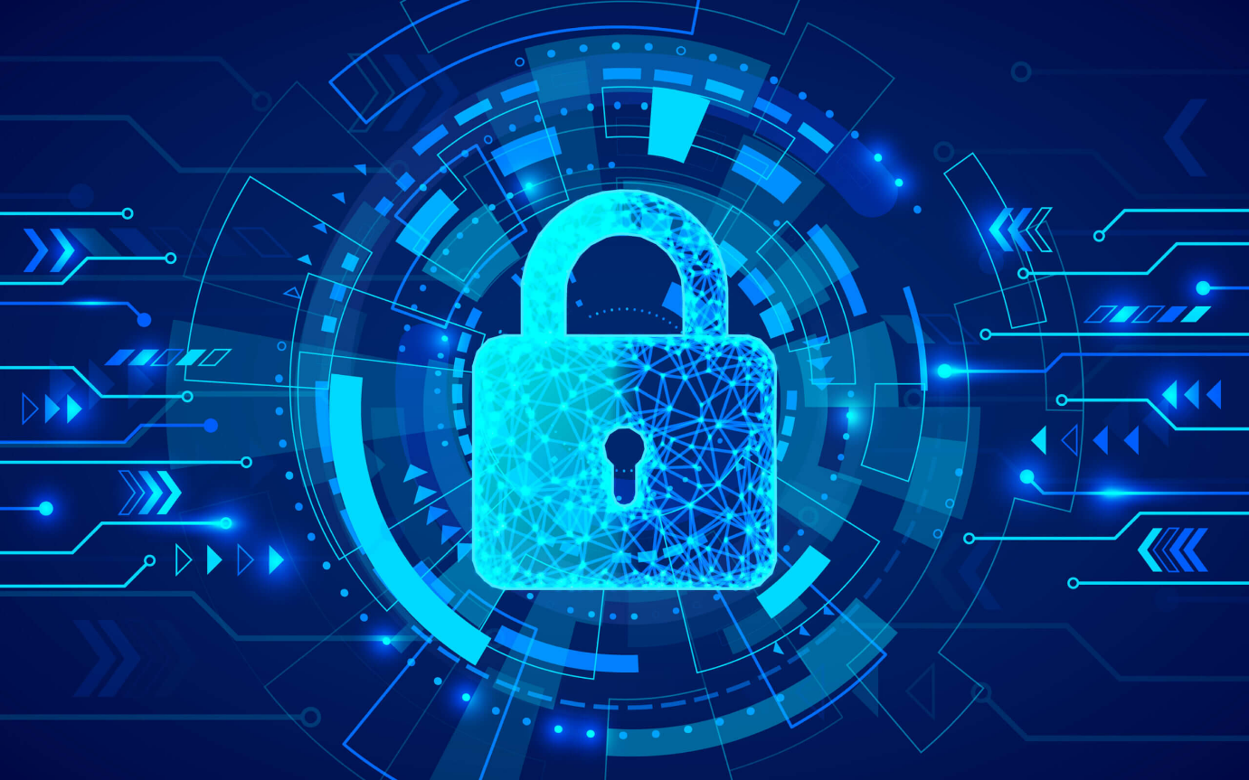
EU Cybersecurity Governance and Regulatory Compliance in the Energy Sector
This training session will:
delve into the critical area of cybersecurity governance and regulatory compliance within the energy sector of the European Union.
explore the evolving regulatory landscape and the key directives and regulations that govern cybersecurity practices in this essential industry.
examine the specific challenges and vulnerabilities facing the energy sector, including critical infrastructure protection, data security, and the increasing reliance on digital technologies.
discuss how EU regulations are designed to address these challenges and promote a secure and resilient energy ecosystem.

Slide 4
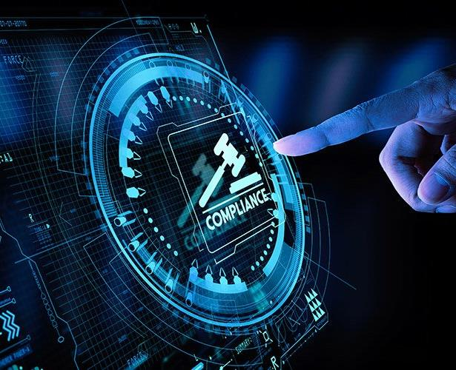
Introduction
The EU has recognized the need for robust cybersecurity measures within the energy sector.
The aim of this session is to provide you with a comprehensive understanding of the EU's cybersecurity strategy, key directives, and best practices for ensuring the security and resilience of energy infrastructure.
We will explore the challenges, solutions, and practical steps that energy companies can take to protect their systems and operations from cyber threats.
Notes:
Welcome to this training session on EU Cybersecurity Governance and Regulatory Compliance in the Energy Sector. The energy sector is a vital component of modern society, and its reliance on digital technologies is increasing. This makes it a prime target for cyberattacks.

Slide 5
Expected Learning Outcomes:
Understand the Critical Importance of Cybersecurity in the Energy Sector
Understand the EU's Cybersecurity Strategy and Regulatory Framework
Identify Specific Cybersecurity Challenges and Vulnerabilities
Understand How Effective Cybersecurity Measures and Best Practices can be Implemented
Comprehend the Role of National and EU Cybersecurity Authorities
Understand Cybersecurity Compliance and Incident Response Requirements
Recognize the Impact of Emerging Technologies on Cybersecurity
Notes:
Welcome to this training session on EU Cybersecurity Governance and Regulatory Compliance in the Energy Sector. The energy sector is a vital component of modern society, and its reliance on digital technologies is increasing. This makes it a prime target for cyberattacks.

Slide 6

Aligning Cybersecurity with Business Objectives
Cybersecurity is not an isolated function. It should be integrated with business objectives, ensuring that security measures are aligned with the organization's strategic goals, operational needs, and risk tolerance.
Companies must consider the impact of cybersecurity on their business operations, financial performance, and reputation, ensuring that security initiatives are aligned with their business priorities.

Slide 7
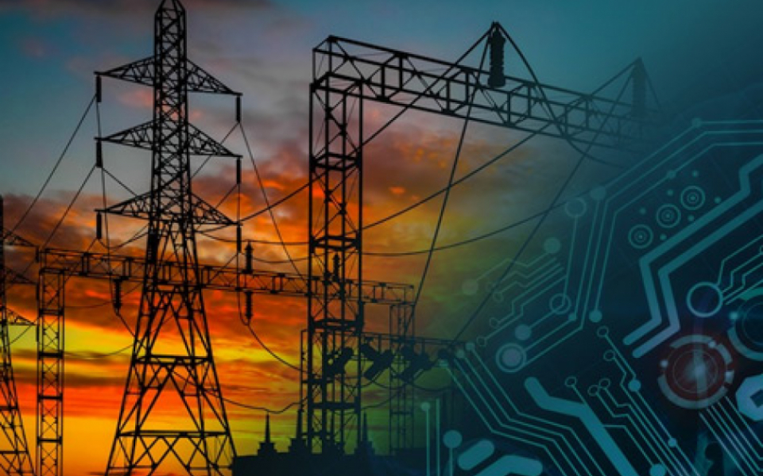
Cybersecurity Landscape in the Energy Sector
The energy sector faces a complex and evolving cybersecurity landscape. Critical infrastructure, including power grids, pipelines, and refineries, are increasingly reliant on digital technologies, creating new vulnerabilities for cyberattacks. These threats can disrupt energy supply, compromise safety, and cause significant economic damage.
Cybercriminals and nation-state actors are actively targeting energy companies, seeking to steal sensitive data, disrupt operations, and cause widespread damage. The energy sector must adopt a proactive and multi-layered approach to cybersecurity, addressing vulnerabilities across the entire value chain, from generation to transmission, distribution, and consumption.

Slide 8
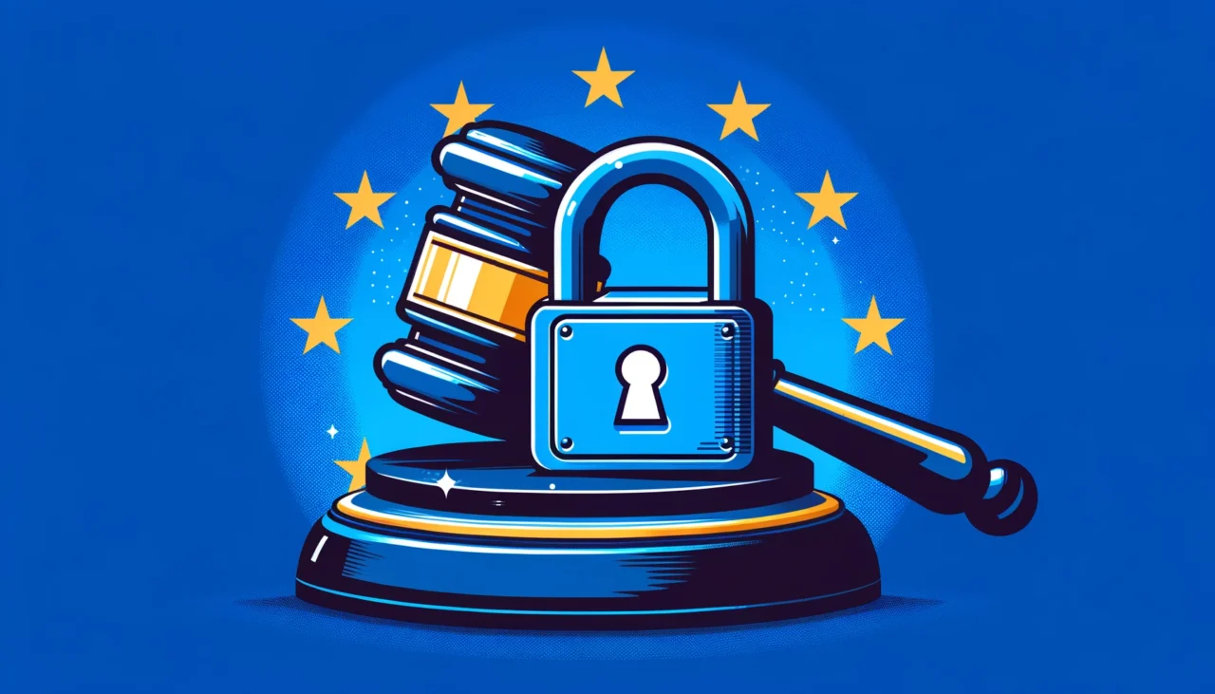
EU Cybersecurity Legislation and Regulations
The EU has adopted a comprehensive cybersecurity strategy to address the growing threats to its critical infrastructure and digital economy. The EU Cybersecurity Strategy outlines a framework for strengthening cybersecurity capabilities across member states, fostering cooperation, and promoting international collaboration.
The EU Cybersecurity Strategy encompasses a range of initiatives, including the development of cybersecurity legislation, the establishment of cybersecurity agencies and centers of expertise, and the promotion of cybersecurity awareness and training programs. The EU is committed to working with industry, academia, and international partners to create a secure and resilient cyberspace.

Slide 9
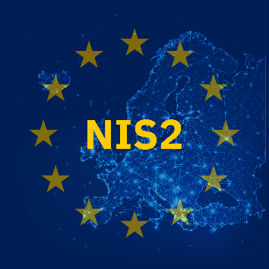
NIS Directive (Network and Information Security Directive)
The NIS Directive, adopted by the European Union in 2016, is a landmark piece of legislation that aims to enhance cybersecurity across critical sectors, including energy, transport, finance, and healthcare.
The Directive establishes a framework for member states to implement national cybersecurity strategies and measures, focusing on risk assessment, incident reporting, and cooperation among stakeholders.
The NIS Directive is designed to improve the resilience of critical infrastructure and services to cyberattacks by promoting a culture of cybersecurity across the energy sector and ensuring the effective sharing of information and best practices.
NIS 2 – October 2024

Slide 10








Slide 11
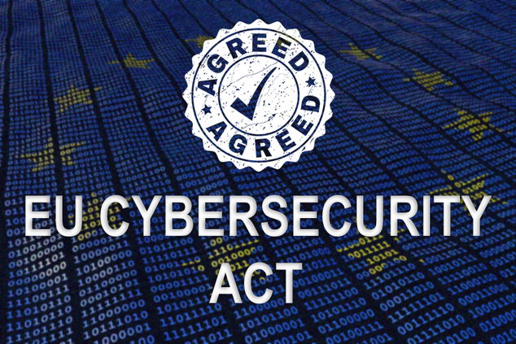
EU Cybersecurity Act
The Cybersecurity Act, adopted by the EU in 2019, complements the NIS Directive and aims to strengthen the EU's cybersecurity capabilities at a collective level. This legislation establishes the European Union Agency for Cybersecurity (ENISA) as the EU's cybersecurity agency, responsible for coordinating cybersecurity efforts across member states.
The Cybersecurity Act also introduces a new framework for cybersecurity certification schemes, allowing for the assessment and certification of cybersecurity products and services, promoting trust and interoperability across the EU. This act, alongside the NIS2 Directive, establishes a comprehensive approach to cybersecurity governance within the EU.

Slide 12

Cyber security objectives (Article 51)
Information security
  To protect data against accidental or unauthorised storage, processing, access, disclosure, destruction, loss, alteration or lack of availability during the entire lifecycle of the ICT product, service or process.
Access control
  That authorised persons, programs or machines are able to access only the data, services or functions to which their access rights refer.
Vulnerability assessment
  To verify that ICT products, services and processes do not contain known vulnerabilities.
User activity monitoring
  To record and make it possible to check which data, services or functions have been accessed, used or otherwise processed, at what times and by whom.
Notes:
International cyber law

Slide 13
Cyber security objectives (Article 51) cont’d
Cyber resilience
  To restore the availability and access to data, services and functions in a timely manner in the event of a physical or technical incident.
Security by design
  That ICT products, services and processes are secure by design and by default.
Patch management
  ICT products, services and processes are provided with up-to-date software and hardware that do not contain publicly known vulnerabilities and are provided with mechanisms for secure updates.

Slide 14

The General Data Protection Regulation (GDPR)
The GDPR is a landmark EU regulation protecting the personal data of individuals within the EU. It applies to all organizations that process the personal data of individuals residing in the EU, regardless of the organization's location.
This regulation mandates data protection principles, such as consent, transparency, and data minimization. It also outlines specific rights for individuals, including the right to access, rectify, and erase their personal data.

Slide 15

EU Cybersecurity Competence Center and Network
The EU Cybersecurity Competence Center and Network plays a vital role in fostering collaboration and knowledge sharing within the energy sector. This network connects national cybersecurity authorities, industry experts, and research institutions across the EU, providing a platform for collaboration, training, and the development of best practices.
The Competence Center provides support and guidance to energy companies on a range of cybersecurity issues, including threat assessment, vulnerability management, and incident response. It also conducts research and development activities to advance cybersecurity capabilities within the energy sector.

Slide 16
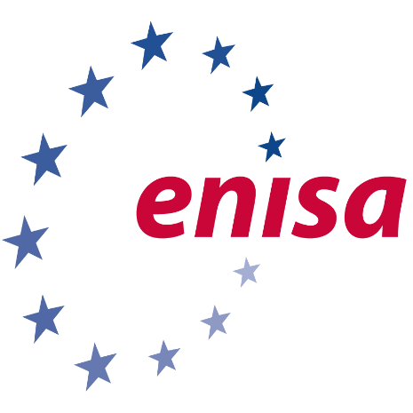
The European Union Agency for Cybersecurity (ENISA)
ENISA is the EU's agency dedicated to supporting cybersecurity in the EU. It provides expertise, guidance, and technical assistance to member states and organizations.
ENISA plays a critical role in promoting a high level of cybersecurity across the EU, fostering cooperation, and strengthening cybersecurity capabilities.

Slide 17
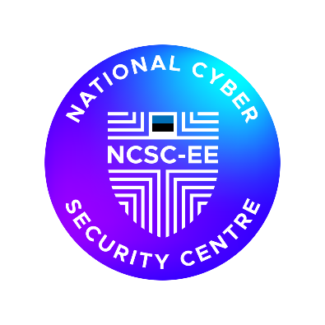
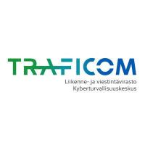
National Cybersecurity Authorities
National Cybersecurity Authorities (NCSAs) are crucial for ensuring cybersecurity in the energy sector. Each EU member state has an NCSA responsible for overseeing cybersecurity within their national borders.
NCSAs work closely with energy companies, providing guidance, conducting audits, and enforcing compliance with EU regulations. They also coordinate with ENISA and other national authorities to address cross-border cybersecurity threats.

Slide 18
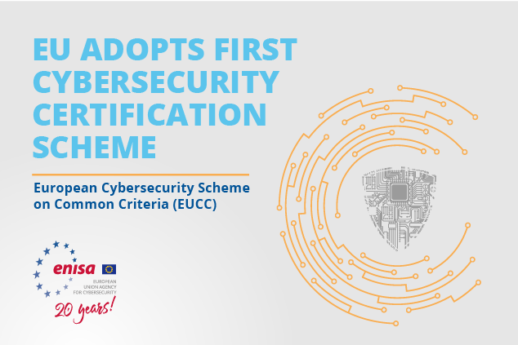
EU cyber security certification framework
Sets EU-wide parameters for the rules, technical requirements, standards and procedures surrounding risk-based certification schemes covering different categories of ICT products, processes and services.
Organisations will be able to obtain certifications that are valid across the EU, reducing the compliance burden on those that currently maintain multiple certifications to meet requirements across different markets.
Cyber security certification will supersede member states’ individual certification schemes from mid-2021, although certificates issued under them will be valid until expiry.

Slide 19

Energy Sector-Specific Cybersecurity Regulations
Beyond broader EU cybersecurity directives, the energy sector faces specific regulations tailored to its unique vulnerabilities and criticality. These regulations address the specific risks of disruptions to electricity and gas supply, ensuring the resilience of energy infrastructure and its continued functioning.
These regulations encompass various aspects of cybersecurity, including incident reporting, vulnerability management, and secure network design. They mandate robust security measures, such as access control, identity management, and data protection, to protect sensitive information and critical systems from cyberattacks.
Paresh Rathod & Cristina Alcaraz
Laurea, Finland & Uni. Of Malaga, Spain

Slide 20

What does this mean for Energy Sector
Real-time requirements
  Some energy systems need to react so fast that standard security measures, such as authentication of a command, or verification of a digital signature, can simply not be introduced due to the delay these measures impose.
Cascading effects
  Electricity grids and gas pipelines are strongly interconnected across Europe and well beyond the EU. An outage in one country might trigger blackouts or shortages of supply in other areas and countries.
Combined legacy systems with new technologies
  Many elements of the energy system were designed and built well before cybersecurity considerations came into play. This legacy now needs to interact with the most recent state-of-the-art equipment for automation and control, such as smart meters or connected appliances, and devices from the 'Internet of Things' without being exposed to cyber-threats.
Clean Energy for all Europe (219)
Paresh Rathod & Cristina Alcaraz
Laurea, Finland & Uni. Of Malaga, Spain
Notes:
n 2019 the EU overhauled its energy policy framework to help us move away from fossil fuels towards cleaner energy - and, more specifically, to deliver on the EU’s Paris Agreement commitments for reducing greenhouse gas emissions.
The agreement on this new energy rulebook – called the Clean energy for all Europeans package – marked a significant step towards implementing the energy union strategy, published in 2015.
Based on Commission proposals published in 2016, the package consists of 8 new laws. Following political agreement by the EU Council and the European Parliament (finalised in May 2019) and the entry into force of the different EU rules, EU countries have 1-2 years to convert the new directives into national law.

Slide 21


The Electricity Directive
The Gas Directive
The Electricity Directive is a key piece of EU legislation governing the electricity market.
It aims to promote competition, security of supply, and environmental sustainability in the electricity sector
The Gas Directive aims to ensure a competitive and secure supply of natural gas in the EU, while promoting the integration of renewable energy sources.

Slide 22
Electricity Directive (EU) 2019/944
The Electricity Directive (EU) 2019/944 is a key EU regulation that directly addresses cybersecurity in the electricity sector. This directive establishes a framework for enhancing the resilience of electricity systems against cyberattacks, ensuring the secure and reliable operation of the European power grid.
The directive sets out specific requirements for electricity companies and system operators, including robust security measures, incident reporting, and cooperation with national authorities. These requirements aim to minimize the risk of disruptions to electricity supply and protect the integrity of critical energy infrastructure. The directive also emphasizes the need for continuous improvement and adaptation to evolving cybersecurity threats.

Slide 23

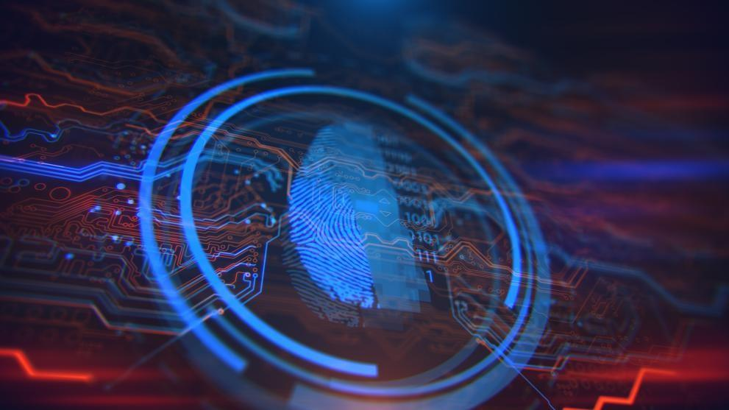
Network code on cybersecurity for the electricity sector (C/2024/1366)
Network code on cybersecurity for the electricity sector (C/2024/1366) – May 2024
Sector-specific rules for cyber security aspects of cross-border electricity flows, including on common minimum requirements, planning, monitoring, reporting and crisis management.
Establishes a recurrent process of cybersecurity risk assessments in the electricity sector.
  systematically identify the entities that perform digitalised processes with a critical or high impact on cross-border electricity flows, their cybersecurity risks and the necessary mitigating measures that need to be implemented.
Governance model to develop, follow and regularly review the methodologies used by stakeholders to promote a harmonised approach in the rapidly evolving knowledge field.

Slide 24

Gas Directive (EU) 2019/692
The Gas Directive (EU) 2019/692 aligns with the EU's broader cybersecurity strategy, specifically targeting the natural gas sector. This directive aims to ensure the secure and reliable operation of the European gas infrastructure by addressing cybersecurity risks.
The Gas Directive, similar to the Electricity Directive, mandates robust security measures for gas companies and operators. These requirements cover aspects like incident reporting, vulnerability management, and secure network design, promoting the resilience of gas infrastructure against cyberattacks. This directive complements the NIS Directive, reinforcing cybersecurity governance within the energy sector.

Slide 25
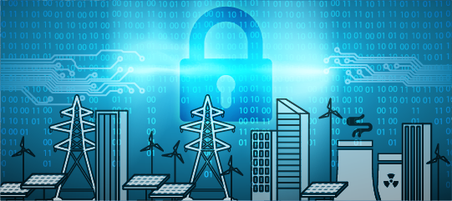
Cybersecurity Requirements for Energy Infrastructure
The energy sector's critical infrastructure demands robust cybersecurity measures to safeguard its operations. These requirements encompass multiple facets, including physical security, data protection, and network resilience. Energy companies must implement a comprehensive approach to protect their assets and ensure the continuity of essential services.
Cybersecurity requirements for energy infrastructure extend beyond traditional IT security measures, encompassing the entire value chain, from generation and transmission to distribution and consumption. These requirements aim to mitigate risks posed by cyberattacks, ensuring the stability and integrity of the energy grid, safeguarding critical systems, and protecting sensitive data.

Slide 26
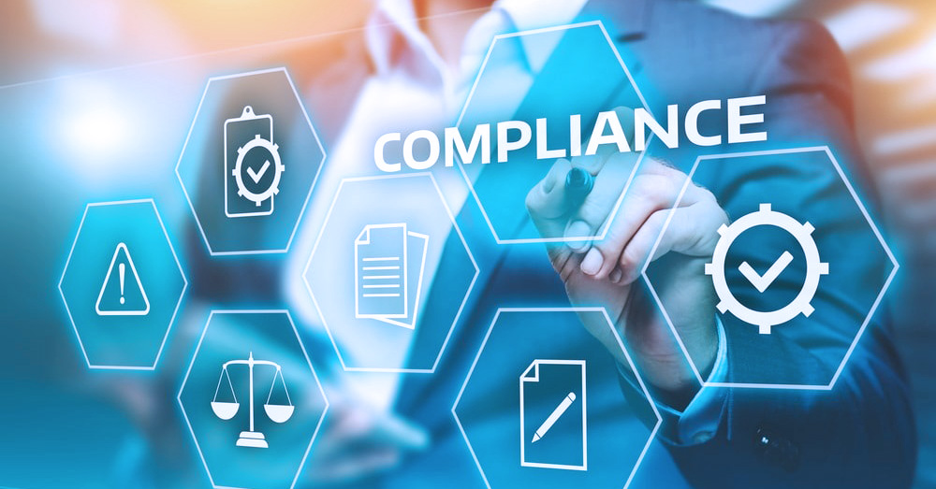
Compliance Challenges for Energy Companies
Energy companies face significant challenges in complying with EU cybersecurity regulations. The evolving nature of these regulations, the complexities of interconnected systems, and the need to balance security with operational efficiency present a formidable task.

Slide 27
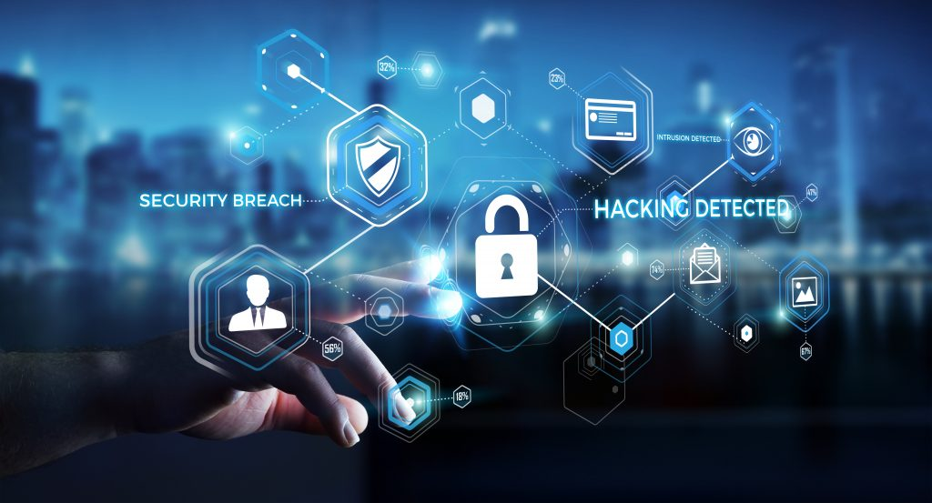
Identifying and Assessing Cybersecurity Risks
Identifying and assessing cybersecurity risks is crucial for energy companies to understand their vulnerabilities and develop effective mitigation strategies.
A comprehensive risk assessment process involves identifying potential threats, analyzing their likelihood and impact, and prioritizing vulnerabilities based on their criticality.

Slide 28

Implementing Appropriate Security Measures
Implementing appropriate security measures is critical for energy companies to protect their critical infrastructure and data. These measures should be tailored to the specific risks identified in the risk assessment process.
They should cover a wide range of areas, including physical security, network security, data security, and user access control.

Slide 29
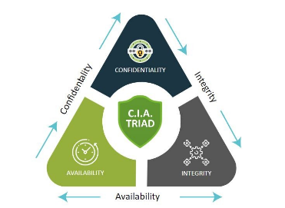
Securing the Energy Sector: The CIA Triad
Confidentiality
What?
  Protecting sensitive information related to energy production, distribution, and consumption from unauthorized access ensures that critical infrastructure is not compromised by malicious actors..
Why?
  Safeguarding proprietary technologies, customer data, and operational details from cyber espionage and theft..
How?
  Utilize encryption, access controls, and secure communication channels.

Slide 30
Securing the Energy Sector: The CIA Triad
Integrity
What?
  Maintaining the accuracy, trustworthiness, and reliability of data is essential to ensure that the energy systems operate correctly.
Why?
  Trustworthy energy supply, reliable communication and any alteration or corruption of data could lead to incorrect decision-making, operational failures, and potentially catastrophic outcomes, such as grid failures or unsafe operating conditions.
How?
  Implement data validation checks, and regular audits, and secure energy delivery.

Slide 31
Securing the Energy Sector: The CIA Triad
Availability
What?
  Ensuring that energy services are continuously available is vital for both economic stability and public safety.
Why?
  Energy systems must be resilient to cyber-attacks, natural disasters, and equipment failures to prevent disruptions that could have widespread impacts on other sectors and daily life..
How?
  Maintain redundant systems, ensure network reliability, and conduct regular system maintenance.

Slide 32
Securing the Energy Sector: The CIA Triad: Challenges
Legacy Systems: Many energy infrastructures rely on outdated technology that lacks modern security features, making them vulnerable to attacks
Complex and Interconnected Networks: The integration of various systems and networks increases the attack surface and complexity of securing the entire infrastructure.
Sophisticated Attacks: Cyber-attacks are becoming more sophisticated, with advanced persistent threats (APTs) targeting critical infrastructure.
Insider Threats: Employees or contractors with access to systems can unintentionally or maliciously compromise security.
Regulatory and Compliance Issues: Keeping up with evolving regulations and ensuring compliance can be challenging and resource-intensive.
Resource Constraints: Limited budgets and skilled cybersecurity professionals can hinder the implementation of robust security measures.Facing threats like cyber-attacks and environmental hazards.

Slide 33
Securing the Energy Sector: The CIA Triad: Solutions
Modernizing Infrastructure: Upgrading legacy systems to incorporate modern security protocols and technologies to reduce vulnerabilities.
Implementing Strong Access Controls: Using multi-factor authentication, role-based access controls, and regular audits to limit and monitor access to critical systems.
Regular Security Assessments and Penetration Testing: Conducting frequent security evaluations and tests to identify and remediate vulnerabilities.
Employee Training and Awareness: Educating employees about cybersecurity best practices and recognizing potential threats to minimize insider risks.
Incident Response Planning: Developing and regularly updating incident response plans to quickly and effectively respond to cyber-attacks.
Collaboration and Information Sharing: Working with industry peers, government agencies, and cybersecurity organizations to share threat intelligence and best practices.
Regulatory Compliance: Ensuring adherence to industry standards and regulations (National and EU)
Investment in Cybersecurity Technologies: Utilizing advanced cybersecurity tools such as intrusion detection systems, firewalls, and encryption to protect networks and data.
Notes:
The CIA Triad is integral to the security and efficiency of the energy sector.
Commitment to these principles ensures a resilient energy sector.

Slide 34
Cyber Risk Management
Proactive
Identify
  The Identify Function assists in developing an organizational understanding of the managing of the cybersecurity risks to systems, people, assets, data, and capabilities.
Protect
  The Protect Function outlines appropriate safeguards to ensure the delivery of critical infrastructure services. The Protect Function supports the ability to limit or contain the impact of a potential cybersecurity event.
Detect
  The Detect Function defines the appropriate activities to identify the occurrence of a cybersecurity event. The Detect Function enables the timely discovery of cybersecurity events.
Respond
  The Respond Function includes appropriate activities to take action regarding a detected cybersecurity incident. The Respond Function supports the ability to contain the impact of a potential cybersecurity incident.
Recover
  The Recover Function identifies appropriate activities to maintain plans for resilience and to restore any capabilities or services that were impaired due to a cybersecurity incident. The Recover Function supports the timely recovery to normal operations, thus reducing the impact of a cybersecurity incident
Responsive

Slide 35
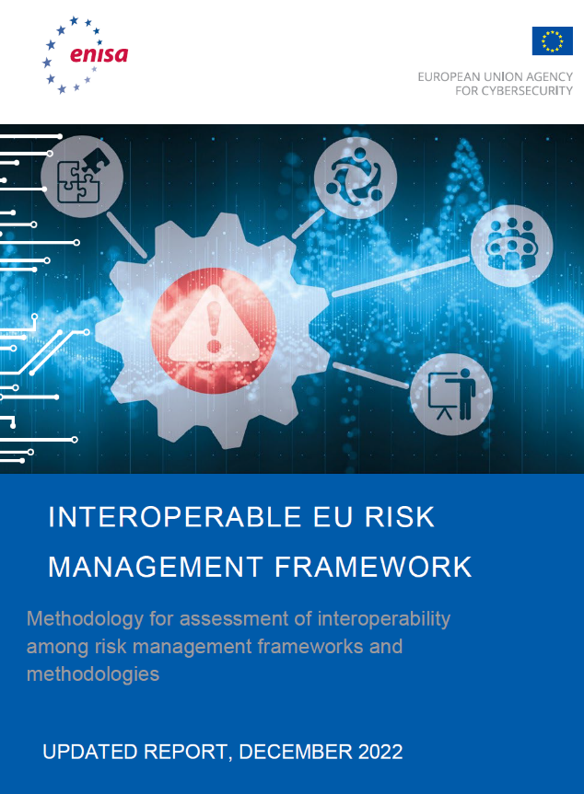
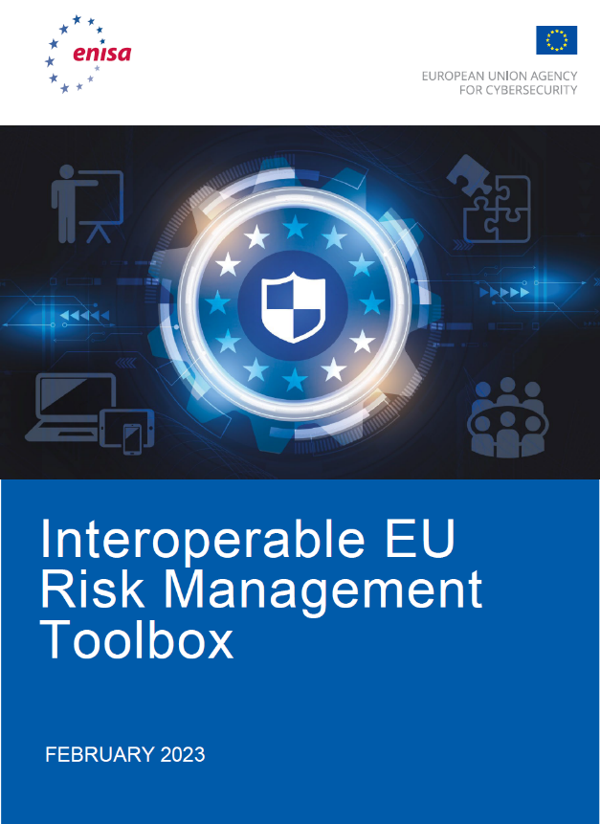

Slide 36
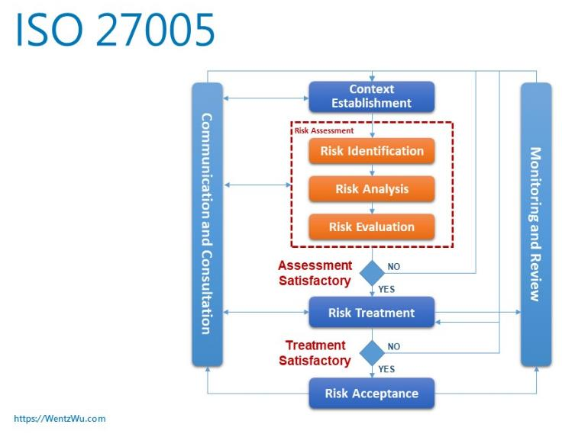
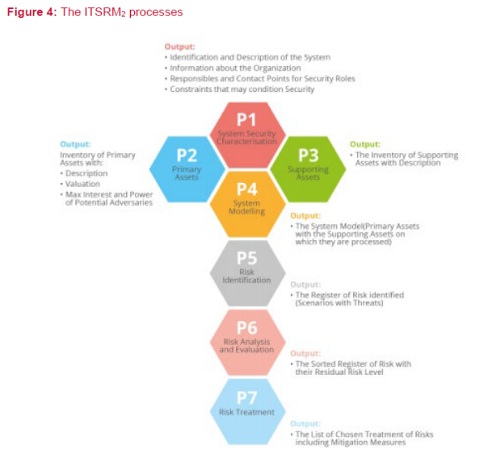
Interoperable Risk Management
Notes:
Risk Monitoring is a process that, although essential for efficient risk management, is independent of the rest of the phases and can typically be conducted using any assessment methodology, process or tool. Overall, there are many characteristics (governance, compliance, privacy) that constitute integral parts of risk frameworks but not all of them affect interoperability
ISO 27005, EU ITSRM2
Risk Identification (Assets, Threats and Vulnerabilities)
Risk Assessment (Risk Calculation and Evaluation),
Risk Treatment (Selection and Implementation of Security Controls, and Calculation of Residual Risk),
Risk Monitoring (Assess effectiveness of measures and monitor risks).
Risk Identification: risk management frameworks are considered interoperable if they can use each other’s asset taxonomy and valuation, threat and vulnerability catalogues, with equivalent results and without negatively affecting subsequent steps. At this level we consider the following features:
o Asset Taxonomy: it indicates whether the framework or methodology requires the use of a specific asset taxonomy.
o Asset Valuation: it indicates whether the framework or methodology requires the use of a specific asset valuation method.
o Threat catalogues: these indicate whether the framework or methodology requires the use of a specific set of threats.
o Vulnerability catalogues: these indicate whether the framework or methodology requires the use of a specific catalogue of vulnerabilities.
• Risk Assessment: risk management frameworks are considered interoperable if they use the same methodology for risk assessment, or their methods can provide results that can be easily mapped to the results of other frameworks. At this level we consider the following features:
o Risk Calculation method: it provides information about the method used for risk calculation. e.g. Risk = Impact x Likelihood; Risk = Impact x Threat Likelihood x Vulnerability Level.
• Risk Treatment: risk management frameworks are considered interoperable if they result in the same set of measures or a set of measures with an equal contribution to reducing levels of risk. At this level we consider the following features:
o Measures catalogue: it indicates whether the framework or methodology requires the use of a specific catalogue of measures. If so, it also considers whether the two catalogues can be mapped to each other.
o Residual Risk Calculation: it considers the chosen measures to evaluate the remaining levels of risk. This process is typically affected by both the risk calculation method and the impact of the chosen security measure(s) on a risk scena

Slide 37
Interoperable Risk Management
Notes:
P1 SYSTEM SECURITY CHARACTERISATION - gather initial information concerning the system and its context, which will be used for the rest of the RM processes. The output of this process includes a high-level description of the system and the organisation, the contact points for security roles, any constraints for security requirements and any mandatory security measures that result from these requirements. is mapped with the ISO 27005 step Context Establishment.
PROCESSES P2 PRIMARY ASSETS AND P3 SUPPORTING ASSETS -identify the Data and Functions (considered as Primary Assets) that are crucial for the organisation to achieve its business objectives, determine their value (from a business perspective) as well as their attractiveness for potential adversaries (combination of the power and interest of potential adversaries that can be motivated by threatening the Primary Asset). is to identify and register the Supporting Assets employed (inventory of hardware and software, a high-level design, an architectural diagram etc.) for the management of the primary assets (Data and Functions provided by the target system). This process is part of the Risk Identification step of ISO 27005.
PROCESS P4 SYSTEM MODELLING - develop a model of a system in terms of associations between primary and supporting assets, data flows, and system architecture. This process is part of the Risk Identification step of ISO 27005.
PROCESS P5 RISK IDENTIFICATION – This process is part of the Risk Identification step of ISO 27005. Its task is to build the risk scenarios that will be analysed. The risk scenarios are used to represent the risks for the organisation and the Primary assets regarding the consequences of potential threats in relation to the confidentiality, integrity and availability of the Supporting Assets. the system model will provide useful information in order to identify which threats are most likely to occur for each triplet ‘Primary Asset / Security Dimension (CIA) / Supporting Asset’. Provide a list of risk scenarios that will be evaluated in P6 Risk Analysis and Evaluation.
PROCESS P6 RISK ANALYSIS AND EVALUATION - the computation of the residual risk level for each risk identified in P5 Risk Identification, based on the list of Security Measures identified to mitigate these risks. The P6 Risk Analysis and Evaluation process uses as input the Primary asset inventory (from P2), the risk scenarios (from P5), the catalogue of threats, the risk scale, the treatment register (from P7, if it exists from past RMs), and the security measures register (from P7, if it exists from past RMs). The output of the P6 Risk Analysis and Evaluation process is the risk register which guides decisions on the treatment of risk. For the analysis of risk, the analyst takes into consideration the likelihood of threats (based on types of threats and potential adversaries, provided by the methodology) and the consequences of a potential incident in a risk matrix. This stage is mapped with the ISO 27005 Risk Analysis and Risk Evaluation processes.
PROCESS P7 RISK TREATMENT - The objective of P7 Risk Treatment is the selection of the risk treatment options that are most appropriate for handling the risks identified taking into consideration the constraints on the organisation. Risk mitigation, avoidance, sharing or acceptance are considered as potential options for treatment. The process takes the results from the previous processes as input and the catalogue of security measures provided by the framework. The process results in a risk treatment register that gathers all the information related to the risk treatment options and applicable security measures if mitigation is chosen.
The process is mapped with the Risk Treatment step of ISO 27005

Slide 38




Slide 39
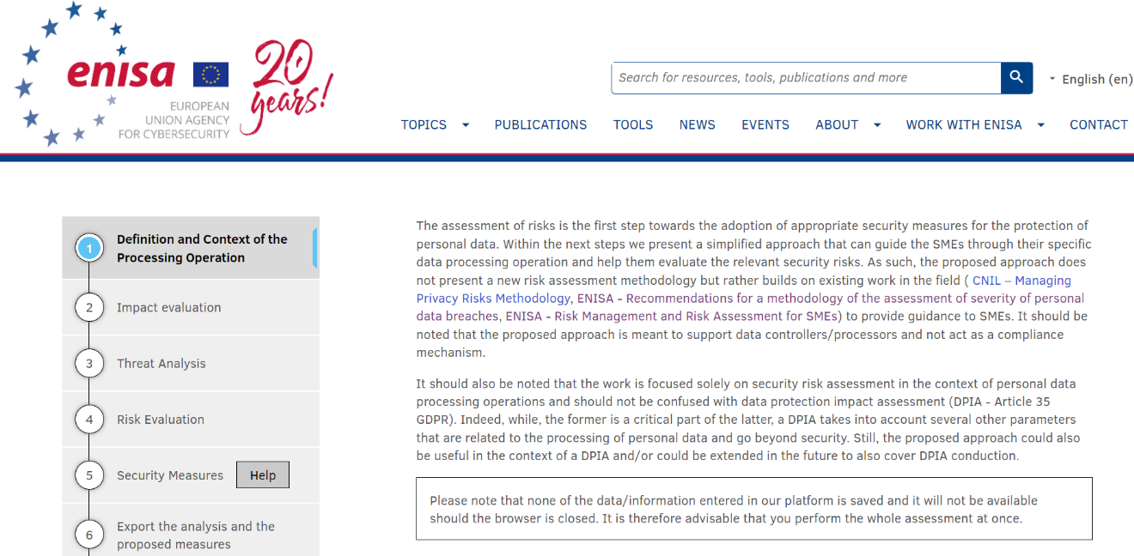
ENISA Tool
https://www.enisa.europa.eu/risk-level-tool/risk

Slide 40
Section V
Security policy and procedures for the protection of personal data
Roles and responsibilities
Access control policy
Resource/asset management
Change management
Data processors
Incidents handling / Personal data breaches
Business continuity
Confidentiality of personnel
Training
Access control and authentication
Training
Access control and authentication
Logging and monitoring
Server database security
Workstation security
Network/communication security
Back-ups
Application lifecycle security
Data deletion/disposal
Physical security

Slide 41

Supply Chain Attacks
Supply chain attacks are cyber attacks against third-party vendors in an organization’s supply chain. Historically, supply chain attacks were targeted at trust relationships, where insecure suppliers in the chain were attacked to gain access to their larger partners.
Software supply chains are highly susceptible to attack, because in modern development organizations, software is not created from scratch, and uses many off-the-shelf components such as third-party APIs, open source code, and proprietary code from software vendors. Any of these could be exposed to security threats and vulnerabilities.
A software supply chain attack might inject malicious code into an application and infect all users of the application, while a hardware supply chain attack compromises physical components and uses them to infiltrate an organization’s systems.
3rd party risk management

Slide 42
Supply Chain Risk
Disruptions from natural disasters: Hurricanes, earthquakes, and floods can disrupt supply chains by damaging infrastructure, disrupting transportation routes, and causing delays or disruptions in production.
Geopolitical risks: Political instability, trade wars, and sanctions can impact supply chains by causing delays or disruptions in the movement of goods or by creating uncertainty about future trade relationships.
Cybersecurity risks: Cyberattacks can compromise the security of supply chain data and disrupt operations by causing system failures or data breaches.
Supplier bankruptcy or financial instability: If a supplier goes bankrupt or experiences financial instability, it can disrupt the supply chain by causing delays or shortages of key components or materials.
Quality issues: Quality issues with materials or products can lead to delays or disruptions in production, as well as damage to a company's reputation.
Labor disputes: Labor disputes, including strikes or protests, can disrupt the supply chain by causing delays or shutdowns of production facilities or transportation routes.
Transportation disruptions: Port closures or port congestions, trucking strikes, or fuel shortages, can impact the movement of goods and cause delays or disruptions in the supply chain.

Slide 43
Step 1: Recognize, Map, and Prioritize the Supply Chain Threat Landscape
Assess all possible risks. I
  understanding the supply chain
  key components by inventorying suppliers and assessing their security posture.
  Group vendors into risk profiles
  Prioritize each third party by their vulnerability level, access to your data and systems, and impact on your organization
  Use questionnaires and on-site visits to assess supply chain security
  Identify the weakest areas in the supply chain and supplement these vendors or ask them to improve their security
  Assess the safety of hardware and software products supplied to your organization
  Identify the processes in the supply chain that pose a threat to sensitive data and systems and determine suitable security measures

Slide 44
Step 2: Create a Multifaceted Supply Chain Security Strategy
Supply chain attacks can have various objectives, including ransom, sabotage, and intellectual property theft. These attacks can take many forms, such as malicious code injections into legitimate software, hijacking software updates, and attacks on IT and operational technologies.
Supply chain attacks can exploit vulnerabilities in:
  The physical flow of assets — Including processing, packaging, and distribution processes.
  The virtual flow of data or software — All virtual flows across connected systems and devices.

Slide 45
Step 3: Manage Remote Work Endpoint Risk
Organizations are exposed to risks caused by the unauthorized behaviours of their supplier’s employees.
Common risks include device loss or theft, employees downloading sensitive data without offline protections, or introducing shadow IT applications, keyloggers, files, and various persistent threats.
Traditional security tools, like virtual private networks (VPNs) and virtual desktop infrastructure (VDI), cannot effectively protect organizations and mitigate these threats. These tools rely on end-users to follow security policies before and after they connect to secured networks. Organizations and supply chain leaders must monitor how remote employees use their devices to protect the supply chain.

Slide 46
Step 4: Continuously Monitor Third-Party Risks
Identify the most valuable corporate assets, so that an effective program can prioritize what needs to be defended.
  Sroprietary information, customer information, and intellectual property,
Pinpointing attack motivations and sensitive assets can help determine:
  Systems and areas of the supply chain that require protection and how to prioritize cybersecurity investments.
Continuous supply chain protection should help uncover evidence of activity already occurring, gain deep visibility, and identify gaps in the organization’s ability to detect these activities
Notes:
Pt“2: You can implement various measures, including threat hunting, centralized log aggregation, and sensor deployment.

Slide 47
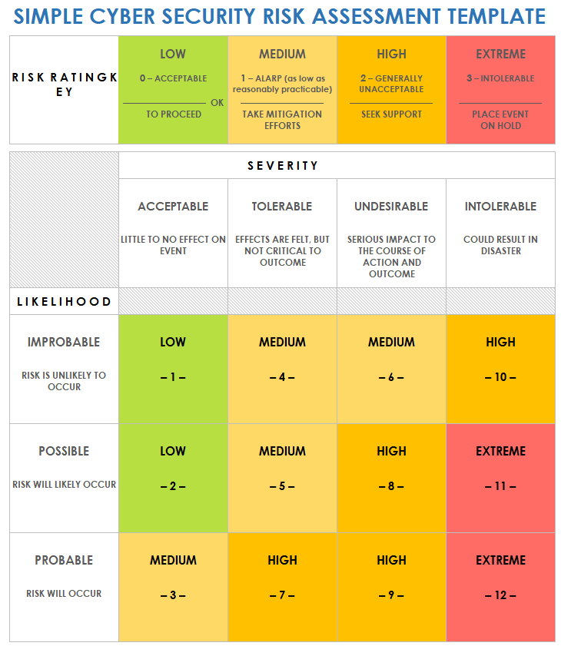
Risk Evaluation

Slide 48
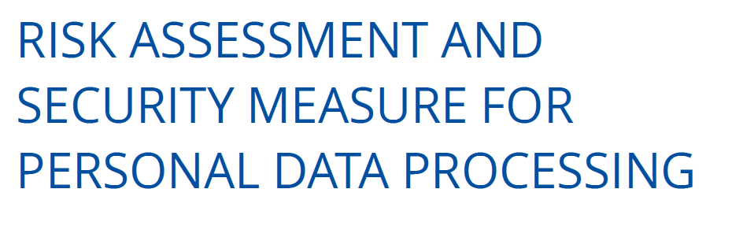
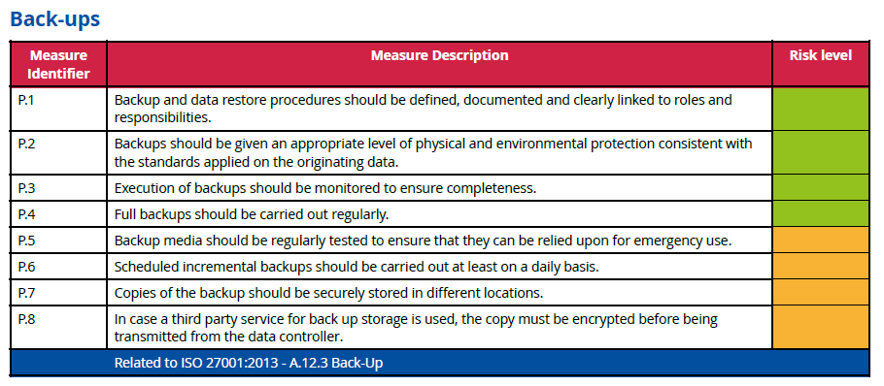
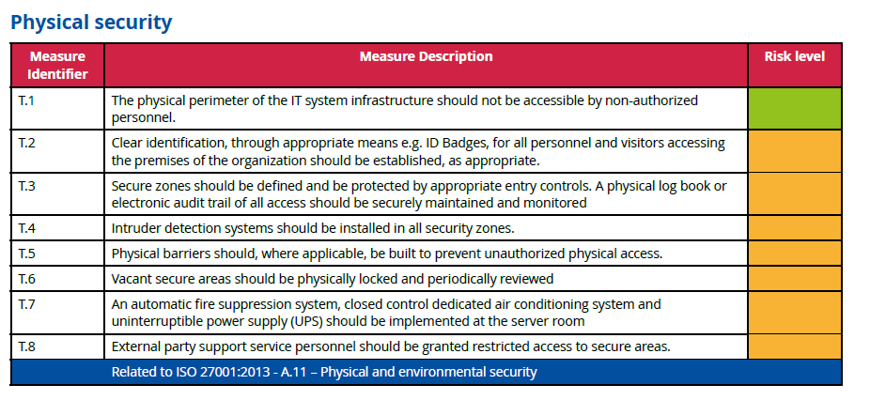
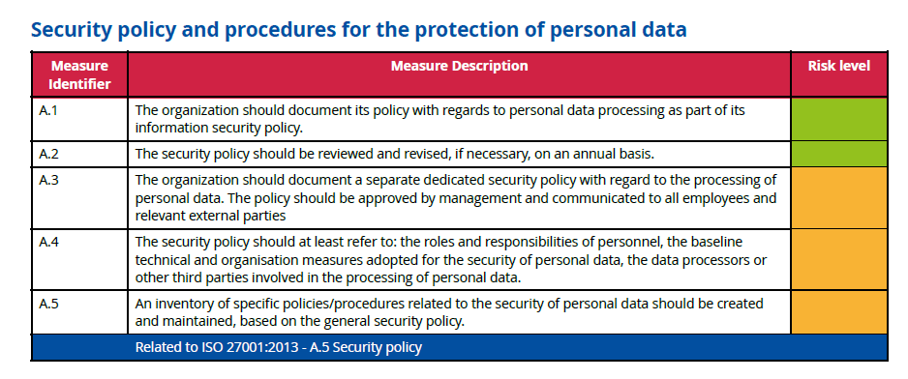
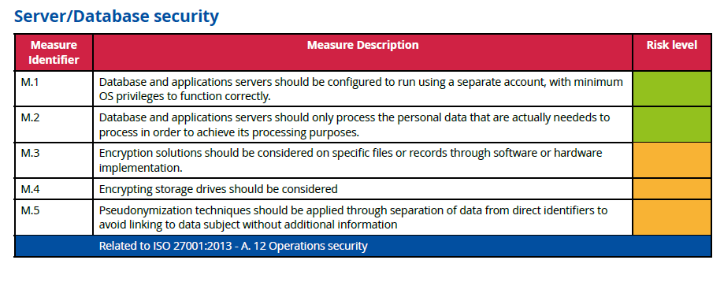
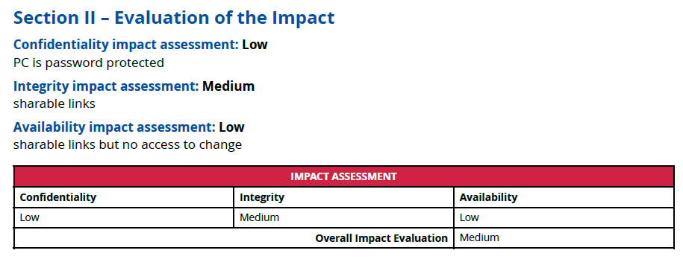
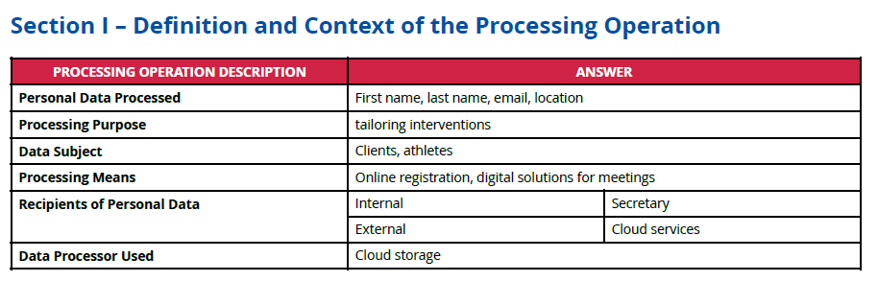
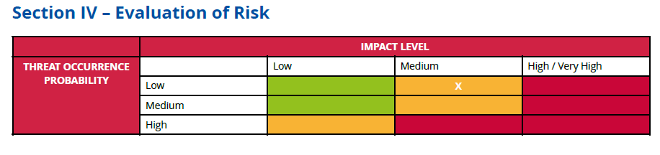

Slide 49
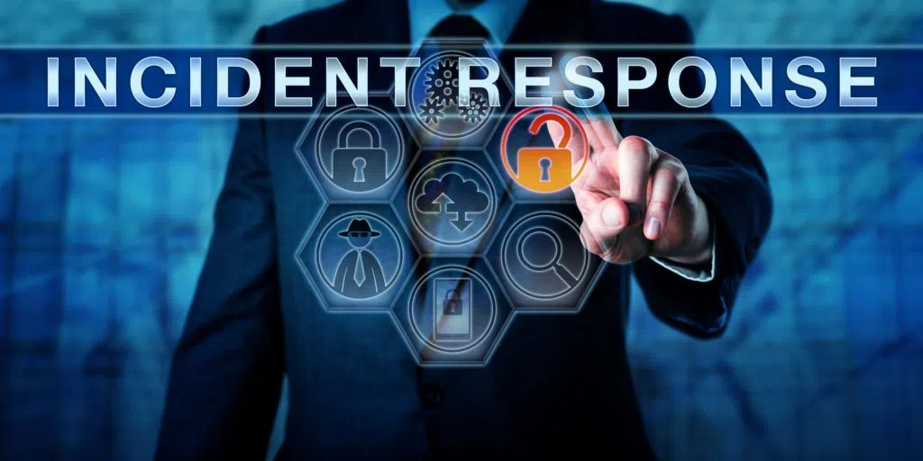
Incident Response and Reporting Requirements
EU cybersecurity regulations mandate comprehensive incident response plans for energy companies.
These plans should outline procedures for detecting, containing, and recovering from cyber incidents.
Reporting requirements involve notifying relevant authorities, such as national cybersecurity agencies, of significant cybersecurity incidents.

Slide 50
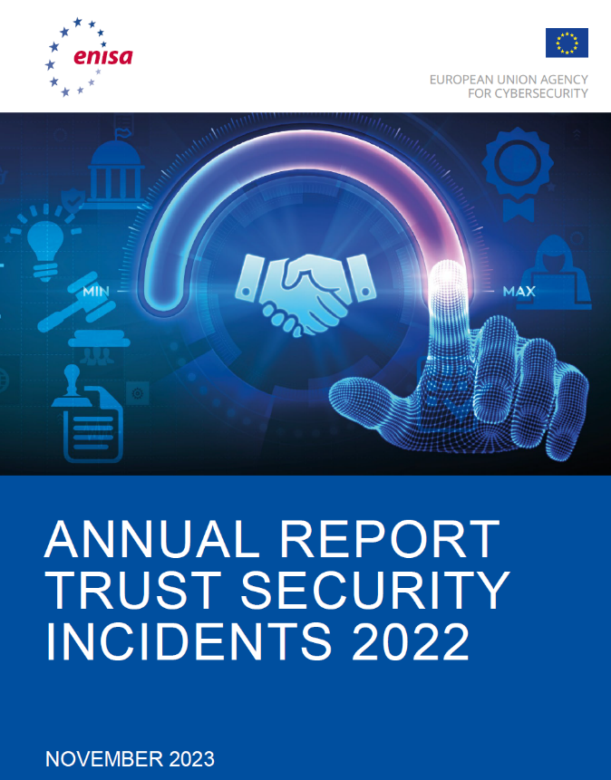
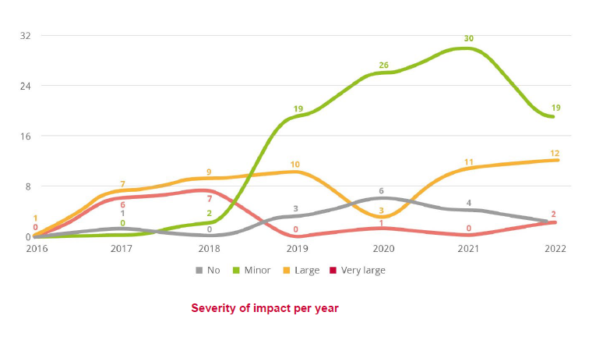
Ciras ENISA
https://ciras.enisa.europa.eu/
Notes:
Approximately 54% (19 incidents) of the reported incidents were rated as minor, showing a stabilisation compared to 2021 if one takes into account the smaller number of reported incidents. 2 disastrous incidents of very large impact were reported in 2022, whereas a slight increase by 1 was observed for incidents with large impact, which overall quadrupled compared to 2020. Furthermore, a decrease by 50% in minor incidents of no impact has been observed, indicating (combined with the overall smaller number of reported incidents) that while the incident reporting mechanism has become more familiar to the providers and there are still challenges in reporting incidents regardless of their sever

Slide 51
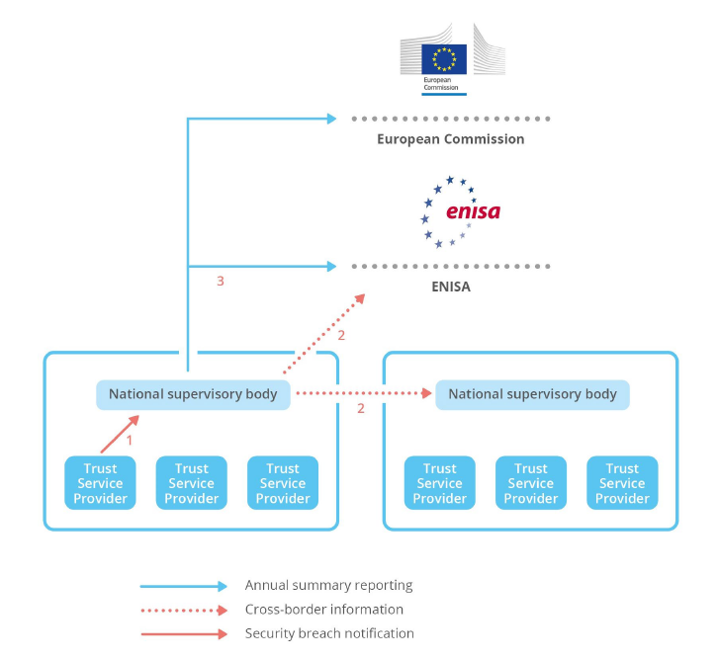
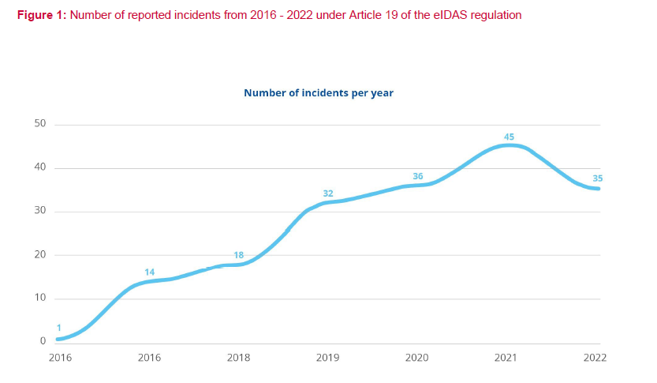
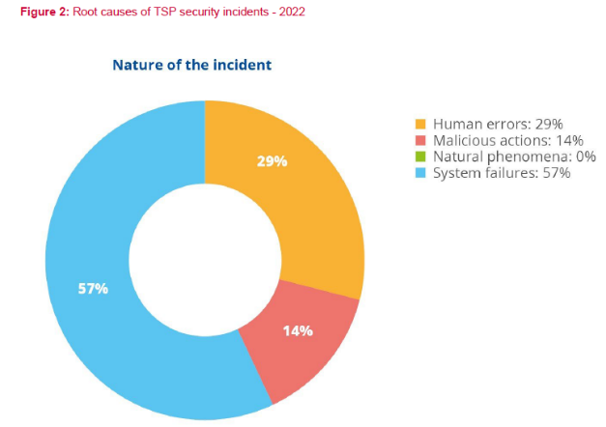
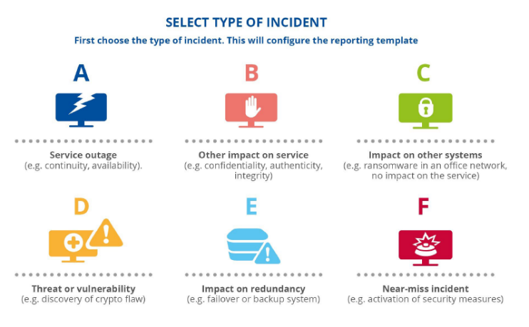
Notes:
The mandatory security breach notification process has three steps as displayed in the figure below:
• Trust service providers notify their national supervisory body about security breaches that have significant impact.
• National supervisory bodies inform each other and ENISA if there is a cross-border impact.
• National supervisory bodies send annual summary reports about the notified breaches to ENISA and the Commis
Type A: Service outage (e.g. continuity, availability). For example, an outage caused by a cable cut due to a mistake by the operator of an excavation machine used for building a new road would be categorised as a type A incident.
• Type B: Other impact on service (e.g. confidentiality, authenticity, integrity). For example, a popular collaboration tool has not encrypted the content of the media channels, which are being established when a session is started, between the endpoints participating in the shared session. This leads to the interception of the media (voice, pictures, video, files, etc.) through a man-in-the-middle attack. This incident would be categorised as a type B incident.
• Type C: Impact on other systems (e.g. ransomware in an office network, no impact on the service). For example, a malware has been detected on several workstations and servers of the office network of a telecom provider. This incident would be categorised as a type C incident.
• Type D: Threat or vulnerability (e.g. discovery of crypto flaw). For instance, the discovery of a cryptographic weakness would be categorised as a type D incid
Type E: Impact on redundancy (e.g. failover or backup system). For example, the breaking of one of two redundant submarine cables would be categorised as a type E incident.
• Type F: Near-miss incident (e.g. activation of security measures). For instance, a malicious attempt that ends up in the honeypot network of a telecom provider would be categorised as a type F incid

Slide 52
Current
https://ciras.enisa.europa.eu/

Slide 53
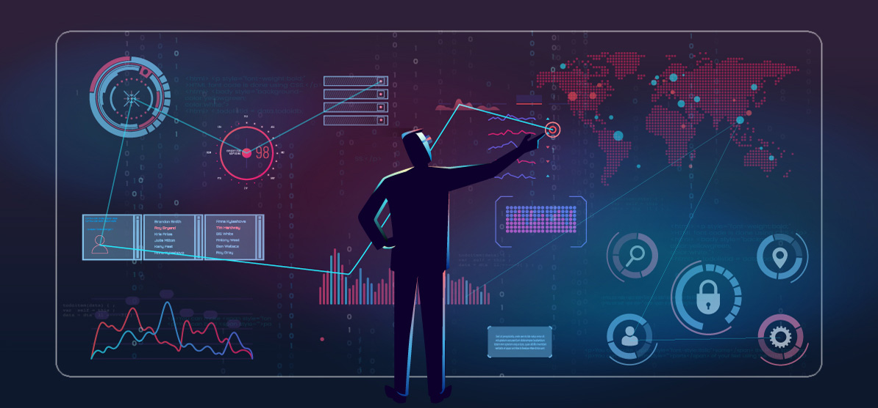
Cyber Threat Intelligence and Information Sharing
Cyber threat intelligence (CTI) is essential for staying ahead of cyber threats. CTI provides insights into the tactics, techniques, and procedures of attackers.
Information sharing between energy companies, national cybersecurity authorities, and international organizations like ENISA is crucial for sharing threat data and best practices.

Slide 54

Incident Response Planning and Exercises
Incident response planning is crucial for energy companies to manage cybersecurity incidents effectively.
Regular exercises, like tabletop simulations and real-world drills, help test the effectiveness of response plans, identify gaps, and improve coordination among stakeholders.

Slide 55

Regulatory Audits and Compliance Assessments
Regular audits and assessments are essential to ensure that energy companies are adhering to cybersecurity regulations and best practices.
These audits help identify any gaps in security controls, evaluate the effectiveness of implemented measures, and ensure continuous compliance with evolving regulatory requirements.

Slide 56

Continuous Improvement and Adaptation
Cybersecurity is an ongoing process. Energy companies must continually improve their security posture and adapt to evolving threats and technologies.
Regular reviews and assessments, ongoing training, and leveraging new security solutions are key to staying ahead of the curve.

Slide 57
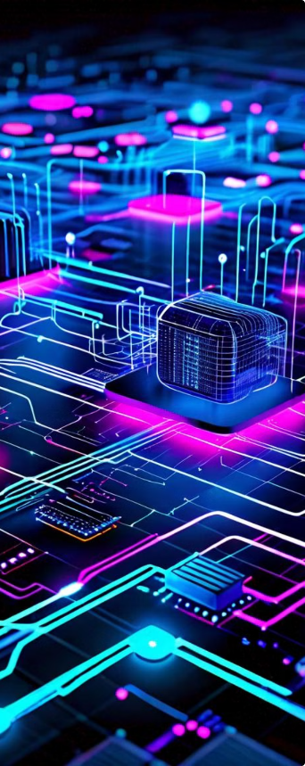
Emerging Technologies and Cybersecurity Challenges
The rapid advancement of emerging technologies presents both opportunities and challenges for cybersecurity in the energy sector. These technologies, such as 5G, IoT, cloud computing, and artificial intelligence (AI), are transforming energy infrastructure, operations, and business models. However, they also introduce new attack vectors and vulnerabilities that need to be addressed.
Energy companies must adopt a proactive approach to managing these cybersecurity challenges. This includes implementing appropriate security controls, developing robust risk management strategies, and collaborating with industry stakeholders to share information and best practices. Continuous monitoring and adaptation are essential as emerging technologies evolve and new threats emerge.

Slide 58
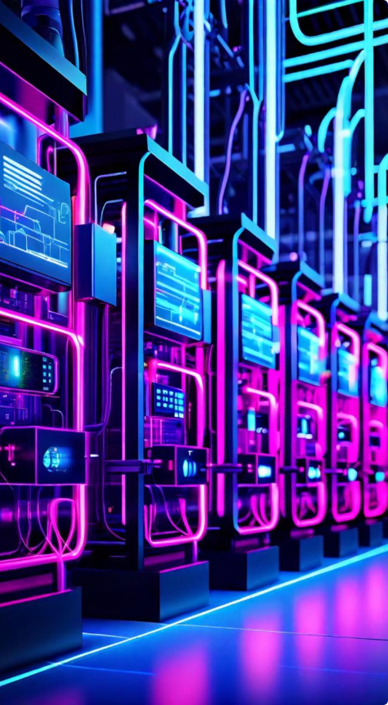
5G and IoT Security
The integration of 5G and the Internet of Things (IoT) in the energy sector introduces new cybersecurity challenges. The high bandwidth and low latency of 5G networks enable the deployment of advanced IoT devices and applications, enhancing efficiency and automation. However, this interconnectedness also creates a larger attack surface, making it crucial to strengthen security measures.
Energy companies must address security vulnerabilities at various levels, including the network infrastructure, IoT devices, and data exchange protocols. Implementing robust security protocols, deploying advanced intrusion detection systems, and adopting secure communication standards are essential to protect critical energy infrastructure from cyber threats in the era of 5G and IoT.

Slide 59
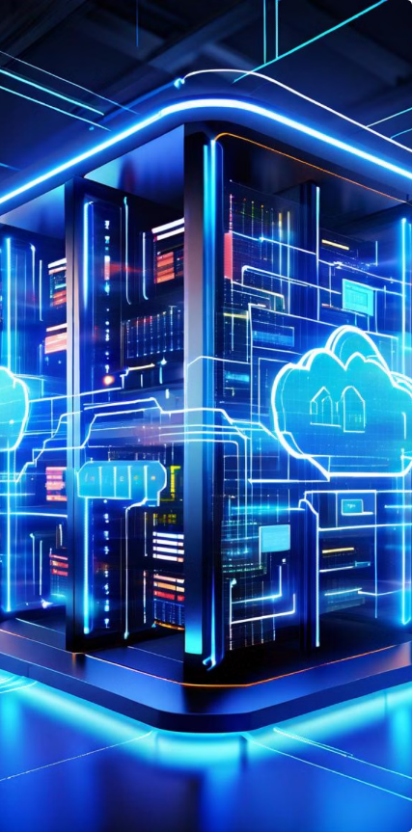
Cloud and Edge Computing Security
The adoption of cloud and edge computing in the energy sector raises unique cybersecurity challenges. These platforms offer significant benefits for energy companies, including scalability, flexibility, and cost savings. However, they also introduce new attack surfaces and vulnerabilities that require careful consideration.
Energy companies must implement robust security measures to protect their data, applications, and critical infrastructure in cloud and edge computing environments. This includes adopting a layered security approach, leveraging advanced security tools, and enforcing strict access control measures. Regular security audits and vulnerability assessments are crucial to identify and mitigate potential risks.

Slide 60

Artificial Intelligence and Cybersecurity
Artificial intelligence (AI) is rapidly transforming the energy sector, offering opportunities for improved efficiency, automation, and decision-making. However, the integration of AI also presents new cybersecurity challenges that require careful consideration and mitigation strategies.
AI algorithms can be susceptible to adversarial attacks, where attackers manipulate data or algorithms to compromise system performance or extract sensitive information. Robust security measures, such as data sanitization, model validation, and threat detection systems, are crucial to protect AI-powered systems from malicious actors.

Slide 61

Conclusion and Key Takeaways
EU cybersecurity regulations are essential for safeguarding energy infrastructure and protecting sensitive data.
Energy companies must implement a robust cybersecurity strategy that aligns with their business objectives.
This includes ongoing education, risk assessment, and continuous improvement.

Slide 62
References
European Union Agency for Cybersecurity (ENISA). (2023). EU Cybersecurity Act https://digital-strategy.ec.europa.eu/en/policies/cybersecurity-act.
Fortinet. (2022). Network Security Fundamentals: A Comprehensive Guide. https://www.fortinet.com/resources/cyberglossary/what-is-network-security
International Organization for Standardization (ISO). (2022). ISO/IEC 27001:2022 - Information technology - Security techniques - Information security management systems - Requirements. https://www.iso.org/standard/27001
European Union Agency for Cybersecurity (ENISA). (2022). Good Practices for Network Security Monitoring.
European Union Agency for Cybersecurity (ENISA). (2021). Threat Landscape Report.
European Commission (2020, July 22). Critical infrastructure and cybersecurity - Energy https://www.enisa.europa.eu/topics/critical-information-infrastructures-and-services.
European Union Agency for Cybersecurity (ENISA) (n.d.). European Union Agency for Cybersecurity (ENISA).
European Commission (2024, February 15). Commission adopts EU network code on energy cybersecurity https://www.smart-energy.com/industry-sectors/cybersecurity/european-commission-adopts-eu-network-code-on-energy-cybersecurity/.
Cruceru, C., Chen, W., Boldt, M., & Eremia, T. (2020). A review of cyber physical attacks on power systems. Renewable and Sustainable Energy Reviews, 131, 110002. (https://www.sciencedirect.com/science/article/abs/pii/S0096300321001041)
European Commission (2021, December 5). The EU Cybersecurity Strategy for the Digital Decade https://digital-strategy.ec.europa.eu/en/policies/cybersecurity-strategy.
The European Commission website: Provides information on the NIS Directive and other relevant regulations. https://www.enisa.europa.eu/
The Council of the European Union website: Offers updates on EU legislation related to cybersecurity. https://www.consilium.europa.eu/en/
All images credit to Adobe AI Image Illustrator - Adobe Firefly
62

Slide 63
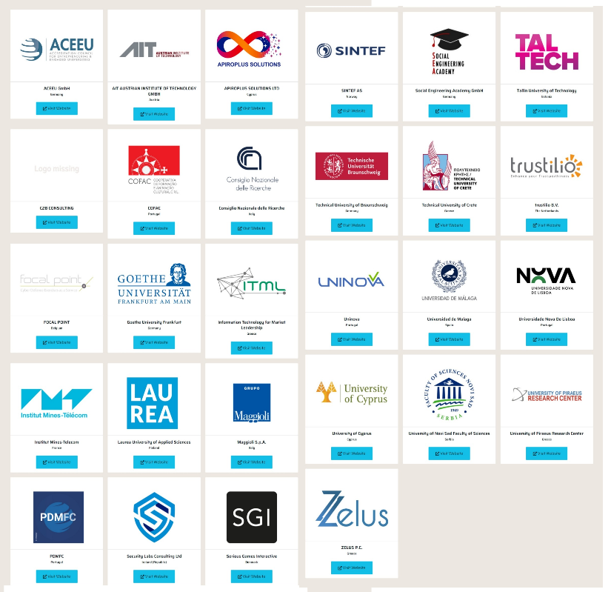

Connect with CyberSecPro: How to register and other practical information
Website:
  www.cybersecpro-project.eu
X (Twitter): https://twitter.com/CyberSecPro_eu
LinkedIn: https://www.linkedin.com/company/cybersecpro-euproject/

Slide 64

Thank you
Please send all questions to trainers

